Slide 1


THE PONDICHERRY STATE CO-OP BANK LTD.,
WELCOMES
To the
PRESENTATION

Slide 2
-1-
PSC BANK
Date of Registration : 10-10-1958
Date of Business
Commenced on : 30-10-1958
Licensed by RBI on : 14-09-1994
Scheduled Status : 20-07-1995
Area of Operation UT of Puducherry

Slide 3
-2-
PSC BANK
OBJECTIVES
Providing service to the affiliated Co-op. Societies.
Accept deposits/issue DDs./Locker facilities.
Grant all types of Loan to affiliated Societies/Individuals
Promote Rural Economic Development- KCC/JL etc.,
Branch outlets/Regional Branches to reach the unreached
SHGs – Help under/unprivileged women.
Policy guidelines to affiliated societies (RBI/NABARD).

Slide 4
-3-
PSC BANK
MANAGEMENT
Last Election
held on: 23-07-1977
The Board assumed charge
on 30-07-1977
The Board period was 30-07-1977 to 30-06-1980

Slide 5

PSC BANK
-4-
CLASSIFICATION OF MEMBERSHIP
Rs. Crore
  Government A class Rs.1,000 .. 1.88
  Societies B class Rs. 100
  Rs.1,000 .. 12.43
  Associate Members C class Rs.5
  Rs.10 .. 0.27
  Total .. 14.58
  The Board of Management is constituted by the representatives of the “B” class members (President / Delegates).

Slide 6
-5-
PSC BANK
Progress of membership
and Share Capital for the 5 years (Rs. lakh)
 | 2007-2008 |  | 2008-2009 |  | 2009-2010 |  | 2010-2011 |  | 2011-2012
Members | Nos. | Amount | Nos. | Amount | Nos. | Amount | Nos. | Amount | Nos. | Amount
A class
Government | 1 | 187.84 | 1 | 187.84 | 1 | 187.84 | 1 | 187.84 | 1 | 187.84
B class
Societies | 284 | 844.25 | 287 | 957.54 | 284 | 1035.88 | 284 | 1148.62 | 284 | 1243.12
C Class
Individuals | 141571 | 10.93 | 151498 | 11.92 | 197895 | 16.59 | 247604 | 21.56 | 298449 | 26.64
Total |  | 1043.02 |  | 1157.30 |  | 1240.31 |  | 1358.02 |  | 1457.60
There is no Govt. contribution for the past 15 years
Eligible for Govt. share is Rs.5 crore

Slide 7
PSC BANK
-6-
LAST 5 YEARS Working STATUS Rs. Lakh
PARTICULARS | Mar-08 | Mar-09 | Mar-10 | Mar-11 | Mar-12
OWNED FUNDS a. Share Capital (Indls& Sty) | 855.19 | 969.46 | 1052.47 | 1170.18 | 1269.76
b. Share Capital (Govt) | 187.84 | 187.84 | 187.84 | 187.84 | 187.84
TOTAL | 1043.03 | 1157.30 | 1240.31 | 1358.02 | 1457.60
RESERVES | 3242.06 | 3286.64 | 3215.76 | 3360.10 | 3376.11
TOTAL | 4285.09 | 4443.94 | 4456.07 | 4718.12 | 4833.71
DEPOSITS a. Individuals | 18199.08 | 22254.38 | 24053.04 | 28907.19 | 38855.86
b. Societies | 6803.45 | 6982.54 | 7425.60 | 7052.97 | 7618.76
c. Public Sector Undertaking | 760.15 | 1223.60 | 878.92 | 1483.05 | 2370.80
d. Local Bodies & Temples | 3081.69 | 3037.46 | 3120.98 | 3452.10 | 4416.96
TOTAL | 28844.37 | 33497.98 | 35478.54 | 40895.31 | 53262.38
BORROWINGS a. Nabard Borrowings | 1143.17 | 1263.49 | 2371.25 | 2770.07 | 1916.64
WORKING CAPITAL | 36009.9 | 41301.06 | 44176.50 | 50072.39 | 62608.58
CASH a. Cash & Bal with Notif. Banks | 2715.43 | 2185.85 | 2836.14 | 3361.78 | 3286.77
b. Balance with other Banks | 31.38 | 55.16 | 71.76 | 92.26 | 122.17
INVESTMENTS a. Short Terms & Call Money | 3001.00 | 4085.00 | 2800.00 | 900.00 | 2471.67
b. Government & Other Sec. | 8574.62 | 10279.15 | 12339.80 | 10868.35 | 14653.57
LOANS AND ADVANCES | 19783.52 | 20874.16 | 23550.16 | 32114.53 | 38728.44
No. of BRANCHES | 20+1 | 20+1 | 23+1 | 27+1 | 27+1
No. of EMPLOYEES | 219 | 215 | 211 | 274 | 272
PROFIT(+)/LOSS(-) | (-)324.00 | (-)145.84 | (+)31.01 | (+) 38.87 | (+) 13.22

Slide 8
-7a-
PSC BANK
Financial Results for the 5 years Rs. Lakh
Liabilities | Mar-08 | Mar-09 | Mar-10 | Mar-11 | Mar-12
Paid up SHARE CAPITAL | 1043.03 | 1157.30 | 1240.31 | 1358.02 | 1457.60
RESERVES & PROVISIONS | 2861.35 | 3076.75 | 2981.32 | 3098.41 | 3170.33
DEPOSITS | 28844.37 | 33497.98 | 35478.54 | 40895.30 | 53262.38
BORROWINGS | 1143.17 | 1263.50 | 2371.25 | 2700.07 | 1916.64
BRANCH ADJUSTMENT | 0.00 | 0.00 | 0.00 | 0.00 | 0.00
RESERVE ON OD INTEREST | 358.46 | 209.89 | 234.44 | 351.66 | 592.52
INTEREST PAYABLE | 844.25 | 1209.78 | 1358.17 | 1198.92 | 1756.82
OTHER LIABILITIES | 846.37 | 900.62 | 481.88 | 458.81 | 445.55
UNDIVIDED PROFIT | 66.94 | 66.94 | 0.00 | 0.00 | 0.00
COMPUTER SUSY.FROM GOVT | 1.94 | 1.94 | 1.94 | 1.94 | 1.94
Total | 36030.53 | 41400.77 | 44157.83 | 50072.39 | 62608.58
cont..

Slide 9
-7b-
PSC BANK
Financial Results for the 5 years Rs. Lakh
ASSETS | Mar-08 | Mar-09 | Mar-10 | Mar-11 | Mar-12
CASH in hand & Bank Balance | 2749.11 | 2241.01 | 2907.90 | 3954.04 | 3408.94
INVESTMENT and Call Deposits | 11575.62 | 14364.15 | 15139.80 | 11268.35 | 17125.23
LOANS AND ADVANCES | 19691.91 | 20874.16 | 23550.16 | 32114.53 | 38728.44
INTEREST RECEIVABLE | 905.03 | 1130.73 | 1269.25 | 1471.20 | 2062.76
BRANCH ADJUSTMENT | 2.37 | 2.37 | 2.36 | 0.00 | 0.00
LAND AND BUILDING | 429.02 | 406.54 | 457.63 | 434.95 | 412.00
FURNITURE | 118.51 | 114.94 | 151.95 | 216.32 | 187.70
Accumulated loss | 324.00 | 469.84 | 438.83 | 399.96 | 386.74
OTHER ASSETS | 214.31 | 1780.96 | 229.97 | 203.78 | 291.97
Total | 36030.53 | 41400.77 | 44157.83 | 50072.39 | 62608.58
cont..

Slide 10
-7c-
PSC BANK
Financial Results for the 5 years Rs. Lakh
INCOME | Mar-08 | Mar-09 | Mar-10 | Mar-11 | Mar-12
Interest on Advance & discount | 1613.27 | 2251.54 | 2521.01 | 3129.08 | 4212.82
Interest & Dividend on Invest | 844.29 | 960.48 | 1042.66 | 925.47 | 1010.75
Commission, exchange &Brokerage | 9.67 | 8.12 | 12.91 | 8.31 | 6.99
Other receipts | 30.73 | 29.82 | 36.32 | 46.56 | 59.95
By overdue interest release | 62.86 | 223.09 | 40.47 | 0.68 | 0.00
Bad Debt Reserve | 0.00 | 66.32 | 126.83 | 0.00 | 0.00
Release of Others- depn on Furnit | 2.83 | 39.20 | 39.47 | 209.84 | 0.00
LOSS during the year | 324.00 | 145.84 | 0.00 | 0.00 | 0.00
Accumulated loss | -- | 469.84 | 438.83 | 399.96 | 386.74
Total | 2887.65 | 3724.41 | 3819.67 | 4319.94 | 5290.51
cont..

Slide 11
-7d-
PSC BANK
Financial Results for the 5 years Rs. Lakh
EXPENDITURE | Mar-08 | Mar-09 | Mar-10 | Mar-11 | Mar-12
INT ON DEPOSIT | 1640.29 | 2162.30 | 2267.89 | 2157.75 | 3384.06
INT ON BORROWINGS | 20.84 | 65.94 | 75.13 | 163.54 | 176.06
SALARIES, ALLOWANCE | 634.29 | 875.72 | 919.52 | 1039.25 | 1065.25
Auditor fee, Law charges and postage | 6.15 | 4.61 | 5.66 | 10.38 | 5.64
DEPRECIATION ON | 56.78 | 59.41 | 75.44 | 85.75 | 88.39
Provi for Asset | 0.00 | 5.07 | 11.96 | 21.98 | 0.00
OD INTEREST PROVISION | 126.06 | 74.52 | 65.02 | 117.90 | 0.00
Provi for Bad Debts | 74.22 | 0.00 | 0.00 | 287.27 | 0.00
Other Expense | 323.24 | 188.84 | 364.68 | 233.38 | 557.89
Working PROFIT for the year | 0.00 | 0.00 | 31.01 | 38.87 | 13.22
Other Provisions-buldg Recoupmt | 5.78 | 288.00 | 3.36 | 163.87 | 0.00
Total | 2887.65 | 3724.41 | 3819.67 | 4319.94 | 5290.51
cont..

Slide 12
-7e-
PSC BANK
Financial Results for the 5 years Rs. Lakh
Sl.No: | Particulars | 2007-08 | 2008-09 | 2009-10 | 2010-11 | 2011-12
a. | Average Yield on Assets | 7.72 | 7.81 | 8.40 | 8.69 | 9.32
b. | Average Cost of Funds | 5.19 | 5.86 | 5.51 | 4.97 | 6.36
c. | Financial Margin (a-b) | 2.53 | 1.95 | 2.89 | 3.72 | 2.96
d. | Miscellaneous Income | 0.13 | 0.65 | 0.16 | 0.11 | 0.10
e. | Gross Margin (c + d) | 2.66 | 2.60 | 3.05 | 3.83 | 3.06
f. | Cost of Management | 2.87 | 2.94 | 2.87 | 2.98 | 2.55
g. | Risk Cost | 0.44 | 0.20 | 0.14 | 0.25 | 0.50
h. | Net Margin | (-) 0.65 | (-) 0.54 | 0.04 | 0.60 | 0.01

Slide 13
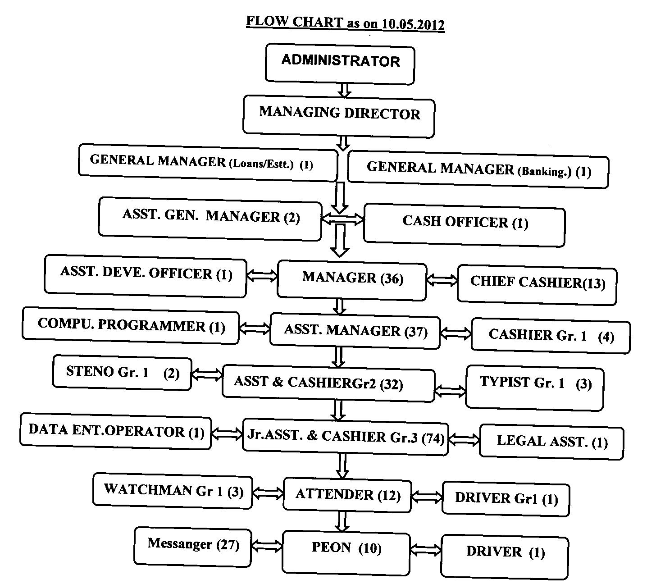
-8-
PSC BANK
ORGANISATION chart

Slide 14
-9-
PSC BANK
Categories of Employees
1 | Managing Director (1)
2 | General Manager (2)
3 | Asst.General Manager (2) | Cash Officer (1)
4 | Manager (36) | Chief Cashier (13) | Development Officer (1)
5 | Asst. Manager (37) | Computer Programmer (1) | Cashier Gr.I (4)
6 | Asst.cum. Cashier Gr.II (32) | Steno Typist Grade I (2) | Typist Gr.I (3)
7 | Asst.cum. Cashier Gr.III (74) | Legal Asst.(1) | Data Entry Operator (1)
8 | Attender (12) | Driver Gr.I (1) | Watch Man Gr.I (3)
9 | Peon (10) | Messenger (27) | Driver Gr.II (1)

Slide 15
PSC BANK
-10-
BENEFITS TO EMPLOYEES
1% Addl. interest on Deposits
Loans: HBA 15 lakhs, Consumer 1 lakh,
Conveyance upto 4 lakhs,
Marriage Rs.1 lakh,
Special Loan 1.5 lakhs,
Job on Compassionate ground

Slide 16
-11-
PSC BANK
Last
GENERAL BODY
Meeting
Held on
02-12-2010

Slide 17
-12-
PSC BANK
AUDIT STATUS
Audit Classification for 2010-2011
“A”

Slide 18
-13a-
PSC BANK
Having the Branches in the region of
Pondicherry : 23 Nos.
Karaikal : 3 Nos.
Mahe : 1 No.
Yanam : 1 No.
Total : 28 Nos.
Out of the above 28 Branches, 10 branches are in it’s own building

Slide 19

PSC BANK
-13-
Location of 28 Branches
BrNo. | Branches | BrNo. | Branches
1 | Bussy (Main) | 15 | Beach
2 | Karaikal | 16 | Sorapet
3 | Bazaar | 17 | T.R.Pattinam
4 | Mahe | 18 | Vevekanatha Nagar
5 | Thirubuvanai | 19 | Airport
6 | Bahour | 20 | Sulthanpet
7 | Kadhirkamam | 21 | H.O.Branch
8 | Villianur | 22 | Muthialpet
9 | Thirukkanur | 23 | Sedarapet
10 | L.R.Palayam | 24 | Moolakulam
11 | Yanam | 25 | Thirunallar
12 | Embalam | 26 | Kalapet
13 | Ariankuppam | 27 | Thavalakuppam
14 | Ilango Nagar | 28 | Kirumampakkam

Slide 20
PSC BANK
-14-
Branchwise Profit and Loss
Rs. Lakh
BRANCHES | Yr-2008 | Yr-2009 | Yr-2010 | Yr-2011 | Yr-2012 | BRANCHES | Yr-2008 | Yr-2009 | Yr-2010 | Yr-2011 | Yr-2012
ARIANKUPPAM | -45.90 | -24.69 | -40.94 | 7.15 | -1.33 | VILLIANUR | -69.22 | -37.76 | -44.42 | -0.24 | 35.81
BAHOUR | -58.04 | -34.74 | -59.62 | -27.58 | -66.13 | VIVEKANDHA NAGAR | -36.79 | -55.69 | -42.18 | -4.15 | -20.56
BAZAAR | -46.51 | -57.95 | -35.40 | 7.49 | 3.42 | YANAM | -28.33 | -47.93 | -52.18 | -43.88 | -92.64
BEACH | -47.58 | -41.62 | -46.02 | -30.66 | -73.02 | AIRPORT RD | -94.64 | -145.82 | -152.15 | -125.40 | -281.40
EMBALAM | -4.21 | 23.78 | -2.24 | 16.47 | 35.20 | HO BRANCH | 286.34 | 338.04 | 485.39 | 293.67 | 210.46
ILANGO NAGAR | 94.05 | 57.84 | 50.42 | 32.90 | 20.79 | SULTHANPET | -2.72 | -1.66 | 7.77 | 30.21 | 50.40
KADHIRKAMAM | -14.99 | -21.54 | 25.38 | 81.78 | 97.83 | MUTHIALPET |  |  | -11.75 | 0.60 | -11.04
KARAIKAL | 2.70 | 64.96 | -12.73 | 72.28 | 120.31 | SEDARAPET |  |  | -5.13 | 0.91 | 6.37
L.R.PALAYAM | 29.44 | 56.56 | 40.41 | 70.82 | 86.37 | MOOLAKULAM |  |  |  | -25.18 | -39.78
MAHE | -100.67 | -105.67 | -108.54 | -114.16 | -157.03 | THIRUNALLAR |  |  |  | -6.88 | -12.87
BUSSY | -559.80 | -621.69 | -732.12 | -390.06 | -470.41 | KALAPET |  |  |  | -6.16 | -7.52
T.R.PATTINAM | -6.41 | 24.39 | -47.47 | -27.88 | -9.89 | THAVALA KUPPAM |  |  |  | -6.40 | -8.87
SORAPET | -5.55 | -1.00 | -3.72 | 3.84 | 1.87 | KIRUMAM PAKKAM |  |  |  | -4.67 | -16.67
THIRUBUVANAI | -1.88 | 43.58 | 45.29 | 75.23 | 31.35 | HEAD OFFICE | 404.70 | 450.55 | 794.94 | 169.61 | 589.07
THIRUKKANUR | -18.00 | -7.81 | -21.98 | -10.78 | -6.87 | TOTAL | -324.00 | -145.84 | 31.01 | 38.87 | 13.22

Slide 21
PSC BANK
-15a-
ACHIVEMENTS on DEPOSITS
Rs. Crore
TARGET FOR THE YEAR 2011-2012 .. 515.30
ACHIEVEMENT .. 532.62
PERCENTAGE OF ACHIEVEMENT .. 103.4 %

Slide 22
PSC BANK
-15b-
ACHIVEMENTS on LENDING
Rs. Crore
TARGET FOR THE YEAR 2011-2012 .. 383.90
ACHIEVEMENT .. 387.28
PERCENTAGE OF ACHIEVEMENT .. 100.9 %

Slide 23
-16a-
PSC BANK
ISSUES AND CHALANGES
Going on financing the Sugar Mill, Spinning Mill,
JPCO and other major sick units due to one pressure
or other without strictly adhering the NABARD norms
leads to heavy NPA, which is in turn leads to heavy loss
to the Bank
Lack of Government participation in the Share Capital
for the past 15 years leads to reduction of CRAR

Slide 24
-16-b
PSC BANK
SUGGESTION:
RCS may recommend for Government Guarantee on Loans.
The Govt. may allocate Share Capital in the Budget provision
(CRAR)
The Govt. should initiate necessary steps to sign MoU for
STCCS (GoI)
The Department may recommend the Government/Quasi-
Government entities to park surplus funds in this Bank.
(Power Corporation, PIPDIC, Slum Clearance Board).

Slide 25
-17-
PSC BANK
PROJECTS IN PIPELINE
Installation of Core-Banking Solution (CBS)
before 31.12.2012 -NABARD providing platform.
Installation of Cheque Truncation System (CTS)
by 01.07.2012 as per RBI direction.
After introducing CBS, ATMS will be opened
On completion of CBS, Open a Website.

Slide 26
-19-
PSC BANK
Mail ID: pscbank@vsnl.net
pscbank@dataone.in
Address: 204 ECR ROAD
MUDALIARPET
PUDUCHERRY 605 004.

Slide 27


Thank You..

