Slide 1


Pondicherry State Co-operative Union

Slide 2
Pondicherry State Co-operative Union
Pondicherry State
Co-operative Union Ltd., P.259
At a Glance

Slide 3
Pondicherry State Co-operative Union
REGISTRATION AND STARTING
Registered on 10-02-1975
Started its working on 23.2.1976.

Slide 4
Pondicherry State Co-operative Union
OBJECTIVES
The objectives of the Pondicherry State Co-operative Union are
To impart Co-operative Education to the members, Leaders of all Co-operative Institutions.
To conduct meeting, seminars on management issues.
To conduct training programme for co-operative society employees, Co-operative Department-Officials and officials of other Government departments.
To provide quality Education as per the Co-operative principles of “Concern for Community and Education and Training”.
To offer suggestions for the development of Co-operative Movement for the entire Union Territory of Puducherry.

Slide 5
Pondicherry State Co-operative Union
MEMBERSHIP
Any Co-operative Society registered under the Pondicherry Co-operative Societies Act, 1972 can take membership on payment of subscription prescribed in the by-laws of the Union.

Slide 6
Pondicherry State Co-operative Union
MANAGEMENT
The Management of the Union shall vest in a Board of Directors constituted as detailed below; as per the existing bye-laws of the Union.
One representative from
each Apex society 6
2. From other Central and Primaries
a) Pondicherry Region 6
b) Karaikal, Mahe and Yanam Regions 2
3. Registrar or his representative 1
4. Managing Director, PSCU 1
___________ Total 16
__________

Slide 7
Pondicherry State Co-operative Union
ELECTION STATUS
The Directors elected shall hold office for a period of three years, commencing from 1st January and ends with 31st December.
Last Election was held on 06-09-2002
Last General Body Meeting was held on 12-08-2004
At present, the Management of the Union is administered by the Administrator Mr. D. BALAKIROUCHENIN, Deputy Registrar, appointed by the Registrar of Co-operative Societies.

Slide 8
Pondicherry State Co-operative Union
The present rates of annual subscription are as follows
Sl. No. | Category of Societies | Amount Rs.
1. | Apex Societies / Mills | 3,000
2. | Central Society / Board | 2,000
3. | Societies working capital exceeding Rs. 5 lakhs | 500
4. | Societies working capital less than 5 lakhs | 250

Slide 9
Pondicherry State Co-operative Union
Source of Finance
Tuition fees – from students on different courses through PICM, CCE and CTTI.
Co-operative Education fund / Annual Subscription from the Societies.
The Government provides Grant/ Subsidy for the salary of the staff working in the Pondicherry Institute of Co-operative Management, Co-operative College of Education and Co-operative Teacher Training Institute.

Slide 10
Pondicherry State Co-operative Union
Administrator- M.D (PSCU)
PRINCIPAL (PICM)
Accountant
Vice-Principal
(PICM)
Administrative Officer
(CCE)
Administrative Officer
(CTTI)
Cashier
Sr. Lecturer
Manager
Lecturers
Jr. Clerk
Attender
Peon
Watchman
Sweeper
Principal
Lecturers
Manager
Attender
Watchman
Sweeper
Jr. Clerk
Principal
Manager
Lecturers
Jr. Clerks
Attender /Watchman
P.A
Attender / Peon
Librarian
Librarian
Art Instructor
P.E.T. Lecturer
Attender / Peon
ORGANISATION
CHART

Slide 11
Pondicherry State Co-operative Union
UNITS
Pondicherry Institute of
Co-operative Management (PICM)
(Estt. Dt. 19th November 1980)
II. Co-operative College of Education (C.C.E.)
(Estt. Dt.11th January 2006)
No.and Date of Recognition Order by NCTE :
F.PN-N/189/SRO/NCTE/2005-06 Dated 09-08-2005
III. Co-operative Teacher Training Institute (C.T.T.I.)
(Estt. Dt. 1st June 2006)
F.PN/ELE/SRO/NCTE/2005-06/3499 Dated 18-10-2005

Slide 12
Pondicherry State Co-operative Union
PONDICHERRY INSTITUTE OF CO-OPERATIVE MANAGEMENT
Offering the following Self – Designed courses
Sl.No. | Name of the Diploma/ Certificate course | Duration | Qualifications | Certification by
1. 2. 3. 4. 5. 6. 7. 8. | A.C.T. – Accounting on Computers using Tally C.J.A.T. – Certificate in Jewel Appraisal and its Tech. C.C. – Certificate in Co-operation C.C.O. – Certificate in Computer Operations C.B. – Certificate in Beautician (Level-I) CCST – Certificate in Cell phone Servicing & Technician C.C.C. – Course on Computer Concepts C.E-P. – Certificate Course in E-Publishing | 2½ Months 2½ Months 2½ Months 3½ Months 10 Days. 10 Days 3½ Months 2 Months | Any Degree 10th Std. Passed Only for Co-op. Employees Employees & others 8th STD 8th STD Employees & others 12th Std | Tally (P) Ltd. P.I.C.M. P.I.C.M. P.I.C.M. P.I.C.M P.I.C.M P.I.C.M P.I.C.M

Slide 13
Pondicherry State Co-operative Union
PONDICHERRY INSTITUTE OF CO-OPERATIVE MANAGEMENT
(in collaboration with)
BHARATHIAR UNIVERSITY
conducting courses under Center for Participatory Programmes (CPOP)
Sl.No. | Name of the Diploma/ Certificate course | Duration / Years | Qualifications | Certification by
1. | BCA * | 3 | H.S.C. Pass | Bharathiar University
2. | B.Sc(CS) | 3
3. | B.Com(CA) | 3
4. | MBA * .General .Marketting Mgmt .Financial Mgmt. .Human Resource Mgmt .Info Systems Mgmt .Retail Mgmt | 2 | Degree Pass
5. | MCA | 3
6. | M.Com | 3
7. | PGDCA | 1
* Started in the Academic year 2011 – 12, on Regular and Week ends other courses will be started from this academic year.

Slide 14
Pondicherry State Co-operative Union
Co-operative College of Education (CCE)
Offering one year B.Ed. Degree course
Approved by the National Council for Teacher Education, Bangalore Affiliated from the Pondicherry University.
NCTE and Pondicherry University approved us to admit 100 students in every year
The Optional subjects
Mathematics | Physical Science
Biological Science | Social Studies
Tamil | English

Slide 15
Pondicherry State Co-operative Union
CO-OPERATIVE TEACHER TRAINING INSTITUTE (CTTI)
Offers two year Diploma course in Teachers Education (D.T.Ed.)
Approved by the Directorate of School Education, Government of Puducherry.
Affiliation from the Directorate of Teacher Education Research and Training (DTERT) Government of Tamil Nadu.
50 students are admitted.

Slide 16
Pondicherry State Co-operative Union
Categories of Employees
Departmental Officials
Managing Director | 1
Vice-Principal | 1
Accountant | 1
Administrative Officers | 2
Administrative Staff
Managers | 3
Junior Clerks | 10
Attenders | 8
Sanitary Helpers | 2
Watchmen | 2

Slide 17
Pondicherry State Co-operative Union
Categories of Employees
Academic Staff (PICM)
Senior Lecturer in Computer Science | 1
Lecturers in Computer Science | 3
Academic Staff (CCE)
Principal | 1
Lecturers | 7
Physical Education Lecturer | 1
Librarian | 1
Academic Staff (CTTI)
Total Strength
51
Principal | 1
Lecturers | 6
Art Instructor | 1
Librarian | 1

Slide 18
Pondicherry State Co-operative Union
Benefits to the Employees
E.L. Encashment
Motor Cycle Advance (@ 9% per annum)
Festival Advance (int. free)
Gratuity Scheme covered under LIC
Contributory Provident Fund

Slide 19
Pondicherry State Co-operative Union
Audit status
Final Audit Report Issued | 2009 – 10
Final Audit under Progress | 2010 – 11
Audit Classification | B Class
performance
Year | Excess of Income over Expenditure (Rs. In Lakhs) | Status
2007 – 08 | 68.82 | Audited
2008 - 09 | 0.96 | Audited
2011 - 12 | 14.11 | Un Audited
Year | Excess of Expenditure over income (Rs. In Lakhs) | Status
2009 – 10 | 23.05 | Audited
2010 – 11 | 10.18 | Un Audited

Slide 20
Pondicherry State Co-operative Union
Achievements
2008 onwards – Obtained Programme Study of IGNOU to conduct B.Ed., course.
2011 onwards – Pondicherry Institute of Co-operative Management signed MOU as Partner Institution of Bharathiar University, Coimbatore to conduct BCA, B.Sc(Comp. Sc.), B.Com(CA), MBA- General, Financial Management, Human Resources Management, Marketing Management, Information system, Management and Retail Management (Six Branches),. MCA and PGDCA
2010-11 Computer Training (Level-I) for the Police Personnel were conducted at PICM. So for 550 personnel were trained in 4 Regions of U.T. of Puducherry.

Slide 21
Pondicherry State Co-operative Union
Achievements Contd…
From 1998 onwards Computer training were imparted to the
following departments /others
Co-operative Department
PIPDIC
Municipality and Commune Panchayats
Revenue and Disaster Management
Survey and Lands Records
Pondicherry Planning Authority
PASIC
PAPSCO
Employees of Co-operative Societies
National Level Online Examination were also conducted at our PICM for the National Institute of Electronics and Information Technology (NIELIT) in two times around 250 students were participated.
National Informatics Centre (NIC) and Government of Puducherry are utilising our computer labs for imparting e-Governance training to the Departmental officials.

Slide 22
Pondicherry State Co-operative Union
Performance of Co-operative College of Education (CCE)
Year | Appeared | Passed
2005 - 06 | 100 | 100
2006 - 07 | 100 | 100
2007 - 08 | 100 | 100
2008 - 09 | 100 | 98
2009 - 10 | 100 | 98
2010 - 11 | 100 | 97

Slide 23
Pondicherry State Co-operative Union
Performance of Co-operative Teacher Training Institute (CTTI)
Year | Appeared | Passed
2006 - 07 I Yr | 45 | 44
2007 - 08 II Yr I Yr | 45 46 | 34 45
2008 - 09 II Yr I Yr | 46 47 | 35 14
2009 - 10 II Yr I Yr | 44 33 | 24 17
2010 - 11 II Yr I Yr | 33 30 | 10 09

Slide 24
Pondicherry State Co-operative Union
Performance of Pondicherry Institute of Co-operative Management(PICM)
Sl. No | Name of Training Programmes / Courses | Total Number of Students/ Members/ Employees benefited
 |  | 07-08 | 08-09 | 09-10 | 10-11 | 11-12
1. | (DCM) Diploma in Co-operative Management | 20 | 7 | 3 | -- | --
2. | (DCA) Diploma in Computer Applications | 11 | 8 | 5 | 5 | --
3. | (DTP) Diploma Desk Top Publishing | 12 | 15 | 10 | 2 | --
4. | (CC) Certificate in Co-operative | 18 | 17 | 38 | 48 | 20
5. | (CCO) Certificate in Computer Operations | 54 | 56 | 40 | 29 | 35

Slide 25
Pondicherry State Co-operative Union
Performance of Pondicherry Institute of
Co-operative Management(PICM)
Contd…..
Sl. No | Name of Training Programmes / Courses | Total Number of Students/ Members/ Employees benefited
 |  | 07-08 | 08-09 | 09-10 | 10-11 | 11-12
6. | (PGDCA) Post Graduate Diploma in Computer Applications | 3 | 4 | 4 | 1 | --
7. | (JAT) Jewel Appraisal and its Techniques | 36 | 112 | 71 | 32 | 16
8. | Tally –Accounting on Computer using Tally | 129 | 112 | 87 | 48 | 37
9.. | Certificate in Gemology | 8 | -- | -- | -- | --

Slide 26
Pondicherry State Co-operative Union
Performance of Pondicherry Institute of
Co-operative Management(PICM)
Contd…..
Sl. No | Name of Training Programmes / Courses | Total Number of Students/ Members/ Employees benefited
 |  | 07-08 | 08-09 | 09-10 | 10-11 | 11-12
10. | Leadership Training Programme to the Board of Directors of Housing Co-op. Societies at Pondicherry region | 11 | -- | -- | -- | --
11. | Leadership Training Programme to the Members of the Board of Management of the Co-op. Societies at Mahe region | 22 | -- | -- | -- | --
12. | Training Programme to Salary Earners Co-op. Societies on the Fringe | 43 | -- | -- | -- | --
13. | Training Programme to Right to Information Act to Fisherman Co-op. Societies /Wearers Co-op. Societies/ Miscellaneous , Milk, Credit, PACS, and other co-operative Societies | 120 | -- | -- | -- | --
14. | Training Programme on Election Procedures to Co-operative Societies for the newly recruited Junior Inspectors | 51 | -- | -- | -- | --

Slide 27
Pondicherry State Co-operative Union
Performance of Pondicherry Institute of
Co-operative Management(PICM)
Contd…..
Sl. No | Name of Training Programmes / Courses | Total Number of Students/ Members/ Employees benefited
 |  | 07-08 | 08-09 | 09-10 | 10-11 | 11-12
15. | Computer orientation Training Programme to the Staff of the primary Agrl. Co-op Societies | 40 | -- | -- | -- | --
16. | One day Programme on Election Procedures to Co-operative Department of the Junior Inspectors | -- | 53 | -- | -- | --
17.. | Certificate in Co-operation in Karikal Region | -- | -- | 40 | -- | --
18. | Short Term Training Programme for the Officials of the Co-operative Department | -- | -- | 47 | 46 | --

Slide 28
Pondicherry State Co-operative Union
Performance of Pondicherry Institute of
Co-operative Management(PICM)
Contd…..
Sl. No | Name of Training Programmes / Courses | Total Number of Students/ Members/ Employees benefited
 |  | 07-08 | 08-09 | 09-10 | 10-11 | 11-12
19.. | Computer Training to the Recruit Police Constables | -- | -- | -- | 175 | --
20. | Computer Training to the Un-employed Youth of Adi-Dravidar Community, Puducherry(PADCO) |  |  |  | 40 | 15
21. | Computer Training to the Police Personnel (Level-I) in Puducherry, Karaikal, Mahe and Yanam. | -- | -- | -- | 305 | 40

Slide 29
Pondicherry State Co-operative Union
Performance of Pondicherry Institute of
Co-operative Management(PICM)
Contd…..
Sl. No | Name of Training Programmes / Courses | Total Number of Students/ Members/ Employees benefited
 |  | 07-08 | 08-09 | 09-10 | 10-11 | 11-12
22. | B.C.A (Bharathiar University) | -- | -- | -- | -- | 23
23. | M.B.A (Bharathiar University) | -- | -- | -- | -- | 23
24. | Certificate in Beautician Course(Level-I) | -- | -- | -- | -- | 10
25. | Certificate in Cell Phone Servicing and Software Training | -- | -- | -- | -- | 10
26. | Computer Concepts On-line Examination conducted by DOEACC Society | -- | -- | -- | 158 | 109
27. | International Year of Co-operative –Drawing Competition | -- | -- | -- | -- | 300
28. | Training Programme on Right to Information Act 2005 to the Department Officials | - | - | - | - | 98

Slide 30
Pondicherry State Co-operative Union
Pipeline Projects
1. Applied for Accreditation to conduct Course on Computer Concepts and other courses from National Institute of Electronics and Information Technology(NIELIT) (formerly DOEACC Society) An Autonomous body of Department of Information Technology, Ministry of Communication & Information Technology, Government of India.
2. AUTO CAD Course: Proposed to conduct Auto Cad course to the Department of Survey and Land Records.
3. BCC Authorised as Partner Institution by NIELIT to conduct Basic Computer Course to Panjayat Raj Functionaries and Employees of Municipality and Commune Panchayat in 4 Regions of U.T. of Puducherry.
4. Bharathiar University This academic year we have planned to conduct other courses like MCA, B.Sc

Slide 31
PUBLICATIONS
1. Kooturavu Sudar | A Monthly Magazine Published by the Pondicherry State Coop. Union
2. Selected Decisions of Co-operative Appellate Tribunal And Government Volume – I (1979 to 2007) | Edited and compiled by Mr. R. Muralidharan Deputy Registrar (Planning and Legal)
3. A Hand book for Election Officers (for conduct of Election to Co-operatives) | Conceived and Designed by Mr. R. Muralidharan Deputy Registrar (Planning and Legal)
4. Compendium of Circulars Orders & Proceedings (1969 – 2009) | Conceived and Compiled by Mr. R. Muralidharan Deputy Registrar (Planning and Legal)
Pondicherry State Co-operative Union

Slide 32
Photo Gallery
Pondicherry State Co-operative Union

Slide 33
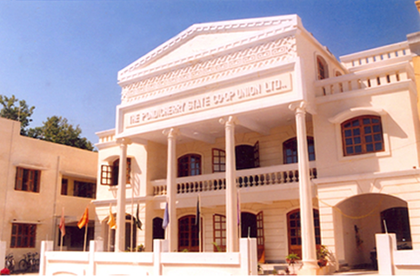
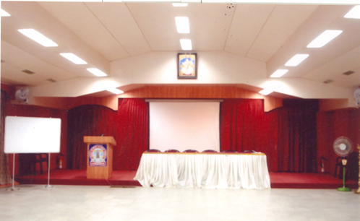
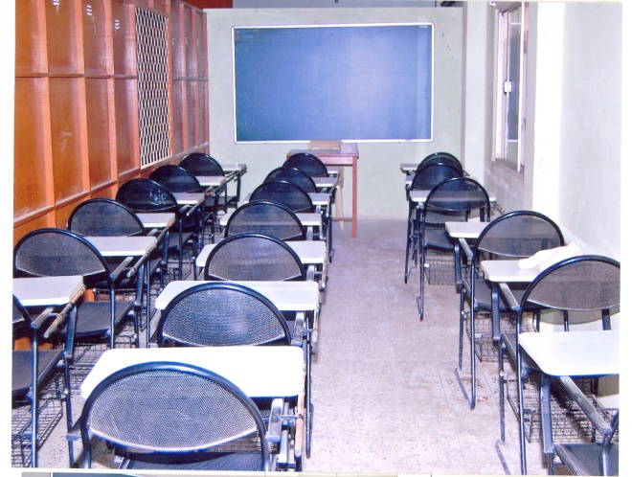
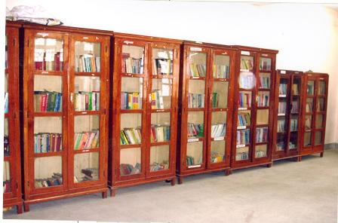
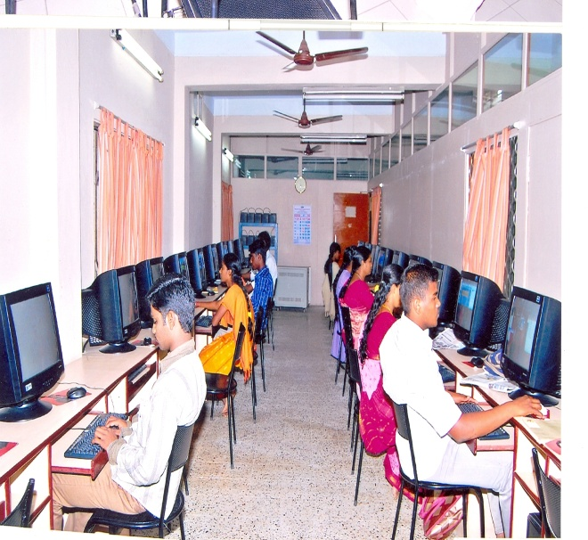
Pondicherry State Co-operative Union
Contact us
Main Office: 62, Suffren Street, Puducherry-605001
Ph: 0413-2331408,2339984
Annex Office: 30, I Floor, Annasalai, Puducherry-605001
Email: pscu@dataone.in
Picm.bu@gmail.com
Website: http://pscu.co.in

Slide 34

For glancing us
Pondicherry State Co-operative Union

