Slide 1
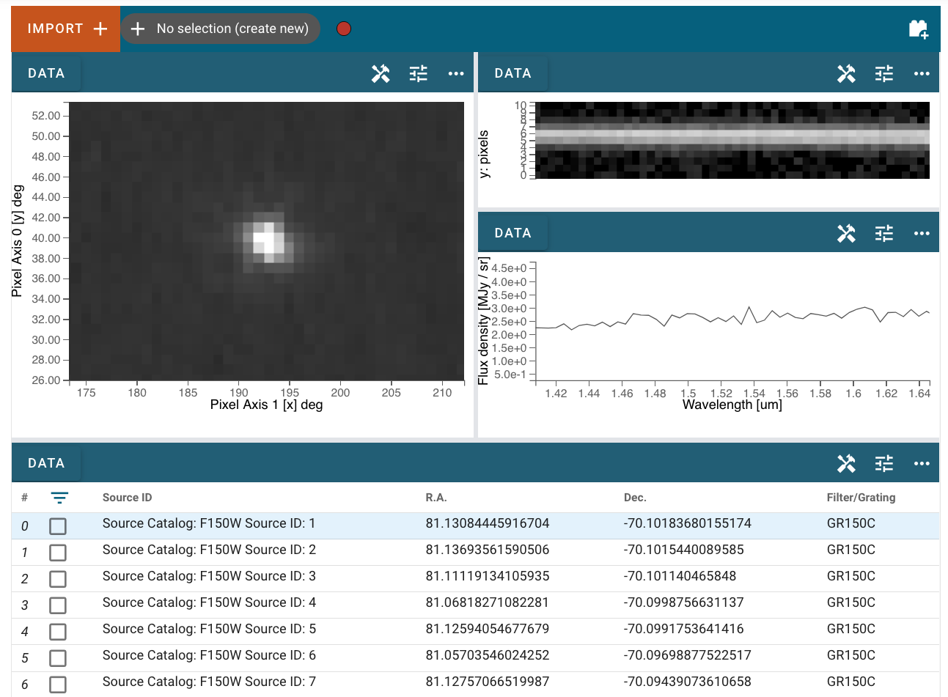
Jdaviz
An interactive visual data analysis tool for JWST in the Jupyter platform

Slide 2
Overview
Interactive, visual data analysis in the Jupyter environment
Embeddable in websites/on the cloud – bring analysis to the dataset rather than needing to download large datasets.
Also usable as a browser-app via voila

Slide 3
(Partial) Tech Stack
Astropy
Bqplot
Glue
Glue-jupyter
Glue-astronomy
ipyvue/ipyvuetify
ipywidgets
Specutils
Traitlets
Voila

Slide 4
Preset Configurations
Each is made up of a set of data viewers that show plots, images, and tables, along with corresponding data analysis plugins, API methods, and display tools.
Specviz: Analysis of single or small numbers of spectra
Imviz: Analysis of two-dimensional images
Cubeviz: Analysis of data cubes (often spectral cubes, with one spectral and two spatial axes)
Mosviz: Analysis of multi-object spectroscopy

Slide 5
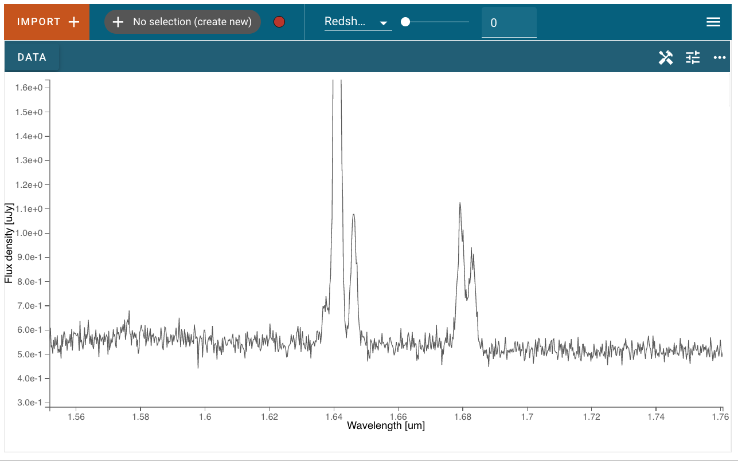

Slide 6
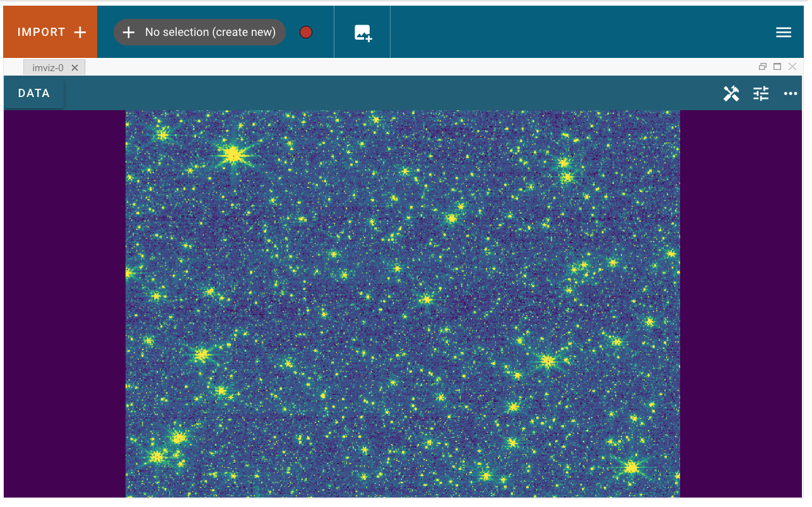

Slide 7
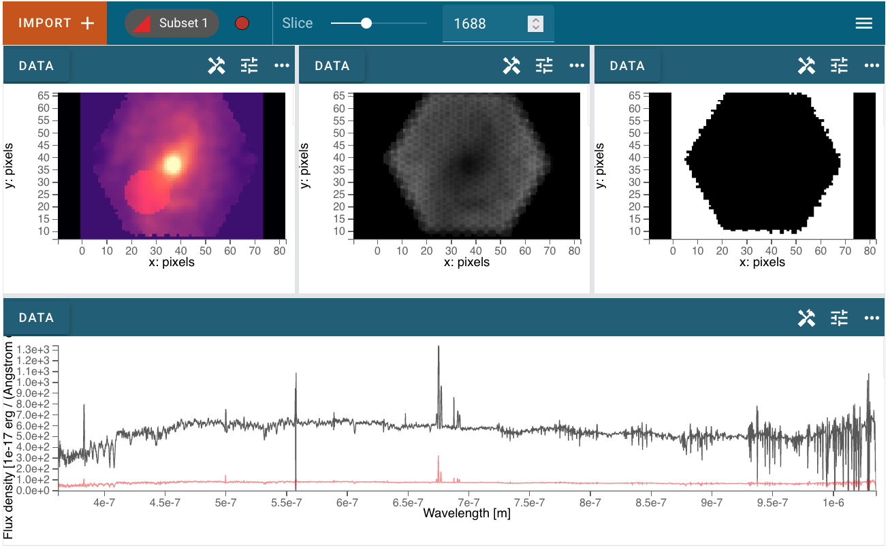

Slide 8
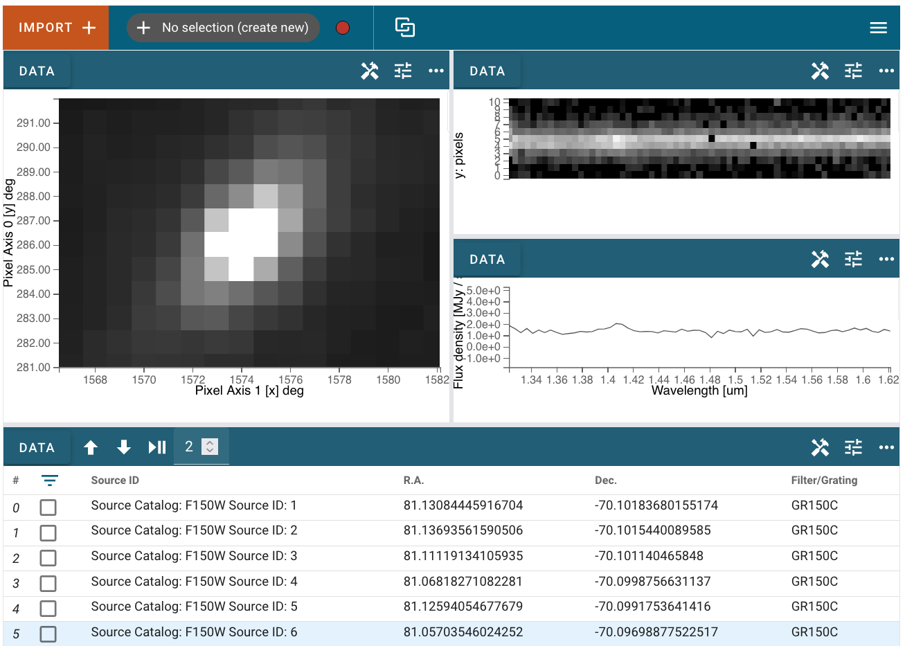

Slide 9
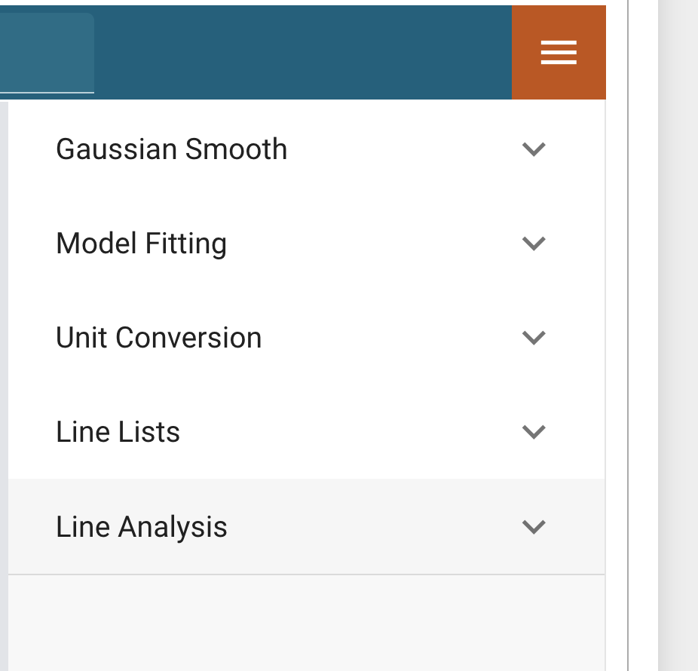
Built-in tools and analysis plugins
Subset (region) selection
Display options (stretch, bias, contrast, etc), panning and zooming, saving to png/svg
Astropy model fitting functionality
Quick-look line analysis and spectral line plotting
Cube collapse and gaussian smoothing

Slide 10
Contributors (in absolutely no particular order)
Nicholas Earl
Jesse Averbukh
Ivo Busko
Duy Nguyen
Pey Lian Lim
Erik Tollerud
Patrick Ogle
Camilla Pacifici
Ori Fox
Thomas Robitaille
Brian Cherinka
Jennifer Kotler
Justin Otor
Kyle Conroy
Mario Buikhuisen
Maarten Breddels
Sara Ogaz
Robel Geda
Larry Bradley
...and many additional people who have tested and given feedback

