Slide 1



JWST Data Analysis Notebooks
Ori Fox (STScI)
And the whole JWST Data Analysis Team
https://spacetelescope.github.io/jdat_notebooks/

Slide 2
Notebook Goals
Develop real science goals for JWST instrument modes
Use real JWST data pipeline products
Integrate Jdaviz into your workflow
Access improved Astropy package tools, including specutils, photutils

Slide 3
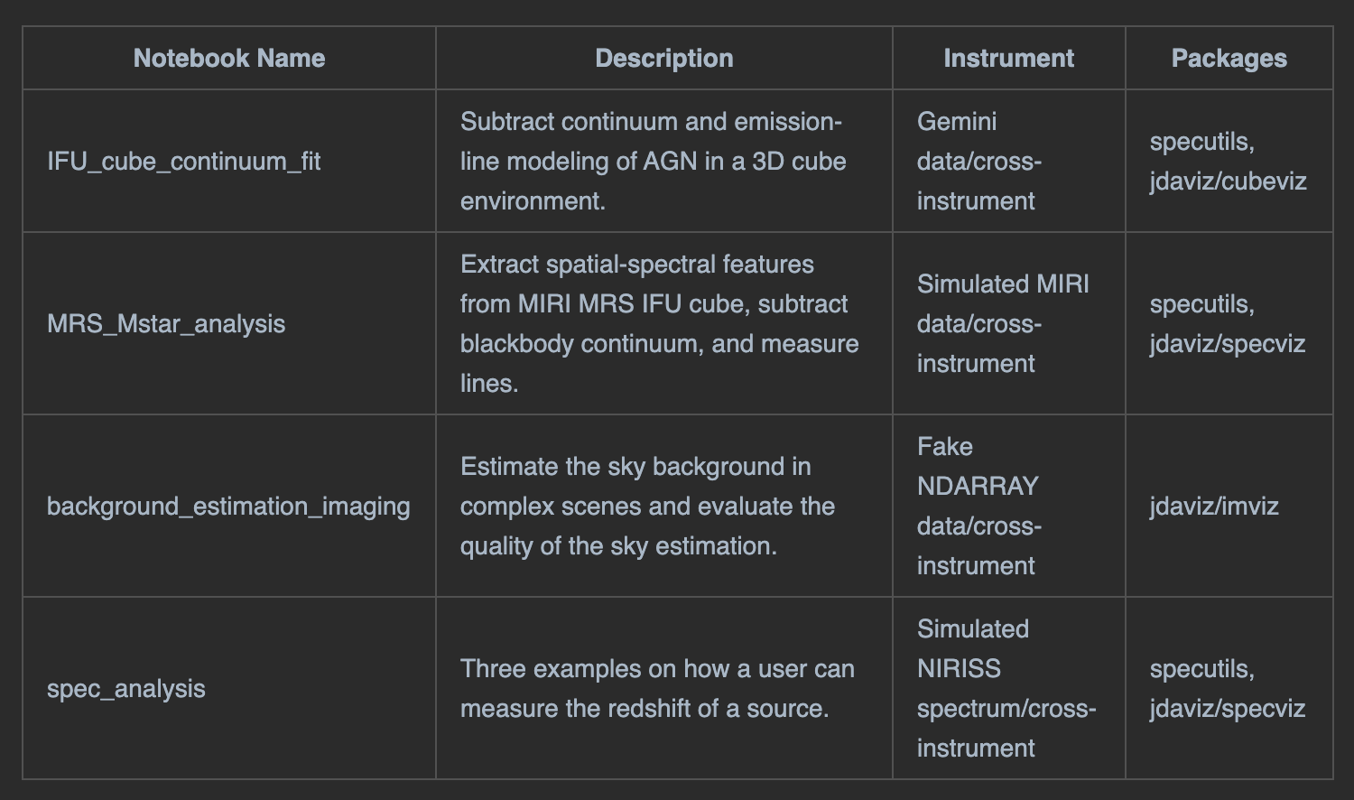
Notebooks to choose from

Slide 4
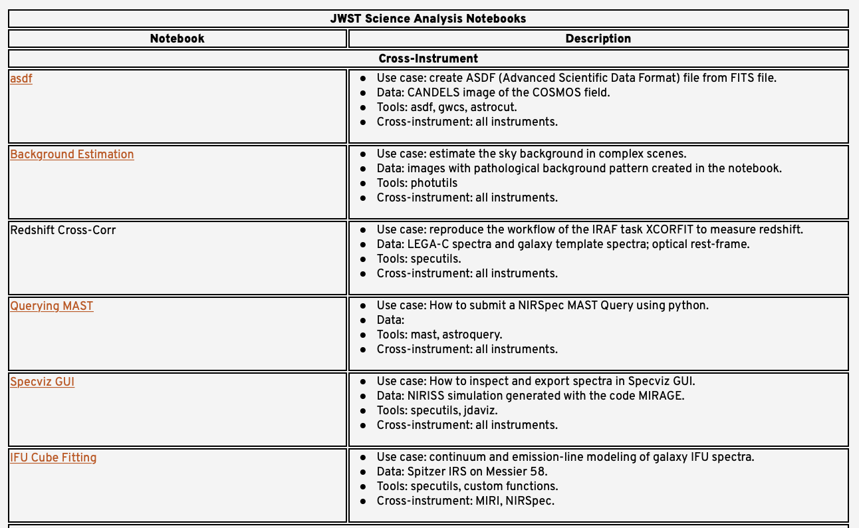
Screenshot Backup

Slide 5
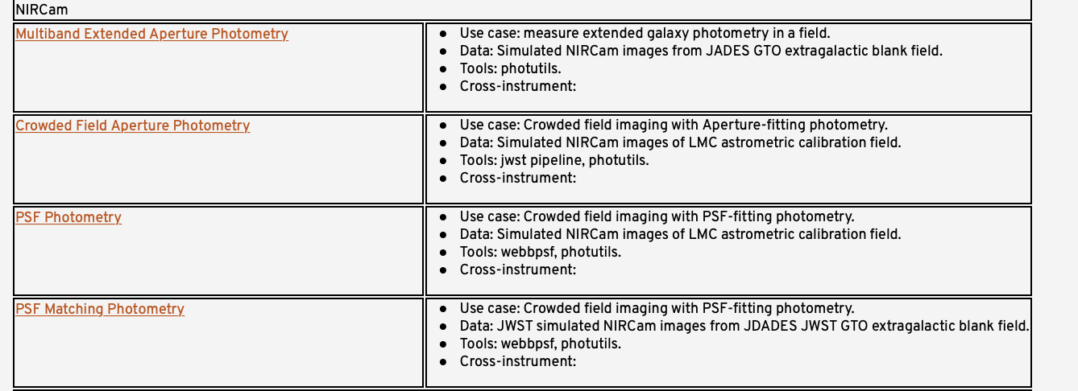
Screenshot Backup

Slide 6
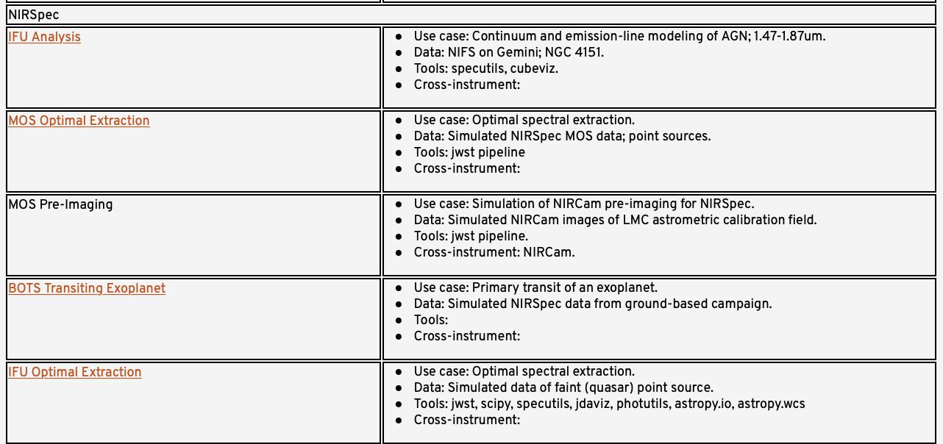
Screenshot Backup

Slide 7
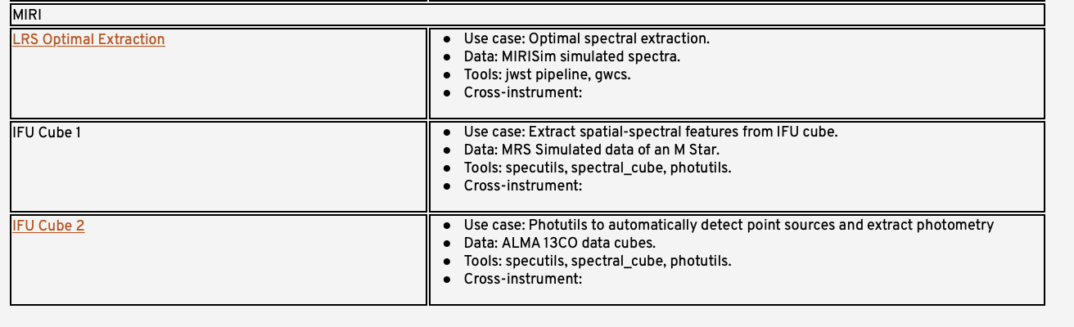
Screenshot Backup

