Slide 1
Category review: Chips
July 2020
Retail Analytics
Brand note: If client logo is not required, use alternate title page layout right click slide thumbnail > Layout > Title

Slide 2
Notes:
To view Privacy video explaining how important data privacy is to Quantium, please click here: https://www.youtube.com/watch?v=Zq1QDAkoRzU
or here Q:\Company Reference\Brand & Design\Brand videos\Q Privacy.mp4
At Quantium, we believe that data is the behavioural footprint of humanity and that it has to be treated with the utmost care and responsibility.
Histories, attitudes, indeed lives are stored within it in ways that aren’t always apparent – and that’s what makes its potential so powerful.
To work with it responsibly, sensitively, we set ourselves the highest data privacy protection and governance standards.
We have spent 17 years perfecting privacy-by-design and secure-by-design principles. Central to this is not holding any personally identifiable information about people –
we neither receive it, and put the necessary protections in place to be unable to decipher it.
Every aspect of handling data is safeguarded: from its de-identification, to its encryption – data security is paramount and of the highest grade.
We pride ourselves on gaining the trust of iconic organisations around the world through years of securely working with their data,
and in turn the trust that builds with their stakeholders.

Slide 3
Executive summary
01
Chips Category Review
The sales increase around Christmas except the Christmas day itself. More chips category can be sold during that time by promotions.
Kettle brand chips are sold the most throughout the data. Next comes Smiths and Doritos respectively.
Mainstream Young Singles, Couples and Retirees purchase the most chips, making up to 25 percent of total sales.
02
Trial Store Assessment
One control store was selected for each trial store except the last trial store 88. We compared 2 control store for this one.
New store layout gave at least better performance in sales as compared to pre-trial period.

Slide 4
01
Category

Slide 5
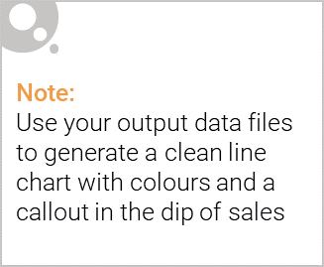
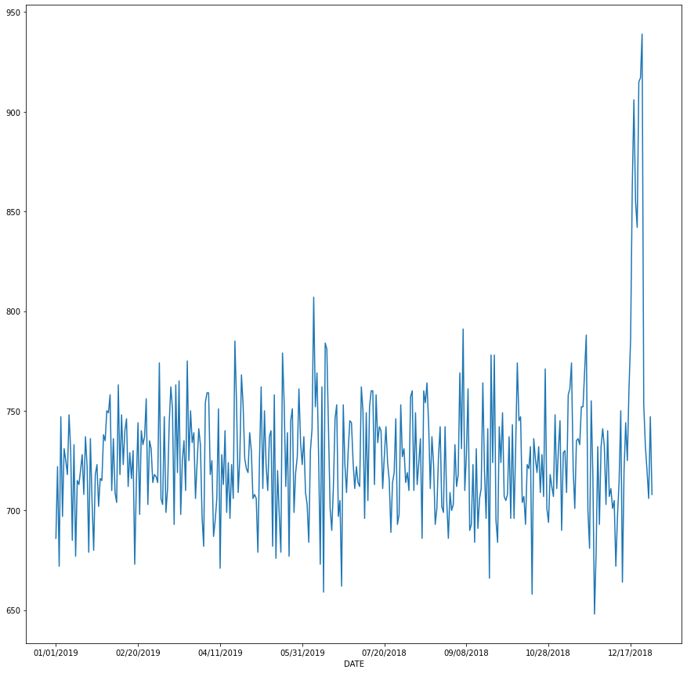
The chips transactions remain consistent throughout over the timeline but a sudden increase is seen near Christmas.
No of Sales

Slide 6

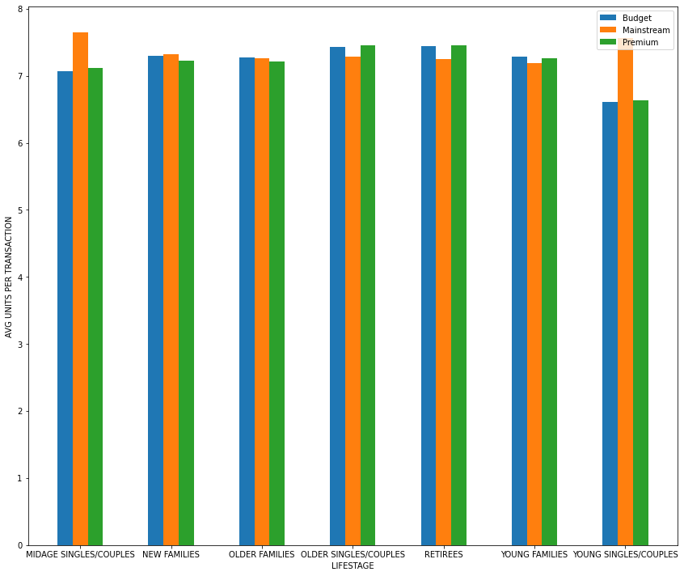
Consistent affluence across each Life stage profile. Mainstream Older Singles/Couples and Retirees purchase the highest average units per transaction.
Snack Food – Chips – Average Units per transaction by affluence and life stage profile

Slide 7
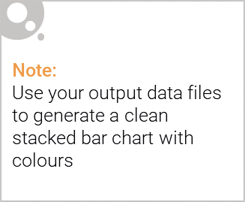
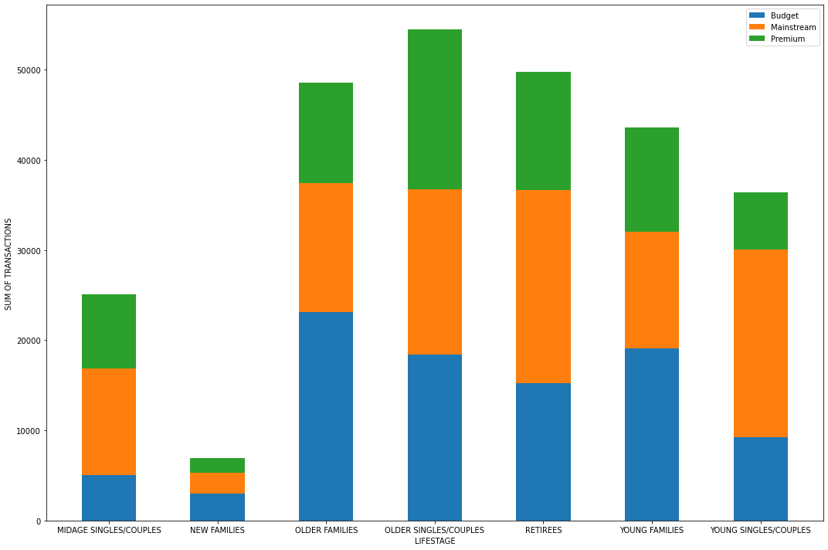
Editable (delete this)
Mainstream Customers are the biggest purchasers. Out of them most chips are purchased by Older Singles/Couples and Retirees.
Snack Food – Chips – Sum of transactions by affluence and life stage profile

Slide 8
02
Trial store performance

Slide 9
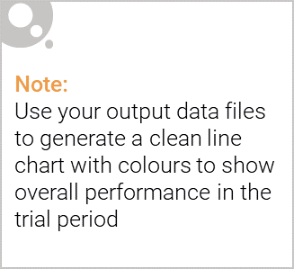
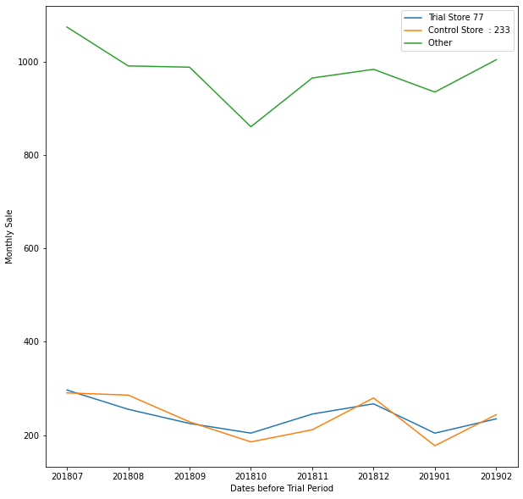
The control store were set up to measure whether trial store are doing better during the trial period or not.
Snack Food – Chips – Monthly sale over the Timeline for Trial Store and Control Store

Slide 10
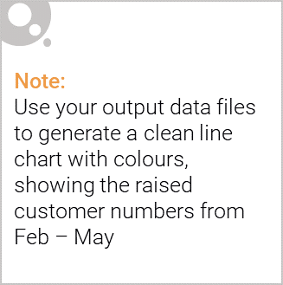
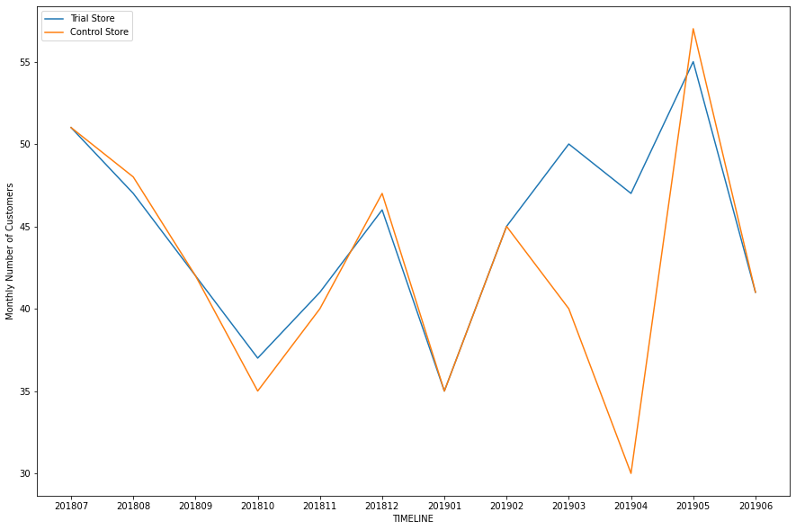
Trial Store performing well in comparison to Control Store during trial period. Hence, trial assessment was successful.
Snack Food – Chips – Monthly number of customers over the Trial Period for Trial Store and Control Store

