Slide 1
IMAGE RECONSTRUCTION FROM DVS
MARCEL GEPPERT & SAMUEL BRYNER

Slide 2
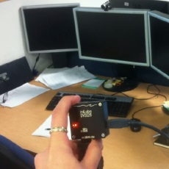
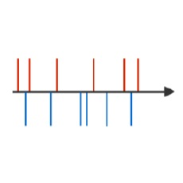
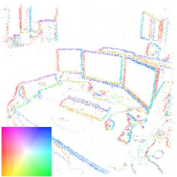
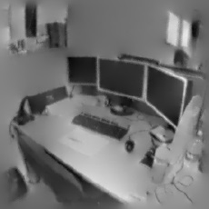

Slide 3
schedule
5 tage
simulation of camera signal
9/3/2015 - 15/3/2015
5 tage
captures test data with known rotation
9/3/2015 - 15/3/2015
5 tage
image reconstruction from gradient map
16/3/2015 - 22/3/2015
20 tage
gradient map building
16/3/2015 - 10/4/2015
15 tage
rotation tracking
23/3/2015 - 10/4/2015
10 tage
component integration
13/4/2015 - 26/4/2015
10 tage
refinement + tuning
27/4/2015 - 10/5/2015
Project Updates
Project Demo
13/4/2015
18/5/2015
2015
Mar
Apr
May
2015

Slide 4
Updated schedule
5 tage
simulation of camera signal
9/3/2015 - 15/3/2015
5 tage
image reconstruction from gradient map
16/3/2015 - 22/3/2015
20 tage
gradient map building
16/3/2015 - 10/4/2015
20 tage
rotation tracking
23/3/2015 - 19/4/2015
10 tage
component integration
20/4/2015 - 3/5/2015
10 tage
refinement + tuning
4/5/2015 - 15/5/2015
Project Updates
Project Demo
13/4/2015
18/5/2015
2015
Mar
Apr
May
2015

Slide 5
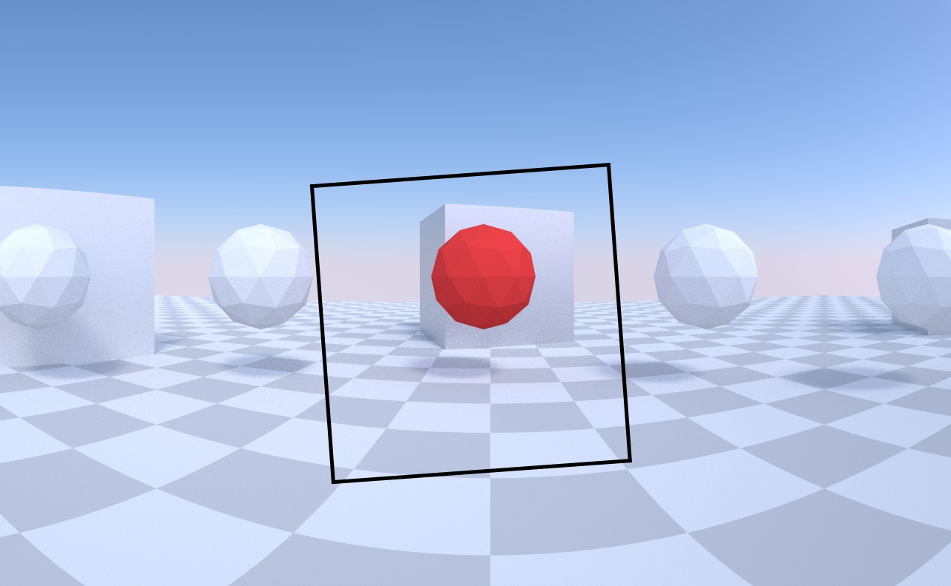
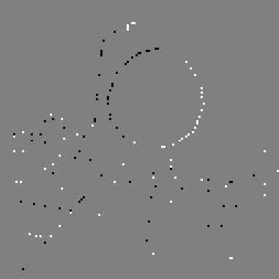
Camera simulation

Slide 6
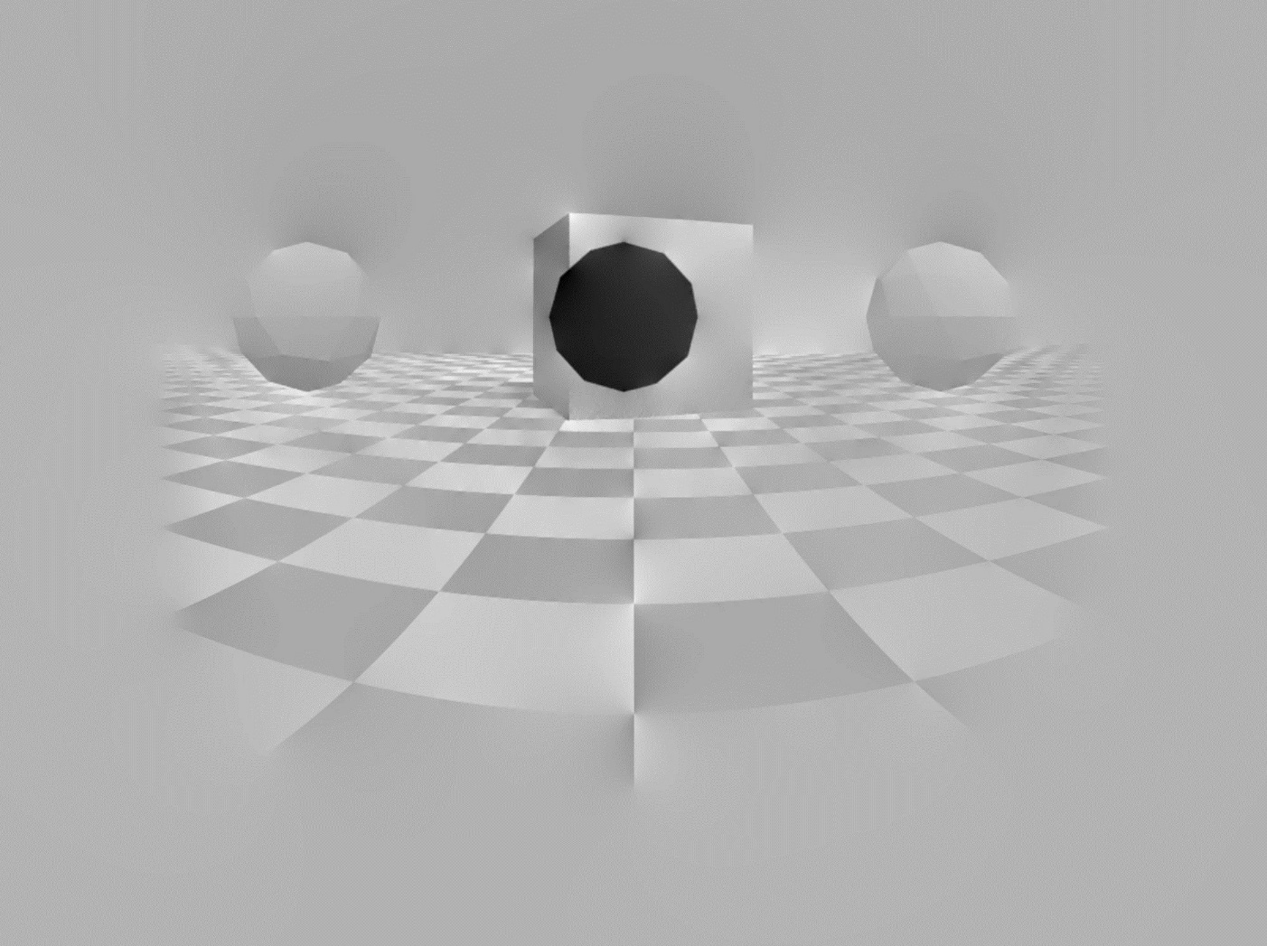
Reconstruction

Slide 7
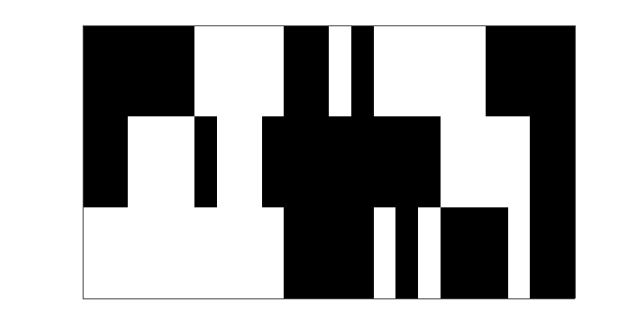
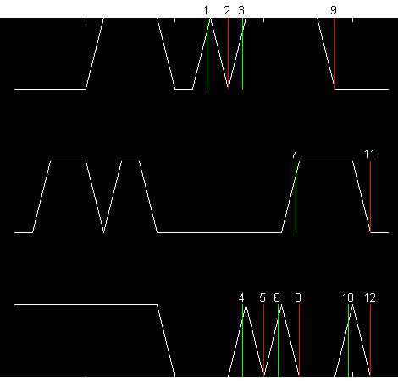
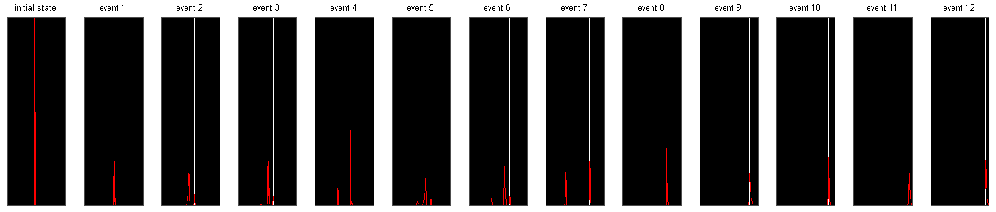
tracking in 1d
initial camera position

Slide 9




tracking: we’ve got an event!
Where did we come from? Where was the last event of this pixel generated?
position at time of last event ($t−τ$)
intensity map (the image)
last event at same pixel ($t−τ_{c}$)
threshold
intensity at time
of previous event
$⇒$ possible origin points
after movement prediction:
likelihood of correspondence
$⇒$ possible destination points

Slide 10
tracking: we’ve got an event!
Where did we come from? Where was the last event of this pixel generated?
position at time of last event ($t−τ$)
intensity map (the image)
possible origin points
threshold
intensity at time
of previous event
possible destination points
likelihood of correspondence

Slide 11



tracking: we’ve got an event!
Where did we come from? Where was the last event of this pixel generated?
possible destination points
likelihood of correspondence
possible origin points
$$×$$
$$×$$
$$=$$

Slide 12
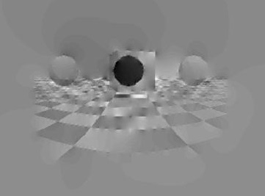
Reconstruction (low resolution)

