Slide 1
MonoSLAM
Real-Time Single Camera SLAM

Slide 2
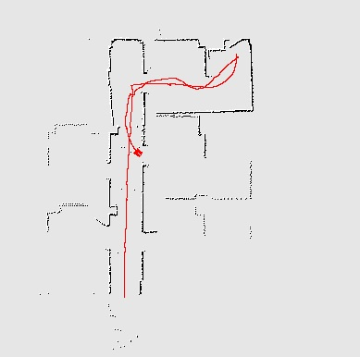
SLAM
Track own movement in unknown environment​
Create map​
Detect loop-closures
Image: kontrivelabs.com

Slide 3
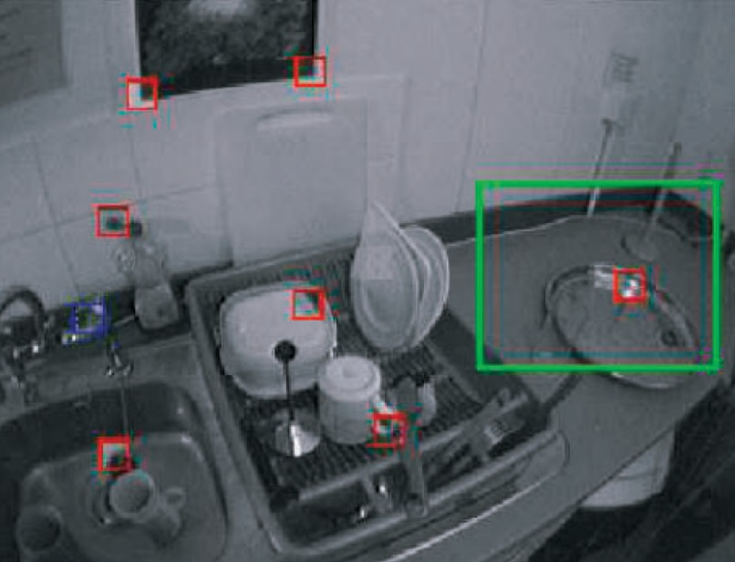
Visual Landmarks
Small image patches
Assumed to show planar surface
Estimate position and orientation

Slide 4
Map
Estimation of camera and landmark positions using EKF
Image patch for each landmark
Estimation of patch orientation with separate EKF for each landmark

Slide 5
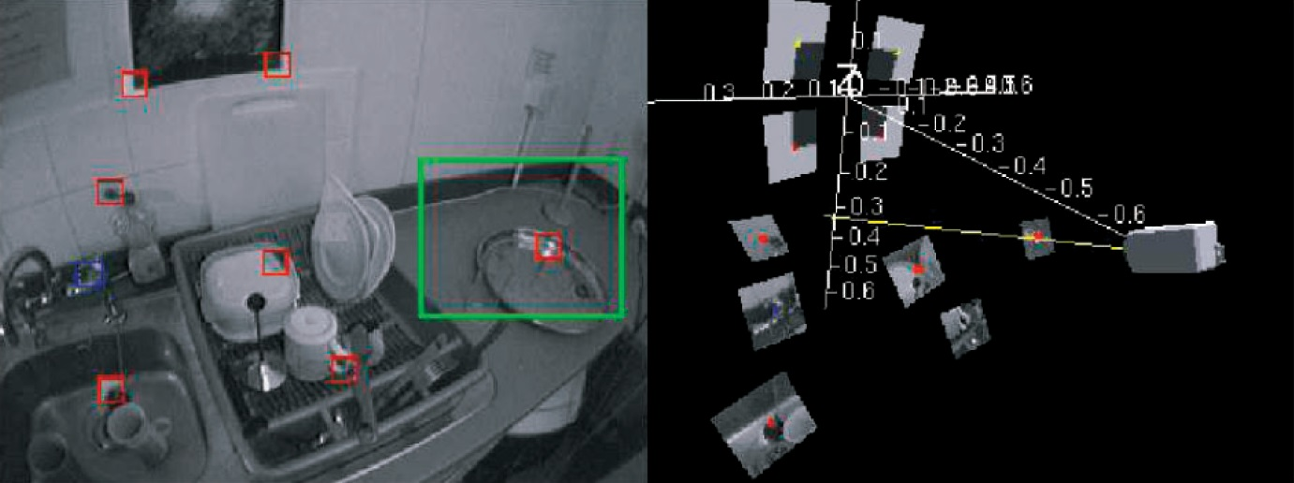
Map

Slide 6
Algorithm Overview
state estimate
update state estimate
predict camera movement
search known landmarks
search new landmarks
image patch
predict patch appearance
normal estimate

Slide 7
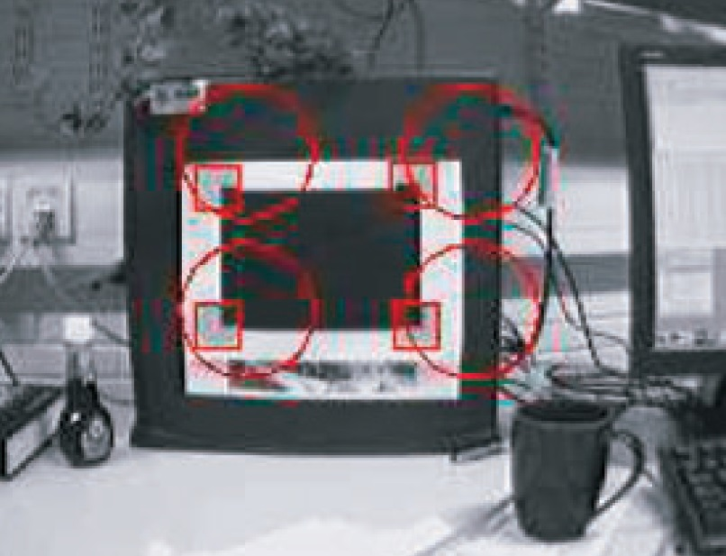
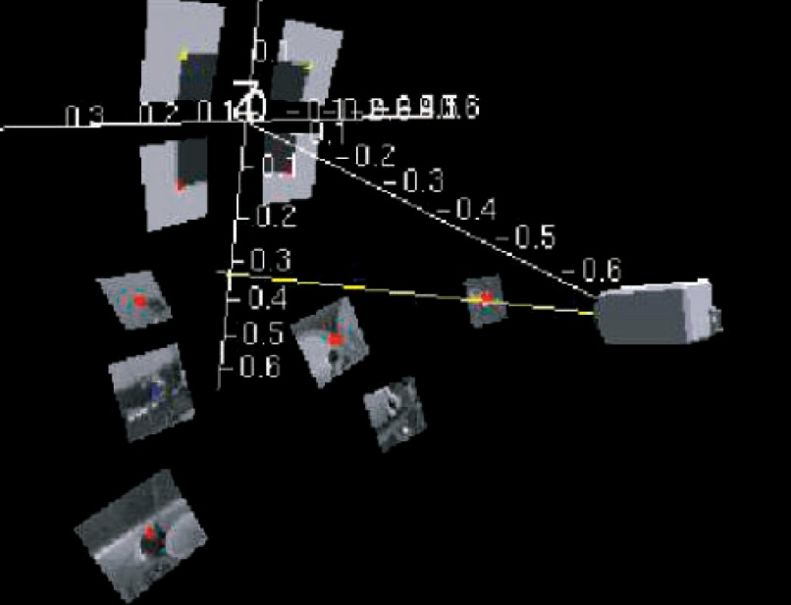
Initialization
Set known target at map origin
Set approximate camera position with uncertainty

