Slide 1



Slide 2
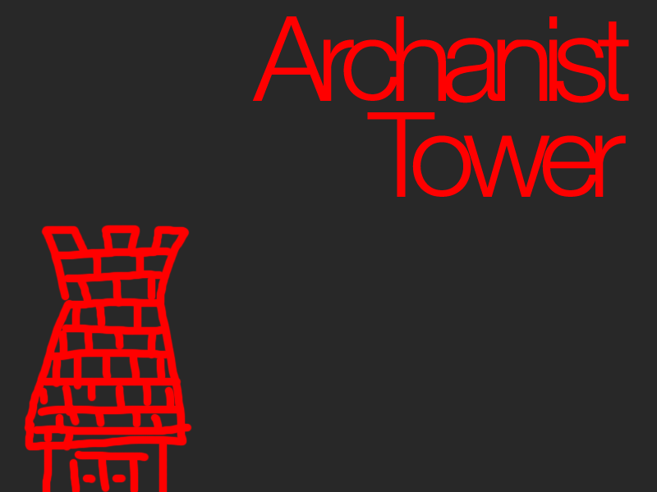

Slide 3
Team Members
Seth Clark
Jerry Hung
Matt Adams
Matt Senn

Slide 4
Game Design
- Dungeon Crawler
- Player Story
-Powerful Wizard who's powers come from colors
-Colors are stolen from the world
-Wizard must collect the colors and kill EVERYTHING!

Slide 5
Game Design
Rules
Player is restricted to health/mana amounts
Player must collect colors relics to gain powers
Outcome
Player kills everything and collects colors: Win
Everything kills player: Lose
Strategy
Collect all the colors
Don't get killed

Slide 6

Game Design
Changes based on playtesting:
-Control Settings
-Better AI
-Visual Changes

Slide 7
Game Development
Seth:
Code Architecture
Anything/Everything
Matt A:
Shaders
Map Design
Jerry:
Enemy Code
AI
Matt S:
Spell Code
AI

Slide 8
Game Development
Graphics: All online resources
Sounds: Legend of Zelda: A Line to the Past
Collision: Per-pixel / Rectangle Intersection

Slide 9
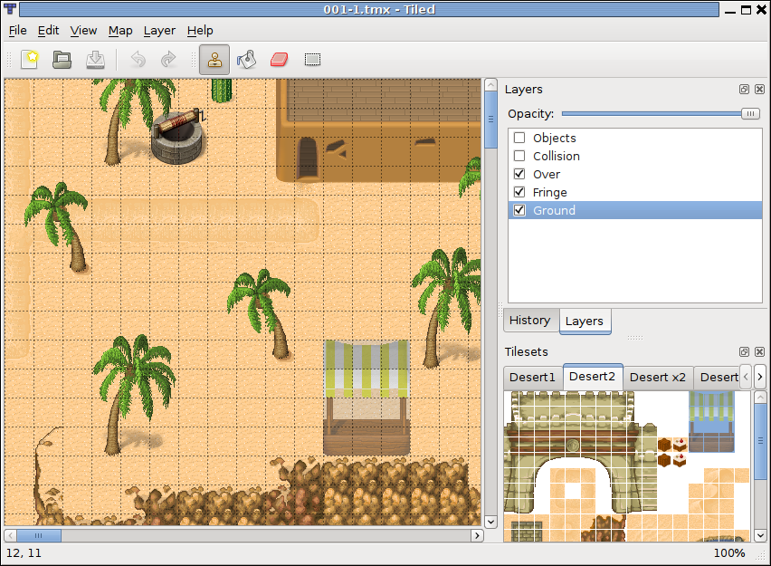
Game Development
Tools Used:
XNA 3.1
Visual Studio 2008
Tiled

Slide 10
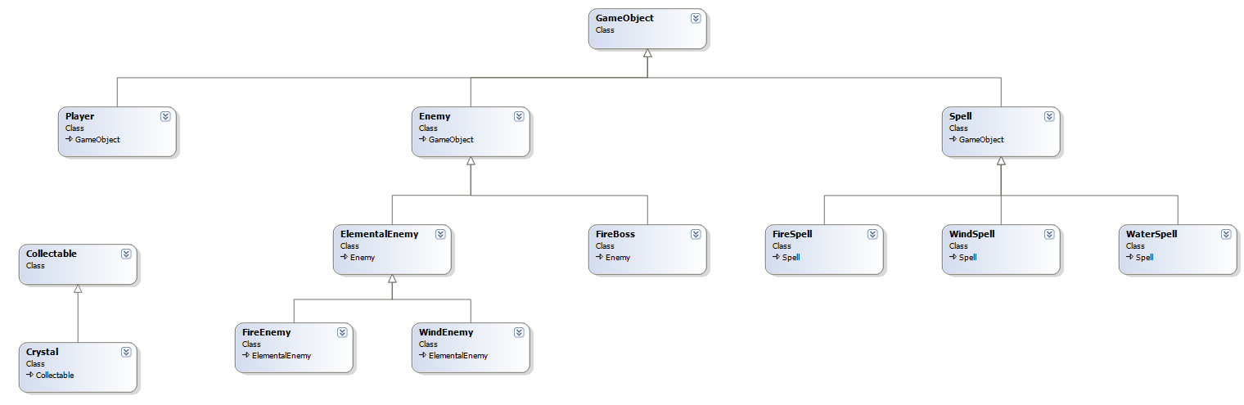
Game Development

Slide 11
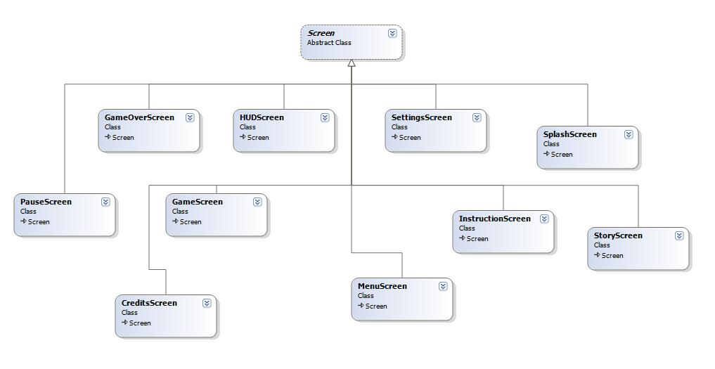
Game Development

Slide 12
Game Development
Functional Minimum: | Status | Date Completed | Milestone
Basic Tile Environment | Complete | Oct 30th 2010 | Prototype
First Level | Complete | Nov 16th 2010 | Alpha 1
Sprite Animations | Complete | Oct 30th 2010 | Prototype
Basic HUD | Complete | Nov 1st 2010 | Prototype
Basic Menu | Complete | Nov 2nd 2010 | Prototype

Slide 13
Game Development
Low Target: | Status | Date Completed | Milestone
Complete Tile Environment | Complete | Nov 11th 2010 | Alpha 1
Player/Enemy Collision | Complete | Nov 11th 2010 | Alpha 1
First Player Combat Spell | Complete | Nov 11th 2010 | Alpha 1
Basic Enemy AI(wandering) | Complete | Nov 13th 2010 | Alpha 1
Basic Shader Effects(remove colors) | Complete | Nov 17th 2010 | Alpha 1

Slide 14
Game Development
Desirable Target: | Status | Date Completed | Milestone
Advanced HUD | Complete | Dec 6th 2010 | Alpha 2
Advanced Menu System | Complete | Nov 15th 2010 | Alpha 1
Completed First Two Levels | Complete | Nov. 28th 2010 | Alpha 2
All Player Combat Spells | Complete | Nov. 24th 2010 | Alpha 2
First Boss Fight | Complete | Dec 3rd 2010 | Alpha 2
Sound Effects | Complete | Dec. 7th 2010 | Alpha 2

Slide 15
Game Development
High Target: | Status | Date Completed | Milestone
Non-Combat Spells(health/mana spells) | Complete | Dec 2nd 2010 | Alpha 2
Unique Enemy AI | Complete | Dec 3rd 2010 | Alpha 2
Completed All Levels | Incomplete
Advanced Shader Effect(add in each color) | Complete | Dec 5th 2010 | Alpha 2

Slide 16
Game Development
Extras: | Status
Spell Combos
Custom Art
Custom Sound Effects
Co-op Mode
Networked Play
More Colors
Story line with NPCs

Slide 17
Game Demonstration
DEMO!!!

