Slide 1


Machine Learning Queueing System for Cloud/Mobile Edge Computing
By Artem Vasilev, Chatchon Chawalaworn, Minxuan Qin, Ovidiu-Alexandru Parfene, Romin Niklas Benfer, Yong Feng

Slide 2
Outline
Introduction
Program Overview
System Model
Live Demonstration
Advantages / Disadvantages
Conclusion
References

Slide 3
Introduction
What does the title actually mean?
Machine Learning Queuing System for Cloud/Mobile Edge Computing
Cloud/Mobile Edge Computing: a concept that enables cloud computing capabilities and close to (at the “edge”) of the cellular network, reducing traffic congestion
Queueing System: a system that maintains our queue
Machine Learning: an algorithm uses sample data in order to make predictions and decisions (here: heuristic gradient calculations)

Slide 4
Introduction
Our goal:
Design an allocation algorithm
Optimize for minimum queueing delays
Build a framework to support said algorithm
How did we achieve it? Created the following system:

Slide 5
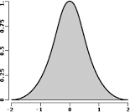
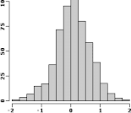
Overview
Our system in a nutshell
Sampling
1
2
Continuous Distribution
Discrete Distribution
Packages
CPU 1
3
CPU 2
Queue
CPU
3
Processors
Fig. 1: System Overview

Slide 6
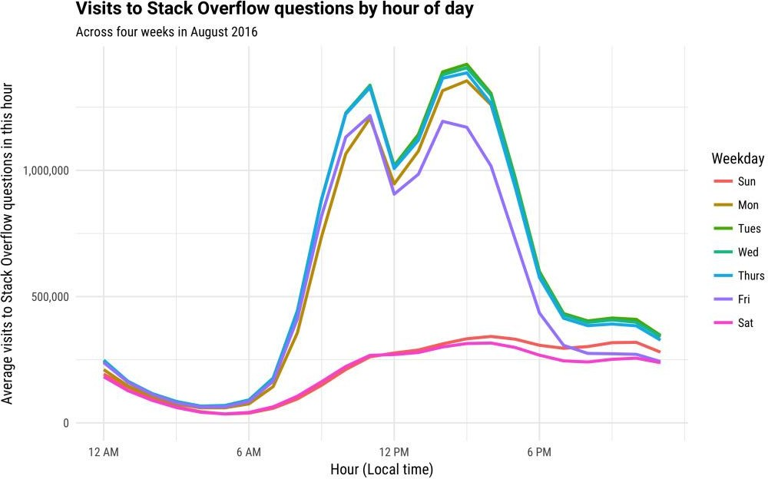
System Model
1. Creating a distribution system
We use
the number of visits to
to
Stack Overflow over
a day
approximate real traffic
Based on that we created a signal generator which represents the distribution of packages throughout the day
Variables allow us to fine-tune the
exact look, but the basic shape
Fig. 2: Visits to Stack Overflow by hour of day Source: Stack Overflow Blog
stays the same

Slide 7
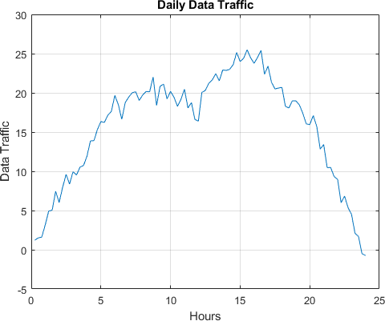
System Model
2. Adding packages to a queue
The Y-Axis
of the distribution how many packages,
determines
enter the queue at a time
Each package has a different random ‘urgency’ value
They are sorted according to this value (smaller value is closer to the end of the queue).
The queue is represented with integers, each symbolizing a package’s maximum time to live
Fig.3: Distribution model

Slide 8
System Model
3. Distributing packages to CPUs
We have 3 CPUs, each with different fixed frequencies
Based on our prediction we assign packages to the CPUs
We should keep the best CPUs free for times of high load, so we prioritize slower
CPUs (also minimizing power consumption)
CPU index | Speed (% of cycle for package) | Max packages/cycle
1 | 0.07 | 14
2 | 0.11 | 9
3 | 0.15 | 6
Table 1: CPU parameters

Slide 9
System Model
3. Distributing packages to CPUs (cont.)
We record and store previous distributions of a program, calculate the mean at each particular time slot and anticipate the calculated number of packages
Possibilities (with a certain tolerance):
- load max 1 CPU (prepare for the upcoming workload)
- load max 2 CPUs
- load as many CPUs as possible (free up the queue)

Slide 10
Live Demonstration

Slide 11
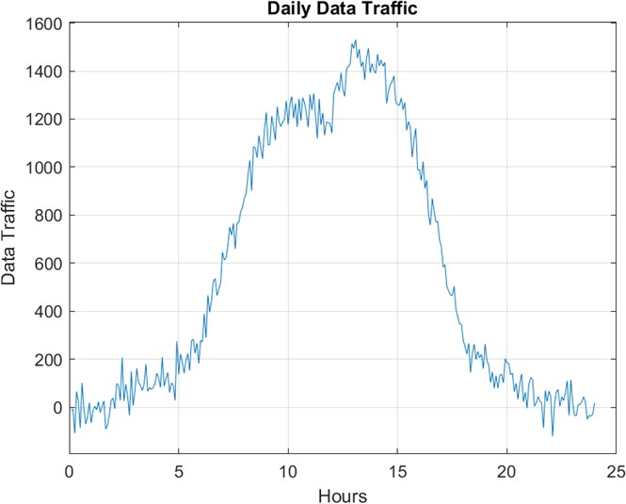
When does this prediction system (not) work?
Edge Cases
Steep Slope
-> drastic change in allocation priority
Sawtooth Signal
-> algorithm becomes very unstable

Slide 12
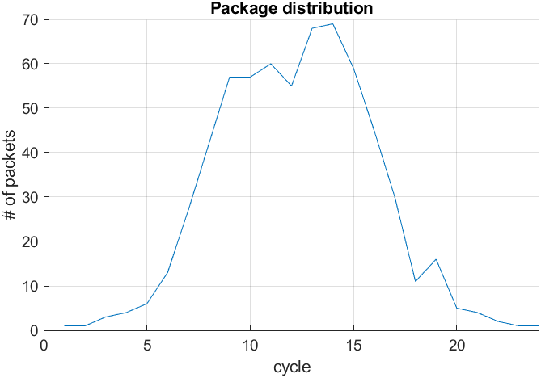
When does this prediction system work optimally?
Use case
Steep Slope
-> drastic change in allocation priority
Smooth distribution -> algorithm can successfully predict incoming traffic

Slide 13
Conclusion
Organization/collaboration notes:
For all of us it was the first cooperative project over a large time frame
It included collaborating over git, weekly meeting, delegating and responsibilities
Overall a very rewarding learning experience
sharing
Project result:
The heuristic gradient calculation model is dynamic and adaptive, but has its
drawbacks

Slide 14
References
Fig. 2:
What programming languages are used at night? – Stack Overflow Blog, 2017.: https://stackoverflow.blog/2017/04/19/programming-languages-used-late-night/

Slide 15
Thank you for your attention!

