Slide 1

Quantum
Cryptography
Zelam Ngo, David McGrogan

Slide 2

Motivation
Age of Information
Information is valuable
Protecting that Information

Slide 3
Quantum Security Benefits
Provably Secure
Evidence of Tampering

Slide 4
History
Stephen Wiesner wrote “Conjugate Coding” in the late sixties
Charles H. Bennett and Gilles Brassard revived the field in 1982 by combining quantum process with public key cryptography.

Slide 5
Fundamentals
Measurement causes perturbation
No Cloning Theorem
Thus, measuring the qubit in the wrong basis destroys the information.

Slide 6
BB84
Set-up
  Alice
    Has the ability to create qubits in two orthogonal bases
  Bob
    Has the ability to measure qubits in those two bases.

Slide 7
BB84
Alice
  Encodes her information randomly in one of the two bases…
    For example,
Basis A | Basis B
ￜ0〉= 0 | ￜ+〉= 0
ￜ1〉= 1 | ￜ-〉= 1

Slide 8
BB84
Alice prepares 16 bits
0101100010101100
in the following bases,
BAABAABAAAABBBBA
Thus the following states are sent to Bob:
+10-10+0101+--+0

Slide 9
BB84
Bob receives the stream of qubits and measures each one in a random basis:
ABAABAAABABBBBAB
Alice’s bits | 0101100010101100
Alice’s bases | BAABAABAAAABBBBA
States sent | +10-10+0101+--+0

Slide 10
BB84
So Bob gets
1-00-0+0+0-+--1+
Alice’s bits | 0101100010101100
Alice’s bases | BAABAABAAAABBBBA
States sent | +10-10+0101+--+0
Bob’s bases | ABAABAAABABBBBAB

Slide 11
BB84
Then Alice and Bob compare their measurement bases, not the results, via a public channel.
Alice’s bits | 0101100010101100
Alice’s bases | BAABAABAAAABBBBA
States sent | +10-10+0101+--+0
Bob’s bases | ABAABAAABABBBBAB
Bob’s results | 1-00-0+0+0-+--1+

Slide 12
BB84
Bob receives the stream of qubits and measures each one in a random basis:
ABAABAAABABBBBAB
So he gets,
**0**0*0*0*+--**
Then Alice and Bob compare their measurement bases, not the results, via a public channel.

Slide 13
BB84
So Bob and Alice are left with 7 useable bits out of 16
_ _ 0 _ _ 0 _ 0 _ 0_ 0 1 1 _ _
These bits will be the shared key they use for encryption.

Slide 14
BB84
Now enter Eve… She wants to spy on Alice and Bob.
So she intercepts the bit stream from Alice, measures it, and prepares a new bit stream to Bob based on her measurements…

Slide 15
BB84
So how do we know when Eve is being nosy?
Well… Eve doesn’t know what bases to measure in, so she would have to measure randomly and 50% of the time she will be wrong…

Slide 16
BB84
Thus, of the bits Bob measures in the correct bases, there is 50% that eve had changed the basis of the bit. And thus it is equally likely that Bob measure 0 or 1 and thus an error is detected 25% of the time.
Eve is found in the errors!

Slide 17
BB84
Eve creates a detectable error 25% of the time
Alice | Eve | Bob | Result
 | No measurement |  | Good bit value
 | No measurement |  | Discarded
 |  |  | Good value, Eve gains information
 |  |  | 50% chance Eve creates an error
 |  |  | Discarded
 |  |  | Discarded

Slide 18
BB84
In a world with perfect transmissions, all Bob and Alice have to do is publicly compare a few bits to determine if any error exists.
Errors exist in reality, thus the only way to detect Eve is to notice an increase in errors.
Thus the transmission process must not have an error rate higher than 25%.

Slide 19
BB84
Alice’s transmitter might sent multiple photons, which Eve could skim
Standard Encryption enhancing protocols can prevent Eve from gaining partial information

Slide 20
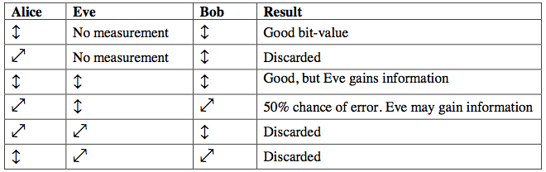
BB84
Eve creates a detectable error 25% of the time:

Slide 21
EPR
Uses entangled qubits sent from a central source
Alice and Bob measure qubits randomly and independently
After measuring, they compare measurement bases and proceed as in BB84

Slide 22
EPR
Advantage over BB84 is that Eve can now be detected using rejected qubits
Eve causes non-violation of Bell inequality – Eve’s measurement is a hidden variable

Slide 23
B92
Uses only two non-orthogonal states: ￜθ〉and ￜθ’〉
Polarized at θ and –θ from vertical
0 < θ < π/4

Slide 24
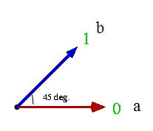
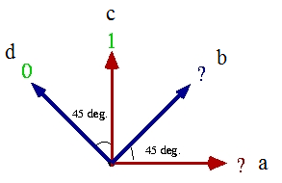
B92
Example at θ=π/8:
Encoding: | Decoding:

Slide 25
B92
Each bit is either successfully received or an “erasure”
Best measurement protocol gives erasure probability of
|〈θ|θ’〉| = cos(2θ)

Slide 26
B92
Eve’s presence revealed by:
  High error rate
  High erasure rate
Erasure rate increase can be avoided; result is then like BB84

Slide 27
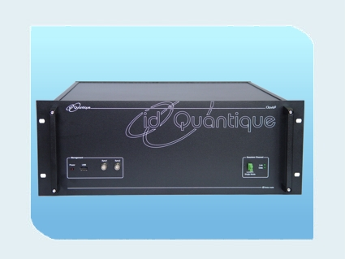
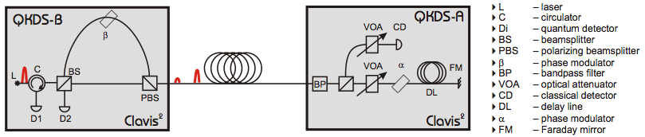
Current State of Affairs
Commercial quantum key distribution products exist

Slide 28
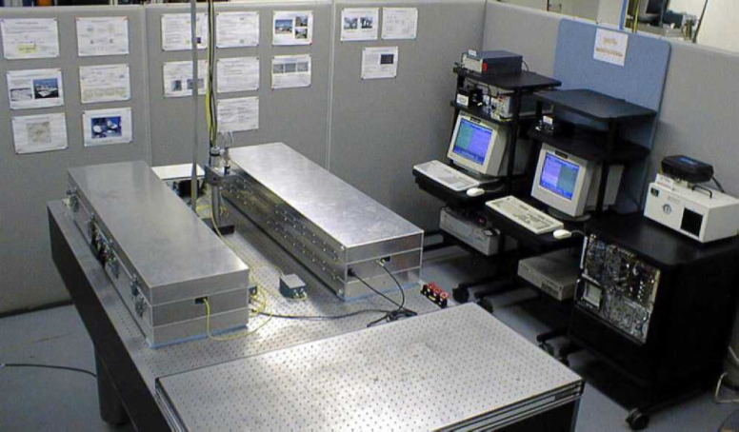
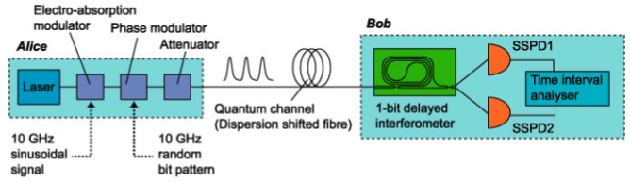
Current State of Affairs
Current fiber-based distance record: 200 km (Takesue et al)

Slide 29
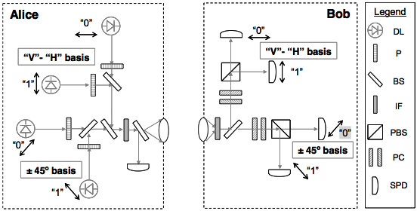
Current State of Affairs
Demonstrated free-space link: 10 km

Slide 30
Future Prospects
Ground-to-satellite, satellite-to-satellite links
General improvement with evolving qubit-handling techniques, new detector technologies

