Slide 1
Open {*.*}

Slide 2
Free Software
Not Freeware
Free as in freedom vs. Free as in Beer !
History
Free Software
Licenses
Getting Help
Contributing

Slide 3
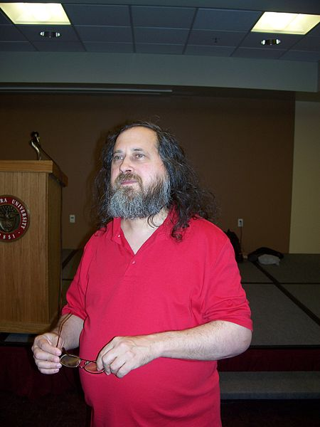
History

Slide 4
Four Freedoms
Freedom 0 – Run it as you wish
Freedom 1 – Study the source and change it as you wish
Freedom 2 – Distribute the original as you wish
Freedom 3 – Distribute the modified copy as you wish

Slide 5
Licenses
GNU
BSD
MIT
Apache
WTFPL
--

Slide 6
Types of Openness & Freedom
Open Access
Open Content
Open Data
Open Design
Open Format
Open Implementation
Open Innovation
Open Research
Open Security
Open Systems
Open Standards

Slide 7
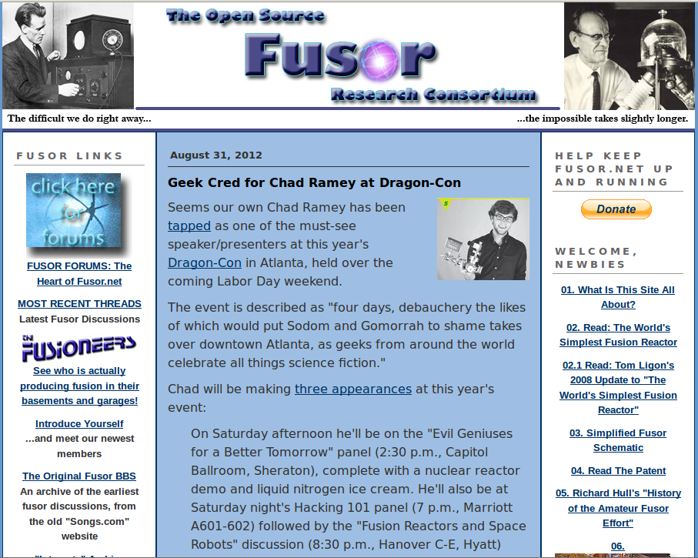
Nuclear Physics – Fusor.net

Slide 8
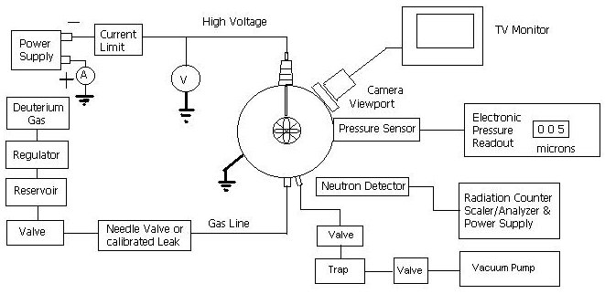
Fusor Schematic :)

Slide 9
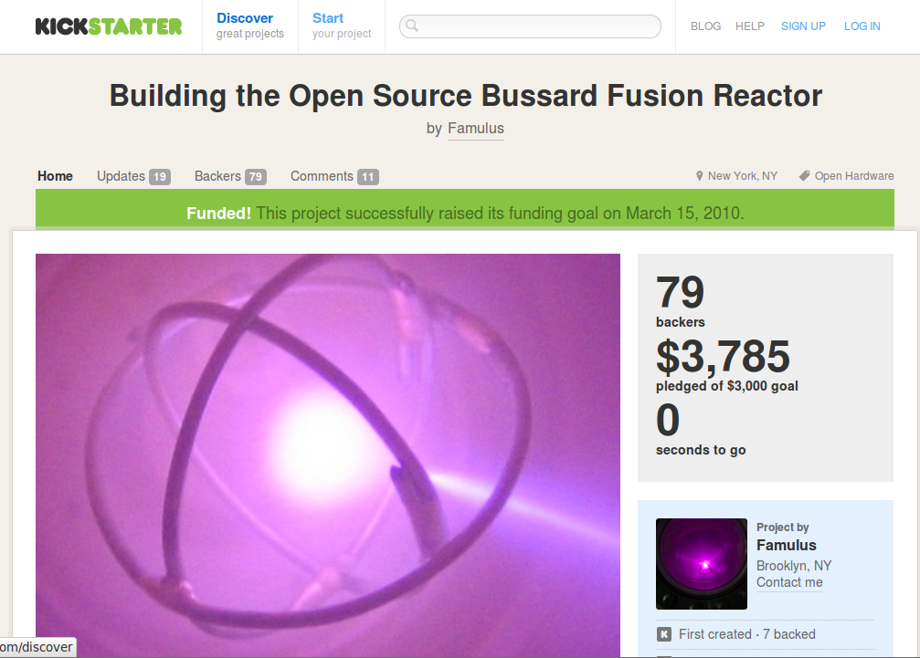
Nuclear Physics – Polywell Proj

Slide 10
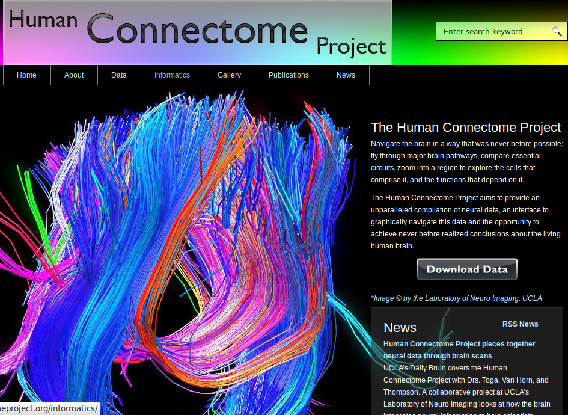

Slide 12
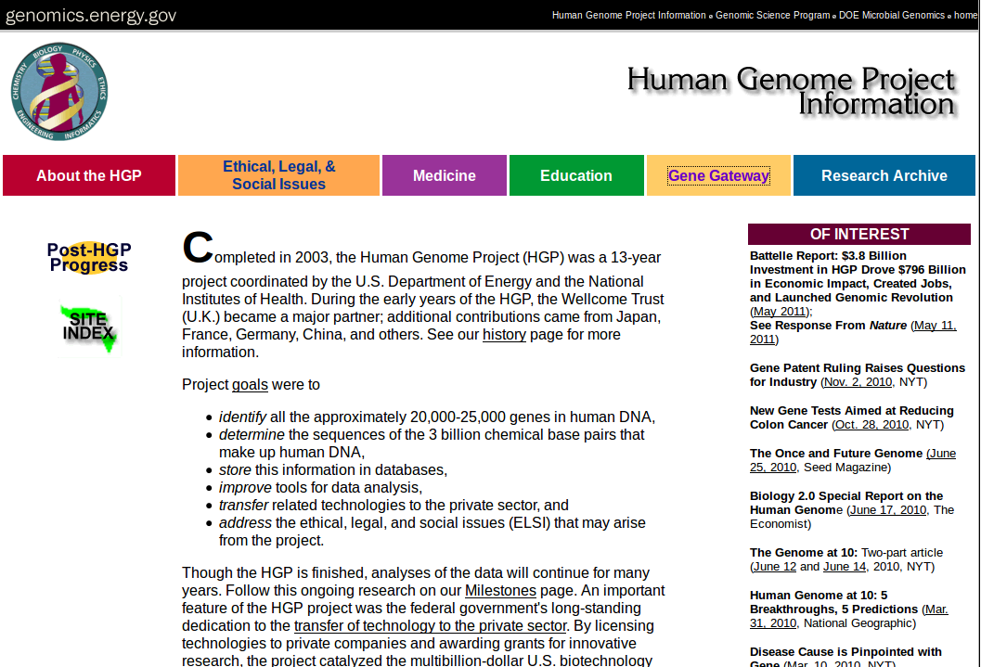

Slide 13
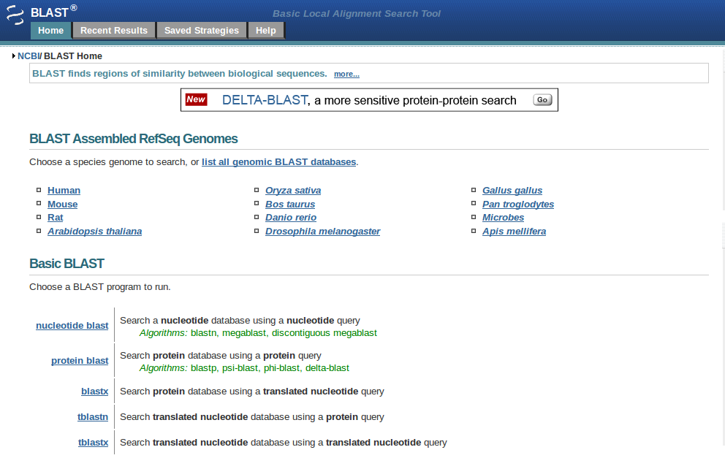

Slide 14
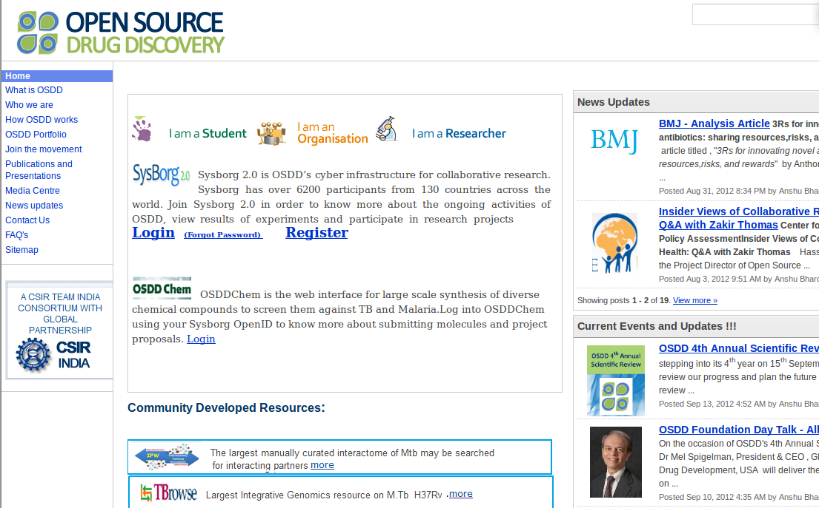

Slide 15
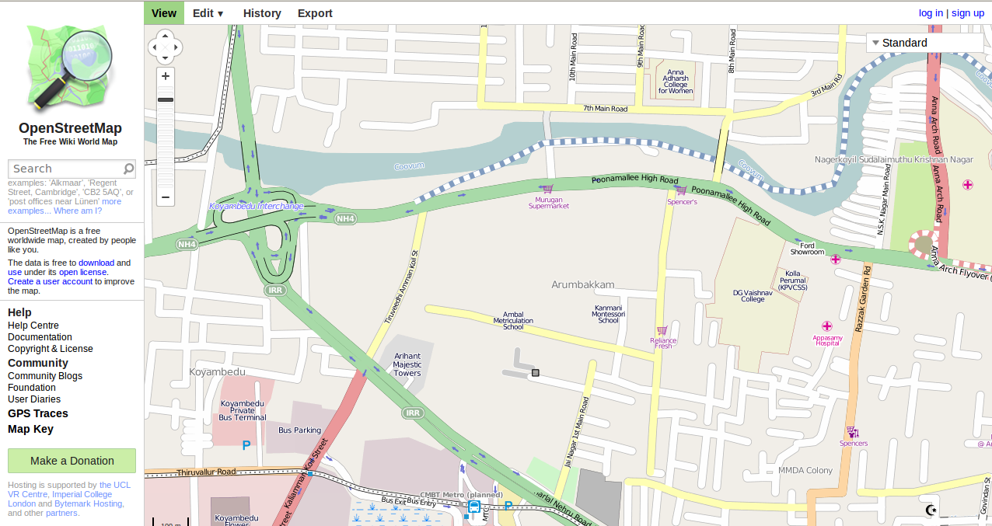
Open Street Map

Slide 16
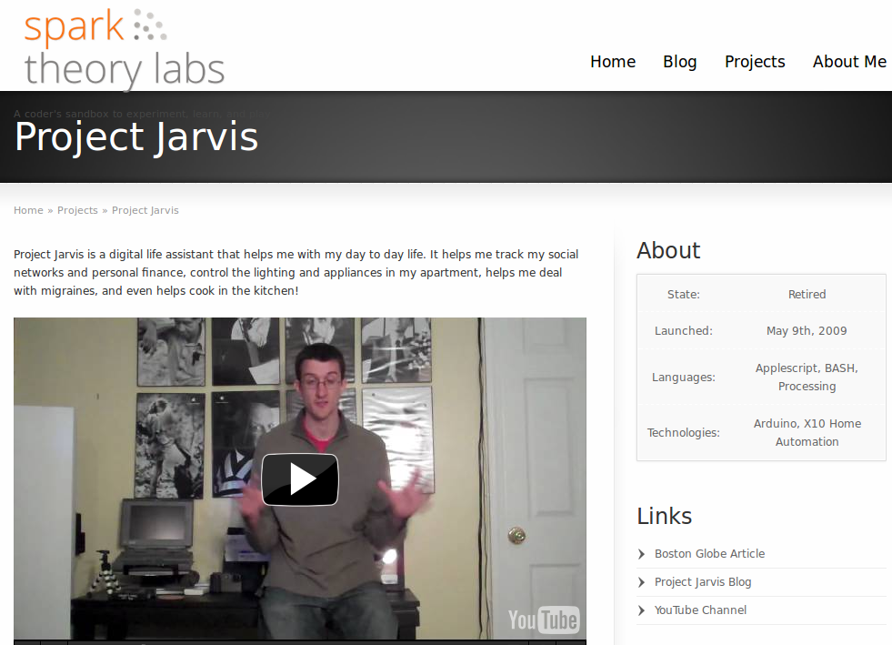

Slide 17
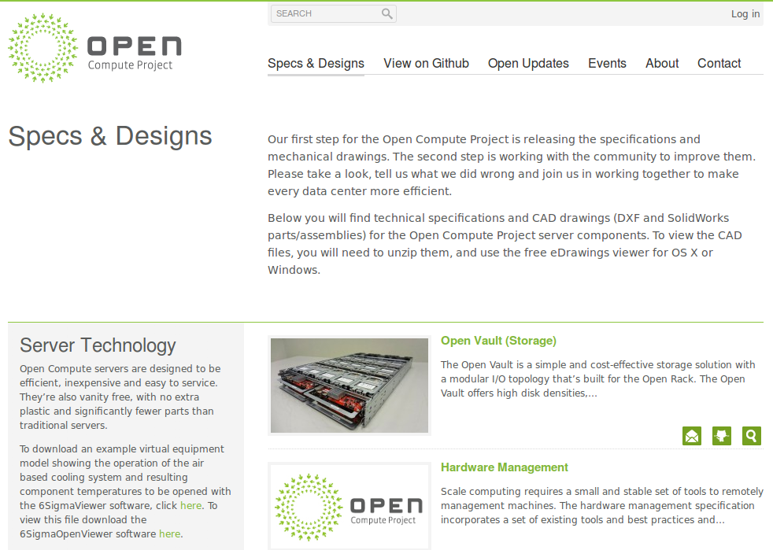

Slide 18
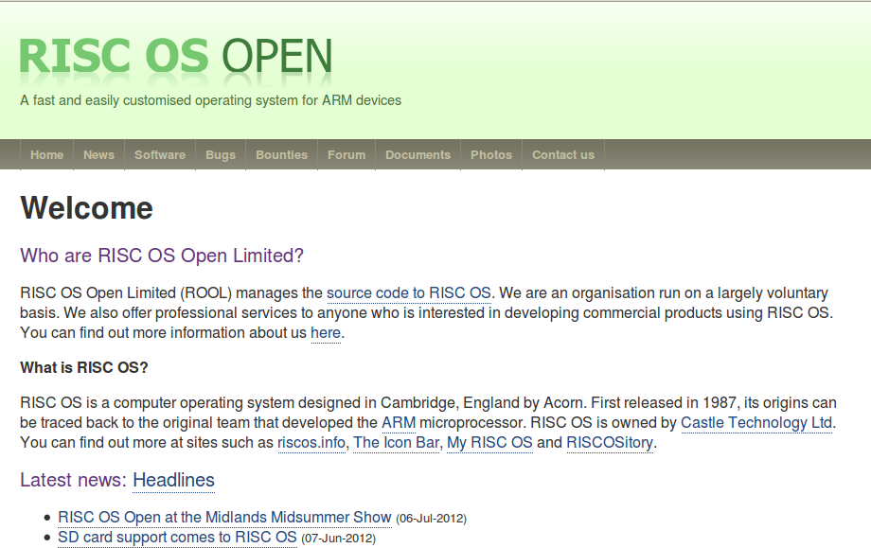

Slide 19
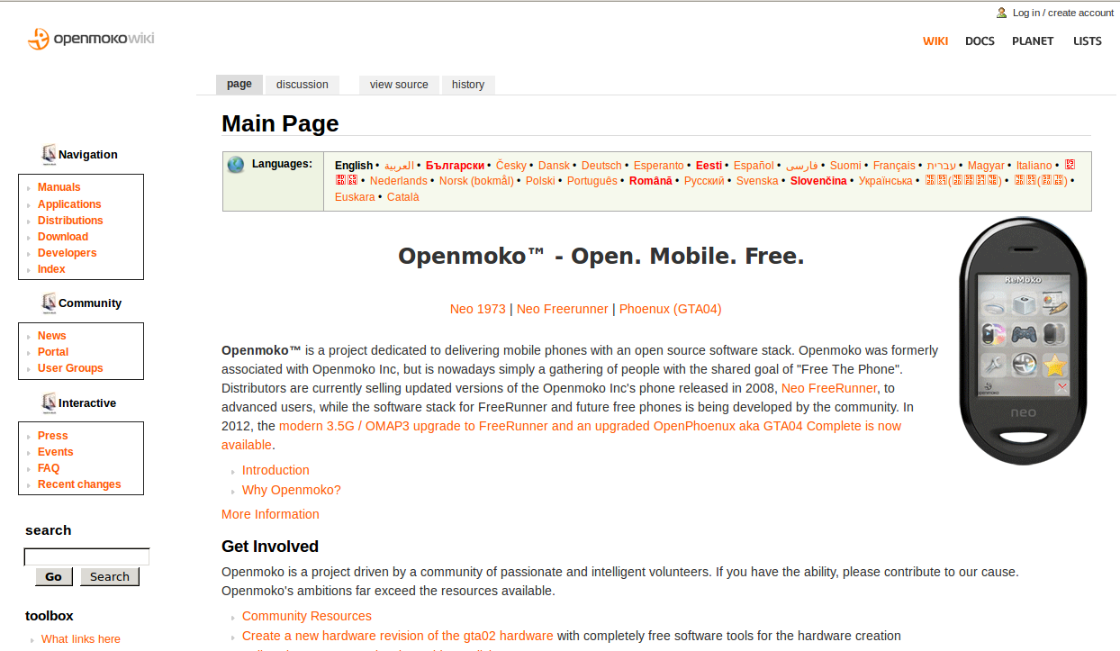
OpenMoko

Slide 20
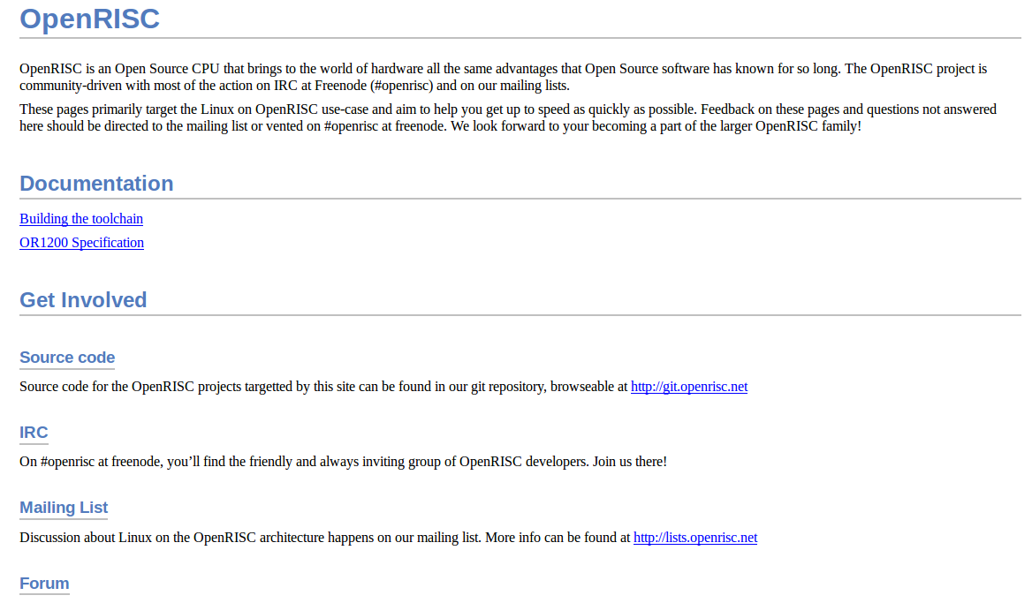
OpenRISC

Slide 21
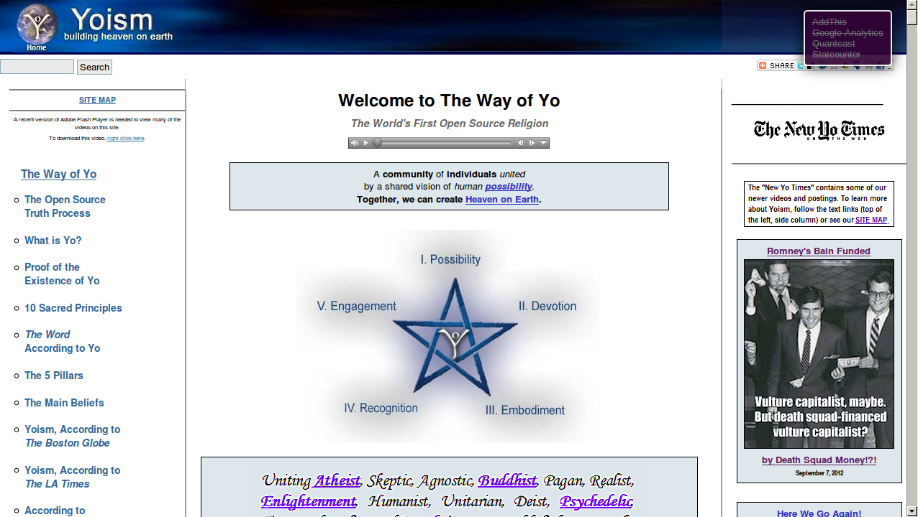
Religion !!!

Slide 22
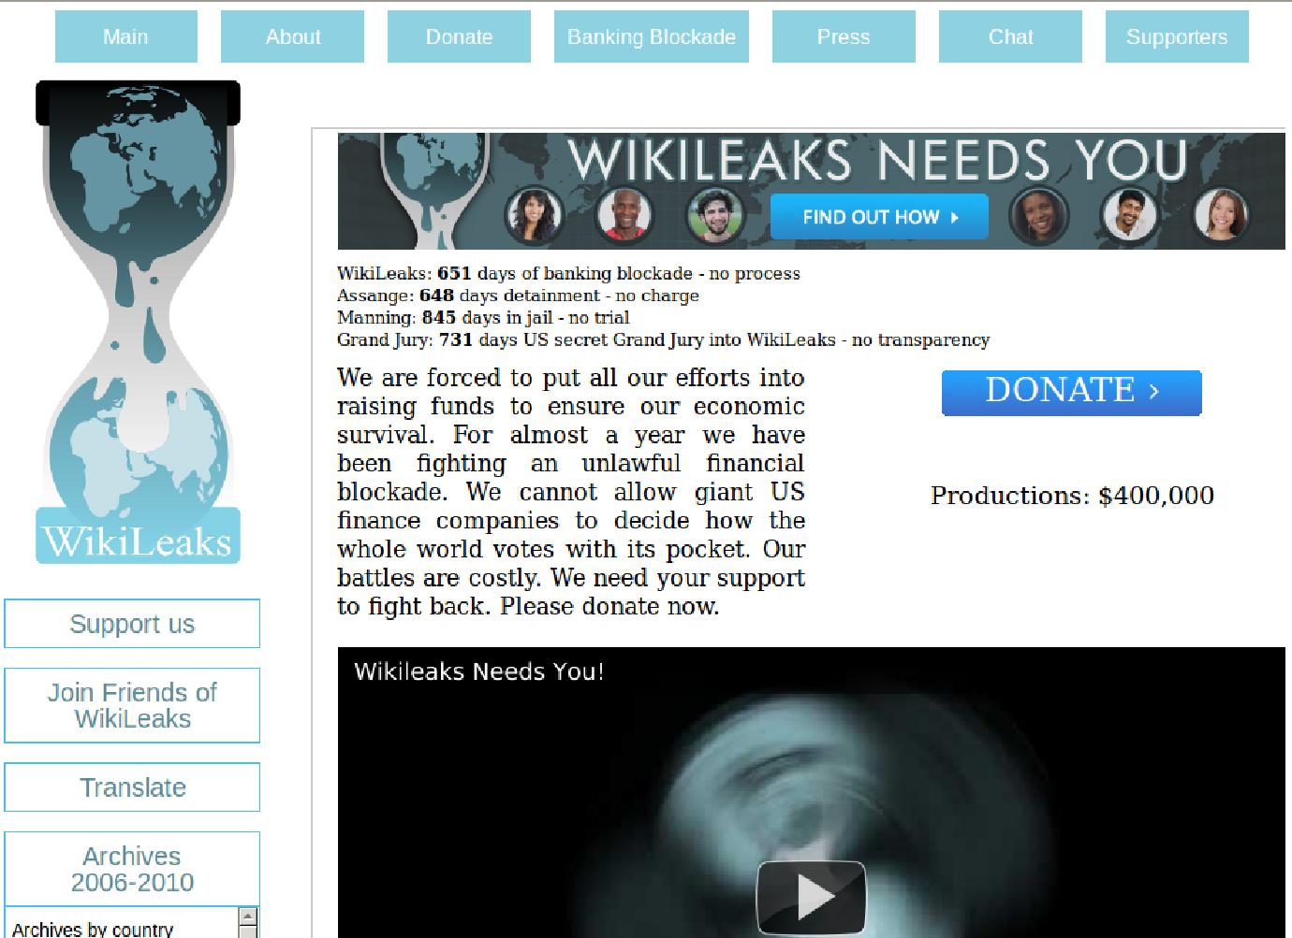

Slide 23
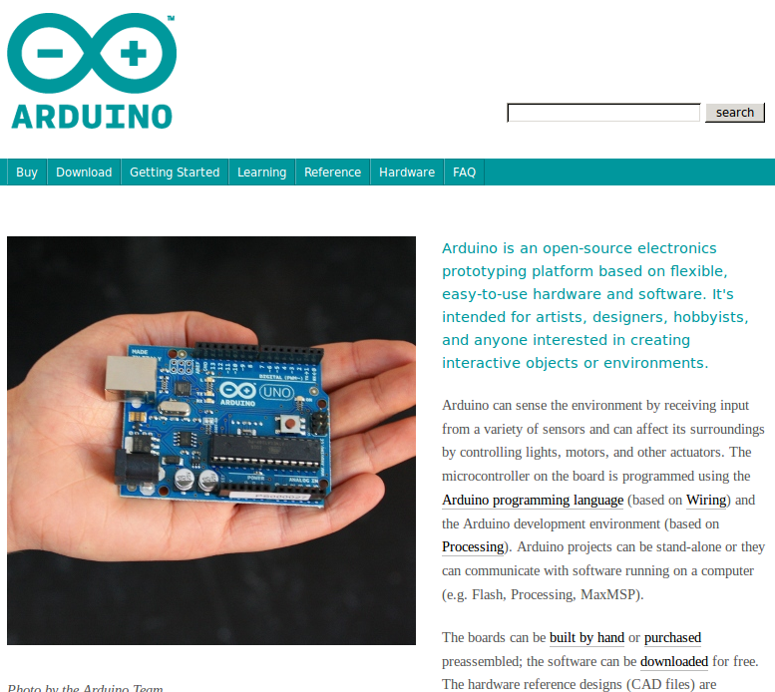

Slide 24
Others
Wikipedia
Project gutenberg / Project Madurai / Wikisource
Open Fonts
Open Learning
  OCW / NPTEL / Khan Academy
  Coursera
  DuoLingo
Open Design for 3D printing
Tamil nadu text book

Slide 25




Open Formats

Slide 26

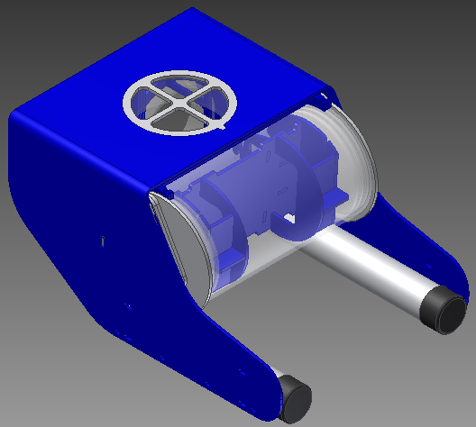
OpenROV

Slide 27
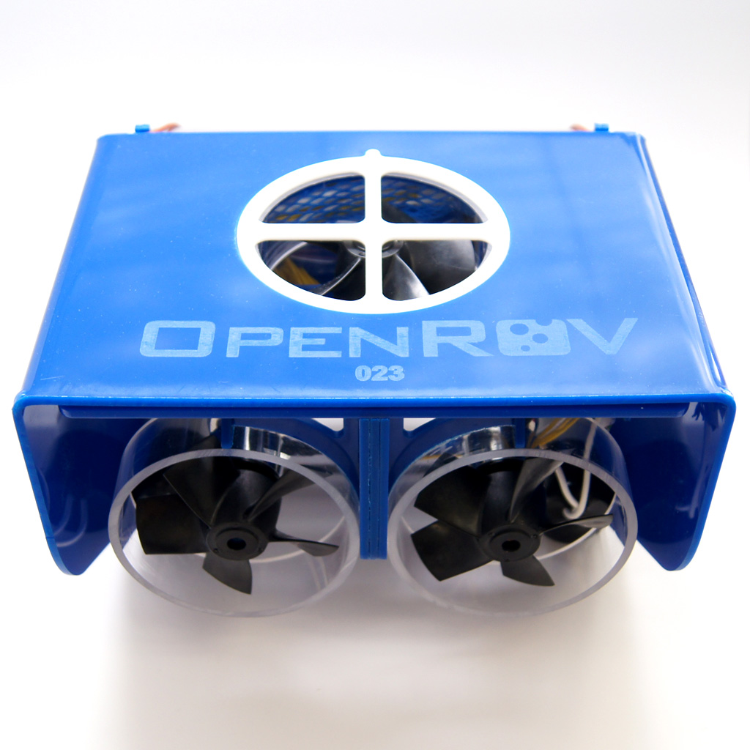
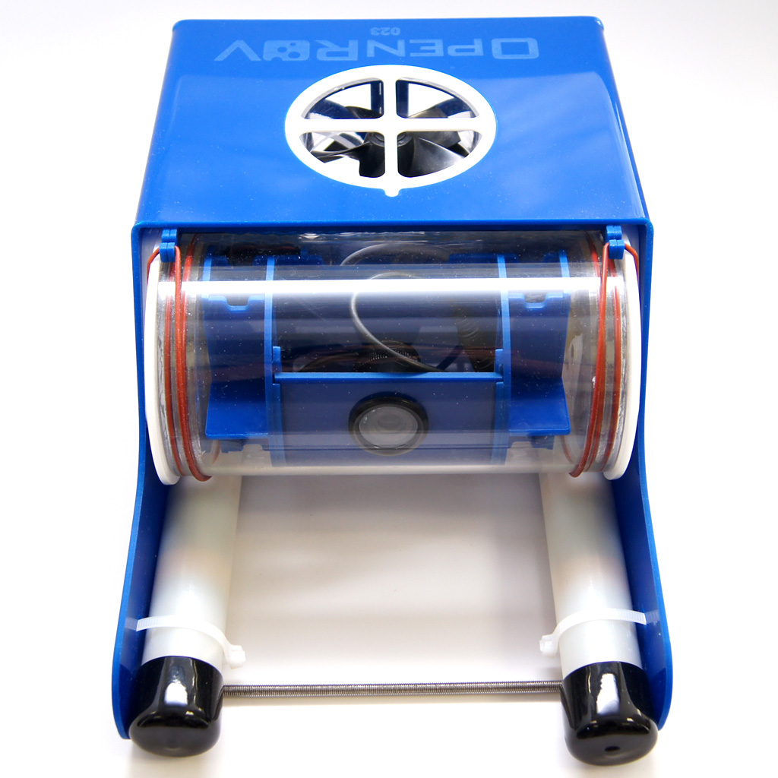

Slide 28
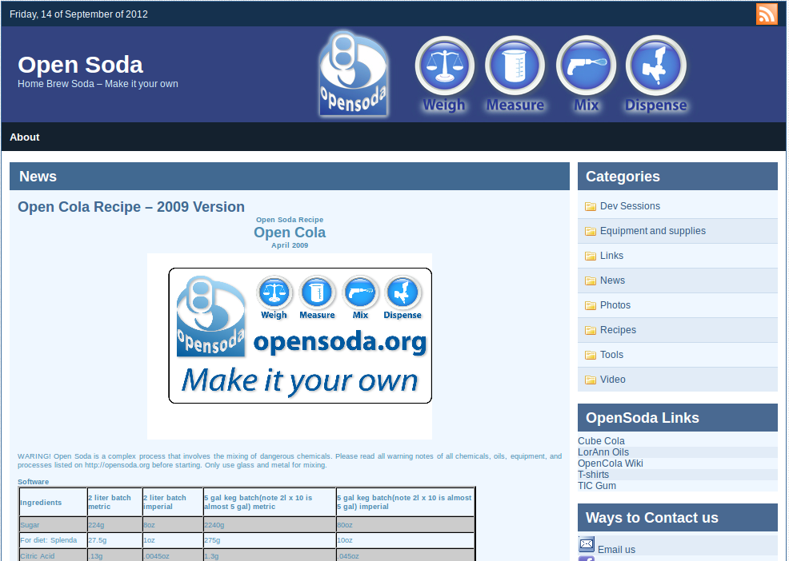
Open Soda

Slide 29
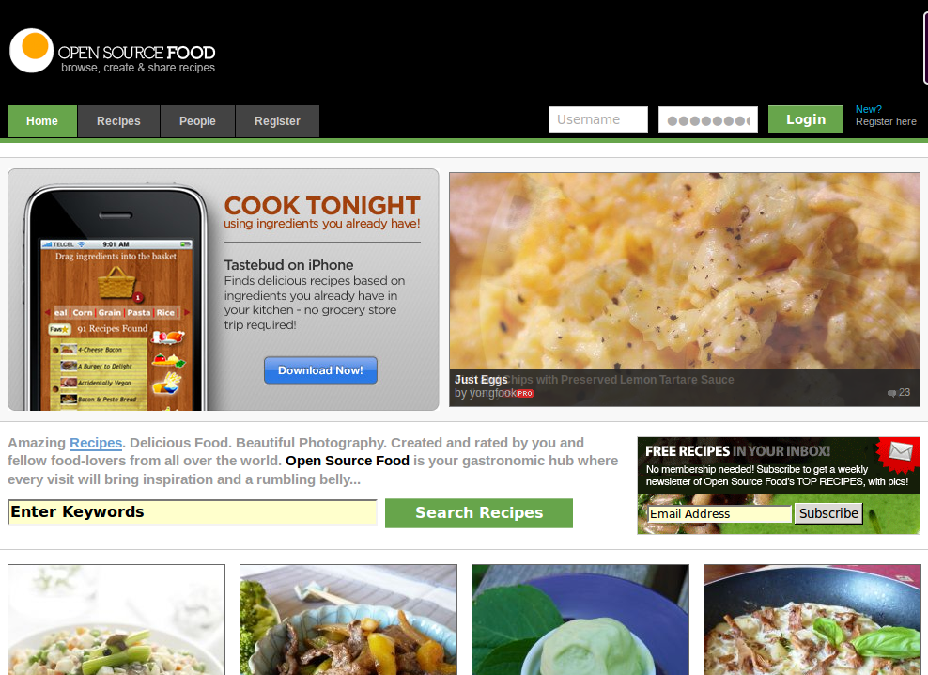
Recepes

Slide 30
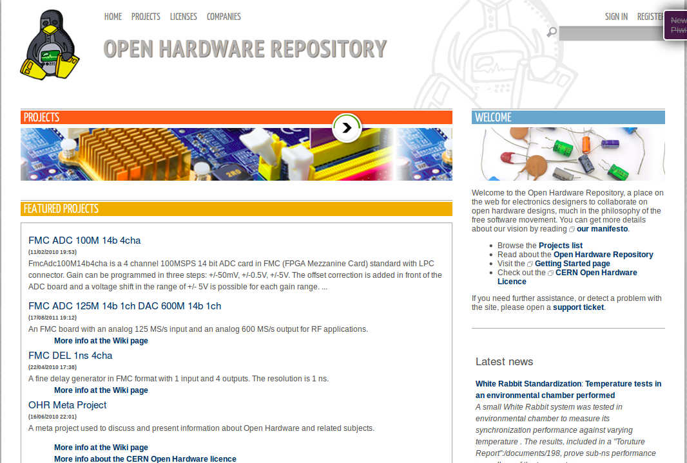
CERN - OHWR

Slide 31
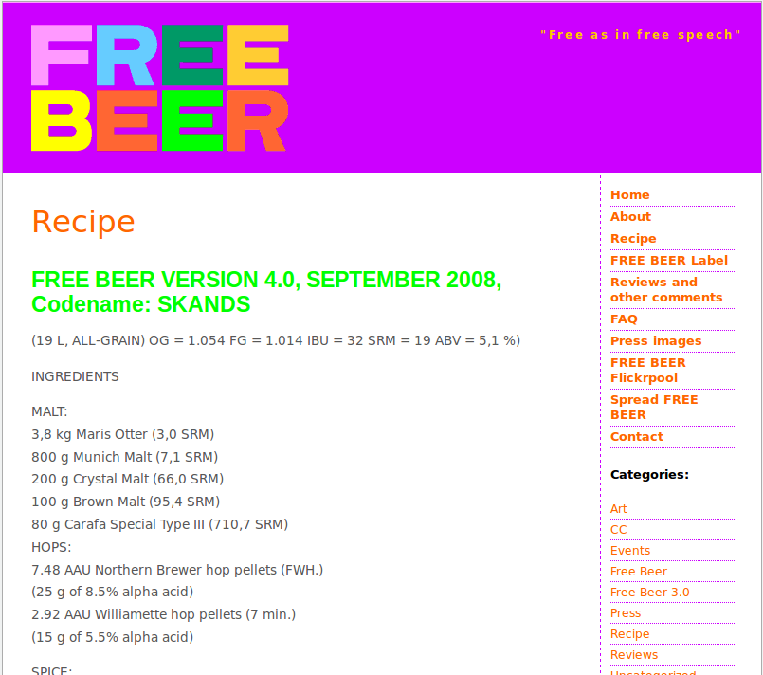
Free as in Beer !

Slide 32
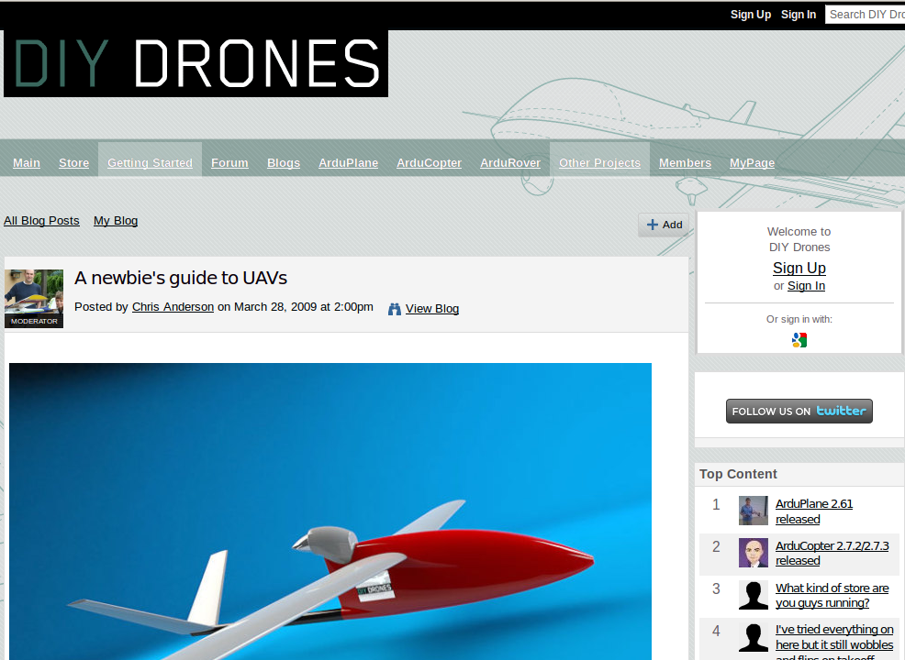

Slide 33

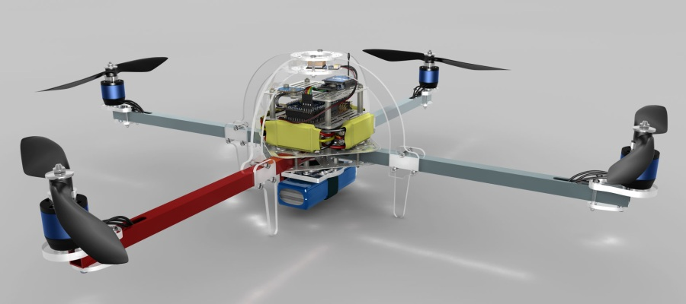

Slide 34

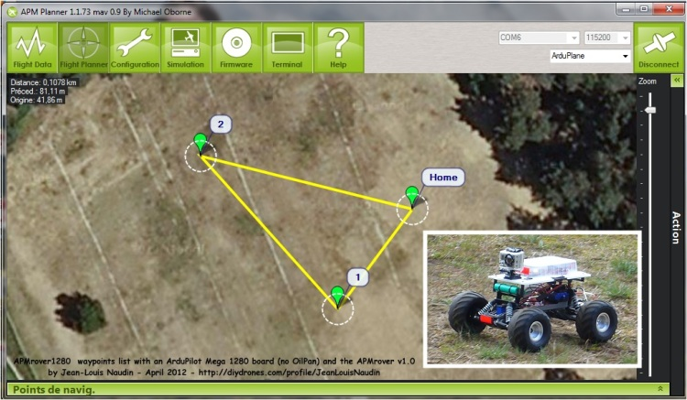

Slide 35
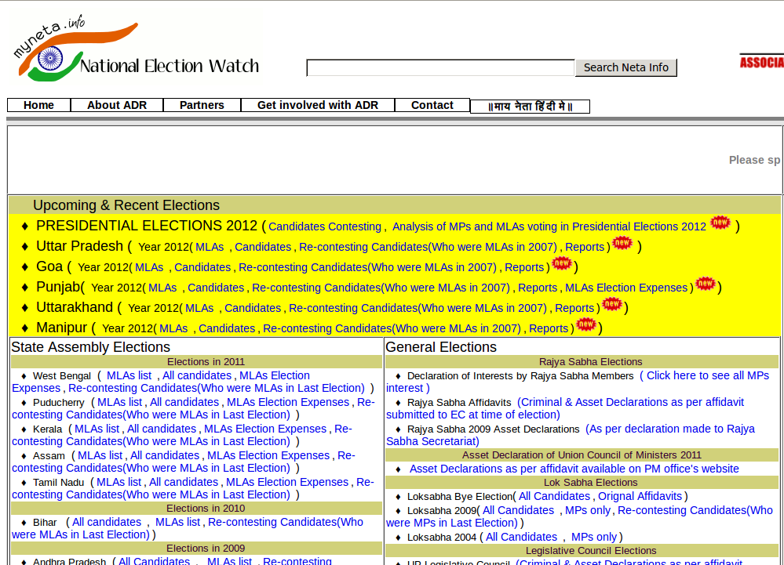

Slide 36
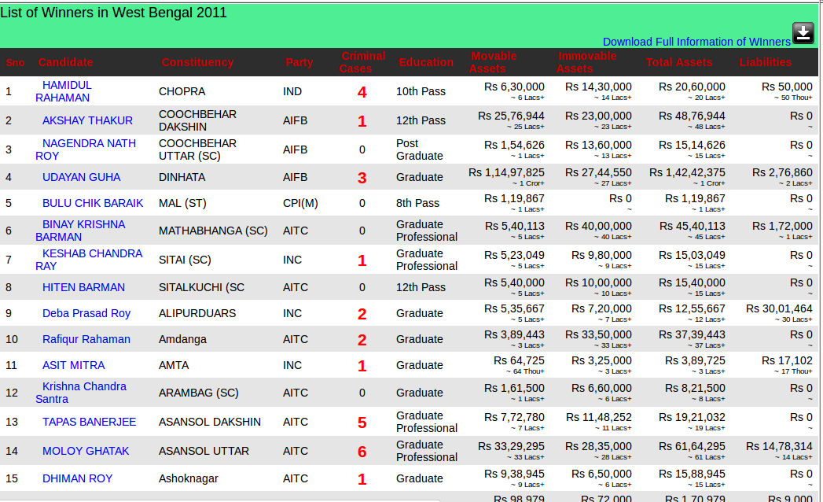

Slide 37
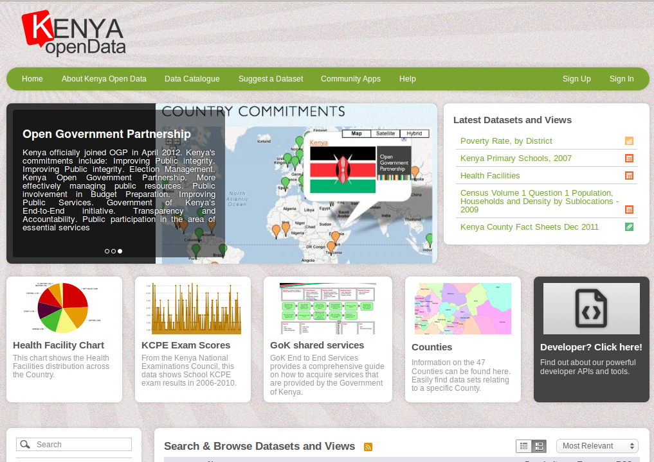

Slide 38
About Me
EternalTyro
dummy@dummy.com
+000 00000001

Slide 39

Questions??

