Slide 1
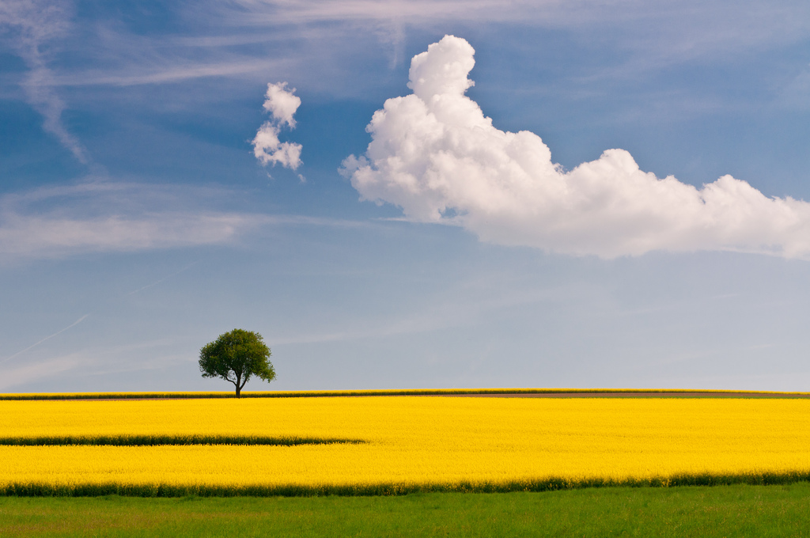
Software Freedom Day - 2012
Cloud Computing

Slide 2
~ Agenda ~
+ Definition
+ The What?
+ The Why?
+ The Who?
+ The How ?
+ Q & A

Slide 3
+ Definition
A computing model where
virtualized computing resources
are provided as a service
over the Internet via API calls.

Slide 4
+ What is cloud?
+ Simple Analogy
+ Differences from Virtualization
+ Features
- Pay-per-use
- Elasticity or Scalability
- Resource Abstraction
- Self Service
- High availability

Slide 5
+ Types of Cloud
+ Public
+ Private
+ Hybrid
Public Cloud
VM
VM
VM
VM
VM
VM
VM

Slide 6
+ Why do we need Cloud
+ Handling heavy work-loads
+ Unexpected fluctuations
+ Ensuring Availability

Slide 7
+ Who are the major players
+ Amazon AWS
+ Rackspace Cloud
+ Private Cloud??
- Eucalyptus
- OpenStack

Slide 8
+ Nuts and Bolts of Cloud
+ Computation
+ Storage ( Block and Flat )
+ Networking
+ Imaging Service
+ Web Service
+ Dashboard?

Slide 9
OpenStack

Slide 10
+ Questions?

