Slide 1
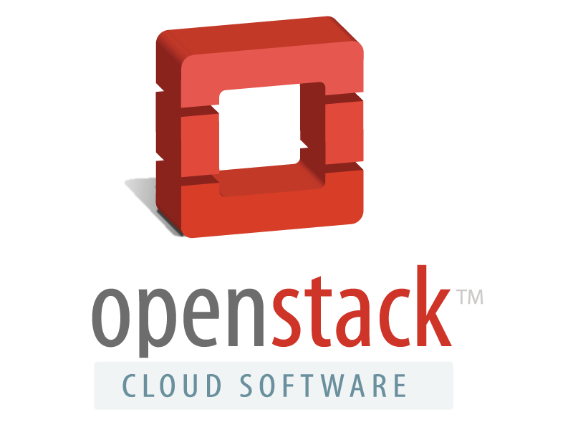

Slide 2

Muchas Gracias :)
...
...
Gholt
VishIshaya
AnneGentle

Slide 3
Takeaways
What?
Why?
Who?
How?
What Next?

Slide 4
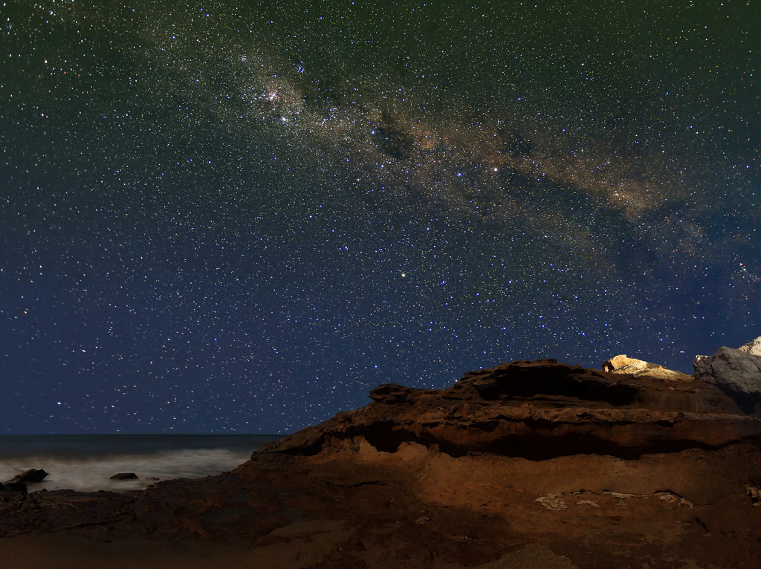
Openstack History
NASA
OpenNebula
Nova - compute
Rackspace
Cloud Files
Swift - Storage

Slide 5

What the duck is that?
It's cloud framework, duh !
Written using Python !
Apache Licensed, Yay :)
Backed by biggies
...

Slide 6

Components
Nova
Glance
Cinder
Quantum
Keystone
Swift
Ceilometer
Others:
  Memcache
  RabbitMQ

Slide 7

Nova
Compute part
KVM | XEN | LXC
ARM / x86 / AMD64
Complete instance lifecycle management

Slide 8
Features
Commodity Server pool
Flat / DHCP / VLAN / IPv6
API access
Distributed architecture
Floating IPs
Security groups and RBAC

Slide 9

Quantum
Network connectivity as a service
Pluggable / Scalable
API driven
Flat / Flat DHCP / VLAN DHCP
Dynamic Floating IPs
Extension framework
  IDS / firewalls
  - Lead balancers / VPNs

Slide 10

Keystone
Identity and access management
Passwd, token, key based access
LDAP? Oh, yes!
Service lists
RBAC
Did I mention APIs??

Slide 11

Glance
Delivery service
  Disk and Server images
REST in peace.. :)
Snapshots
Formats
Raw, qcow2, OVF
AMI, VHD, VDI, VMDK

Slide 12

Dashboard

Slide 13
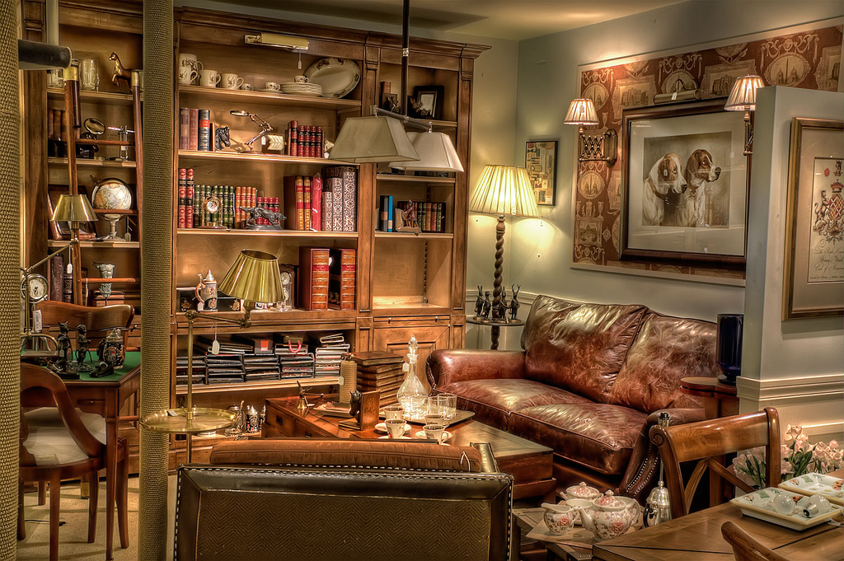
Storage

Slide 14
Cinder
Block storage service
Persistent
Mountable
Analogous to EBS

Slide 15
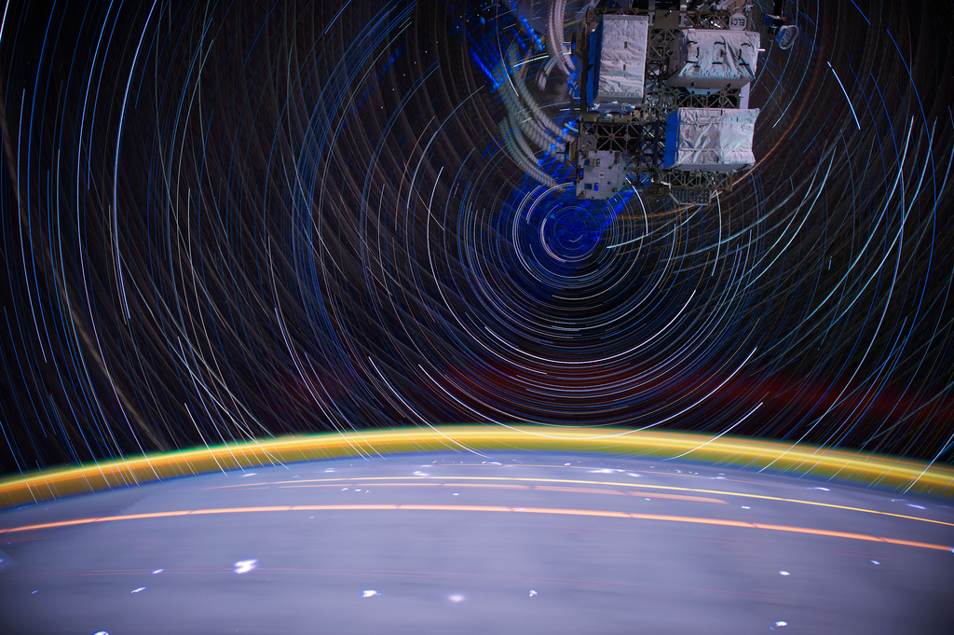
Swift

Slide 16
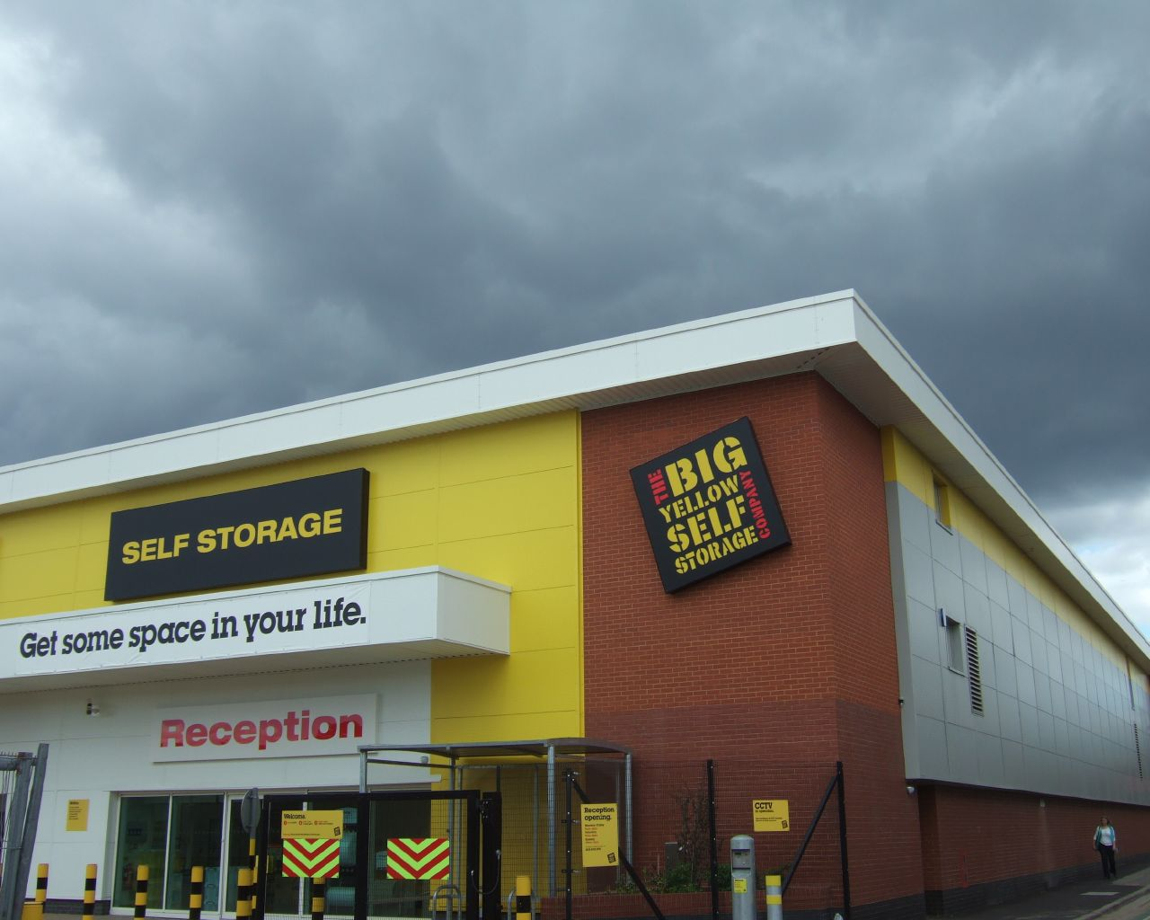
Swift
Object Store
Analogous to S3
Infinite Storage
REST based API
Consistent Hash ring
HEAD , PUT, GET, POST, DELETE

Slide 17
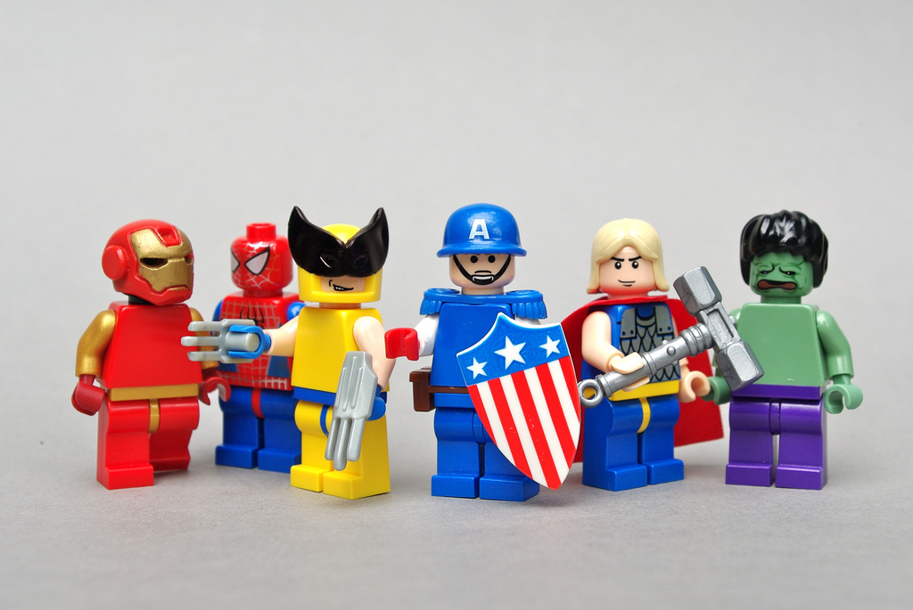
Heroes are awesome
Code
File bugs / Fix bugs
Translate
Document
Help out / Educate
Build something awesome!

Slide 18

Heeeeelp!

Slide 19
Image Credits.
Flickr Users:
  nicholall
  --sam--
  Lrargerich
  Zoomion
  Pagedooley
  risayv
Simple Desktops
Flickr users:
  Scarygami
  Dunechaser
  create_joy
  Phillykevflicks
  marcp_dmoz
  asphericlens

Slide 20

Questions??

