Slide 1
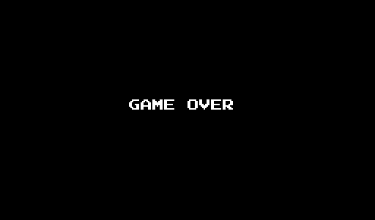
Press R to restart

Slide 2
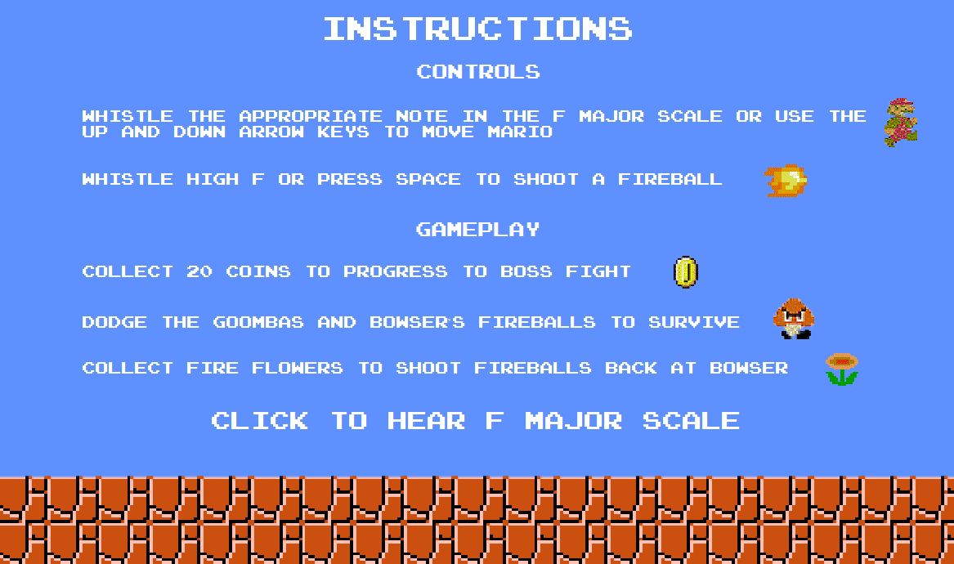
Back
Instructions
Back
Press P to pause
You may shoot one fireball per fire flower you collect

Slide 3
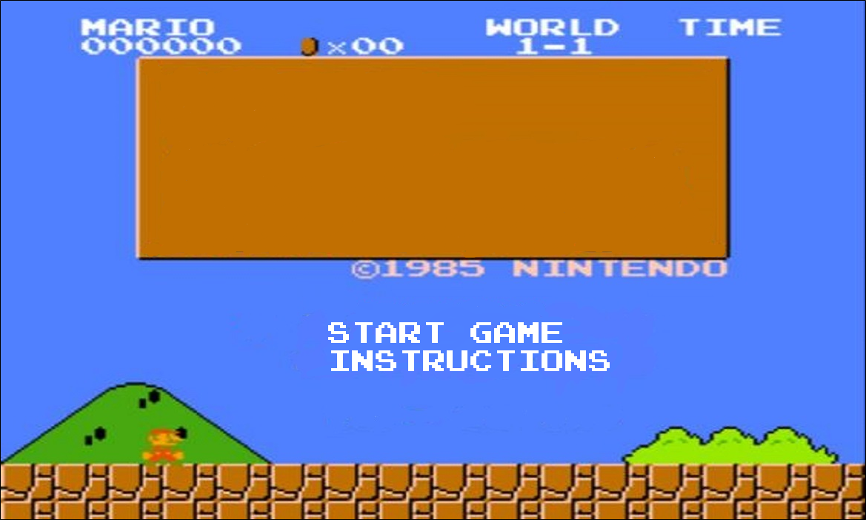
Super Mario
Whistle

Slide 4
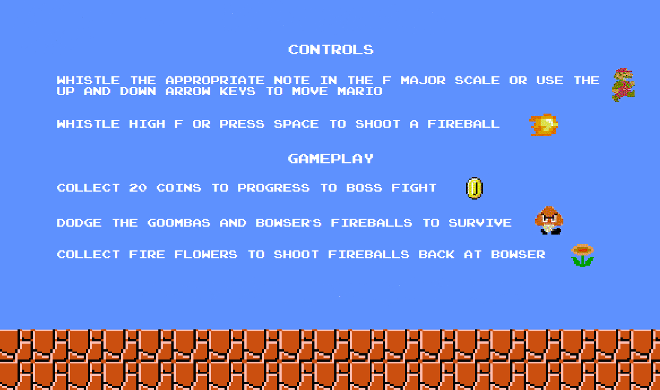
Game Paused
You may shoot one fireball per fire flower you collect

Slide 5
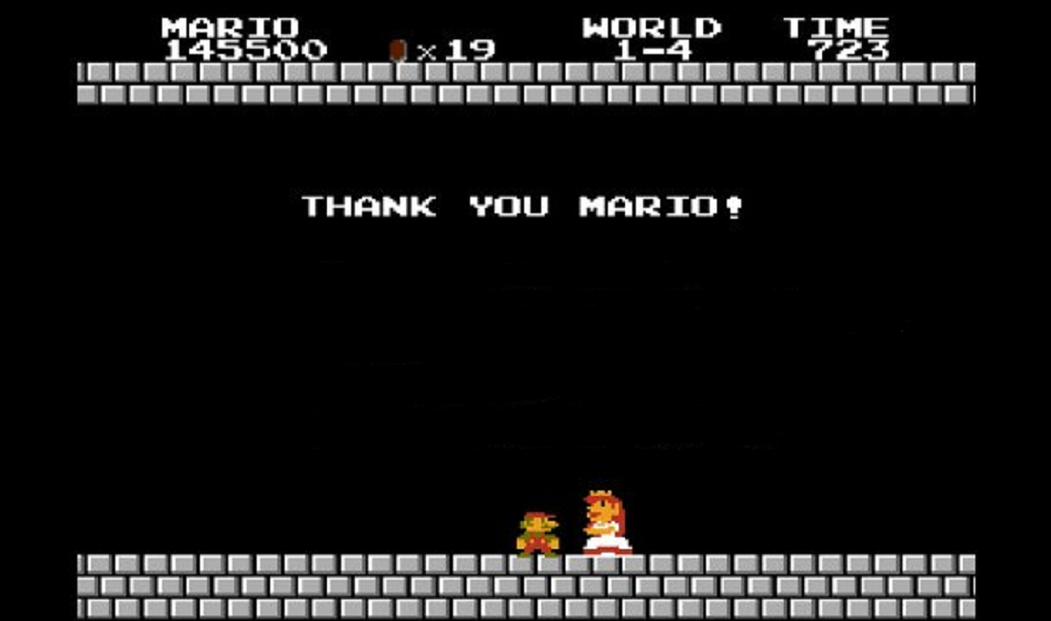
You Win!
Press R to play again

