Slide 1
TuneTribe
Mauricio, Shauna, Emmanuel, Kannan

Slide 2

What is TuneTribe?
TuneTribe is a social platform designed for music enthusiast and artists alike. A place where people can share their music taste and where small artists can grow their follower base.

Slide 3

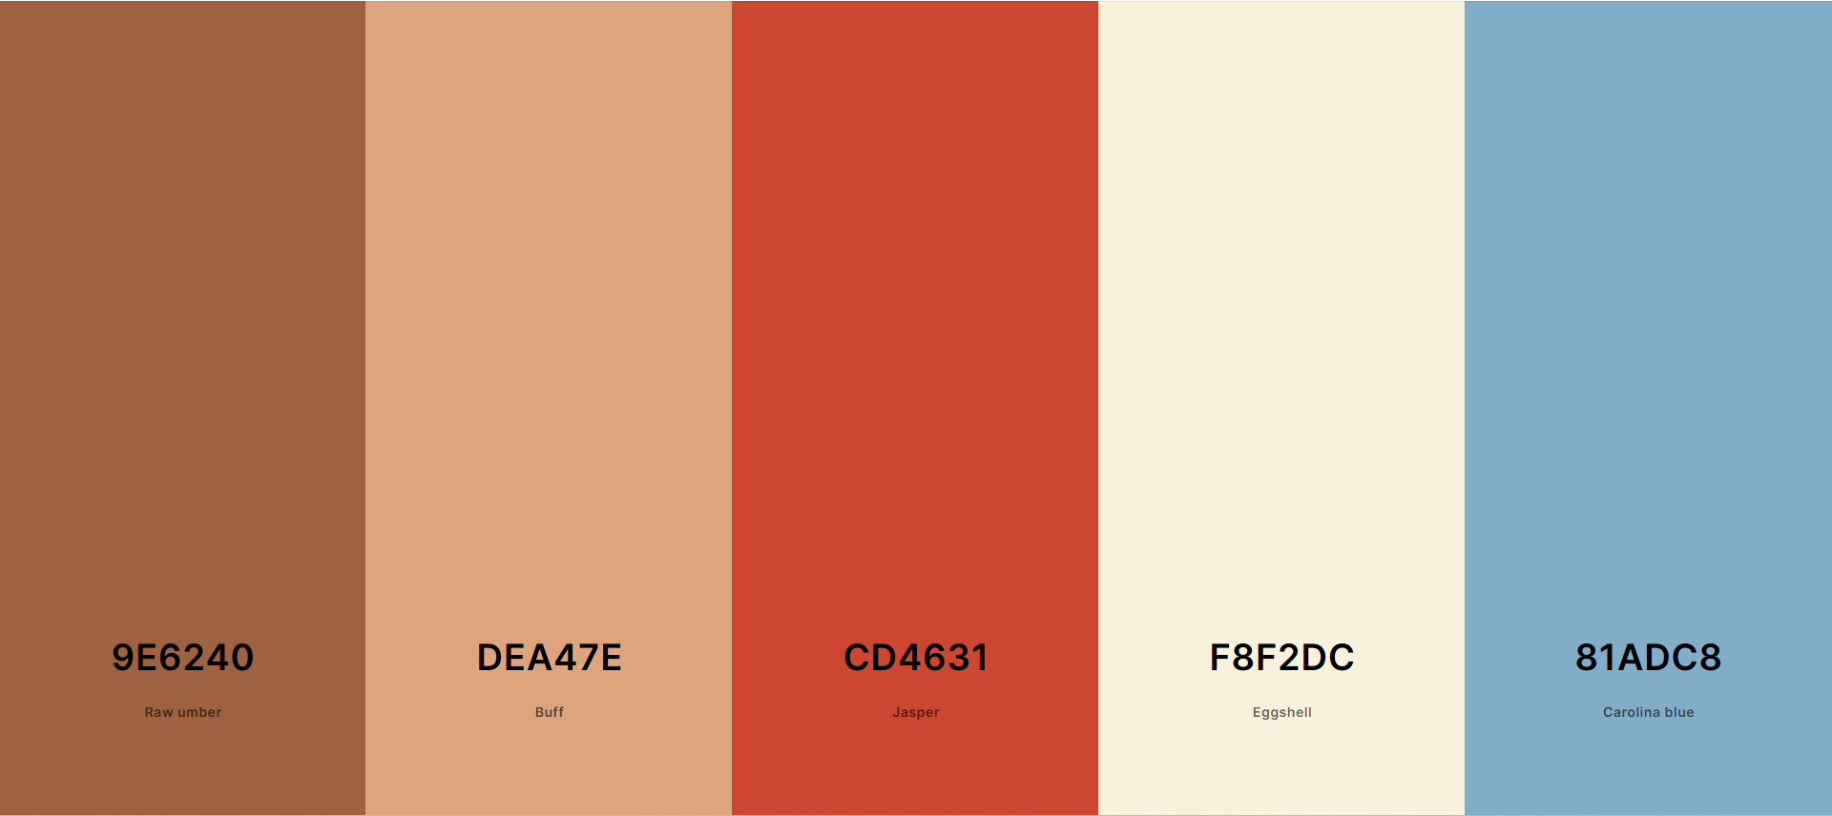
Logo and Color Palette

Slide 4

Who are the users?
Normal Users
Artists
Moderators
Admins

Slide 5
Normal User
Create a post
Short Caption
Song name and disc art
Short clip of the song
Comment/like posts
Add songs to profile
Display your favorite songs
Generate artist recommendation
Based on the music they listens to
Recommend songs to tribe mates
Login

Slide 6
Artist
Link song information
Link Spotify, apple music
Access music report
How many people see the post
Access royalty info
Friend other Artists
Login

Slide 7
Moderator
Delete comments
Temporarily ban users
Limit users from commenting
Send ban request for users
Delete posts
Login

Slide 8
Admin
Ban Users
Ban Artists
Uploading unauthorized content
Remove moderator permission
Comments
Banning
Remove artist permission
Music upload
Managing profile
Login

