Slide 1
Programmable Networks
By Miro, Roger, Tim, Jan and Jules

Slide 2
Find high-level requirements for NetComplete and visualize them
Visualize properties in a network graph
Notes:
Introduction: Explain what our project is about and that it was reformulated from the one above to the one below

Slide 3
Visualization requirements
Intuitive
Easy sharing
Clear
Unambiguous
Easy access to information

Slide 4
Input requirements derivation
Derived from various papers, projects and startups
Found:
Reachability
Failure resistance / N-connectivity
Security
Load balancing
Resource management
Preferential routing
Notes:
Couldn’t do affinity clustering, because [reason]
Did analysis of research papers, similar projects as suggested by stakeholder
Failure resistency / N-connectivity
Example input: The network should tolerate X node failures (or Y link failures)
Reachability
Security:
Option to allow clients to announce only their IP range and to receive only their traffic
Example input: A list of which clients own which address spaces
Path from A to B should not cross (or alternative should always go) through C
Access control
Example input: A should only be reachable from B, not from other nodes
Load balancing
Example input: Use X paths from A to B with equivalent load
Resource management
Example input: Use server X as few as possible (e.g. because it is old and slow)
Preferential routing
Example input: For connection A to B, use with priority 1 path X, with priority 2 path Y, ..

Slide 5

David Fischer
"Let’s build a running system"
ETH graduate, 26 years old, Junior Network Operator
Ambitious & enthusiastic
Goal:
Network stability, availability and performance; reduce human errors
Explainability of network topology
Pain points:
Inheriting old burdens
Non-intuitive network configuration
Strongly dislikes repetitive tasks
Afraid of making severe mistakes
Notes:
Goal: Improve process to achieve network stability, uptime, security, speed, and performance by reducing the impact of human error and increasing the explainability of network topology and properties.

Slide 6

Hans-Peter Dullinger
Stanford graduate, 52 years old, Senior Network Operator
Key characteristics
Efficient & effective
Has too much to do
Goal: A running network with little additional effort
Pain points:
Stress
Worries about job security
Annoyed by big changes in the network (and the required work)
"Never change a running system"
Notes:
Goal: Improve process to achieve network stability, uptime, security, speed, and performance by reducing the impact of human error and increasing the explainability of network topology and properties.

Slide 7
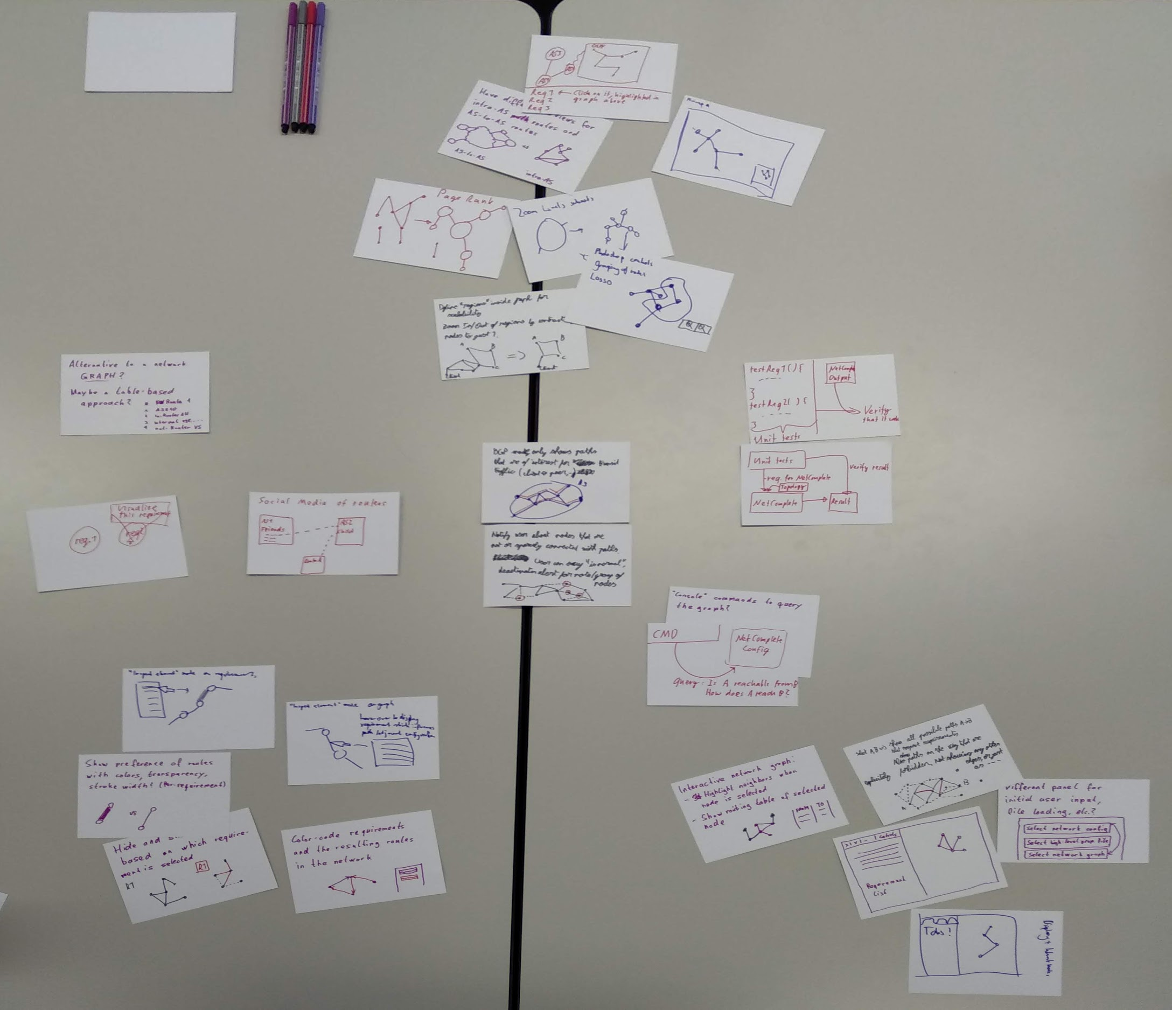
50 thoughts

Slide 8
Three ideas
Split screen: Controls + graph
Social media for network graphs
Full screen graph with VR

Slide 9
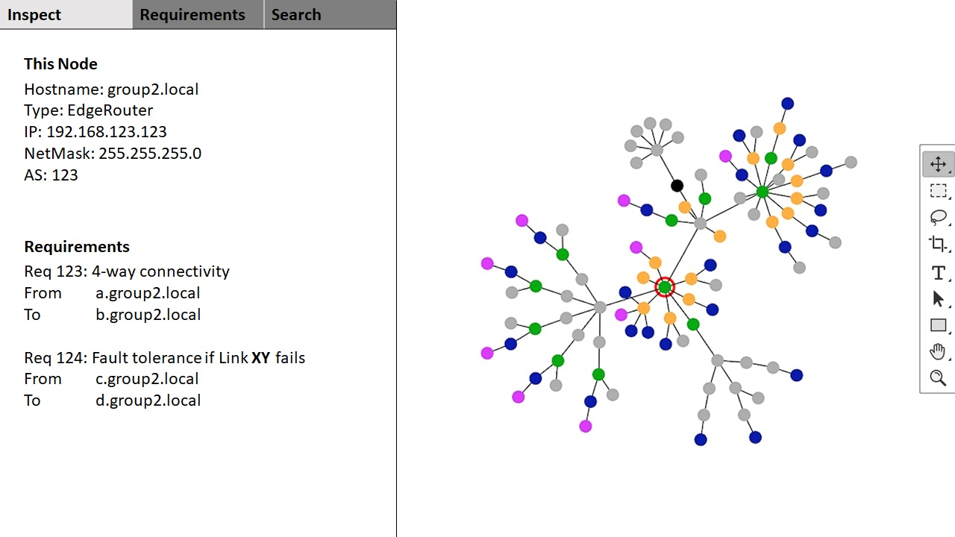
Notes:
The left part of the screen (maybe a third) is filled with general controls and the requirements, on the right side is the network graph
You can select nodes on the right and then it shows you informations about that node on the left (general infos, requirements that affect it, ...)
You have tabs for different requirements / functionality in the left panel
You can select a requirement on the left, then the graph on the right side highlights the affected nodes
Example for reachability from A to B it highlights the path between them
Graph can be colour coded to show e.g. preferences of paths
Photoshop controls: We also have regions defined in the graph for scalability (e.g. AS complexity hidden if not needed)

Slide 10
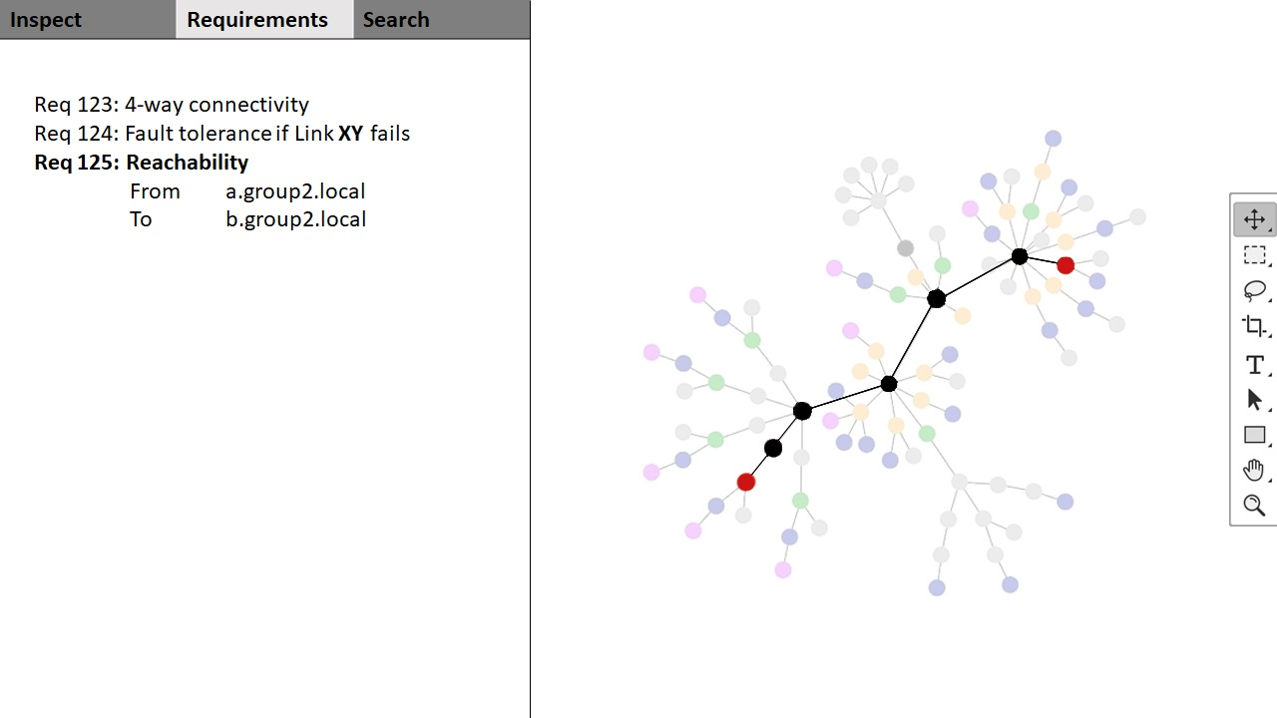
Notes:
The left part of the screen (maybe a third) is filled with general controls and the requirements, on the right side is the network graph
You can select nodes on the right and then it shows you informations about that node on the left (general infos, requirements that affect it, ...)
You have tabs for different requirements / functionality in the left panel
You can select a requirement on the left, then the graph on the right side highlights the affected nodes
Example for reachability from A to B it highlights the path between them
Graph can be colour coded to show e.g. preferences of paths
Photoshop controls: We also have regions defined in the graph for scalability (e.g. AS complexity hidden if not needed)

Slide 11
Strengths
Easy & intuitive navigation (familiar UI)
Search for named requirements
Detailed information
Good overview
Highlighted nodes / requirements
Easy to implement

Slide 12
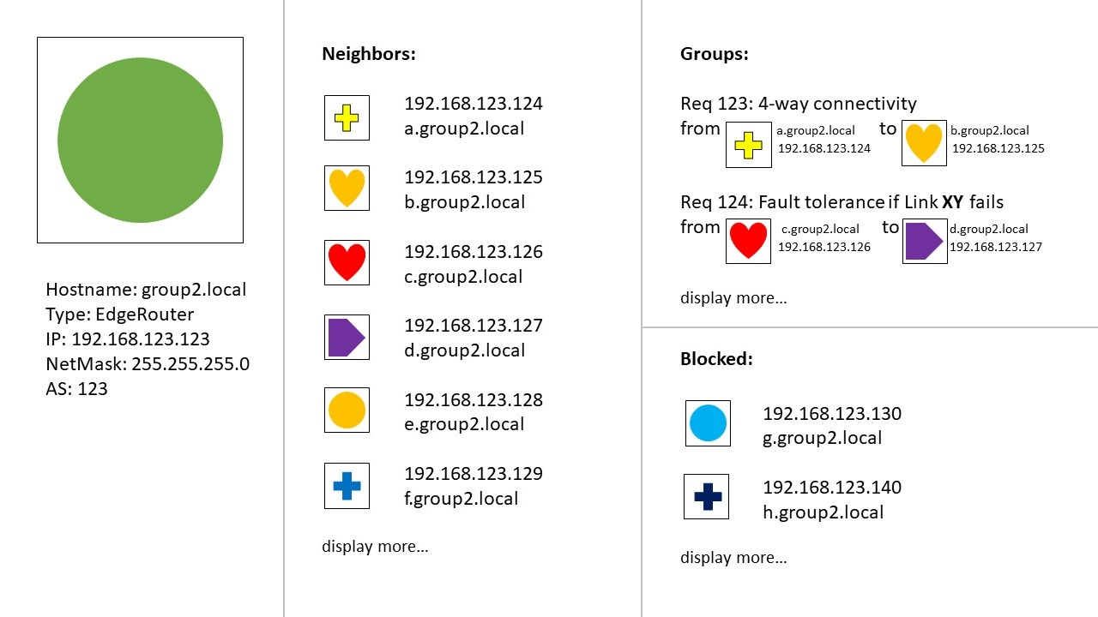
Notes:
There is a profile for each network node (AS, router)
General information (IP, hostname, router type, ...) is listed in the profile
Profile pictures are symbols for different router types, maybe also sizes (e.g. star for AS, larger ASes have more points, maybe with a logarithmic scale)
Relations of nodes are listed as friendship relations
Forbidden paths are blocked friends
Requirements are groups
On the profile of a node you see in which groups it is, i.e. which requirements affect that node
There is a site for each groups, showing its members and general information about that requirement

Slide 13
Strengths
Good local view
Easy to learn
Familiar UI
Hides complexities of large network graphs
Concise profile for each requirement
Requirements as important as nodes

Slide 14
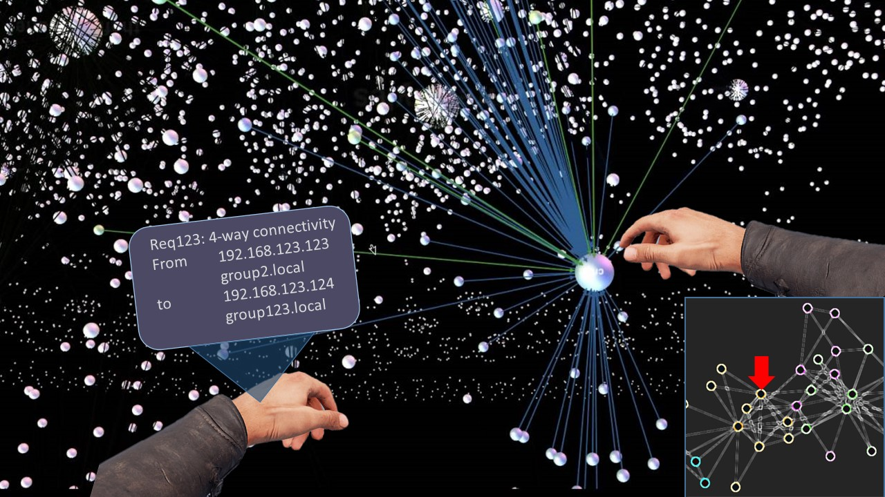
Notes:
The graph spans over the full screen
Virtual reality
Inspect element: If you point with the right hand on a node, you see an info panel on your left arm, which show which requirements affect that node and other information (like its routing table)
You can zoom in
E.g. ASes are bundled into a symbol, if you select it, you see the internal nodes and network
Maybe also photoshop tools
There is a minimap that shows you where you are in the full graph
Page rank like scaling
To approximate importance with size

Slide 15
Strengths
Simple, hides clutter
Graph is central
Very visual way to show network to others
Various possible input methods
Also possible as desktop or AR application

Slide 16
Feedback
or
Questions?

Slide 17
Resources
Personas:
Both from https://www.pexels.com (10.2018), attribution not required

