Slide 1
Neighbors:
192.168.123.124
a.group2.local
192.168.123.125
b.group2.local
192.168.123.126
c.group2.local
192.168.123.127
d.group2.local
192.168.123.128
e.group2.local
192.168.123.129
f.group2.local
display more…
Groups:
Req 123: 4-way connectivity
from a.group2.local to b.group2.local
192.168.123.124 192.168.123.125
Req 124: Fault tolerance if Link XY fails
from c.group2.local to d.group2.local
192.168.123.126 192.168.123.127
display more…
Blocked:
192.168.123.130
g.group2.local
192.168.123.140
h.group2.local
display more…
Hostname: group2.local
Type: EdgeRouter
IP: 192.168.123.123
NetMask: 255.255.255.0
AS: 123

Slide 2
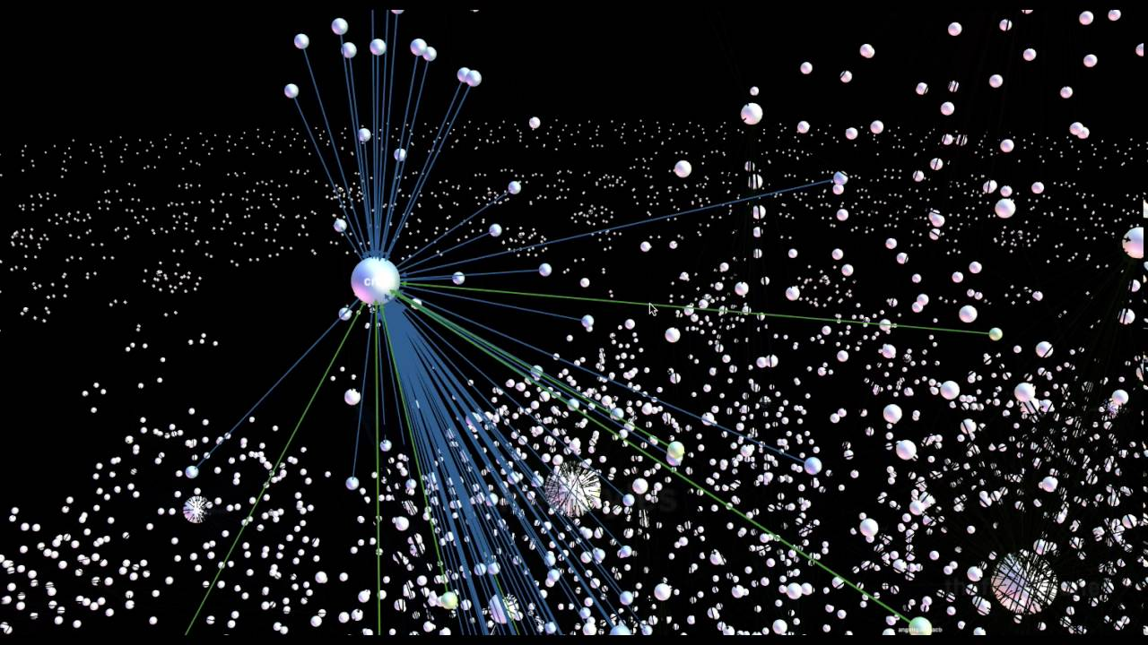

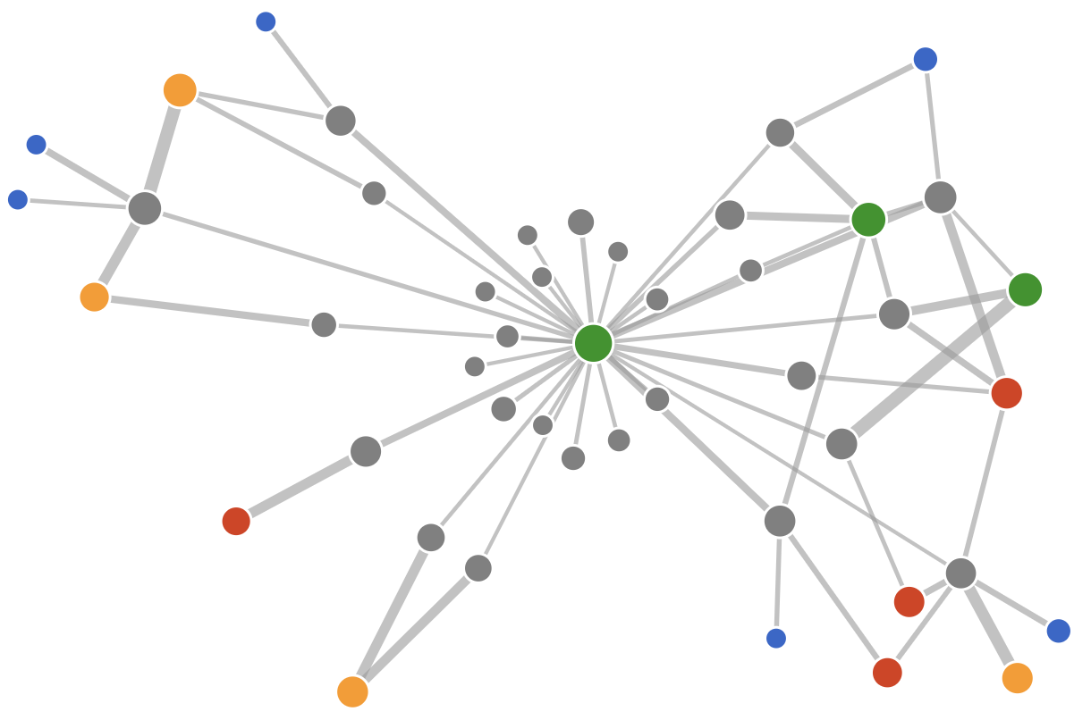

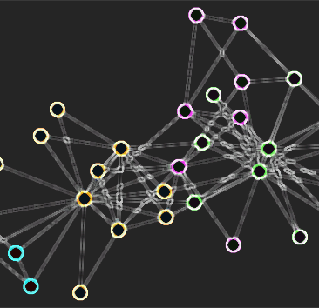
Req123: 4-way connectivity
From 192.168.123.123 group2.local
to 192.168.123.124 group123.local

Slide 3
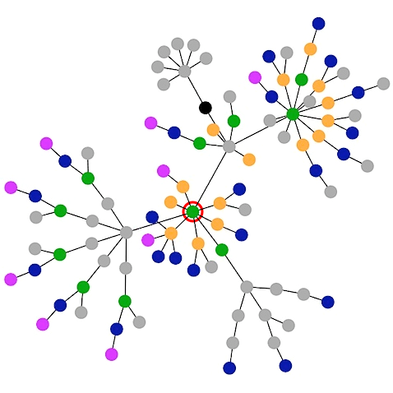

Inspect | Requirements | Search
This Node
Hostname: group2.local
Type: EdgeRouter
IP: 192.168.123.123
NetMask: 255.255.255.0
AS: 123
Requirements
Req 123: 4-way connectivity
From a.group2.local
To b.group2.local
Req 124: Fault tolerance if Link XY fails
From c.group2.local
To d.group2.local

Slide 4
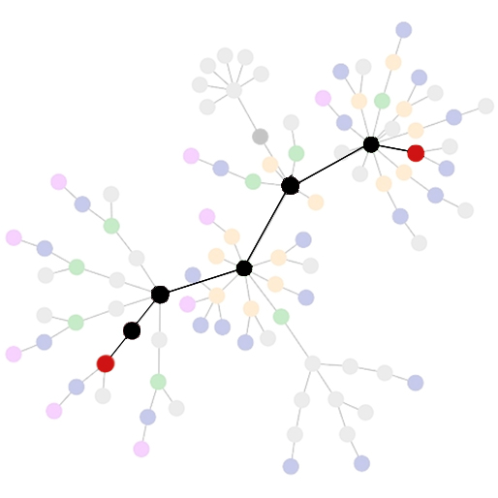
Inspect | Requirements | Search
Req 123: 4-way connectivity
Req 124: Fault tolerance if Link XY fails
Req 125: Reachability
From a.group2.local
To b.group2.local

