Slide 1
How to build HPC software at CSCS: a practical introduction
User Lab Day 2022
Alberto Invernizzi, Harmen Stoppels and Luca Marsella, CSCS
September 2nd 2022

Slide 2

Outline of the Presentation
Cray Programming Environment
Easybuild Framework
Spack workflows
Useful Links
CSCS office building in Lugano

Slide 3
Cray Programming Environment

Slide 4
Piz Daint Specifications
Model | Cray XC50/XC40
XC50 Compute Nodes (Intel Haswell processor) | Intel® Xeon® E5-2690 v3 @ 2.60GHz (12 cores, 64GB RAM) and NVIDIA® Tesla® P100 16GB
XC40 Compute Nodes (Intel Broadwell processor) | Intel® Xeon® E5-2695 v4 @ 2.10GHz (2 x 18 cores, 64/128 GB RAM)
Login Nodes | Intel® Xeon® E5-2650 v3 @ 2.30GHz (10 cores, 256 GB RAM)
Interconnect Configuration | Aries routing and communications ASIC Dragonfly network topology
Scratch capacity | Piz Daint scratch filesystem: 8.8 PB
File Systems:
/project is mounted with read-only access on compute nodes
A Practical Introduction to CSCS HPC Infrastructure

Slide 5
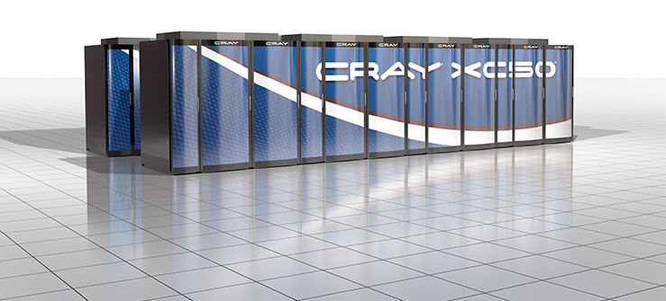
Cray Linux Environment 7.0 UP03
Cray Linux Environment (CLE) is the operating system on Cray systems
CLE 7.0 UP03 is based on the SUSE Linux Enterprise Server version 15
CLE 7.0 UP03 software release is available on Piz Daint since Feb 2022
HPE Cray Technical Documentation:
https://support.hpe.com
A Practical Introduction to CSCS HPC Infrastructure

Slide 6

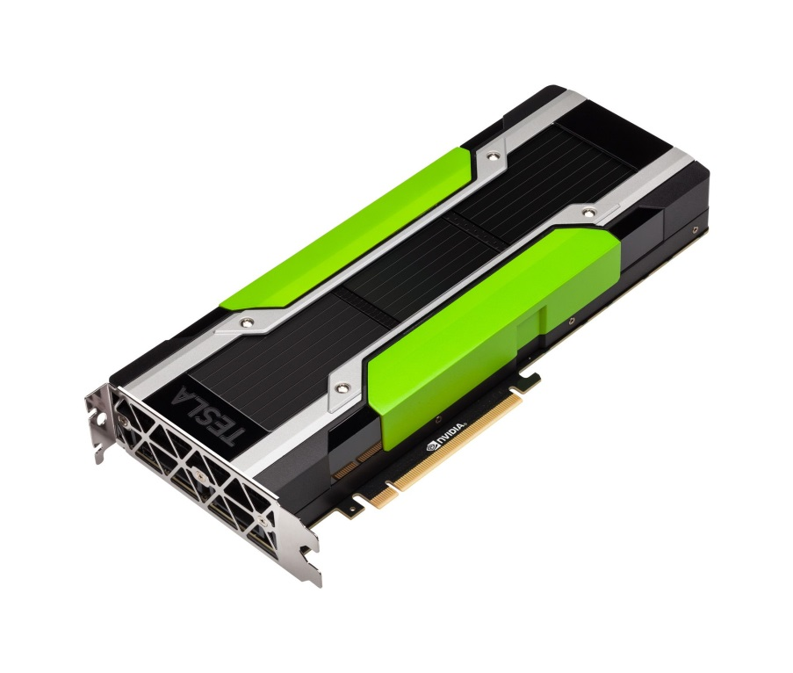
NVIDIA CUDA Toolkit v11
Comprehensive development environment to build GPU-accelerated applications
compiler for NVIDIA GPUs
optimized math libraries
debugging and performance tools
Features programming guides, user manuals, API reference and online documentation to get started quickly
NVIDIA developer portal: https://developer.nvidia.com/cuda-zone
NVIDIA Tesla P100 GPU Accelerator
A Practical Introduction to CSCS HPC Infrastructure

Slide 7
Cray XC Programming Environment
Cray XC PE 21.09 includes the Cray Developer Toolkit - CDT 21.09
non-default Programming Environments can be accessed with cdt modules
The following products have been updated within this release:
Cray Compiling Environment - CCE
cce 12.032, cray-mpich 7.7.18, cray-libsci 20.09.1
Cray Performance Measurement & Analysis Tools - CPMAT
Perftools 21.09.0
Cray Environment Setup and Compiling support - CENV
modules 3.2.11.4 and craype 2.7.10
Third party products
GCC 10.3.0 and 11.2.0, cray-python 3.9.4.1, cray-R 4.1.1.0
A Practical Introduction to CSCS HPC Infrastructure

Slide 8
Setting the Programming Environment
CSCS systems use the modules framework
The modules manage applications and libraries path
You can check currently loaded modules with module list
Some modules are already loaded at login
The default environment on Piz Daint is PrgEnv-cray
The default architecture is XC50 (Intel Haswell): craype-haswell
You can browse the available modules with module avail
You must adjust your target architecture
daint-gpu targets the XC50 (Intel Haswell and P100 Tesla GPUS)
daint-mc targets the XC40 (Intel Broadwell multicore)
These modules update the MODULEPATH
A Practical Introduction to CSCS HPC Infrastructure
Notes:
Add a slide with a simple workflow to change programming environment

Slide 9
Static vs Dynamic linking
Binaries can be linked statically and dynamically to the libraries on the system:
Cray compiler wrappers (cc, CC, ftn) create dynamically-linked executables by default
Static linking: wrapper flag -static or export CRAYPE_LINK_TYPE=static before building
Dynamically linked binaries can generally be used after a system library update
Statically linked binaries using directly or indirectly the network interface libraries (uGNI/DMAPP) must be recompiled after an update:
This includes applications using MPI or SHMEM libraries, as well as the PGAS (Partitioned Global Address Space) languages such as UPC, Fortran with Coarrays, and Chapel
DMAPP (Distributed Shared Memory Application) and uGNI (user Generic Network Interface) are tied to specific kernel versions and no backward or forward compatibility is provided

Slide 10
Non-default Programming Environments with Cray Development Toolkit
Use the command module avail cdt to get the list of available cdt modules
Loading a non default cdt module while building or at runtime requires prepending CRAY_LD_LIBRARY_PATH to LD_LIBRARY_PATH
The environment variable CRAY_LD_LIBRARY_PATH holds every product library path in the current environment, updated when modules are loaded / unloaded
In the example below, we link dynamically the library of cray-libsci provided by the non-default unsupported Programming Environment cdt/20.08 (Aug 2020):
module load cdt/20.08 export LD_LIBRARY_PATH=$CRAY_LD_LIBRARY_PATH:$LD_LIBRARY_PATH <build command> or <run command>
More info on the User Portal at https://user.cscs.ch/computing/compilation

Slide 11
EasyBuild Framework

Slide 12
What is EasyBuild?
HPC software installation framework by UGhent (Belgium)
automates software builds, allowing to reproduce easily previous builds
recipes written in Python with automatic dependency resolution
Key features
supports co-existence of versions/builds with dedicated installation prefix
allows sharing with the HPC community of EasyBuild users
code patching generating modulefiles and retaining logs of the build
Advanced features
recipe file (know as easyconfig) used for build is archived
build entire software stack with a single command in parallel
More details on https://easybuild.readthedocs.io

Slide 13
EasyBuild on Piz Daint
EasyBuild is available loading EasyBuild-custom
The architecture on Piz Daint defines CRAY_CPU_TARGET
module load daint-gpu EasyBuild-custom
The installation folder is set by EASYBUILD_PREFIX
Defaults to $HOME/easybuild/daint/<haswell|broadwell>
Adjust MODULEPATH with module use $EASYBUILD_PREFIX/module/all
Most useful EasyBuild options
eb -S/--search <pattern> | grep Cray Recipes matching Cray toolchains
eb <name_version>.eb -r Build a package resolving dependencies
eb -h / -H Short / full help message

Slide 14
Customize existing recipes
Extend or customize existing EasyBuild recipes
clone CSCS repository
git clone https://github.com/eth-cscs/production.git
EasyBuild recipes are listed alphabetically under the folder
production/easybuild/easyconfigs
Use your local repository defining EB_CUSTOM_REPOSITORY
export EB_CUSTOM_REPOSITORY=<abs_path>/production/easybuild
Load EasyBuild after selecting the target architecture
module load daint-gpu EasyBuild-custom

Slide 15
HPE Cray and NVIDIA Documentation
Cray man pages
Textual help files on the command line of Cray systems
man command followed by the name of the man page
Described on man(1) page accessible with man man
HPE Cray Technical Documentation at http://support.hpe.com
Quick access and search of Cray books
man pages and third-party documentation
Available in HTML and PDF formats
NVIDIA Documentation Portal at http://docs.nvidia.com
NVIDIA compiler: nvcc --help
A Practical Introduction to CSCS HPC Infrastructure
15

Slide 16
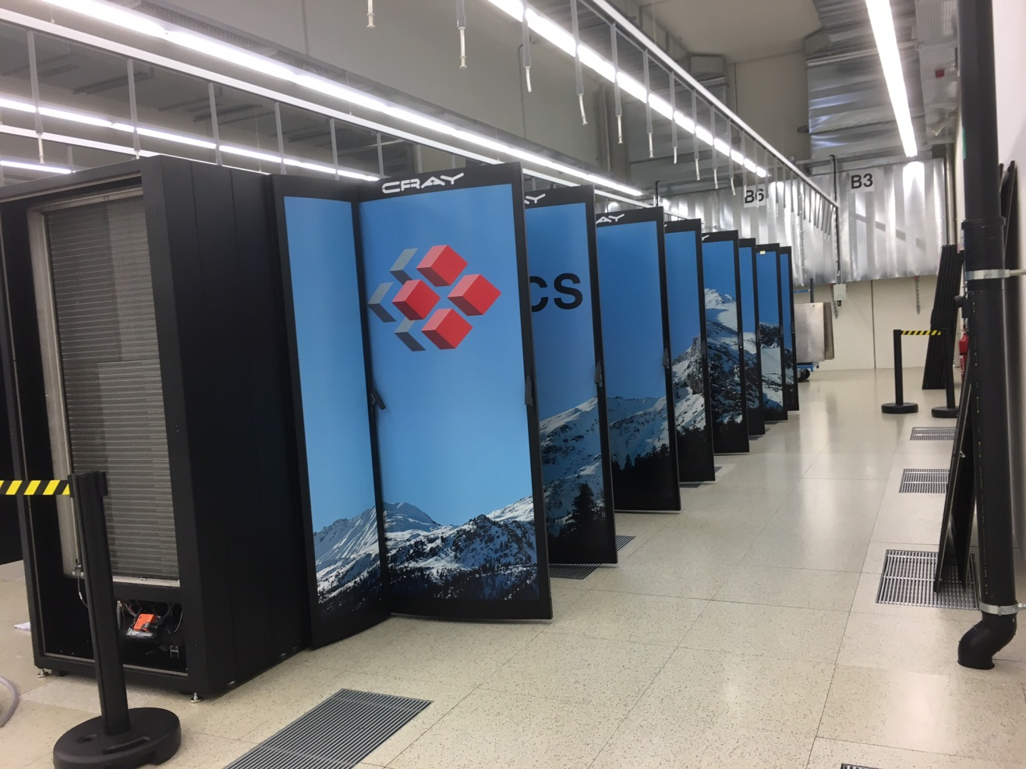
Useful Links
CSCS User Portal:
http://user.cscs.ch
HPE/Cray documentation:
https://support.hpe.com
NVIDIA Documentation:
https://docs.nvidia.com
Contact us:
https://support.cscs.ch
Piz Daint in the machine room at CSCS

Slide 17
Thank you for your kind attention

