Slide 1
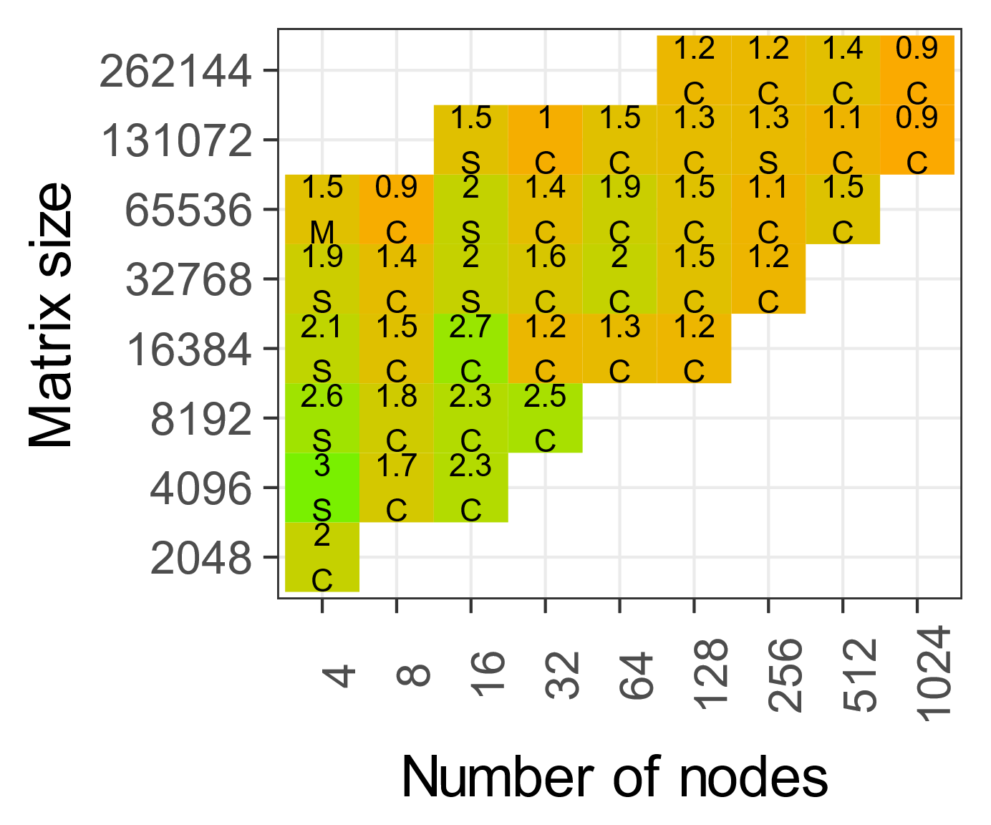
Input does not fit in the memory
Performance below 3% of hardware peak

