Slide 1
Documentation perspectives: Isambard-AI & Isambard 3 If it isn’t documented, it doesn’t exist; if it’s documented, you support it
Richard Gilham,
Bristol Centre for Supercomputing

Slide 2
Framework & Working Practices
Written using Material for MkDocs
Concerns about health of MkDocs
Treat as docs-as-code
Lightweight branch-review-commit process
Allow no-review emergency changes
All team members expected to write & review content within expertise areas
Can be a challenge when everyone feels busy
Smaller ‘systems’ team set direction and maintain platform

Slide 3
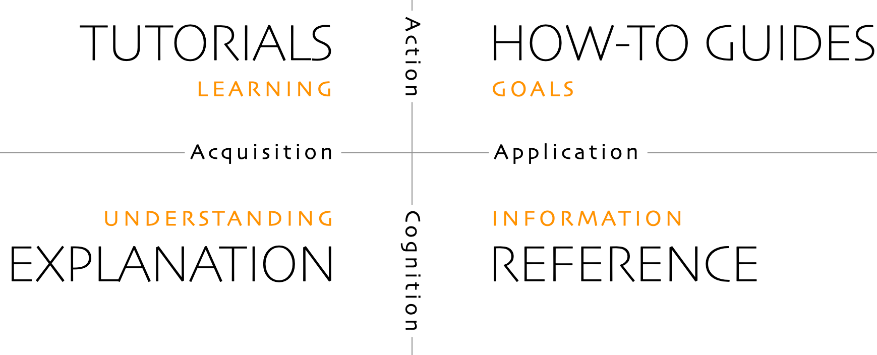
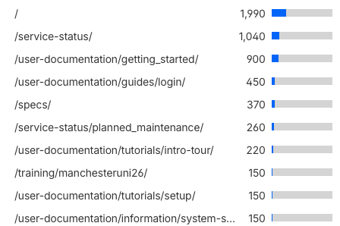
Docs organisation
Diataxsis framework
Key pages- status + onboarding
LLMs for us- useful but not perfect
Copilot review via GitHub
Claude code for drafting
Reviewing and auditing
https://diataxis.fr

Slide 4
Community contributions?
Reputational risk
Defacing by bad actors
Forks & local mirrors
Promises often more forthcoming than PRs
Risk & process vs reward?
Allow hand-picked trusted individuals

Slide 5
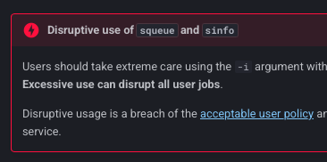

Users & LLMs
Users will use google LLMs for support…
…and will blindly follow advice
LLMs make ‘docs’ and ‘support’ convergent from a user perspective
Exploring LLMs for support but cautious of quality
Feed with docs, support ticket database

