Slide 1
CPE perspectives: Isambard-AI & Isambard 3
Richard Gilham,
Bristol Centre for Supercomputing

Slide 2
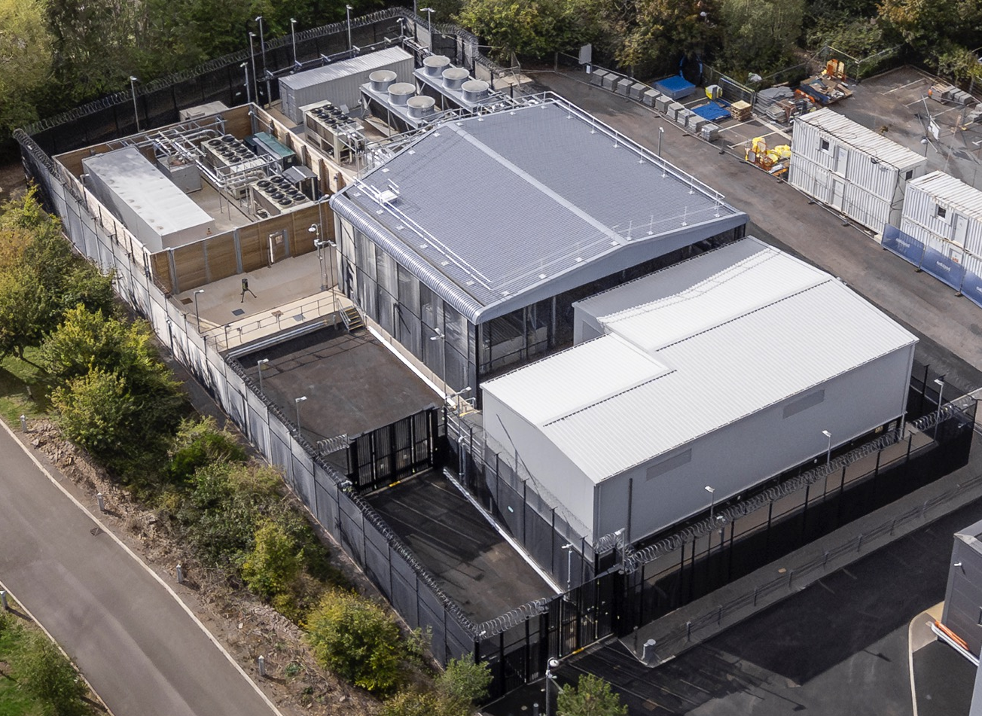
BriCS Services
Isambard-AI:
1362 nodes 4xGH200s
AI focus; academia, government & commercial (SME)
Isambard 3:
384 nodes Grace-Grace
Academia (UK Tier2/NCR)
BlueCrystal 5:
AMD CPUs
Internal to University of Bristol
More under construction…

Slide 3
Userbase: Large & Diverse
Sciences to arts & humanities to AI research
Beginner to expert
HPC, Cloud & Workstation experience
Bring what they have, not start from scratch
Compiled and interpreted languages
Containers, conda, Spack etc
<1 to >1000 nodes
Project duration 3-12 months
~1000 projects/year; 1000s of users

Slide 4
Support: Scalability is crucial
100:1 user to BriCS ratio + fast project turnover
= little scope for intensive ‘RSE’ support
Users largely need to help themselves:
Documentation (more in the Read the Docs BoF)
Servicedesk
Training
Less emphasis on tuning/optimisation (lower ROI in the first approximation)

Slide 5
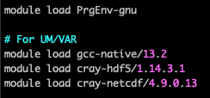
CPE (and related)
Document to pick up GNU by default
Quick and reliable route to a first run
Module load and go
‘Experts’ will always spend time playing
NCCL & MPI over Slingshot very important
Latest models need ~8 nodes (24 GH200s)
Good integration with containers
CUDA and NVIDIA Driver versions
Too old for latest AI models
Slow cadence bad for cybersecurity

