Slide 1


PEAD/CUG 2026: CINES Environment
Cédric Jourdain jourdain@cines.fr
CINES
France, Montpellier
HPC Engineer

Slide 2
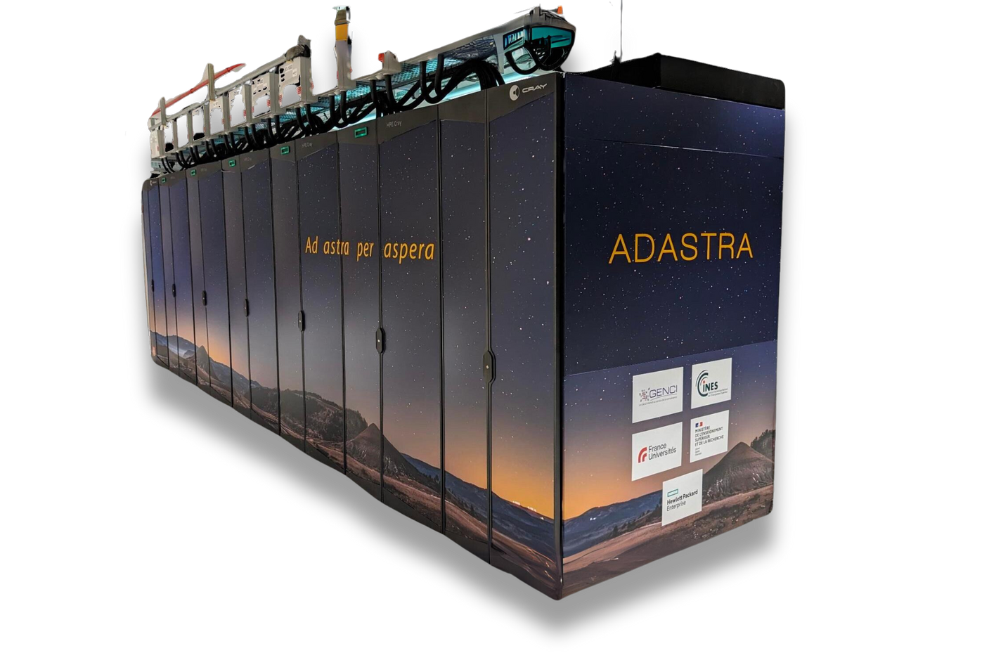







CINES: French National Centre for HPC/AI
Adastra Supercomputer:
GPU partition: 356 nodes
8 AMD MI250X GCD, 64G HBM2/GCD
CPU partition: 544 nodes
2 AMD Genoa 96c, 768G DDR5-5200 /node
APU partition: 28 nodes (—> extend to 112 nodes in 26Q3)
4 AMD MI300A, 24c/APU, 128G HBM3/APU, 228 CU/APU)
75 PFlop/s
Rankings
June 2022
4
Nov 2022
3
June 2023
3
Nov 2023
3
June 2024
9
June 2022
10
Nov 2022
11
June 2023
12
Nov 2023
17
June 2024
20

Slide 3
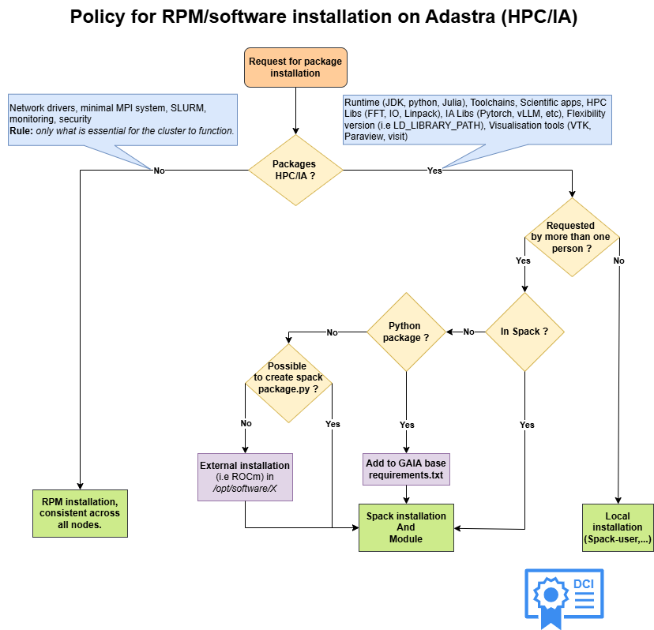
How CINES provide software environments
Layered Software Stack
Base system:
RPM (OS, drivers, SLURM, etc.) [with Ansible]
→ As minimal as possible
Cray Programming Environments
CINES Overlay Shim (COS)
→ Overlay (versioned) to rebuild the CPE environment
CINES software stack
Objective: Stable, Flexible, Reproducible*
Approach: Automation of software stack deployment
CI (GitLab) + Spack + Reframe
Spack-User!

Slide 4
CINES Overlay Shim (COS):
Problem with CPE:
Backward compatibility issue
Lack of support
Slow fix development following tickets
Our approach:
Extract and version CPE (/opt/cray, modules, configs), version everything
Store as portable artefact on shared FS (or squashfs)
Rebuild environment via bind mounts
Benefits:
Faster deployment & hot fix ➔ flexibility
Consistent across nodes
No significant issue at scale (sbcast)
Preserves user environments across system updates

Slide 5

CINES Software stack
« Base » software stack deployed with GNU compiler
Tools
Scientific libraries
« With no MPI dependencies and/or no risk of ABI or symbol incompatibility during linking»
-------------------------------- /opt/software/gaia/prod/latest/Base ----------------------------------
anaconda3/2025.12-2 gsl/2.7.1 nsimd/3.0.1
aocc/5.0.0 hpctoolkit/2025.0.stable-mpi openblas/0.3.28
autoconf/2.72 hpcviewer/2024.02 opencl-icd-loader/2024.05.08
binutils/2.43.1 hwloc/2.9.1-rocm-gpu openjdk/17.0.11_9
blitz/1.0.2 hwloc/2.9.1 (D) papi/7.1.0
bzip2/1.0.8 imagemagick/7.1.1-29 paraview/5.13.0-osmesa
cfitsio/4.3.0 intel-oneapi-compilers/2025.2.0 paraview/5.13.0 (D)
cmake/3.27.9 intel-oneapi-mkl/2025.2.0 patchelf/0.17.2
cmake/4.0.3 (D) jasper/3.0.3 poppler/23.04.0
ddt/25.0.1 jdk/21.0.8 proj/9.4.1
doxygen/1.13.2 julia/1.10.0 python/3.12.1
easybuild/4.7.0 libsndfile/1.2.2 qt/5.15.11
eigen/3.4.0 libtirpc/1.3.3 r/4.4.0
ferret/7.6.0-mpi libtool/2.4.7 rclone/1.68.1
ffmpeg/6.1.1 libxml2/2.13.4 rust/1.78.0
firefox/149.0.2 libxsmm/1.17 sox/14.4.2
gdal/3.8.5 llvm/20.1.6 suite-sparse/7.8.3
gdb/16.2 metis/5.1.0-int64 swig/4.1.1
git/2.48.1 metis/5.1.0 (D) udunits/2.2.28
glew/2.2.0 mmg/5.7.1 valgrind/3.23.0-mpi
gmake/4.4.1 mpfr/4.2.1 visit/3.4.2
gmp/6.2.1 mpifileutils/0.11.1-mpi xpmem/master
gmsh/4.13.1-mpi nco/5.1.9-omp-mpi zlib-ng/2.1.4
gnuplot/6.0.0 ncview/2.1.9-mpi zlib/1.3.1
grace/5.1.25-mpi ninja/1.12.1

Slide 6
CINES Software stack
« Base » software stack deployed with GNU compiler
Tools
Scientific libraries
« With no MPI dependencies and/or no risk of ABI or symbol incompatibility during linking»
« Extensible » software stack via the <COMPILER>-CPU|GPU-<VERSION> modules. Each version of the software stack is based on a version of the Cray programming environment (CPE/XX.YY). There is one version per
Architecture (GPU and CPU)
Compilers (gcc and cce)
----------------------------- /opt/software/gaia/prod/latest/Core -------------------------------------------
CCE-CPU-5.0.0 CCE-GPU-5.0.0 (L) GCC-CPU-5.0.0 GCC-GPU-5.0.0 develop spack-user-5.0.0
----------------------------- /opt/software/gaia/prod/5.0.0/CCE-GPU-5.0.0 -----------------------------------
boost/1.88.0-mpi magma/2.8.0-rocm-gpu parmetis/4.0.3-mpi
gromacs/2025.4-omp-rocm-mpi-gpu netcdf-c/4.9.2-mpi petsc/3.23.4-omp-rocm-kokkos-mpi-gpu
hdf5/1.14.6-mpi netcdf-cxx/4.2-mpi slepc/3.23.2-rocm-mpi-gpu
heffte/2.4.1-rocm-mpi-gpu netcdf-cxx4/4.3.1-mpi suite-sparse/7.8.3-omp
kokkos/4.6.01-rocm-gpu netcdf-fortran/4.6.1-mpi suite-sparse/7.8.3 (D)
lammps/20250612-plumed-rocm-kokkos-mpi-gpu parallel-netcdf/1.14.0-mpi superlu-dist/9.1.0-int64-omp-rocm-mpi-gpu

Slide 7
CINES Software stack
« Base » software stack deployed with GNU compiler,
Tools
Scientific libraries
« With no MPI dependencies and/or no risk of ABI or symbol incompatibility during linking»
« Extensible » software stack via the <COMPILER>-CPU|GPU-<VERSION> modules. Each version of the software stack is based on a version of the Cray programming environment (CPE/XX.YY). There is one version per
Architecture (GPU and CPU)
Compilers (gcc and cce)
CINES software stack lifecycle:
production: Stable and supported stack
develop: new stack currently under development, available to users
archive: deprecated and with reduced support
------------------------- /opt/software/gaia/prod/latest/Core ---------------------------
CCE-CPU-5.0.0 CCE-GPU-5.0.0 GCC-CPU-5.0.0 GCC-GPU-5.0.0 spack-user-5.0.0 develop
------------------------- /opt/software/gaia/deprecated ---------------------------------
CCE-CPU-4.0.0 CCE-GPU-4.0.0 GCC-CPU-4.0.0 GCC-GPU-4.0.0 archive

Slide 8
CPE Dependencies
Adastra software stack:
Cray/HPE stack
What we rely on from CPE:
CPEs modules (far too many)
CINES stack (Spack-based)
What we rely on from CPE:
MPI & Network stack (Cray-MPICH, PMI, libfabric, Slingshot)
Compilers & GPU ecosystem (CCE, ROCm/HIP, LLVM)
Selected optimised libraries (e.g. cray-fftw, cray-libsci)

Slide 9
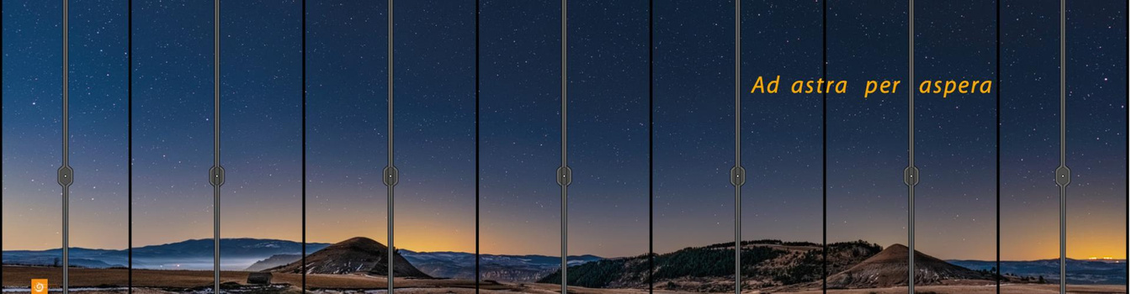
Expectation from HPE
What would be welcome?
Longer compatibility across OS upgrades
More extensive testing and validation of CPE releases
Avoiding Cray wrappers
Network stack openness (strong support beyond Cray-MPICH, e.g. OpenMPI)
Clear documentation explaining the concepts and semantics of CPE products
`amd-mixed` is deprecated, but was very useful
What is problematic?
Limited alternatives for GPU programming in Fortran. ➔ But not something HPE alone can address
Default library (“no ldconfig ! Only module”)
Lack of consistency between ROCm and amd-mixed compared to GNU/Cray (module/PrgEnv)
Thanks for your attention
Cédric Jourdain (jourdain@cines.fr)

