Slide 1
Evolutionary
Coding Agents
AlphaEvolve, OpenEvolve, and what happens when you let a
language model mutate code against a scoreboard
Sânziana · ETH Zürich
MAS FDD — From Data to Decisions · FS26
Notes:
30 minutes total. Aim: 24 min talk + 5 min demo/questions. Open cold with the number on the next slide — do not introduce yourself first, do it after the hook lands.

Slide 2
THE HOOK
48
1969
Strassen's recursion gives 49 for this setting.
1969 → 2025
56 years. No improvement in the complex case.
scalar multiplications
May 2025
An LLM-driven evolutionary search writes the program that finds 48.
to multiply two 4×4 complex matrices
Nobody wrote the algorithm. Somebody wrote the score.
AlphaTensor previously reached 47 in mod-2 arithmetic; 48 is the first improvement in the complex-valued setting. Novikov et al., 2025.
2
Notes:
~1 min. Say the number, pause, then explain. The punchline is the last line: the human contribution moved from writing the algorithm to writing the evaluation. Don't over-claim: AlphaTensor's 47 is mod-2 — flag it, the audience will contain someone who knows.

Slide 3
WHY NOW
Twelve months, three receipts
Not a lab demo any more — a paper, a chip, and a product SKU.
Nov 2025
May 2026
Jul 2026
67 open problems
Into the silicon
Generally available
Georgiev, Gómez-Serrano, Tao & Wagner run AlphaEvolve over 67 problems in analysis, combinatorics, geometry, number theory. Improved on 23, matched 36.
Jeff Dean: AlphaEvolve proposed a circuit design "so counterintuitive yet efficient" it was integrated directly into next-generation TPUs.
Ships to every Google Cloud customer on the Gemini Enterprise Agent Platform. Evaluators run client-side; your code never leaves your infra.
Question for you: what changed — the models, or the way we point them at problems?
3
Notes:
~1.5 min. This replaces the tweet-wall: three dated, checkable facts beat twenty screenshots and won't age badly. Ask the question out loud and let it hang for 5 seconds — it is the thesis of the whole talk (answer: mostly the second).

Slide 4
ROADMAP
Where we're going
01
The idea
Search, but the mutation operator has read the literature.
02
The machine
AlphaEvolve's four components, and what each one buys you.
03
The evidence
Mathematics, infrastructure, industry — and the ablations.
04
The catch
Where it fails, and a paper that says the loop barely matters.
05
Your turn
OpenEvolve, a checklist, and a live run.
4
Notes:
~30 s. Move fast. This slide exists so people can locate themselves later, not to be read aloud in full.

Slide 5
01 · THE IDEA
One loop, four verbs
Everything else in this talk is an implementation detail of this diagram.
SAMPLE
The two things a human supplies
pick a parent
from the archive
A seed program
Any working baseline, however bad.
STORE
MUTATE
keep it if it
earns a slot
LLM proposes
a diff
A scoring function
Automatic, deterministic-ish, and honest.
EVALUATE
The agent supplies the "how".
You keep ownership of the "what".
run it, get
a number
5
Notes:
~2 min. Draw the loop verbally as you go: sample, mutate, evaluate, store. The key framing to plant here: the human writes the score, not the solution. Everything later hangs off that.

Slide 6
01 · THE IDEA
Genetic programming had this loop in 1992
What changed is the mutation operator — and the arithmetic of trust.
Classical mutation
LLM mutation
Perturb a syntax tree at random. Valid code, but semantically blind. Needs enormous populations, and it cannot use anything anyone has ever written about your problem.
Proposes edits that are plausible given the code's meaning and the whole scientific literature. Feed it a PDF of the relevant paper and the proposals get better. It is a prior over useful directions.
The generator–verifier gap
Generation is creative and unreliable. Verification is cheap and exact. Evolution is the wrapper that converts the first into the second: bad mutations are simply outscored and pruned, while a few wild ones supply the diversity that escapes a local optimum. Hallucination stops being a failure mode and becomes the exploration budget.
Framing after T. Tao, "Mathematical exploration and discovery at scale" (blog, Nov 2025).
6
Notes:
~2 min. This is the conceptual centre of the lecture — if they remember one slide, make it this one. The line that lands: 'hallucination stops being a failure mode and becomes the exploration budget'. Say it slowly.

Slide 7
01 · THE IDEA
A three-year lineage
2023–24
FunSearch
Nature. Evolves a single Python function. Cap set problem, online bin packing. Proof of concept that an LLM can produce new, provably correct mathematical knowledge.
2025
AlphaEvolve
Whole files instead of functions. Diff-based edits, an LLM ensemble (fast + strong), multiple metrics, evolved meta-prompts. Closed source.
2025–26
The open ecosystem
OpenEvolve, ShinkaEvolve, CodeEvolve, GigaEvo, ThetaEvolve, DeepEvolve. Reproductions, sample-efficiency tricks, and open-weight backbones at ~1/10 the cost.
The recipe generalised faster than the results did. That is usually a sign the recipe is the contribution.
7
Notes:
~1 min. Fast slide. Point out that ThetaEvolve reaches state of the art on some AlphaEvolve problems with an 8B open-weight model — that matters for anyone in the room without a Google budget.

Slide 8
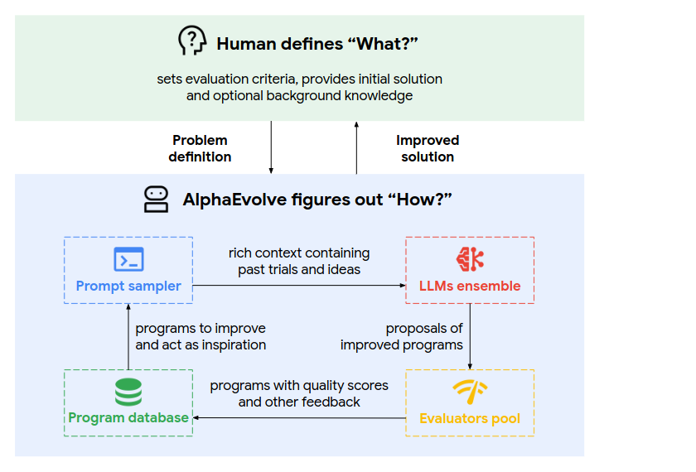
02 · THE MACHINE
The contract: you define "what", it figures out "how"
Read this as an interface,
not an architecture
You own the problem definition, the evaluation criteria and the initial solution.
You may optionally hand over background knowledge — even raw PDFs of the relevant literature.
What comes back is human-readable code you can inspect, debug and reject.
Figure: Novikov et al., AlphaEvolve white paper (2025), Fig. 1.
8
Notes:
~1 min. Stress the third bullet — interpretability is the reason Google can actually deploy the Borg scheduler result. A neural controller could not have been shipped there.

Slide 9
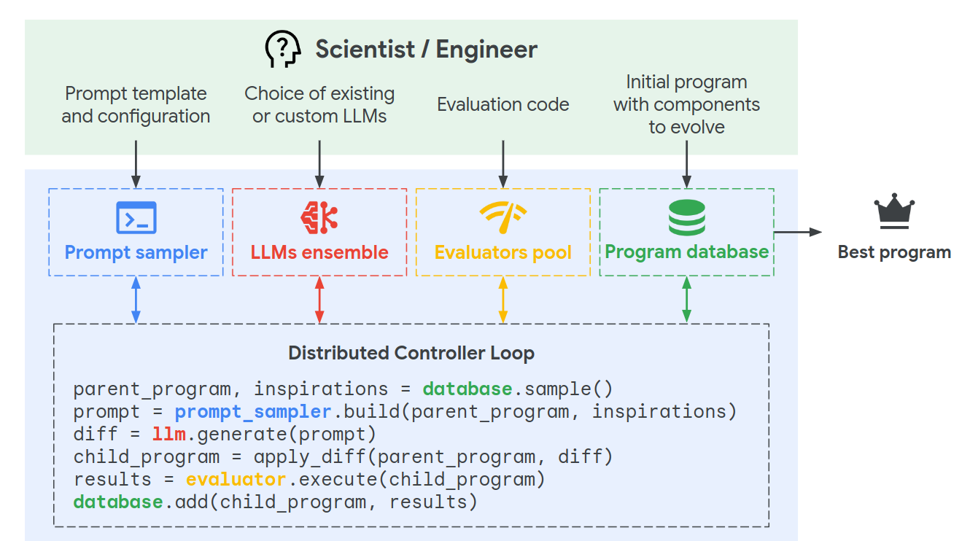
02 · THE MACHINE
Six lines of pseudocode, four moving parts
Prompt sampler
Builds the context: parent, rivals, scores, errors.
LLM ensemble
Cheap+fast for breadth, strong+slow for depth.
Evaluators pool
Your code. The only source of truth.
Program database
Decides who gets to reproduce.
Asynchronous by design: the bottleneck is evaluator throughput, not the LLM.
Figure: Novikov et al., AlphaEvolve white paper (2025), Fig. 2.
9
Notes:
~1.5 min. Walk the six pseudocode lines out loud — sample, build, generate, apply, execute, add. That is the entire system. Then the punchline: three of the four boxes are generic. Only the evaluator is yours.

Slide 10
02 · THE MACHINE
What you actually write
Two files. The markers tell the agent which lines it is allowed to touch.
Everything outside the block is scaffolding
# ---------- initial_program.py ----------
import numpy as np
# EVOLVE-BLOCK-START
def construct(n: int) -> np.ndarray:
"""Return a candidate configuration."""
return np.random.rand(n, 2)
# EVOLVE-BLOCK-END
# ---------- evaluator.py ----------
def evaluate(program_path) -> dict:
cfg = run(program_path)
if not feasible(cfg):
return {"score": 0.0}
return {"score": objective(cfg),
"runtime": t, "margin": m}
Imports, harnesses, plotting, the verifier itself — frozen. The agent cannot cheat by rewriting them.
The return dict is the fitness signal
Extra metrics are not decoration: optimising several often improves the one you actually care about, because diverse high scorers seed better prompts.
Cascade your evaluator
Cheap smoke test first, expensive full run only for survivors. This is where your compute budget lives or dies.
10
Notes:
~2 min. This is the slide people photograph. Keep the code on screen while you talk. Mention the diff format: the LLM emits SEARCH/REPLACE blocks, not whole files, which is why it scales to real codebases.

Slide 11
02 · THE MACHINE
The database is the algorithm
Keeping only the best program is how you guarantee a local optimum.
MAP-Elites archive
Island model
Bin programs by behaviour (complexity, diversity, runtime…). Each cell keeps its own champion, so a slow-but-clever program is never deleted by a fast-and-dumb one. Competition is local.
Run several semi-isolated populations, each with its own archive. Migrate elites on a ring every N generations. Independent lineages get time to develop before they have to compete.
Why this matters
Quality-diversity is what turns a greedy hill-climber into an explorer.
The archive is also the memory the prompt sampler draws on — diverse elites make better in-context examples than five near-copies of the leader.
2
1
3
4
behavioural feature 1 →
11
Notes:
~2 min. Mouret & Clune (2015) for MAP-Elites, Tanese (1989) for islands — both pre-LLM. Worth saying: the evolutionary machinery here is 30 years old and unmodified. OpenEvolve's default: 5 islands, population 500, ring migration.

Slide 12
02 · THE MACHINE
The prompt is where the search actually happens
Parent
The program to be mutated, in full.
Two levels of
abstraction at once
Inspirations
A few top performers plus a few deliberately diverse ones, with their scores attached. The model sees a fitness landscape, not a single example.
The system optimises the parameters of a construction and the strategy used to find constructions.
An evolved program might combine a hand-rolled heuristic, a SAT solver and a second-order method with no convergence guarantee — a combination no single researcher would have bothered to try.
Artifacts
Stderr, stack traces, profiler output, failed assertions — fed straight back. The model debugs its own previous attempt.
Meta-prompt
The instruction template itself is an evolvable object. Prompts that produce good children survive.
12
Notes:
~1.5 min. The artifacts channel is the most underrated feature — it is what makes the thing feel like a competent engineer rather than a random generator. OpenEvolve implements everything here except meta-prompt evolution.

Slide 13
03 · THE EVIDENCE
Does the machinery earn its keep?
The AlphaEvolve ablation: remove one component, rerun, compare.
No evolution
Sample independently, never build on past programs. Biggest single loss.
And one knob nobody expects
No context in prompts
Drop the scored inspirations. The model stops learning the landscape.
Parallel threads.
More threads sharply accelerate time-to-discovery — but at the cost of more total LLM calls for the same result. Wall-clock and budget pull in opposite directions, and you have to pick.
This is the trade-off that decides whether a run is affordable, not the choice of selection operator.
No meta-prompt evolution
Smaller but consistent degradation.
No full-file evolution
Restrict to a single function, FunSearch-style. Hurts on the harder problems.
Small base model only
Cheap models suffice for easy problems; only frontier models solved the ones needing elaborate constructions.
Left: Novikov et al. (2025), ablations on the kissing-number and third autocorrelation problems. Right: Georgiev, Gómez-Serrano, Tao & Wagner (2025), Fig. 1.
13
Notes:
~2 min. Put the original ablation figure here if you want the plot itself — I've written the reading of it, which is what the audience needs either way. Set up the tension for slide 17: these ablations compare AlphaEvolve to crippled AlphaEvolve. Nobody compared it to a dumb baseline.

Slide 14
03 · THE EVIDENCE
Mathematics: 67 problems, one afternoon each
Problem | Before | After
Kissing number, 11 dimensions | 592 | 593
Packing 26 circles, sum of radii | 2.634 | 2.63586
First autocorrelation inequality | 1.5098 | 1.5053
Heilbronn triangles, n = 11 | 0.036 | 0.0365
Erdős minimum overlap | 0.380927 | 0.380924
Uncertainty inequality | 0.3523 | 0.3521
23 / 67
problems where the state of the art was improved
36 / 67
matched the best known construction
hours
typical setup time per problem, versus months for a bespoke solver
Improvements are small. That is the point: they are improvements on records that stood for years, obtained without expertise in the field.
Generalizer mode: shown its own optima for small n, the system sometimes writes a construction valid for all n. One such construction, for the Nikodym problem, was human-readable enough to inspire a new Tao paper.
Georgiev, Gómez-Serrano, Tao & Wagner, arXiv:2511.02864. Bounds as reported in Novikov et al. (2025).
14
Notes:
~2 min. The audience will want to know if these are 'real'. Gómez-Serrano's framing is the best answer: any single one of these could have been found by a domain expert in a few months; they got comparable results across many fields in a day or two. Also worth one sentence: a finite-field Kakeya construction from AlphaEvolve was proved by Deep Think and formalised in Lean by AlphaProof — a full discovery-to-verification pipeline.

Slide 15
03 · THE EVIDENCE
Then the results stopped being Google's
Nine months later, the records set by AlphaEvolve are themselves being broken.
Kissing number, d = 11
Ramsey numbers
Erdős problems
593 → 604
R(3,17), R(4,15)
a running tally
AlphaEvolve's record, beaten on an open agent leaderboard where participants build on each other's submissions.
Bounds tightened for the first time in decades — a domain where each problem's structure differs enough that no single hand-rolled search works.
A community wiki now tracks AI contributions problem by problem. AlphaEvolve appears alongside GPT-5.x, Aristotle, AlphaProof and Seed Prover.
Tao's caveat, worth repeating verbatim in spirit: these are scattered successes among a large sea of unreported failures — and the systems are best at the long tail of problems that were already within reach of standard techniques.
EinsteinArena (launched March 2026); Erdős problems AI wiki, github.com/teorth/erdosproblems.
15
Notes:
~1.5 min. This is the slide that shows the field moved past the paper you're teaching. Good for credibility. If pressed for time, this is the first slide to cut.

Slide 16
03 · THE EVIDENCE
The part that pays for the research
0.7%
23%
20%
of Google's worldwide compute recovered, continuously, by an evolved Borg scheduling heuristic for stranded resources
speedup on a matrix-multiplication kernel inside Gemini's own training stack — about 1% of total training time
reduction in Spanner write amplification via evolved LSM-tree compaction heuristics
30%
14% → 88%
10×
fewer variant-detection errors in DeepConsensus DNA sequencing correction
feasible-solution rate for AC optimal power flow, cutting expensive post-processing
lower error on Willow quantum-processor circuits for molecular simulation
Google DeepMind AlphaEvolve one-year impact report, May 2026; Novikov et al. (2025). Also reported: a TPU arithmetic-circuit simplification adopted into next-generation silicon.
16
Notes:
~2 min. Pick two or three, don't read all six. The Borg one is the strongest for this audience: a small percentage of an enormous number, delivered as readable code an SRE can review. If someone asks about money: press coverage estimates the 0.7% at several hundred million dollars a year, but Google has not published a figure — flag that as an estimate.

Slide 17
04 · THE CATCH
Now the slide Google's blog post doesn't have
No metric, no agent
"Simple Baselines are Competitive with Code Evolution"
If a candidate can't be scored automatically in seconds to minutes, none of this applies. That excludes most interesting problems.
Gideoni, Risi & Gal (Oxford / Sakana), February 2026. Two deliberately dumb baselines match or beat evolutionary pipelines across mathematical bounds, agentic scaffolds and ML competitions.
Their conclusion: the search space and the domain knowledge in the prompt set the performance ceiling. The evolutionary pipeline is secondary.
The evaluator is the attack surface
A badly designed score gets optimised into a degenerate or trivial solution. Reward hacking, with a fitness function.
Noisy evaluation selects noise
Small validation sets plus high variance means you promote lucky programs. Hand-designed baselines then win on the test set.
The intellectual work migrated. It did not disappear — it moved from designing the algorithm to designing the search space and the score.
It doesn't produce insight
It produces witnesses. Problems needing a genuinely new idea remain out of reach.
17
Notes:
~2.5 min. Do not rush this. It is the difference between a lecture and a product demo, and it is what a room of ETH people will respect. The honest synthesis: the loop is a convenience, the evaluator is the science. That sets up the checklist perfectly.

Slide 18
05 · YOUR TURN
Is your problem shaped like this?
Five questions. One "no" and you want a different tool.
1
Can a candidate be scored automatically?
Seconds to minutes, no human in the loop, no manual judgement.
2
Is the score honest?
Is there a cheap degenerate solution that scores well? Assume it will be found.
3
Can you write down a search space?
Something a program can output. This is the step that actually needs your expertise.
4
Is a few percent worth it?
These systems deliver small margins reliably. At scale that is money; at n = 1 it is noise.
5
Do you have a baseline and a held-out set?
Otherwise you cannot tell improvement from overfitting to your own evaluator.
Cheapest possible experiment: one afternoon, one evaluator, a $20 API budget, and a baseline you already trust.
18
Notes:
~1.5 min. This is the slide the FDD audience takes back to work. Slow down, let them write it down.

Slide 19
05 · YOUR TURN
OpenEvolve in practice
The faithful open reimplementation. Three files and a config.
Has
max_iterations: 1000
llm:
primary_model: "<fast, cheap>"
secondary_model: "<slow, strong>"
temperature: 0.7
database:
population_size: 500
num_islands: 5
migration_interval: 20
feature_dimensions:
[complexity, diversity, score]
evaluator:
cascade_evaluation: true
enable_artifacts: true
MAP-Elites archive · island model with ring migration · artifacts side-channel · cascade evaluation · checkpointing · an evolution-tree visualiser you can click through
Lacks
Meta-prompt evolution, and the distributed evaluator fleet that makes AlphaEvolve's throughput possible. In exchange you get to read every line.
Neighbours
ShinkaEvolve for sample efficiency · CodeEvolve for CVT-MAP-Elites and open-weight backbones · GigaEvo for a modular DAG evaluator · ThetaEvolve for test-time RL on 8B models
19
Notes:
~1.5 min. Config knobs worth naming out loud: num_islands, migration_interval, exploitation_ratio, feature_dimensions. Everything else is defaults. Set up the demo here.

Slide 20
IN CLOSING
Five things to keep
01
Evolution is a trust-conversion wrapper
It turns an unreliable generator into a reliable optimiser. The evaluator does the converting.
02
Value has migrated to problem formulation
Search space and score, not selection operators. That work is still human, and still hard.
03
It industrialises the long tail
Not one breakthrough — hundreds of small, verified wins, each cheap enough not to need justifying.
04
It is now infrastructure
In TPU silicon, in Spanner, in Gemini's training loop, and on a cloud price list since July.
05
It finds witnesses, not insight
Anything requiring a genuinely new idea is still yours.
Thank you — questions, then a live run if the network cooperates.
20
Notes:
~1 min. Land on point 5 — it is the honest one and it leaves the audience with the right mental model.

Slide 21
IF TIME ALLOWS
Live: circle packing, 26 circles in a unit square
Maximise the sum of radii. Baseline: 26 identical circles on a grid.
Before you start
Checkpoint from a completed run already loaded in a second tab. If the live run stalls, you switch tabs and nobody notices.
Minute 1
Show initial_program.py and evaluator.py. Point at the EVOLVE-BLOCK markers.
Minute 2
Launch. Narrate the first few generations: the score jumps early, then flattens.
Minute 3
Open the evolution tree on the finished checkpoint. Show two islands that found structurally different packings — that is MAP-Elites doing its job, visibly.
A live LLM run in front of an audience is a coin flip. Record it beforehand and play the recording.
21
Notes:
Reserve 4 minutes. Sum of radii for 26 circles is a good demo because the visual output is immediately legible — people see the packing, not a number. Strongly consider a screen recording instead of a live run.

Slide 22
SOURCES
References
Novikov et al. (2025)
AlphaEvolve: A coding agent for scientific and algorithmic discovery. arXiv:2506.13131
Georgiev, Gómez-Serrano, Tao & Wagner (2025)
Mathematical exploration and discovery at scale. arXiv:2511.02864 — plus the problem repository on GitHub
Romera-Paredes et al. (2024)
Mathematical discoveries from program search with large language models. Nature 625 (FunSearch)
Gideoni, Risi & Gal (2026)
Simple Baselines are Competitive with Code Evolution. arXiv:2602.16805
Sharma (2025)
OpenEvolve — github.com/algorithmicsuperintelligence/openevolve
Lange et al. (2025) · Assumpção et al. (2025) · Khrulkov et al. (2025)
ShinkaEvolve · CodeEvolve (arXiv:2510.14150) · GigaEvo (arXiv:2511.17592)
Mouret & Clune (2015) · Tanese (1989)
MAP-Elites · island-model genetic algorithms
Google DeepMind (May 2026, Jul 2026)
AlphaEvolve one-year impact report; general availability on Google Cloud
Tao (Nov 2025)
terrytao.wordpress.com — the clearest short explanation of why the loop works
22
Notes:
Leave this up during questions.

