Slide 1
React: Toolchains Micro-Frontends
Evan Hanawalt

Slide 2
Contents
React Toolchains
Micro-Frontend Architecture

Slide 3
What is a Toolchain?
A frontend Toolchain is a set of tools used to:
Manage Packages
Compile/ Transpile code
Bundle
Minify
Lint
Test
Infinitely more things…

Slide 4
Toolchain Examples
All-in-one
Custom
Create React App
Client-side rendering
Served statically from any server
Unopinionated about routing
Next.js
Server-side rendering
Static generation
Built-in routing
Backend features
Many others…
Nodejs – development and build runtime
NPM – package management
Webpack – bundling and optimizing code
Babel – complies javascript or typescript to allow modern language features to run on browsers.

Slide 5
Routing/ Rendering Methods
Client-side rendering/routing
Page is rendered in client browser.
HTTP requests for web pages are redirected to one HTML document.
After first page load, navigation between pages is handled by JavaScript, not HTTP.
Server-side rendering
Server Renders a templated HTML document for each request.
Page meta-data can be custom for each page.
Routing can be handled by server or JavaScript.
Static generation
Rendering occurs at build time.
Page data must be known at build time.

Slide 6
Micro-Frontend Architecture
Enables code-splitting/ sharing from different endpoints at the module level.
Frontend apps can consume/produce JavaScript modules at runtime.
Allows development and deployment of new components in a large app individually.

Slide 7
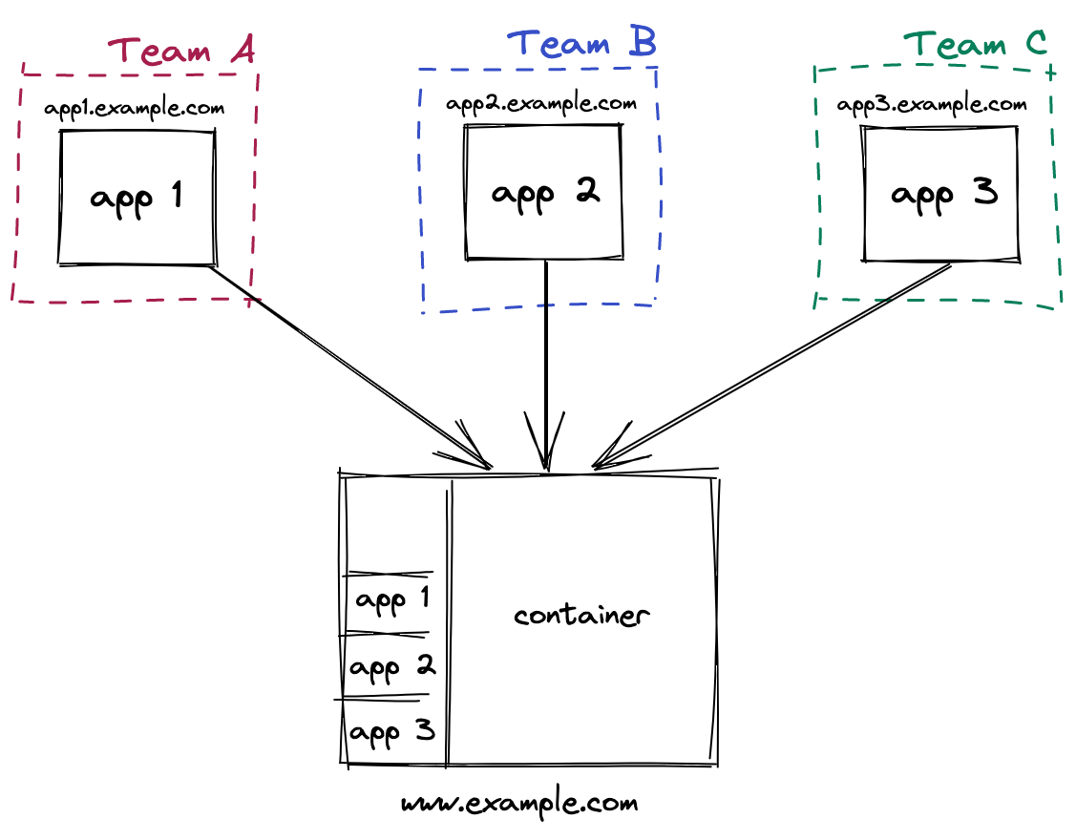
Micro-Frontend Architecture

Slide 8
Demo
https://github.com/eth305/react-presentation

Slide 9
Thank you
https://reactjs.org/docs/getting-started.html
https://beta.reactjs.org/ (new docs)
https://reactrouter.com/
https://webpack.js.org/concepts/module-federation/

