Slide 1
Neural Network Zoo CNN
Convolutional Neural Network - Unleashing Image Recognition Power
Team Cheetah: Ethan Phan, Elizabeth Martinez, Sydney Chilso

Slide 2
Introduction
This section provides a comprehensive overview of Convolutional Neural Networks (CNNs), emphasizing their significance in image processing and pattern recognition, much like a cheetah's swift actions in the wild.

Slide 3
01
What is CNN?

Slide 4

Definition of CNN
Convolutional Neural Networks (CNNs) are advanced deep learning models tailored primarily for visual data processing, including images and videos. They are designed to automatically detect and learn patterns essential for various tasks such as image classification, object detection, and more.

Slide 5
Architecture Breakdown
CNNs are built using several key layers:
- **Convolutional Layers**: These layers help in detecting features from the input image, such as edges, textures, and colors.
- **Pooling Layers**: They are responsible for down-sampling the feature maps to reduce dimensionality while retaining essential information.
- **Fully Connected Layers**: These layers compile the information extracted from the previous layers to make definitive classifications, such as recognizing a specific object in the image.

Slide 6
Key Feature of CNNs
One of the defining characteristics of CNNs is their ability to automatically learn and extract features from images without the need for manual feature engineering. This capability allows CNNs to recognize complex patterns and structures within visual data, making them highly effective for tasks such as object detection and image classification. By leveraging layers that focus on different aspects of the input image, CNNs can progressively refine their understanding, resulting in high accuracy and efficiency in processing visual information.

Slide 7
Applications
02

Slide 8
Facial Recognition
CNNs are extensively used in facial recognition technologies, enabling devices to identify individuals based on their unique facial features. This application is prominent in security systems, technology devices like smartphones, and social media platforms, where the software analyzes and matches facial data. The high accuracy of CNNs in distinguishing between different faces has transformed how identity verification is approached, making it faster and more reliable.

Slide 9
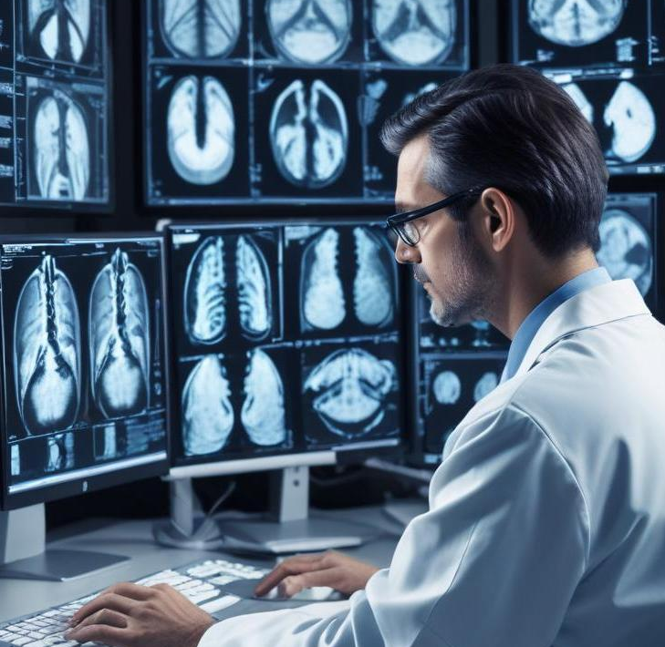
Medical Imaging
In the medical field, CNNs play a critical role in analyzing images from X-rays, MRIs, and CT scans. By employing deep learning techniques, CNNs help in detecting anomalies such as tumors or fractures that may be missed by the human eye. This application improves diagnostic accuracy and speed, allowing healthcare professionals to make informed decisions and enhance patient outcomes based on precise image analysis.

Slide 10
Self-Driving Cars
CNNs are integral to the development of self-driving cars, where they are utilized to interpret and analyze visual data from the vehicle's surroundings. By identifying pedestrians, road signs, and other vehicles, CNNs contribute to the vehicle's decision-making processes, ensuring safer navigation. Their capacity to learn from large datasets of road images enables them to adapt to various driving conditions, enhancing the overall safety and efficiency of autonomous transportation systems.

Slide 11
Conclusions
Convolutional Neural Networks have revolutionized the way we process and analyze visual data. Their applications span various industries, from healthcare to autonomous vehicles, showcasing their versatility and efficiency. Despite their advantages, it's crucial to remain aware of challenges such as bias and the need for large datasets. Continued research and development in CNN technology promise to enhance their capabilities and address existing limitations.

