Slide 1
Macroeconomic Insights by County & Industry
Building a Macroeconomic Index
Ethan Hill

Slide 2
EDA Goal: create new features that identify high risk counties/industries for SMB activity
Project Goal: develop a macroeconomic health index, models that predict SMB default risk
Bonus: join Census data by industry, identify “hidden-prime” SMBs with index, connect Enigma data

Slide 3
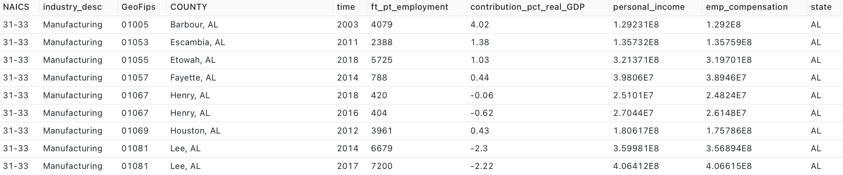
Data
ehill_work.bea_data_naics_2
Unique rows on Industry/County/time at 2-Digit NAICS level (2022)
Data spans 2001-2021, updated annually
ft_pt_employment: total full/part-time employed
contribution_pct_real_GDP: percent value contribution to US GDP (0.038 = 0.038%)

Slide 4
INDUSTRY BY COUNTY

Slide 5
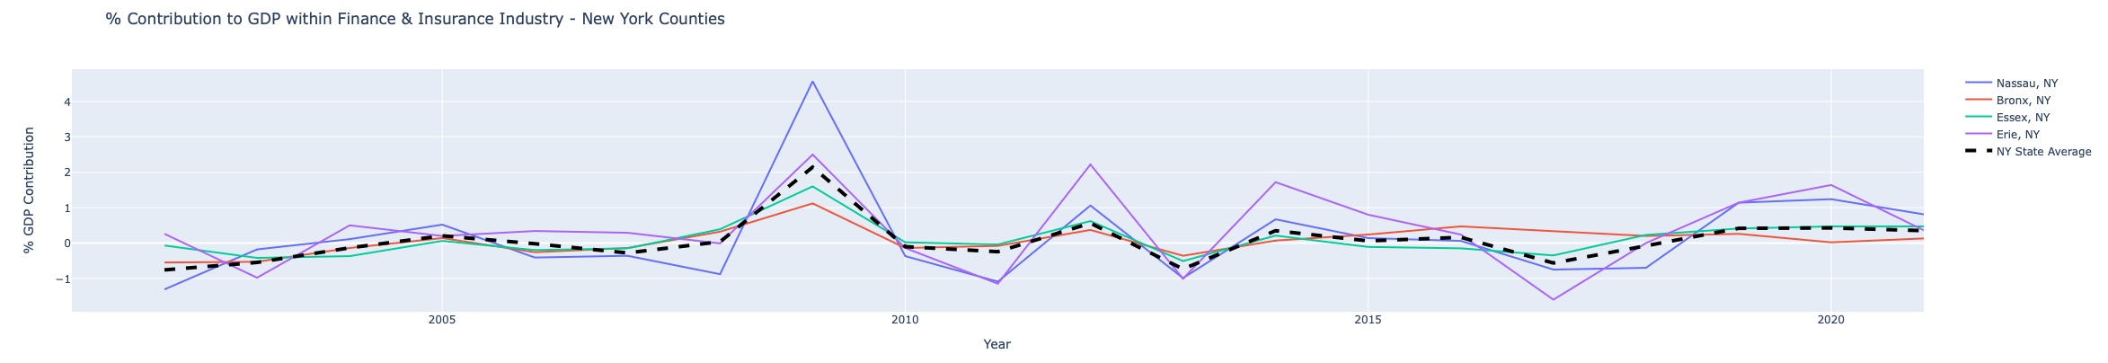
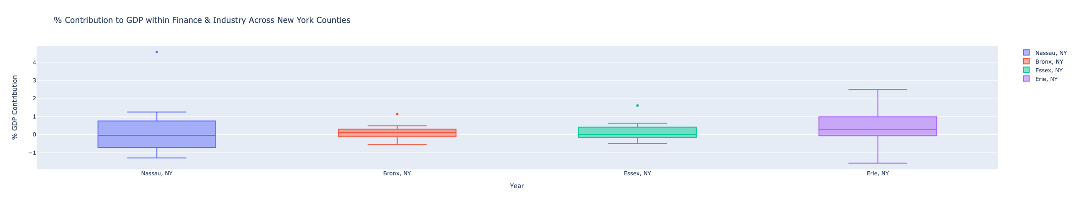
GDP by Industry at County Level - New York
Time Series Focus
GDP over/underperformance in comparison to state averages
Feature: diff_gdp_vs_state_avg
GDP per capita is an included feature -> not necessary when focus is positive vs negative contribution
Distribution Focus
Frequency that an industry falls at/below 0% GDP contribution
Feature: negative_gdp_frequency
* Negative GDP contribution: "when taxes on production and imports less subsidies and gross operating surplus are added to the industry's compensation of employees, GDP contribution may be negative"

Slide 6
COUNTY

Slide 7
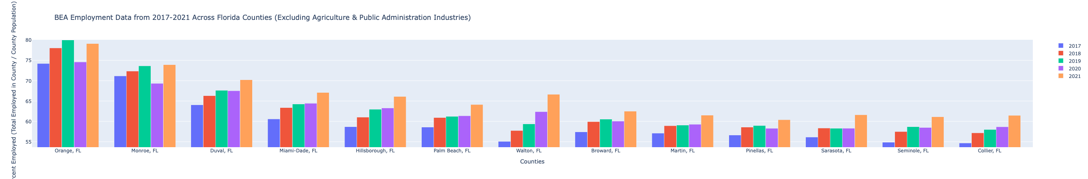
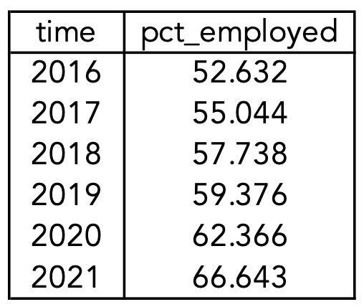
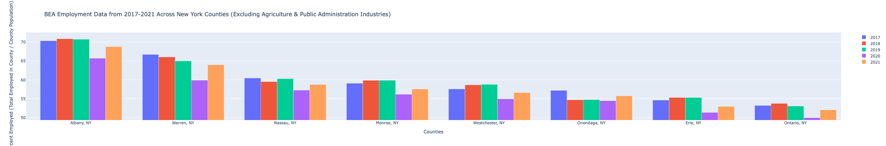
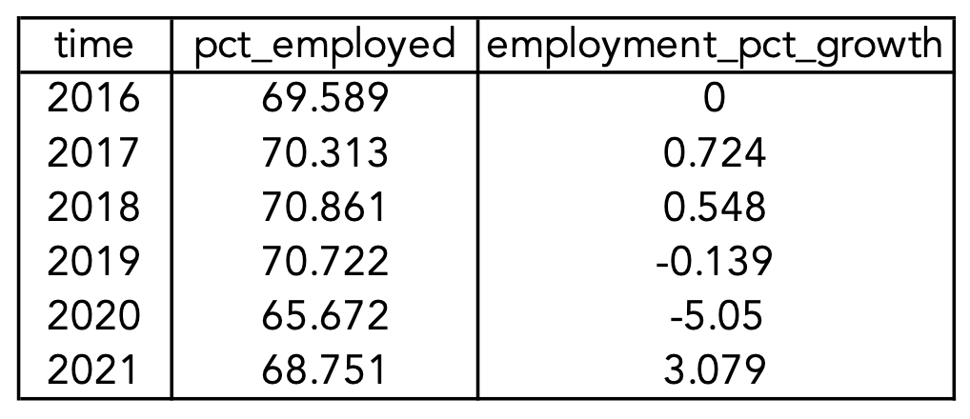
Employment Percentage by County
Florida
Healthy growth across many counties, even post-COVID
* Snapshot of 13/67 Florida counties
Walton, FL
New York - Employment Percentage
General decline in NY county employment, especially the drop offs post COVID (5.05% decrease in 2020)
employment_pct_growth measures the annual percent change in employment percentage
* Snapshot of 10/62 New York counties
Albany NY

Slide 8
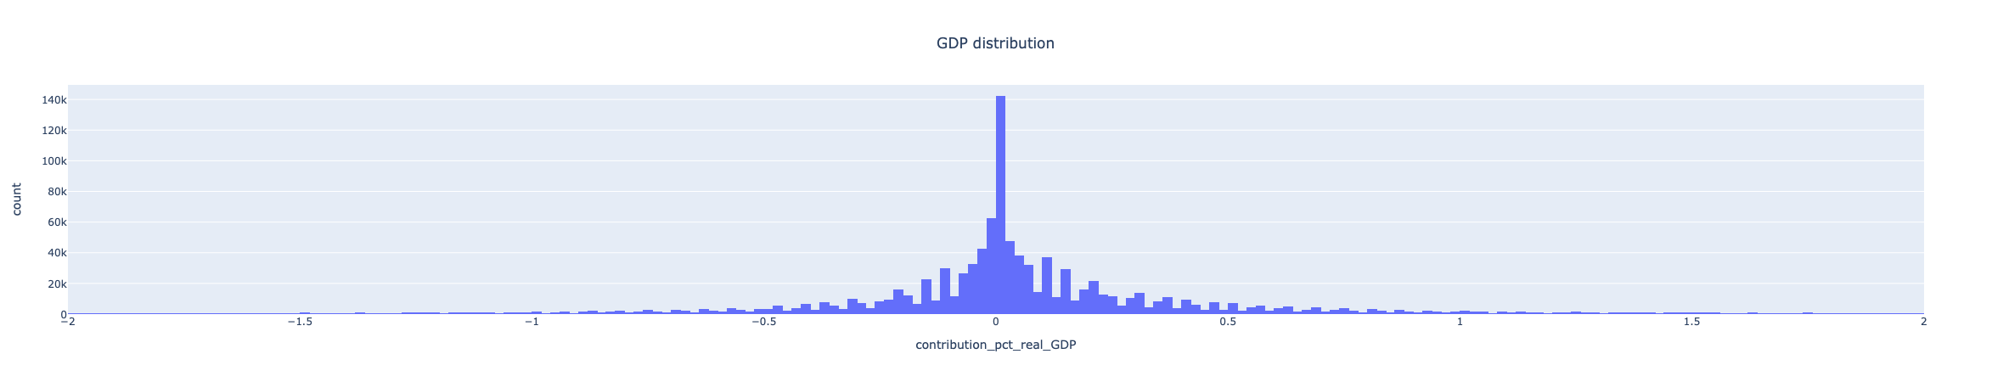
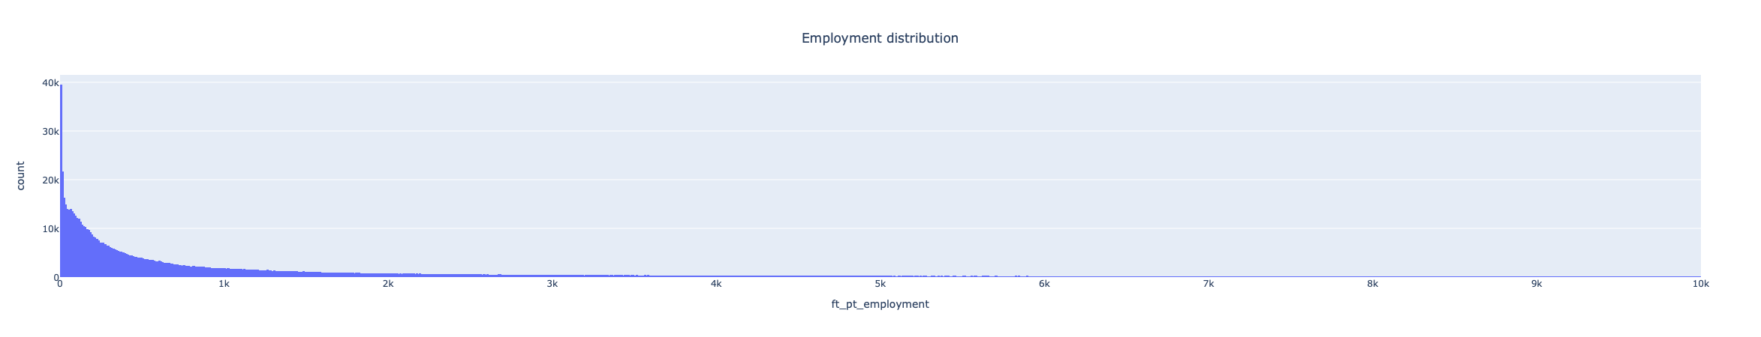
Next Step: Macroeconomic Index
Attribute Distributions
Ex: -1.5% GDP contribution in a county/industry is a significant value on our normal distribution -> greater impact on macro index
N(0.0832, 1.974)

