Slide 1
Interview Presentation by Yichen (Ethan) Lu
University of Michigan - Ann Arbor
MS in EECS

Slide 2
Background
Master's student in Electrical Engineering and Computer Science at the University of Michigan, specializing in Signal, Image Processing, and Machine Learning.
Recent Research Focus: AIGC, Computer Vision, Machine Learning
Key Research:
Optimization of FISTA-NET for mPACT (DL)
LLM Alignment Using Generated Feedback (RLHF)
Comparative Analysis in Medical Image Segmentation (CV, Stable-Diffusion, U-NET)
Visual Instruction Tuning Enhanced Recipe Generation (Multimodal LLM)
Analysis and Implementation of Recipe Generation Models (ML system, more on SDE)

Slide 3
Project 1: LLM Alignment Using Generated Feedback
Advisor: Assistant Prof. Samet Oymak, University of Michigan
Objective:
Developed techniques in reinforcement learning from human feedback (RLHF) to enhance model alignment with human values and preferences.
Targeted large language models (LLMs) to make them more responsive to human-like reasoning and ethically aligned outputs.
Approach:
Based on DPO, Implemented a self-learning and teacher-guided training paradigm, creating a dual feedback loop system.
Achievements:
Enhanced model responses, achieving high performance close to Alpaca 7B on AlpacaEval 2.0.
Relevance to Trustworthy AI:
Demonstrates foundational progress in making LLMs safe, reliable, and transparent by aligning AI outputs with human ethical considerations.

Slide 4
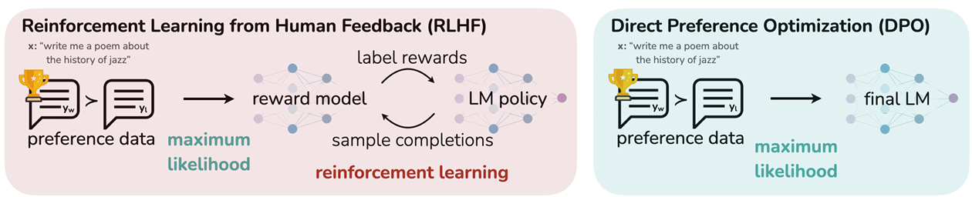
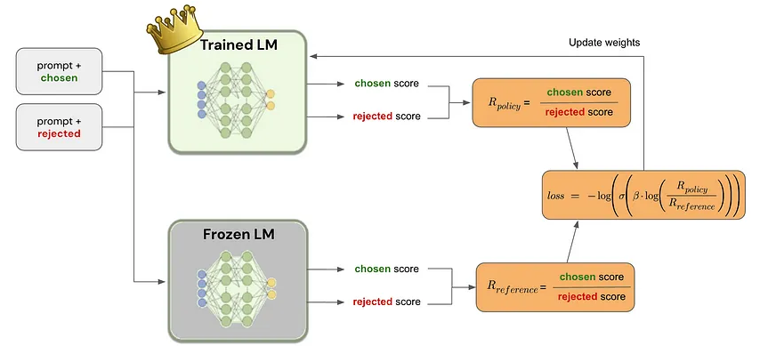
Project 1: LLM Alignment Using Generated Feedback

Slide 5

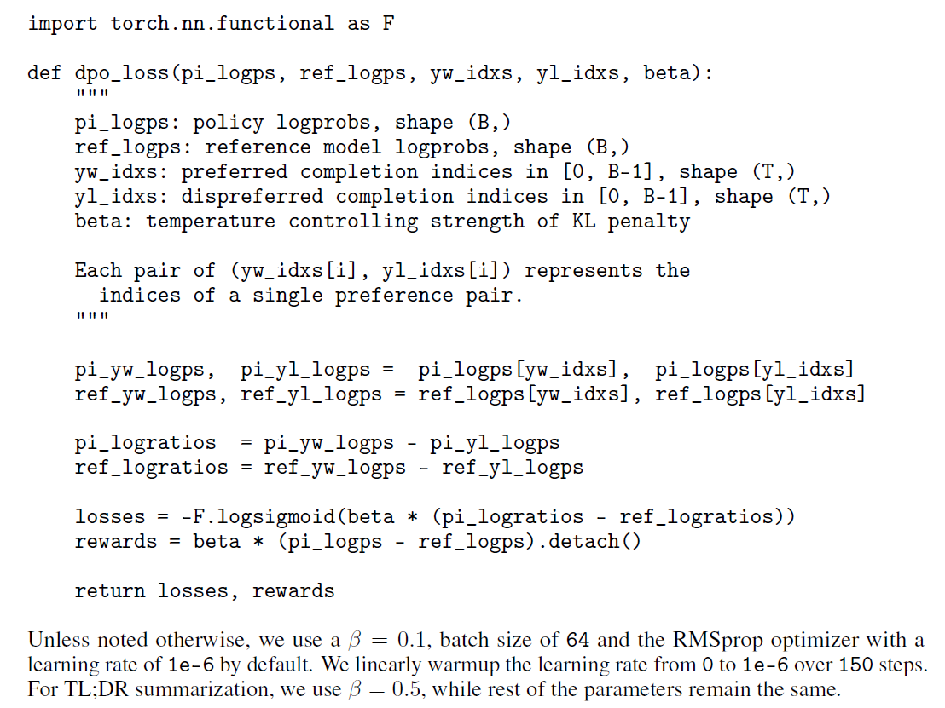
How to Implement
Project 1: LLM Alignment Using Generated Feedback
Construct the offline dataset of preferences pairs
Optimize the language model π_theta to minimize for the given π_ref and D and desired β.
Notes:
Thanks for Tianxin’s explanation for the DPO equation. So next, I gonna explain how does the loss function of DPO works. First of all, fine-tuning method in DPO can be specifically divided into two pipelines

Slide 6
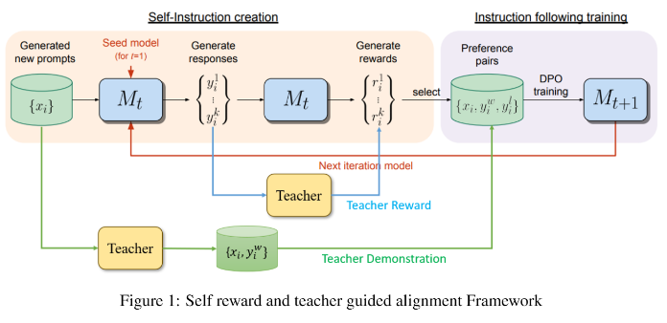
Project 1: LLM Alignment Using Generated Feedback
Baseline: phi-2b (with no FT)
Pipeline:
SFT
Self reward
Teacher reward
Teacher demonstration

Slide 7
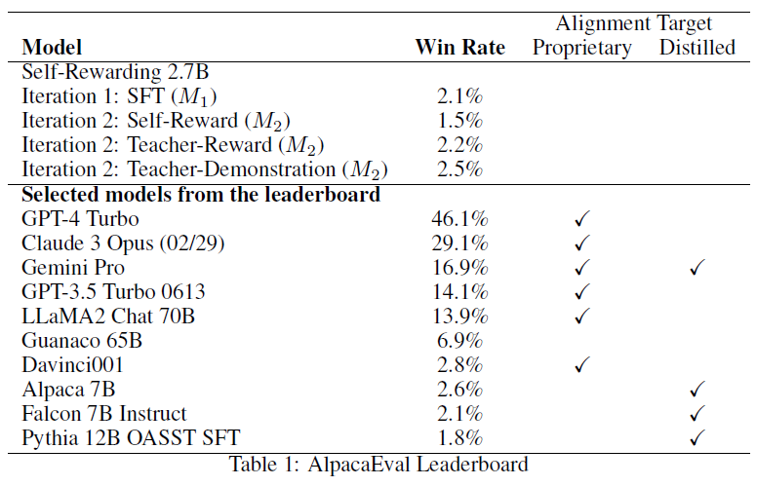
Project 1: LLM Alignment Using Generated Feedback
Benchmark: AlpacaEval 2.0

Slide 8
Project 1: LLM Alignment Using Generated Feedback
Unsolved Problem:
Feedback diversity: in addition to simple reward or punishment signals, the dimensions of feedback can be enriched, such as adding refined labels or graded evaluations, so that the model not only understands right and wrong, but also gradually grasps different contexts and complexities.
Feedback Quality: ensure the consistency and high quality of feedback. If human feedback carries subjective bias, it may affect the learning process of the model. More refined feedback criteria can be introduced, or even expert labeling or multiple validation can be utilized to reduce errors.

Slide 9
Project 2: Visual Instruction Tuning Enhanced Recipe Generation
Advisor: Prof. Honglak Lee, University of Michigan
Objective:
Fine-tuned the LLaVA (Large Language and Vision Assistant) model to interpret visual inputs and generate precise cooking instructions.
Approach:
Incorporated structured training datasets with visual elements to ensure accurate step-by-step recipe guidance.
Achievements:
Demonstrated significant improvement in accuracy of generated visual instructions, validating model’s capacity for real-world usability.
Set a benchmark for cross-modal applications in domains requiring high interpretability and trustworthiness.
Relevance to Trustworthy AI:
This project showcases how AI can be designed to deliver user-friendly, dependable responses in complex visual-data contexts.

Slide 10
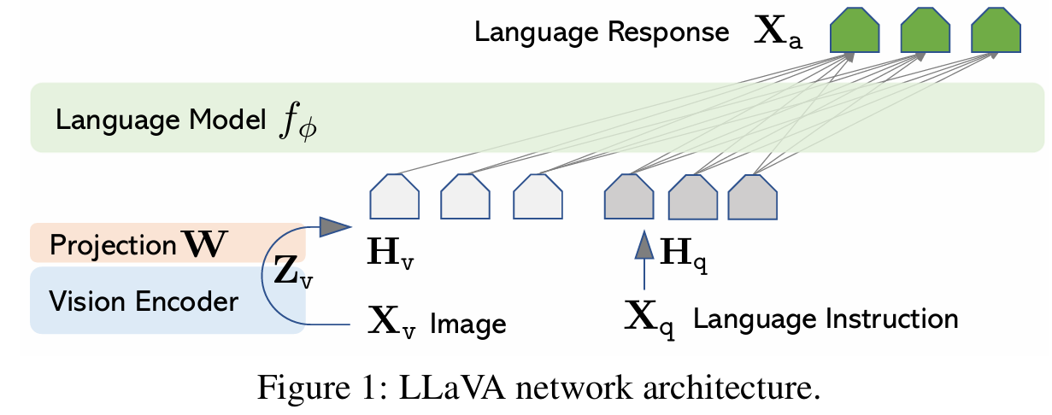
Project 2: Visual Instruction Tuning Enhanced Recipe Generation

Slide 11
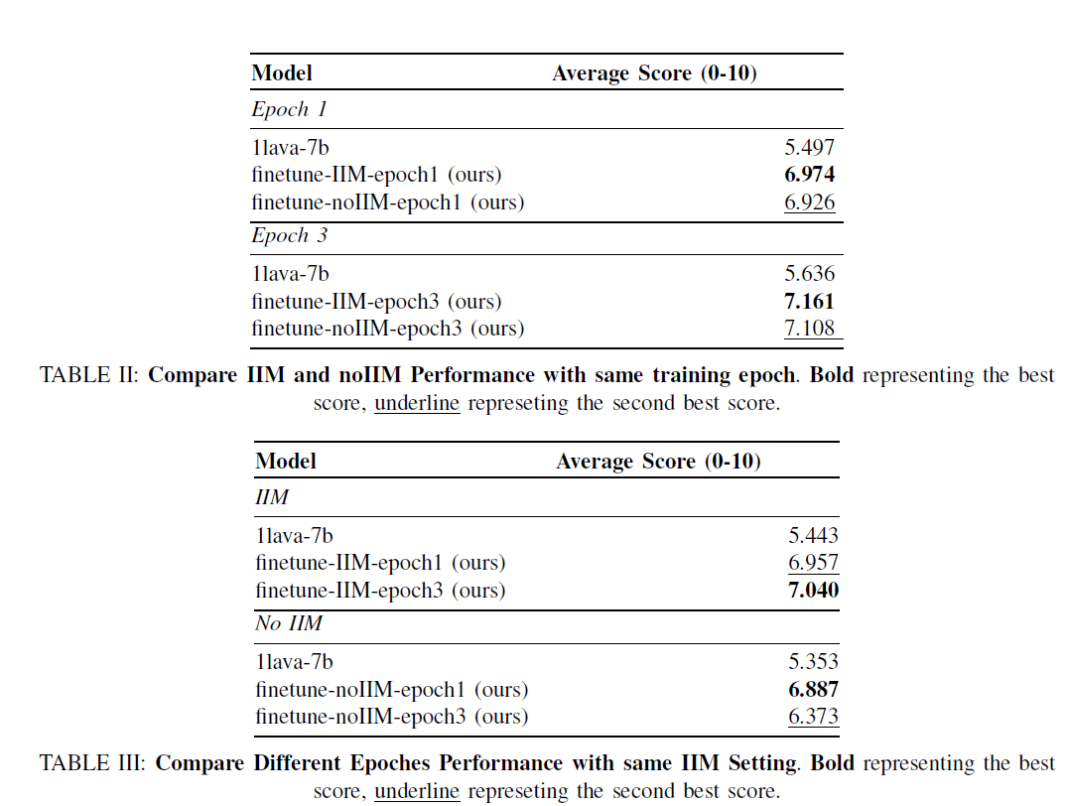
Mode Collapse
Project 2: Visual Instruction Tuning Enhanced Recipe Generation
Ingredients and Instructions Mentioned
In this project, it is used to enhance the model’s performance in generating multi-turn dialogues.

Slide 12
Research Goals
Interested in advancing the field of trustworthy AI, particularly through alignment of LLMs with ethical standards.
Committed to exploring AI applications that enhance real-world usability, transparency, and reliability.
Looking forward to collaborating in interdisciplinary research groups to push boundaries in machine learning and AI.

