Slide 1
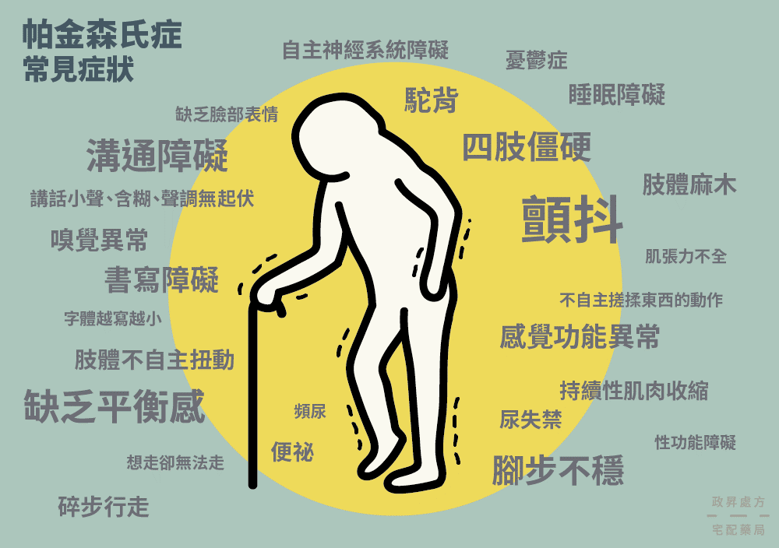
Parkinson's disease
A BRIEF
INTRODUCTION OF
Parkinson's disease

Slide 2
01
INTRODUCTION
02
Prevention
CONTENT
03
TREATMENT

Slide 3
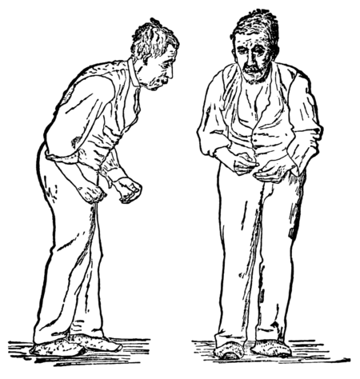


Part 01
INTRODUCTION

Slide 4
INTRODUCTION
About 2 percent's of PD patient dead in 2015
What it is
2%
Parkinson‘s disease is a long-term degenerative disorder of patient’s brain.
About 1.7 percent of elderly had got this disease.
1.7%

Slide 5
INTRODUCTION
About 2 percent's of PD patient dead in 2015
Causes
2%
Environment: MPTP enter the brain → turn into MPP+ → mutation or death of substantia nigra dopaminergic neurons → PD
Other: genetic, age, head damage, etc.
Cigarettes and coffee may prevent PD but don’t smoke :/
About 1.7 percent of elderly had got this disease.
1.7%

Slide 6
INTRODUCTION
Up to 78% percent of people with PD have Parkinson's disease dementia.
Symptoms
78%
In the early stage of this disease, there are several symptoms like shaking, difficulties in walking.
However it can also cause depression, dementia, hallucinations or even death.

Slide 7
INTRODUCTION
Symptoms
Females are less likely to be affected by PD.
67%
The average life expectancy of PD is 7 to 15 years.
In addition, Males are more often affected by this disease.

Slide 8

Part 02
Prevention

Slide 9
Prevention
Exercise in middle age may reduce the risk of Parkinson's disease.
Caffeine also appears protective with a greater decrease in risk occurring.
According to figures, smoking may help people to prevent Parkinson's Disease.
Notes:
Exercise in middle age may reduce the risk of Parkinson's disease later in life. Caffeine also appears protective with a greater decrease in risk occurring with a larger intake of caffeinated beverages such as coffee. According to figures, smoking may help people to prevent Parkinson's Disease. It is not known what underlies this effect. More People have used tobacco, the less likely they are to develop PD.

Slide 10
Prevention
Antioxidants, such as vitamins C and E, have been proposed to protect against the disease.
There have been preliminary indications that the use of anti-inflammatory drugs and calcium channel blockers may be protective.
A 2010 meta-analysis found that nonsteroidal anti-inflammatory drugs (apart from aspirin), have been associated with at least a 15 percent (higher in long-term and regular users) reduction of incidence of the development of Parkinson's disease.
Notes:
Antioxidants, such as vitamins C and E, have been proposed to protect against the disease. There have been preliminary indications that the use of anti-inflammatory drugs and calcium channel blockers may be protective. A 2010 meta-analysis found that nonsteroidal anti-inflammatory drugs (apart from aspirin), have been associated with at least a 15 percent (higher in long-term and regular users) reduction of incidence of the development of Parkinson's disease.

Slide 11
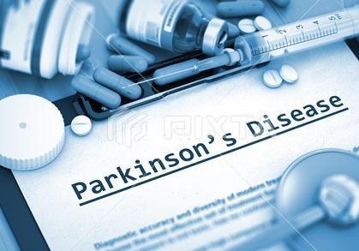

Part 03
TREATMENT

Slide 12
TREATMENT
Parkinson's medications
Deep Brain Stimulate
Treatment for Parkinson's disease is one of the most difficult and acute fields in medicine.
But there have been many remarkable changes in it
Surgery from Parkinsons
Gamma Knife Treatment

Slide 13
TREATMENT
Parkinson's medications
More and more neuroscientists focus their interest in the study of Parkinson s disease, and different animal PD models have been established, such as mouse, monkey and rat models. With these models Scientists have developed new drugs, and they have a better understanding of this diseases. Most people can get relief from their Parkinson’s symptoms with medicines.

Slide 14
TREATMENT
Surgery from Parkinsons
Generally, surgery is only considered as a treatment for Parkinson's disease when medication cannot control symptoms.

Slide 15
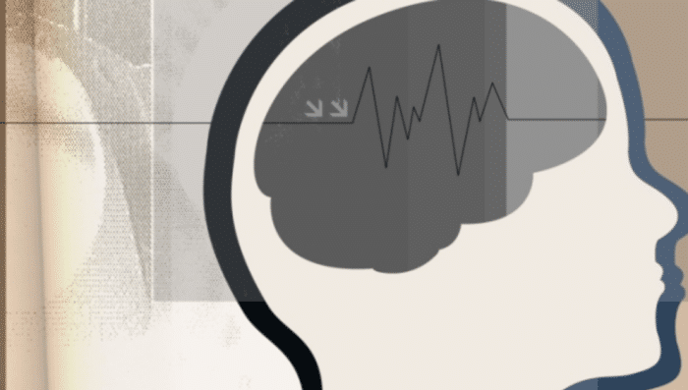
TREATMENT
Deep Brain Stimulate
Deep brain stimulation is a way to inactivate parts of the brain that cause the symptoms of Parkinson's disease. Deep brain stimulation has shown promise in treatments of Parkinson’s disease, it may help all the cardinal features of the disease.

Slide 16
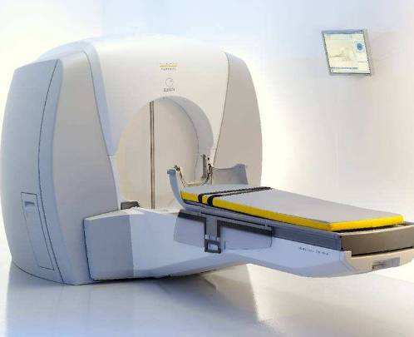
TREATMENT
Gamma Knife Treatment
Not actually a "knife" at all, the gamma knife is a machine that emits hundreds of powerful, highly focused gamma radiation beams. It allows for a more precise and concentrated treatment than with other radiation treatments.

Slide 17
2019
THANK YOU

