Slide 1
RECIPE5ND Design Specification
TEAM MEMBERS: OGHENEOVO (Nova) Abu
Manuel Berlanga
Ethan Hann
Thu Le
Mark Odom

Slide 2
INTRODUCTION
To describes the architecture and design for the Recipe5nd application being developed
A smartphone application that will provide its users a simple and quick way to look up recipe using ingredients they already own
Complex and no one diagram or model can easily express a system’s architecture and design
Logical View – major components, their attributes, and their operations
UI Design View – individual UI components of the system will look like
Database Design View – how the data of the system will be saved

Slide 3
DESIGN GOALS
The design should minimize complexity and development effort
The design should be easily traceable to functional requirements outlined in the SRS
The design should be easy to follow and clearly show the flow of data through the application

Slide 4
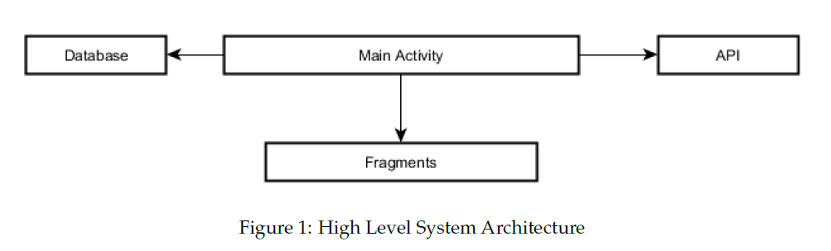
LOGICAL VIEW – HIGH-LEVEL DESIGN
Main Activity – entry point into the application, handles switching between various modules on user interaction
Fragments – individual modules of the application
Database – responsible for processing and handling saved data of the application
API – central repository from which recipes will be retrieved

Slide 5

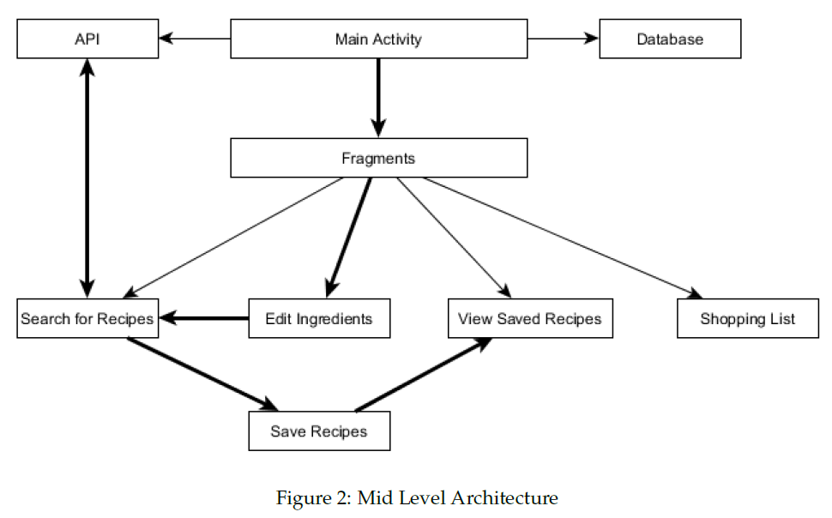
LOGICAL VIEW – MID-LEVEL DESIGN
Searching for Ingredients – handles the connection and searching of the API and returns recipe results
Editing User Ingredients – handles the editing of user’s ingredients and provides that list of ingredients to the search module
Saving Recipes – handles the favoring of recipes after user has searched and been presented with recipes
Viewing Saved Recipes – responsible for displaying to the user the recipes that were saved
Shopping List – handles keeping a shopping list

Slide 6
DETAILED CLASS DESIGN – SEARCH FOR RECIPES
SearchFragment - UI of the search fragment
SearchResultsFragment - UI of the search results, initiated when searching is completed
SearchDetailsFragment - UI of the recipe details, initiated when user selects a recipe from search results
FetchIds - AsyncTask that runs in the background to connect to API and retrieve recipe IDS based on ingredients
FetchRecipe - AsyncTask that runs in the background and retrieve recipes from API based on IDs
SearchRecyclerAdapter - data retrieval from AsyncTasks
SearchView - filter the user’s ingredients based on a filter search

Slide 7
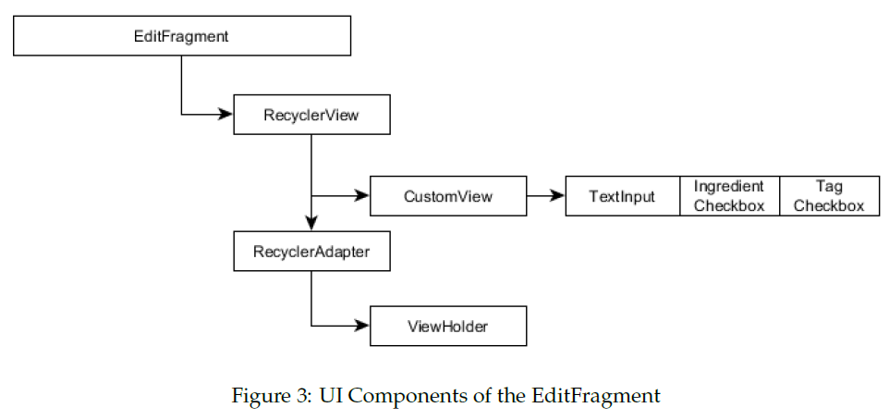
DETAILED CLASS DESIGN – EDIT INGREDIENTS
EditFragment – UI of the edit ingredients screen

Slide 8
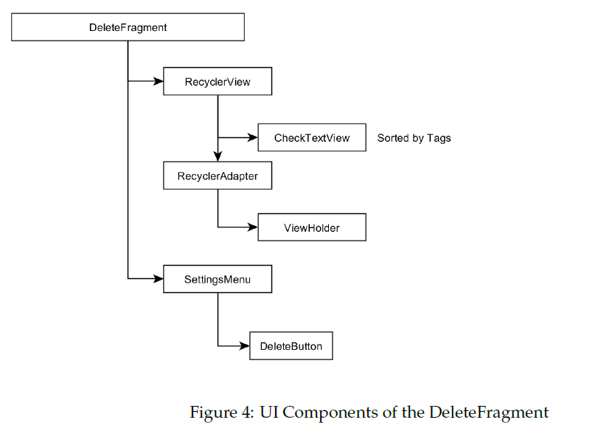
DETAILED CLASS DESIGN – EDIT INGREDIENTS
DeleteFragment – UI of delete screen, initiated when user indicates they want to delete items

Slide 9
DETAILED CLASS DESIGN – SAVED RECIPES
SavedRecipesFragment – has the same layout as the SearchResultsFragment
ViewDetailsFragment – the UI of viewing saved recipe details

Slide 10
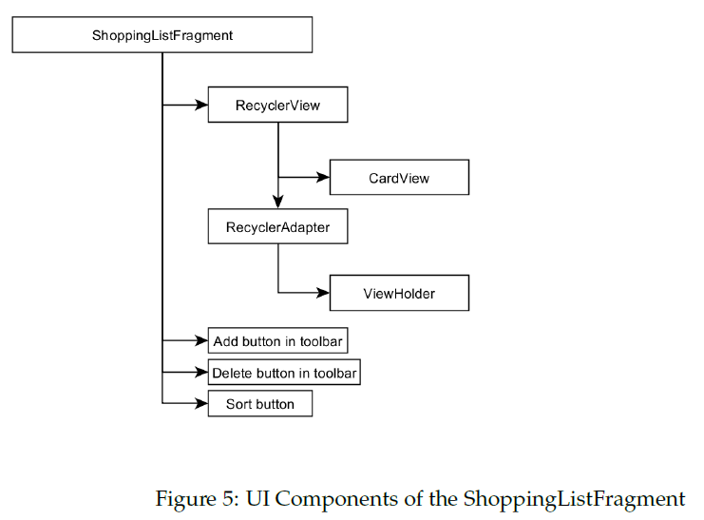
DETAILED CLASS DESIGN – SHOPPING LIST
ShoppingListFragment – the UI of shopping list

Slide 11
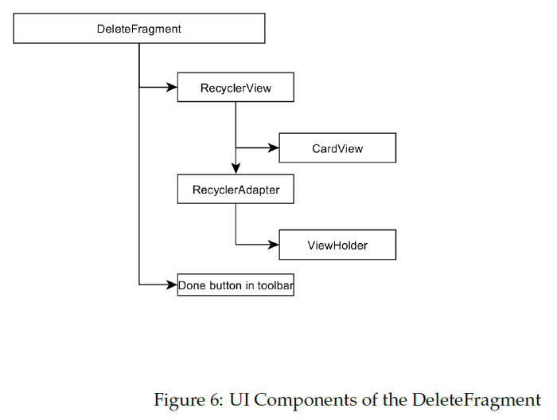
DETAILED CLASS DESIGN – SHOPPING LIST
DeleteFragment – the UI of the delete screen, initiated when user indicates they want to delete a shopping list

Slide 12
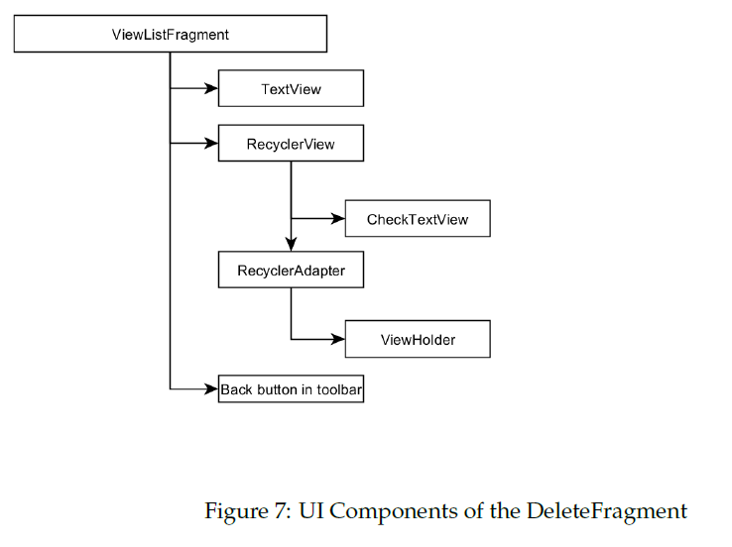
DETAILED CLASS DESIGN – SHOPPING LIST
ViewListFragment – UI of viewing a shopping list’s items

Slide 13
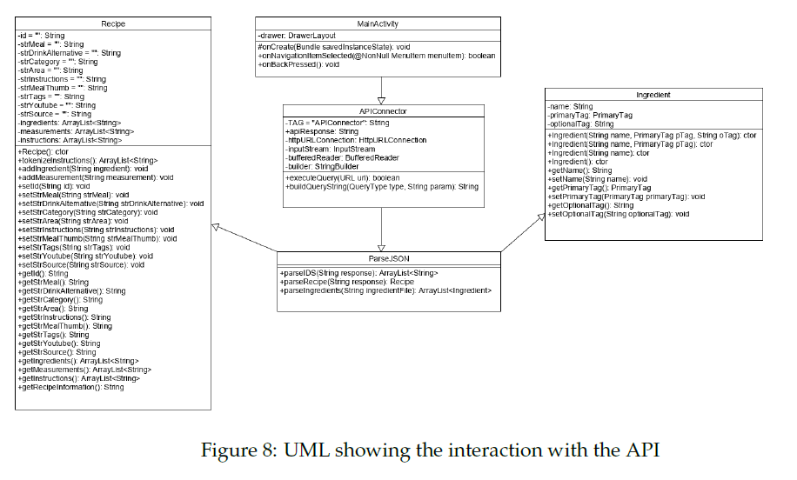
UML DIAGRAM

Slide 14
UI DESIGN VIEW
Color scheme: primary color of dark blue and secondary color of light orange
Styling of the application: Google’s Material Design
Entry point will be the Main Activity with the Edit Ingredients Fragment

Slide 15
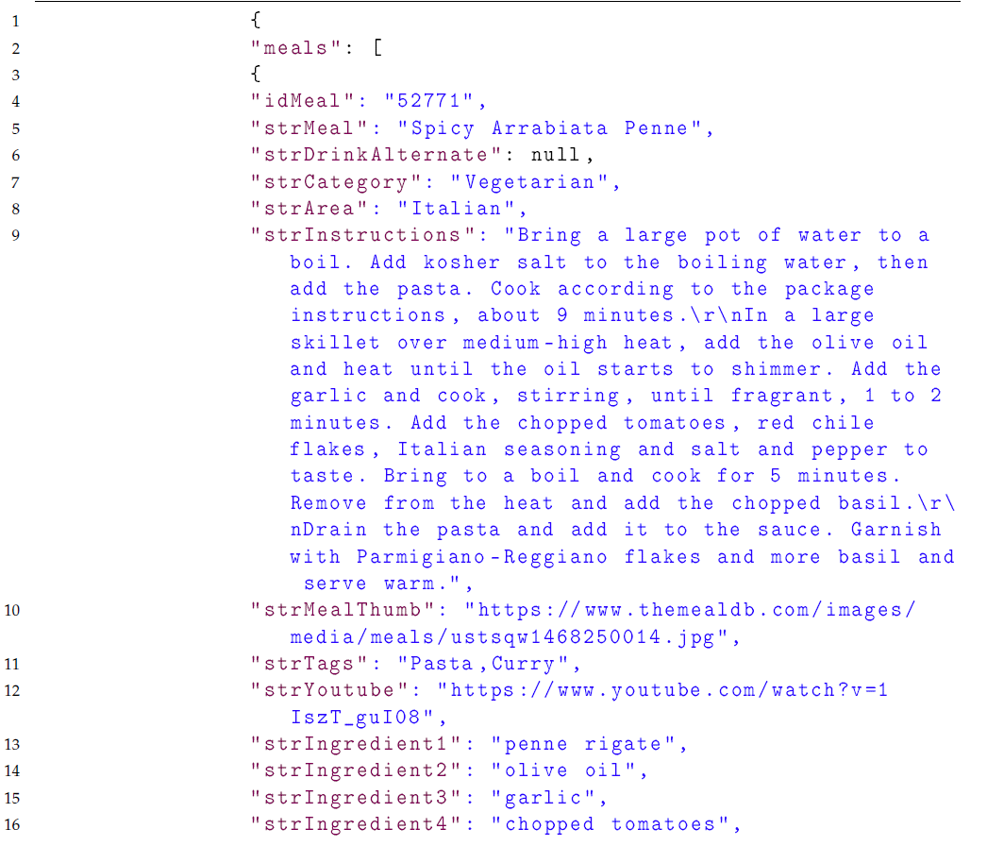
DATABASE VIEW
Data will be handled using JSON files
The API returns a JSON file when querying it for recipes
Data will be saved locally on user’s device inside the application’s folder
When searching for recipes by ID, the file format returned as follows:

Slide 16
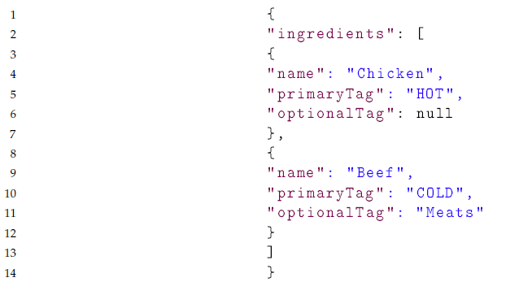
DATABASE VIEW
Saving user’s ingredients:

Slide 17
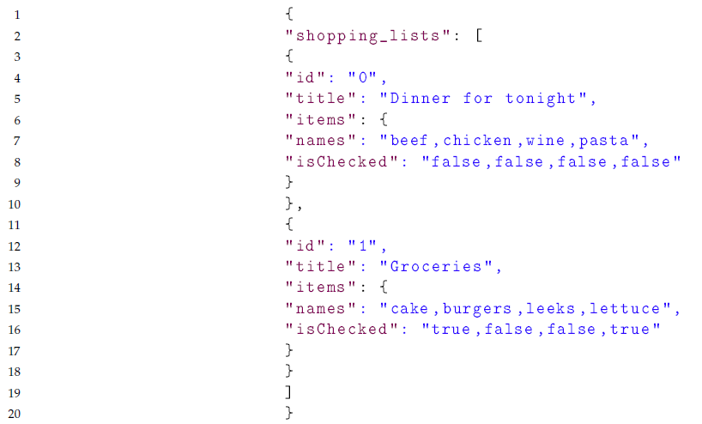
DATABASE VIEW
Saving user’s shopping lists:

