Slide 1
Multi-Tasking
14

Slide 2
Topics for Today:
Introduction on threading

Slide 3
Introduction
We NEED the ability to run two operations simultaneously in the computer.
For example – The clock ticking in the computer and you moving the mouse.
Or watching a video while Chrome downloading a file.
A thread is a separated flow of execution – So you’re program can preform two things at once
Each thread (חוט) is an operation being run in parallel.
The threads doesn’t have to be REALLY parallel, just to seem so.

Slide 4
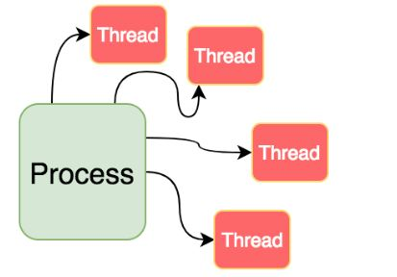
Threads and Processes
In the old days, each program ran one Process, and each process run number of threads.
Today, for number of reasons, a program can run multiple processes.
In python, threads doesn’t really run in parallel, but processes do.

Slide 5
Threads and Processes
So, we use threading for things we want to run in semi-parallel, and processes for efficiency.
Tasks that spends a lot of time waiting for actions to happen are normally good candidates (Like what?)
Execution paths needed to be run in parallel are as well.

Slide 6
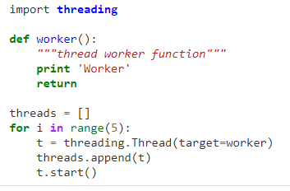
Example 1

Slide 7
Exercise 1
Create a module that runs 10 threads, each printing all the numbers from 1 to 100. Please preform time.sleep(0.01) (sleeping for 0.01 seconds) after each print in each thread.

Slide 8
Daemon Threads
If you set daemon to True, the thread won’t stop the program from ending.

Slide 9
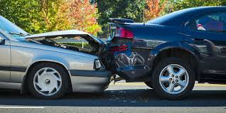
Race Conditions
What happens when 2 threads are trying to use/change the same source?
Unexpected problematic behavior, that’s what!
This situation is called Race Condition (for the threads are racing for one shared resource).
There are a different approaches and techniques for this issue, being super problematic (AND SO ANNOYING TO DEBUG!)
We are going to use the Locking and Queue pythonic object, which is Thread-safe (meaning, you can use it from different threads safely).

Slide 10
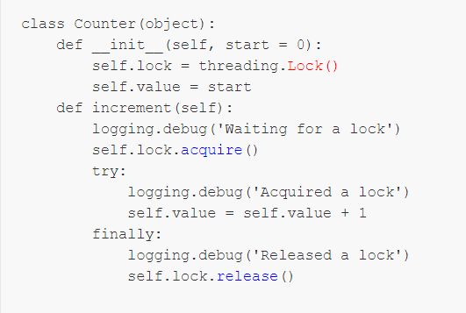
Locking
The main option for dealing with race conditions.

Slide 11
Locking - Exercise
Please create a program for counting straws. The program should contain object which contains a function for adding straw removing straw and printing current straw amount.
The program should be THREAD-SAFE!

Slide 12
Queue Object
Just like a normal queue, but thread-safe.
**Pycharm Example**

Slide 13
Queue Exercise
We can insert and pop into and from this class the same as we would with one thread!
Create a program of two threads – one creating a random number and inserting to the queue until there are 100 items in the queue (and then waits until there is one popped and create another). Another thread is reading from the queue each 5 seconds all the numbers, printing it and writing it to a file.

Slide 14
Contrast Exercise
Use your Queue object
Create a program that does two things:
Reads image files from certain directory
Inserts them into the queue from the last exercise
Performs canny edge detector on them
Saves them in a new directory

Slide 15
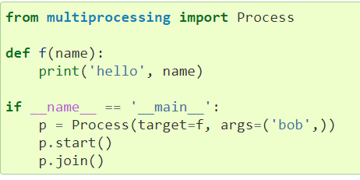
Creating New Processes
Using the multiprocessing module:

