Slide 1
SAASE Orientation Survey
Exploratory Data Application
Ethan Lott
Spring 2025
Notes:
Good afternoon, everyone, and welcome to my presentation on the proof-of-concept Exploratory Data Application that I developed for the Orientation Survey results.

Slide 2
Overview
Data INTRODUCTION AND CLEANING
Application Development
Key Insights
Moving Forward
Notes:
Just for a quick outline of the presentation:
I’ll start by describing the dataset I was given access to, and the cleaning process I employed.
Then I’ll move into the actual development of the application – justification for technical architecture, key features, etc.
I’ll follow that with some examples of key insights that a user might glean from using it.
Finally, I’ll mention a few ways in which I would improve the application if I had more time to work on it, especially if it were to be scaled to work with much larger datasets.

Slide 3
Data Introduction
Survey results (n = 1,047):
9 statements with responses ranging from “Strongly agree” to “Strongly disagree” – Note: each statement is “positive”
8 statements about “Grit” with responses ranging from “Very much like me” to “Not at all like me” – Note: some “positive”, some “negative”
Student demographics (n = 3,918):
Transfer vs. freshman, First generation, On vs. off campus, Living community, College
Notes:
I’m sure you’re all familiar with the data tables I was provided, but just as a quick refresher:
The first data table contained the simulated survey results, including 9 questions on various aspects of Binghampton student life like sociality and academic preparedness.
Each of these questions were answered of a scale from “Strongly agree” to “Strongly disagree.” It’s important to note that the content of each of these statements is positive, meaning that there is a justified implicit assumption that the more a student agrees with the statement, the better.
In addition, there were 8 statements separately classified as regarding “Grit.” In contrast to the previous questions, it’s important to note that not all these statements could be deemed “positive.” For instance, one read “I am diligent” but another was along the lines of “I have difficulty maintaining my focus.”
The second table contained demographic information for all students, not just those that completed the survey.

Slide 4
Data Cleaning
Joined tables on XID.
Improved readability.
Accounted for ordinality.
Notes:
My first step was of course to check for any missing values or other abnormalities like typos, impossible values, etc., but I suppose as this data was simulated, I was fortunate enough to not have to deal with any of that. Even so, there were a few aspects I wanted to refine before continuing with my analysis.
-Since I wanted to focus on those students that did submit the survey, I joined the two tables on the ID column such that each observation in the results table included that respective student’s demographic information.
-Survey responses ranged from “Strongly disagree” to “Strongly agree”, or for the Grit questions, “Not at all like me” to “Very much like me.” To complete quantitative analysis, these columns were converted to ordinal data ranging from 1 to 5, with 5 being the most positive.
-Additionally, I opted to refactor certain data to improve its readability, such as replacing “Y” and “N” with “Yes” and “No” and representing each question’s contents in a keyword or two rather than the whole statement.

Slide 5

Application Development
Technical Architecture
R Shiny Application:
Easily deployable.
Seamless integration with CSS and JavaScript.
Tab-based, point-and-click UI.
Visualization packages:
ggplot2, patchwork
Notes:
Now on to the actual development. I chose to work within the R Shiny framework for a couple of reasons.
One, I find the base structure of Shiny apps and R plots to be much more intuitive than that of say matplotlib or seaborn in Python.
Additionally, this framework in conjunction with the R Studio IDE lends itself to easy deployment both locally and on the web.
Also, these apps are specifically structured to implement CSS and JavaScript code for more control over User Experience.
Speaking of user experience, the user interface in organized in a tab-based, point-and-click fashion. I find this to be a great option when designing applications for the lowest common denominator, where I don’t know how familiar the user is with the data in question. This would be in contrast to requiring the user query specific variables or scroll through a data table.

Slide 6

Application Development
Key Features
Filtering by demographic.
Topic-centric exploration:
Sociality, Wellness, Success, and Grit.
Provides a more easily digestible narrative.
ANOVA statistical testing:
Looks for significance in variation between demographic groups.
Notes:
So, what can the app be used for? I mentioned that it’s a tab-based interface, and the two tabs offer “Free Exploration” and “Demographic Analysis.” The “Free Exploration” tab allows users to view the distribution of responses to each individual statement, filtered to their liking by demographic properties.
The “Demographic Analysis,” on the other hand, groups the statements by common theme. My thought was that this would make it easier to reach categorical conclusions about differing responses among demographic groups. In addition to the graphical representation of any difference, I performed a simple Analysis of Variance test to check the significance of said difference.

Slide 7
Application Development
Performance Optimization
Input
Output
Question
Plot
Filters
Notes:
One quick note about optimization:
The default reactive paradigm in Shiny is to update a given output when any of its input variables is updated. This would mean that as the users flip through demographic categories, updating filters or changing the question of interest, the app would need to generate and display a new plot any time there’s a change. This isn’t a huge problem when dealing with small datasets like this one, but as a point of good practice …

Slide 8
Application Development
Performance Optimization
Input
Output
Question
Button
Plot
Filters
Notes:
I added a button to each tab to act as a buffer between selecting variables and updating the plot. This can hugely improve the performance of the app as it saves both memory and computational power.

Slide 9
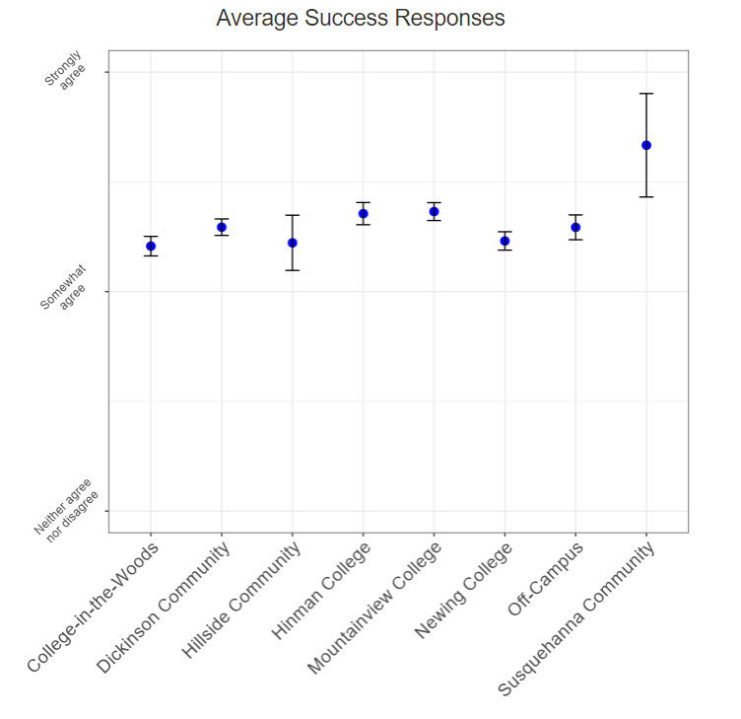
Key Insights
Every question had overwhelmingly positive responses.
One large jump came from Susquehanna Community.
Upon further inspection, n was too small to make a reliable conclusion (p=0.111).

Slide 10
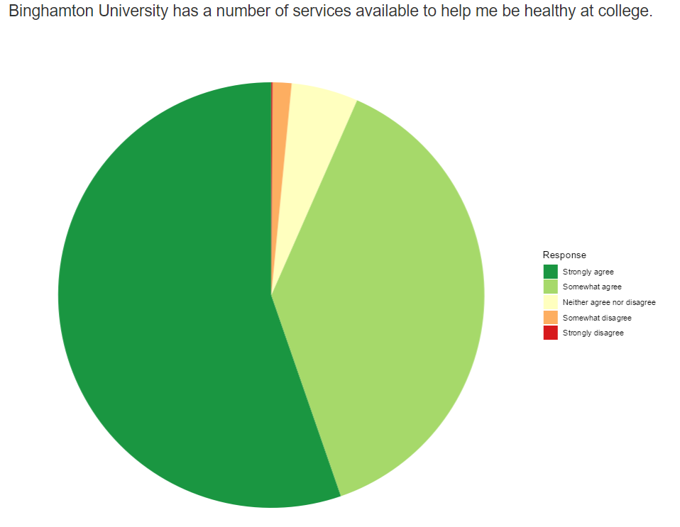
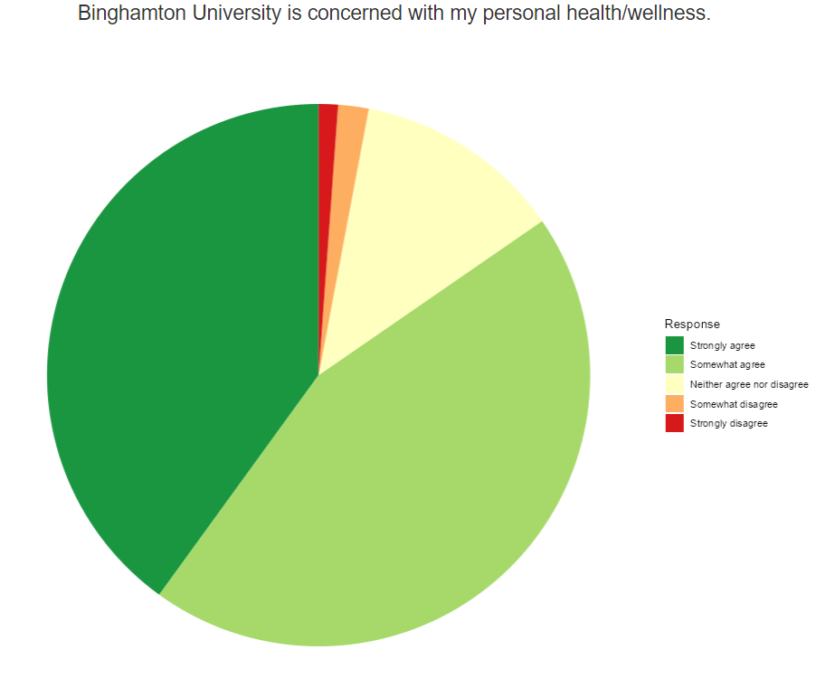
Key Insights, cont.

Slide 11
Moving Forward
Scalability:
Efficiency of code.
Random sampling.
Enhancement:
Aesthetic/ease of use improvements.
Consideration of response bias/representation.
Homogeneity in sentiment.
Focus on negative responses.
Notes:
Looking to the future, a few things jump out at me as necessary and important improvements.
For one, the hard deadline on this project forced me to take certain shortcuts in code elegance, meaning that it’s likely not as efficient as I would like. Given more time, I would focus some energy on refactoring the actual codebase.
Additionally, if this application were to be scaled for use on larger datasets, I would consider implementing relative random sampling rather that attempting to analyze the entire dataset. This app is designed to be a top-level exploration tool, not a full statistical analysis, so I would want to prioritize ease of access and quick performance over total precision.
And like I mentioned, Shiny apps lend themselves extremely well to integration with CSS and JavaScript. I did use a bit of CSS for this proof of concept, but there are certainly more implementations I would want to experiment with.
Take into account the amount of students from each community, say, that responded, relative to other communities.
Grit: all positive.
Explore the negative responses to see what we can do better.

Slide 12
Thank you for your consideration!

