Slide 1
SAASE Orientation Survey
Exploratory Data Application
Ethan Lott
Spring 2025

Slide 2
Overview
Data Refinement
Application Development
Demonstration
Key Insights
Moving Forward

Slide 3
Data Refinement
Accounted for ordinality.
Joined on XID.
Improved readability.

Slide 4
Application Development
Technical Architecture
R Shiny Application:
Easily deployable.
Seamless integration with CSS and JavaScript.
Tab-based, point-and-click UI.
Visualization packages:
ggplot2, patchwork

Slide 5
Application Development
Key Features
Topic-centric exploration:
Sociality, Wellness, Success, and Grit.
Provides a more easily digestible narrative.
Filtering by demographic.
Statistical testing:
Looks for significance in variation between groups.

Slide 6
Application Development
Performance Optimization
Dependence map.

Slide 7
Application Demonstration

Slide 8
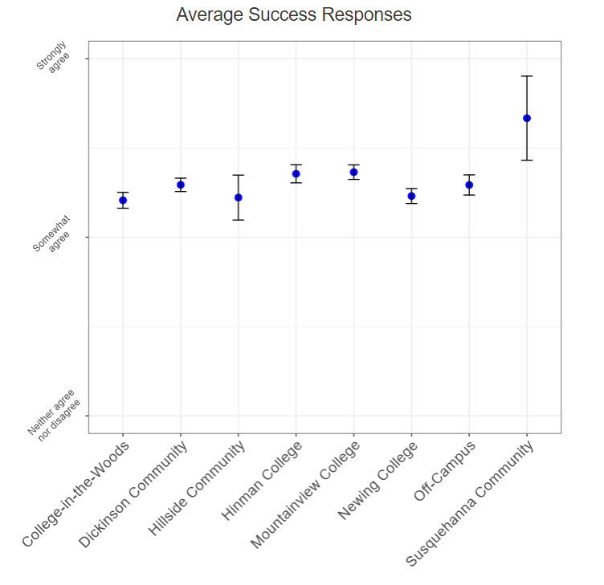
Key Insights
Every question had overwhelmingly positive responses.
The only large jump came from Susquehanna College.
Upon further inspection, n was too small to make a reliable conclusion.

Slide 9
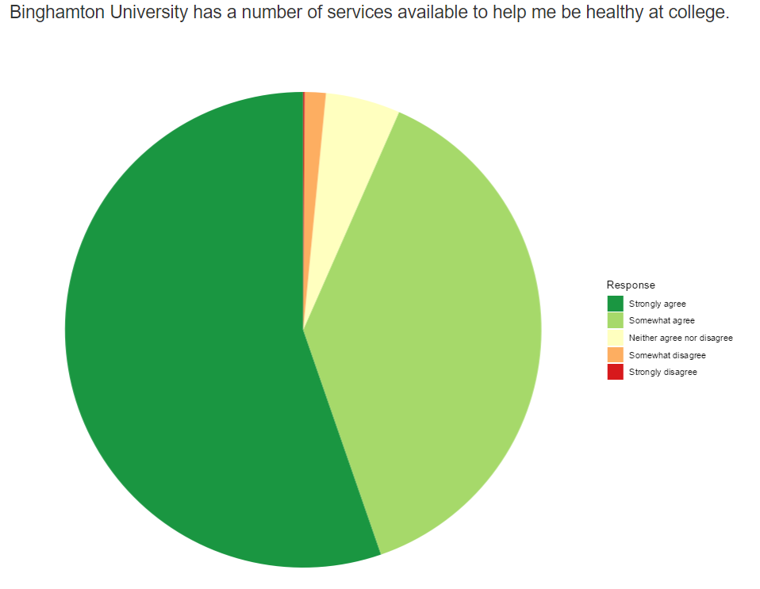
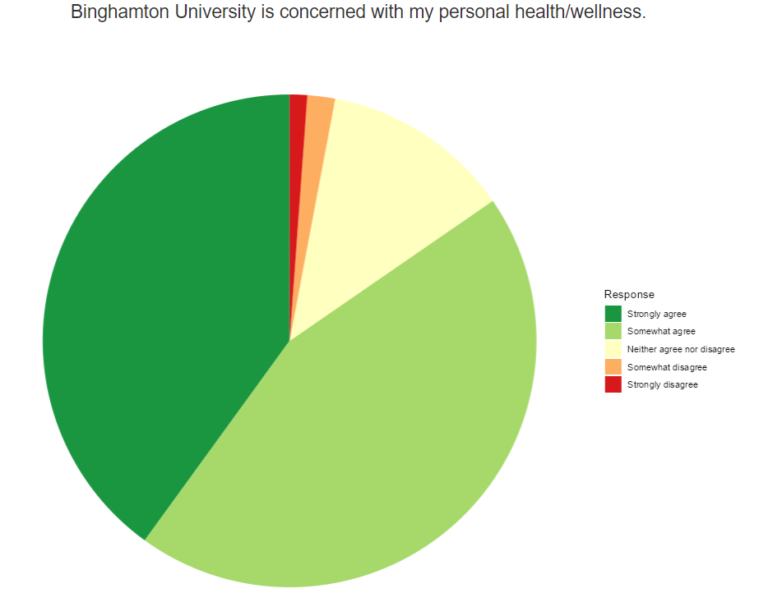
Key Insights, cont.

Slide 10
Moving Forward
Scalability:
Differential privacy.
Random sampling.
Enhancement:
Aesthetic/usability improvements.
Machine Learning implementation.

Slide 11
Thank you for your consideration!

