Slide 1
SAASE Orientation Survey
Exploratory Data Application
Ethan Lott
Spring 2025
Notes:
Good afternoon, everyone, and welcome to my presentation on the proof-of-concept Exploratory Data Application that I developed for the simulated Orientation Survey results.

Slide 2
Overview
Data INTRODUCTION AND CLEANING
Application Development
Demonstration
Key Insights
Moving Forward
Notes:
Just for a quick outline of the presentation:
I’ll start by describing the dataset I was given access to, and the cleaning process I employed.
Then I’ll move into the actual development of the application – justification for technical architecture, key features, etc.
I’ll follow that with a brief demonstration of the app and share some examples of key insights that a user may glean from using it.
Finally, I’ll mention a few ways in which I would improve the application if I had more time to work on it, especially if it were to be scaled to work with much larger datasets.

Slide 3
Data Introduction
Survey results (n = 1,047):
9 statements with responses ranging from “Strongly agree” to “Strongly disagree” – Note: each statement is “positive”
8 statements about “Grit” with responses ranging from “Very much like me” to “Not at all like me” – Note: some “positive”, some “negative”
Student demographics (n = 3,918):
Transfer vs. freshman, First generation, On vs. off campus, Living community, College
Notes:
I’m sure you’re all familiar with the data tables I was provided, but just as a quick refresher:
The first data table contained the simulated survey results, including 9 questions on various aspects of Binghampton student life like sociality and academic preparedness.
Each of these questions were answered of a scale from “Strongly agree” to “Strongly disagree.” It’s important to note that the content of each of these statements is positive, meaning that there is a justified implicit assumption that the more a student agrees with the statement, the better.
In addition, there were 8 statements separately classified as regarding “Grit.” In contrast to the previous questions, it’s important to note that not all these statements could be deemed “positive.” For instance, one read “I am diligent” but another was “I have difficulty maintaining my focus.”

Slide 4
Data Cleaning
Accounted for ordinality.
Joined tables on XID.
Improved readability.
Notes:
My first step was of course to check for any missing values or other abnormalities like typos, impossible values, etc., but I suppose as this data was simulated, I was fortunate enough to not have to deal with any of that. Even so, there were a few aspects I wanted to refine before continuing with my analysis.
-Survey responses ranged from “Strongly disagree” to “Strongly agree”, or for the Grit questions, “Not at all like me” to “Very much like me.” To complete quantitative analysis, these columns were converted to ordinal data ranging from 1 to 5, with 5 being the most positive.

Slide 5

Application Development
Technical Architecture
R Shiny Application:
Easily deployable.
Seamless integration with CSS and JavaScript.
Tab-based, point-and-click UI.
Visualization packages:
ggplot2, patchwork

Slide 6
Application Development
Key Features
Topic-centric exploration:
Sociality, Wellness, Success, and Grit.
Provides a more easily digestible narrative.
Filtering by demographic.
ANOVA statistical testing:
Looks for significance in variation between demographic groups.

Slide 7
Application Development
Performance Optimization
Input
Output
Question
Plot
Filters

Slide 8
Application Development
Performance Optimization
Input
Output
Question
Button
Plot
Filters

Slide 9
Application Demonstration

Slide 10
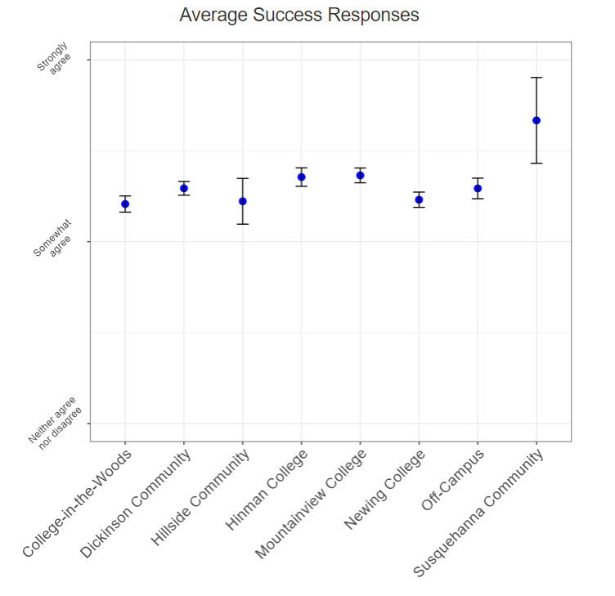
Key Insights
Every question had overwhelmingly positive responses.
One large jump came from Susquehanna Community.
Upon further inspection, n was too small to make a reliable conclusion (p=0.111).

Slide 11
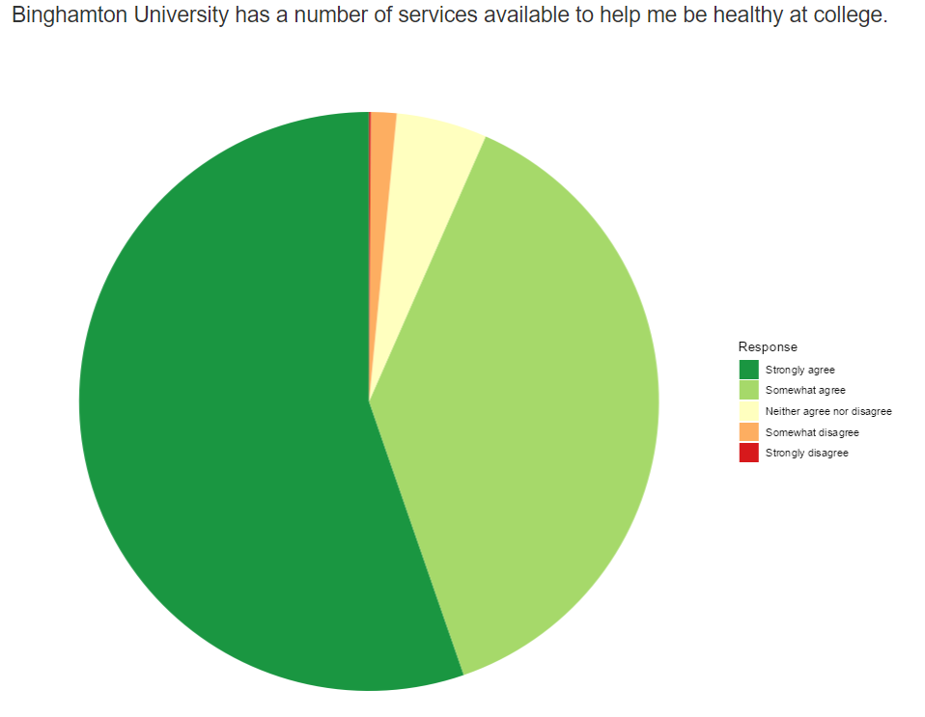
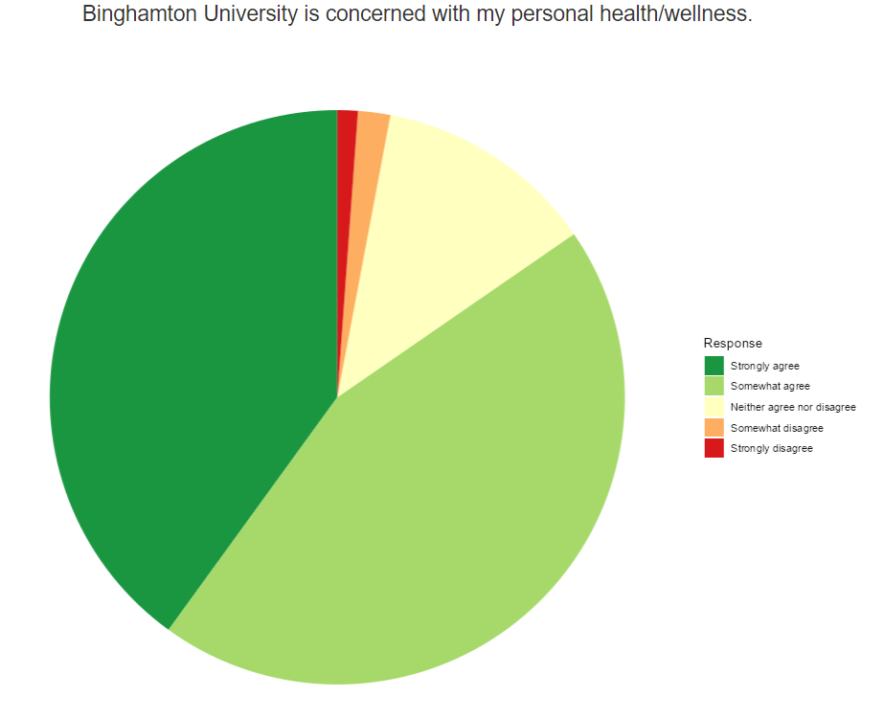
Key Insights, cont.

Slide 12
Moving Forward
Scalability:
Differential privacy.
Random sampling.
Enhancement:
Aesthetic/ease of use improvements.
Consideration of response bias/representation.
Homogeneity in sentiment.

Slide 13
Thank you for your consideration!

