Slide 1

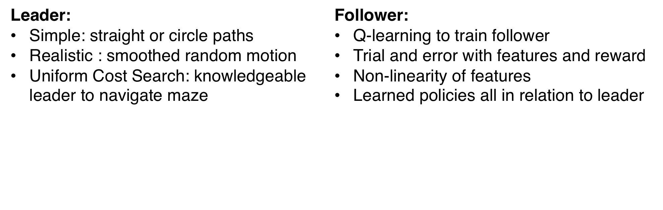
School Specific Estimates of Returns to Increased Education Spending in Massachusetts
By Isaac Kasevich, Zane Kashner, and Ethan Oro
Motivation
Methods
Results and Analysis
Flocking is a natural phenomenon seen in birds, schools of fish, and other animals
“Boids”: artificial life research program to model and learn from flocking
Single-Agent learning vs. Rule-Based
Single-Agent learning with different features
Learning Flocking Behavior: Leader & Feature Extraction
Previous work: rule-based models to dictate the motion of flocking agents
Our approach: use learning instead
Compare these approaches in scenarios
Multi-Agent flocking simulation
Problem Definition
Can learning algorithms outperform traditional rules in open space? With constraints?
Multi-Agent Behavior
Obstacle Manipulation
Leader:
Same as single-agent learning
Followers:
Adjusted features and rewards
Train a single agent and apply learned behavior
With same behavior, visually different
One “robot” with domain knowledge
Add obstacles to world in form of maze
Leader: Uniform Cost Search
Q-learning for weights (R: negative for walls, positive for following)
Compare average reward of learned actions to those of hard coded rules
Train maze and (unseen) test maze
Obstacle Manipulation: average cumulative reward over 20 iterations, 1200 actions each
Challenges
Future Work
Defining an unstructured task
  Defining a reward function
  Defining a metric
  Determining features (number of)
Creating our own environment
Training multiple Boids simultaneously
Training time
Remove the leader (unclear how realistic)
Incorporate multi-agent flocking behavior to world with obstacles
Comparison of methods with other forms of noise (random Gaussian noise)
Crowdsource feedback on evaluation metrics

