Slide 1
Updates: ML/AI modeling
Previous update
Current status
Database: 24,000 points
Only 300 control points
One model architecture (feed-forward neural network)
Model parameters tuned by hand
Good performance (0.80 AUC)
Strong bias towards recall
  High rate of true positives
  Low rate of true negatives
Post-hoc explainability
Now, 52,000 total points
And 1,500 control points
Multiple algorithms “competing” to be selected
Quantitative cross-validation
Better performance (0.88 AUC)
Balanced performance
  High rate of true positives
  High rate of true negatives
Built-in explainability

Slide 2
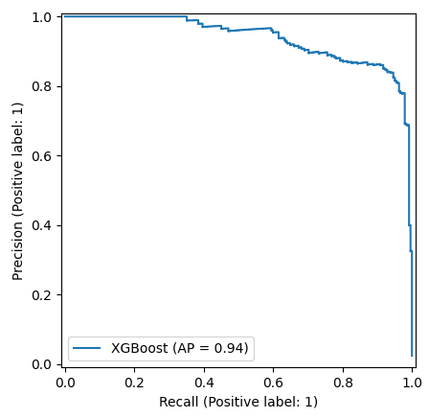
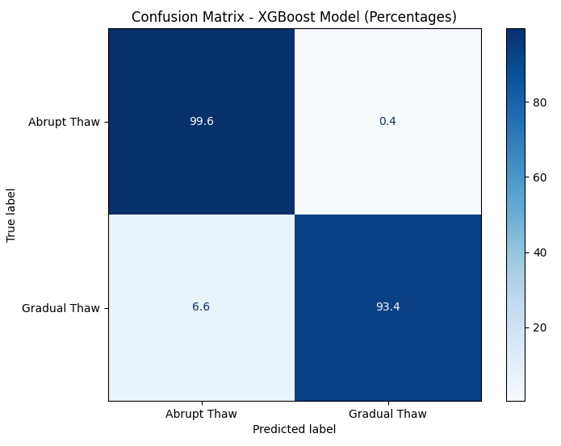
Model predictions are robust across the full dataset
Very high “area under the curve” implies strong generalizability
Minimizing rate of false positives
Minimizing rate of false negatives

Slide 3
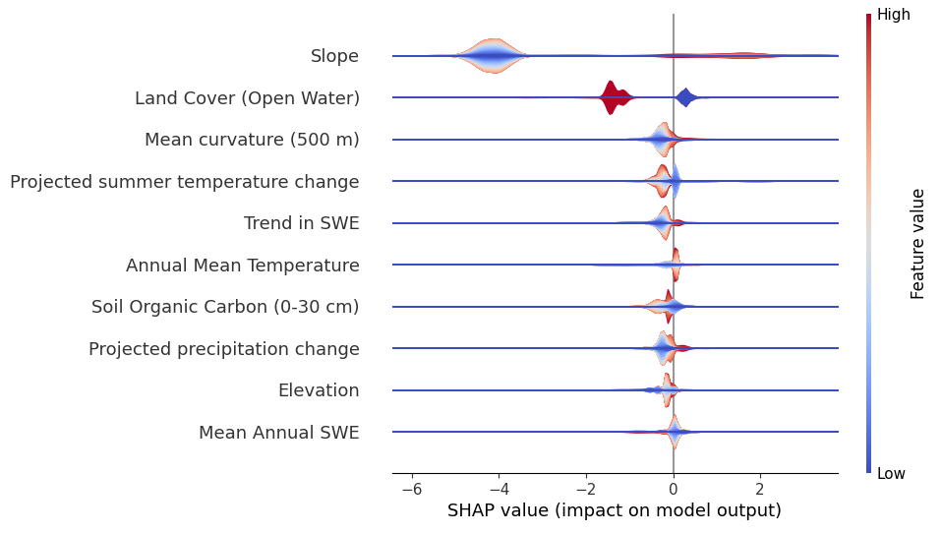
But, explainability is dominated by thermokarst lakes
Only relevant for lake features
Abrupt thaw
Gradual thaw

Slide 4
Final steps before publication
Model analysis
  Population splitting: how do our predictions change if we remove the thermokarst lakes from the dataset for a subset of models?
  Spatial cross-validation: how well do our best-performing models generalize between regions?
Interpretability
  Pointwise decision analysis: is there a common explanation for the abrupt thaw points incorrectly classified as non-abrupt thaw?
  Leveraging expert knowledge: at field sites under intensive study, does our model’s interpretation match the current state of knowledge?
Science communication
  Generalizing results: what does our model predict across the state of Alaska? Which regions are more/less susceptible to abrupt thaw?
  Draft manuscript: in progress, expected submission by end of August

