Slide 1
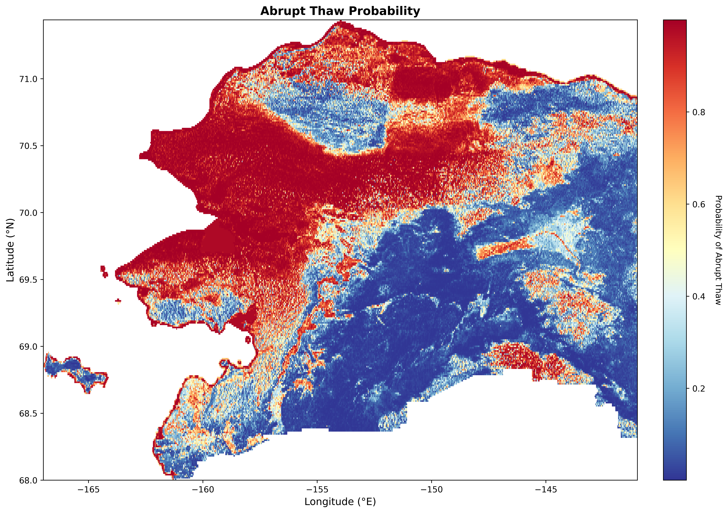
~40% of interior and Arctic Alaska is susceptible to abrupt thaw

