Slide 1
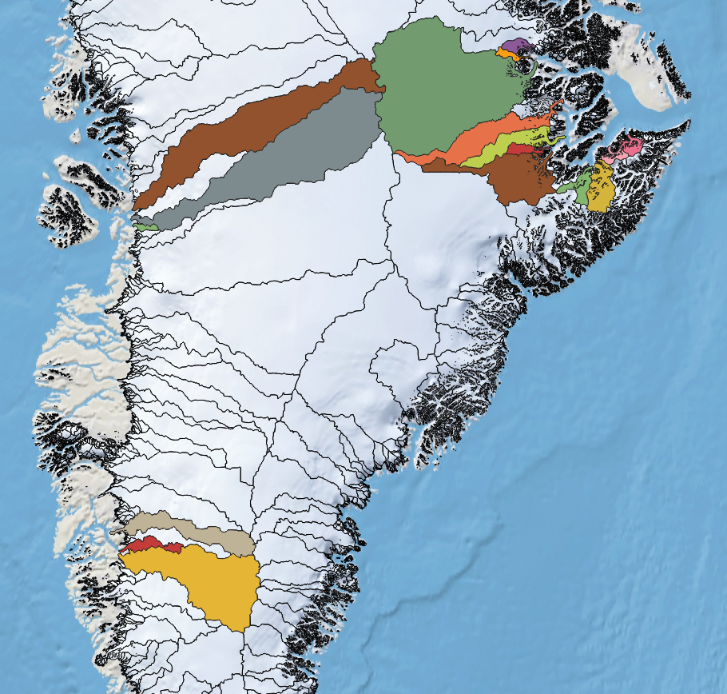
Disko Bay /
Eqip Sermia system
Scoresbysund system, including:
- Gåsefjord
- Vestfjord
- Rødefjord
- Hinks Land
Nuup Kangerlua /
Nuuk system

Slide 2
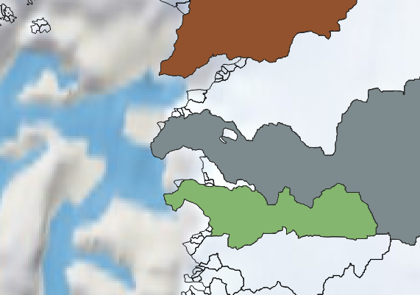

Slide 3
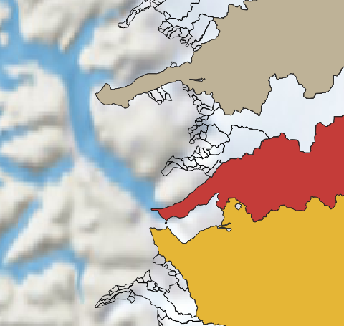

Slide 4
