Slide 1
ETHAN SETH S. GRATUITO
CHEM 13 - ORGANIC CHEMISTRY
BS Chemical Engineering 2A
name it,
draw it

Slide 2


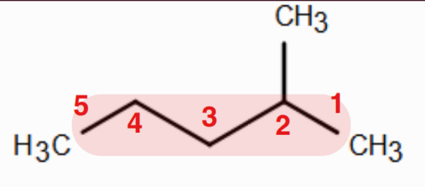
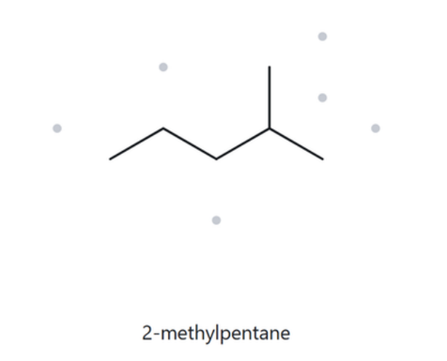
CARD A01 — STRUCTURE → NAME
Level: Foundation | Molecular formula (counted): C6H14
  Numbered Parent
  Naming Trail
Parent: Longest chain = 5 C → pentane.
Numbering: Left → right gives 4; right → left gives 2. 2 < 4, so number from the right.
Substituents: Methyl on C2.
  My Name (Written First)
  The Alkane Check
2-methylpentane
Verification Strip
Parent: pentane (5C) | Locants: 2 | Substituent: methyl | Alphabetical: methyl | Formula: C₆H₁₄

Slide 3
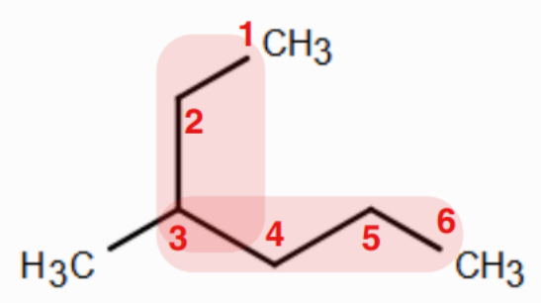
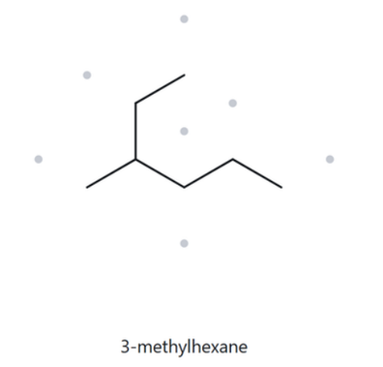
CARD A02— STRUCTURE → NAME
Level: Foundation | Molecular formula (counted): C7H16
  Numbered Parent
  Naming Trail
Parent: Longest chain = 6 C → hexane.
Numbering: Top → bottom gives 3; bottom → top gives 4. 3 < 4, so number from the top.
Substituents: Methyl on C3.
  My Name (Written First)
  The Alkane Check
3-methylhexane
Verification Strip
Parent: hexane (6C) | Locants: 3 | Substituent: methyl | Alphabetical: methyl | Formula: C₇H₁₆

Slide 4
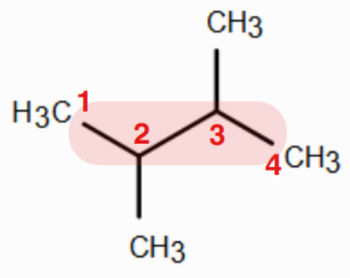
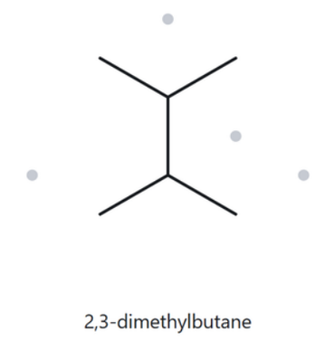
CARD A03— STRUCTURE → NAME
Level: Foundation | Molecular formula (counted): C6H14
  Numbered Parent
  Naming Trail
Parent: Longest chain = 4 C → butane.
Numbering: Both directions yield locants 2,3. The sets tie.
Substituents: Two methyl groups → 2,3-dimethyl.
  My Name (Written First)
  The Alkane Check
2,3-dimethylbutane
Verification Strip
Parent: butane (4C) | Locants: 2,3 | Substituent: methyl | Alphabetical: methyl | Formula: C₆H₁₄

Slide 5
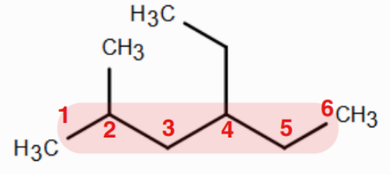
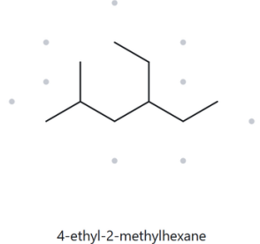
CARD A04— STRUCTURE → NAME
Level: Developing | Molecular formula (counted): C9H20
  Numbered Parent
  Naming Trail
Parent: Longest chain = 6 C → hexane.
Numbering: Left → right gives {2,4}; right → left gives {3,5}. {2,4} wins.
Substituents: Ethyl on C4, methyl on C2. Alphabetical order places ethyl first.
  My Name (Written First)
  The Alkane Check
4-ethyl-2-methylhexane
Verification Strip
Parent: hexane (6C) | Locants: 2 & 4 | Substituent: methyl & ethyl | Alphabetical: ethyl & methyl | Formula:C₉H₂₀

Slide 6
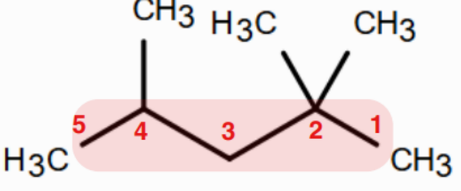
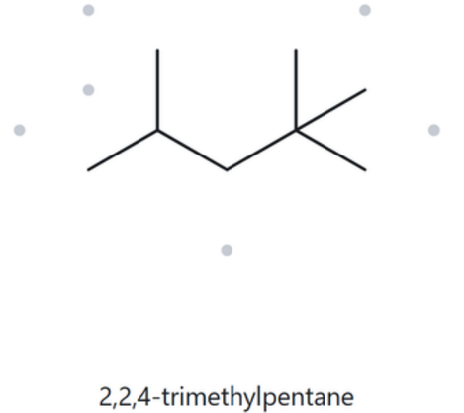
CARD A05— STRUCTURE → NAME
Level: Developing | Molecular formula (counted): C8H18
  Numbered Parent
  Naming Trail
Parent: Longest chain = 5 C → pentane.
Numbering: L→R gives {2,4,4}; R→L gives {2,2,4}. At the first point of difference, 2 < 4. Number from right.
Substituents: Three methyl groups → 2,2,4-trimethyl.
  My Name (Written First)
  The Alkane Check
2,2,4-trimethylpentane
Verification Strip
Parent: pentane (5C) | Locants: 2,2,4 | Substituent: methyl | Alphabetical: methyl | Formula: C₈H₁₈

Slide 7
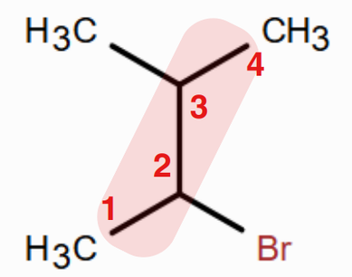
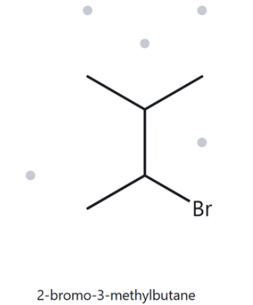
CARD A06— STRUCTURE → NAME
Level: Developing | Molecular formula (counted): C6H13Br
  Numbered Parent
  Naming Trail
Parent: Longest chain = 5 C → pentane.
Numbering: Both directions yield locants {2,4}. Tie-break is alphabetical: bromo (b) beats methyl (m).
Substituents: Bromo on C2, methyl on C4.
  My Name (Written First)
  The Alkane Check
2-bromo-4-methylbutane
Verification Strip
Parent: butane (4C) | Locants: 2 & 3 | Substituent: methyl & bromo- | Alphabetical: bromo- & methyl | Formula: C₅H₁₁Br

Slide 8
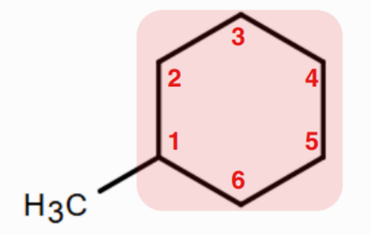
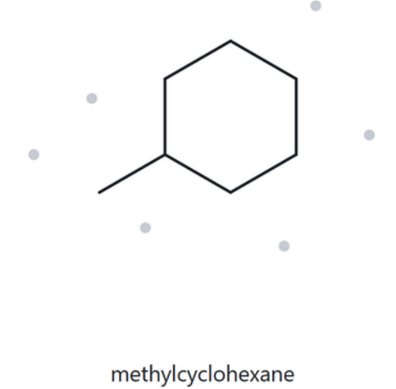
CARD A07— STRUCTURE → NAME
Level: Developing | Molecular formula (counted): C7H14
  Numbered Parent
  Naming Trail
Parent: Ring is parent → cyclohexane.
Numbering: Only one substituent is present, so it is automatically at position 1. Locant is omitted in the final name.
Substituents: Methyl.
  My Name (Written First)
  The Alkane Check
methylcyclohexane
Verification Strip
Parent: cyclohexane (6C) | Locants: 1 | Substituent: methyl | Alphabetical: methyl | Formula: C₇H₁₄

Slide 9
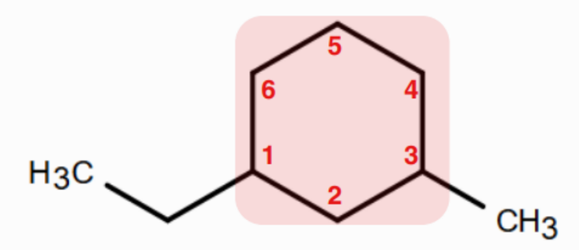
CARD A08— STRUCTURE → NAME
Level: Challenge | Molecular formula (counted): C9H18
  Numbered Parent
  Naming Trail
Parent: Ring is parent → cyclohexane.
Numbering: Both short ways around yield {1,3}. Alphabetical tiebreak gives C1 to ethyl (e before m).
Substituents: Ethyl on C1, methyl on C3.
  My Name (Written First)
  The Alkane Check
1-ethyl-3-methylcyclohexane
Verification Strip
Parent: cyclohexane (6C) | Locants: 1 & 3 | Substituent: methyl & ethyl | Alphabetical: ethyl & methyl | Formula:C₉H₁₈

Slide 10
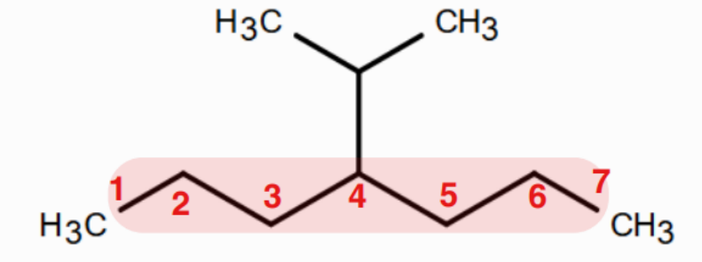
CARD A09— STRUCTURE → NAME
Level: Challenge | Molecular formula (counted): C9H18
  Numbered Parent
  Naming Trail
Parent: Ring is parent → cyclohexane.
Numbering: Both short ways around yield {1,3}. Alphabetical tiebreak gives C1 to ethyl (e before m).
Substituents: Ethyl on C1, methyl on C3.
  My Name (Written First)
  The Alkane Check
1-ethyl-3-methylcyclohexane
Verification Strip
Parent: heptane (7C) | Locants: 4 | Substituent: isopropyl | Alphabetical: isopropyl | Formula: C₁₀H₂₂

Slide 11
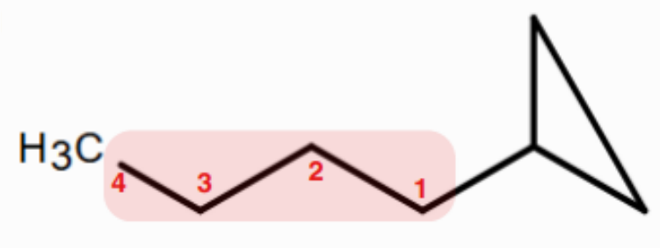
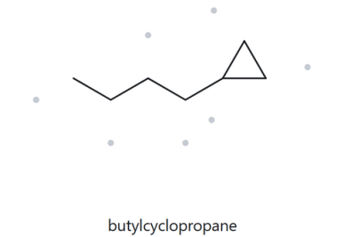
CARD A10— STRUCTURE → NAME
Level: Challenge | Molecular formula (counted): C7H14
  Numbered Parent
  Naming Trail
Parent: Per current rules for this activity, the ring is the parent even if the chain has more carbons → cyclopropane. Numbering: Only one substituent, no locant needed. Substituents: 4-carbon straight chain → butyl.
  My Name (Written First)
  The Alkane Check
butylcyclopropane
Verification Strip
Parent: butane (4C) | Locants: 1 | Substituent: cyclopropyl | Alphabetical: cyclopropyl | Formula: C7H14

Slide 12
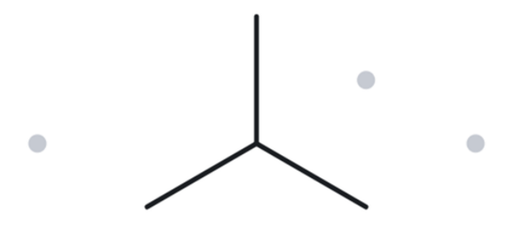
CARD B01— NAME→STRUCTURE
Level: Foundation | Given Name: 2-methylpropane
  Name Decoded
  Bond-Line Structure
Parent: propane → 3-carbon chain.
Substituents: methyl on C2.
Expected formula: 3 + 1 = 4 C; open chain → C4H10 .
  Formula Check
  Back-Check
Counted from drawing: C4H10
Open chain rule: CnH2n+2 = C4H10 (Matches)
✓ Match
The Alkane returned: 2-methylpropane. Drawn structure perfectly reconstructs the given name.
Verification Strip
☑ parent length ☑ substituent positions ☑ formula agrees ☑ back-check recorded

Slide 13
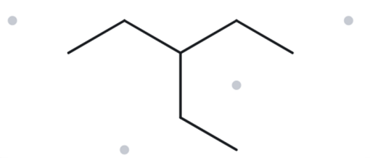
CARD B02— NAME→STRUCTURE
Level: Foundation | Given Name: 2-methylpropane
  Name Decoded
  Bond-Line Structure
Parent: pentane → 5-carbon chain.
Substituents: ethyl on C3.
Expected formula: 5 + 2 = 7 C; open chain → C7H16 .
  Formula Check
  Back-Check
Counted from drawing: C7H16
Open chain rule: CnH2n+2 = C7H16 (Matches)
✓ Match
The Alkane returned: 3-ethylpentane
Verification Strip
☑ parent length ☑ substituent positions ☑ formula agrees ☑ back-check recorded

Slide 14
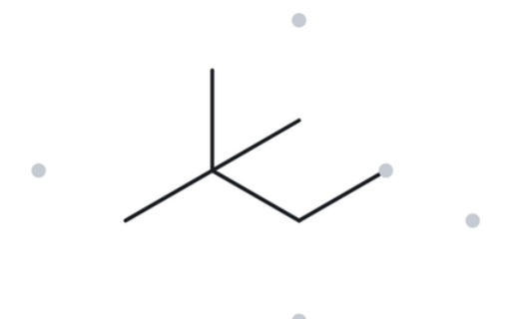
CARD B03— NAME→STRUCTURE
Level: Foundation | Given Name: 2,2-dimethylbutane
  Name Decoded
  Bond-Line Structure
Parent: butane → 4-carbon chain.
Substituents: two methyls on C2.
Expected formula: 4 + 2 = 6 C; open chain → C6H14 .
  Formula Check
  Back-Check
Counted from drawing: C6H14
Open chain rule: CnH2n+2 = C6H14 (Matches)
✓ Match
The Alkane returned: 2,2-dimethylbutane.
Verification Strip
☑ parent length ☑ substituent positions ☑ formula agrees ☑ back-check recorded

Slide 15
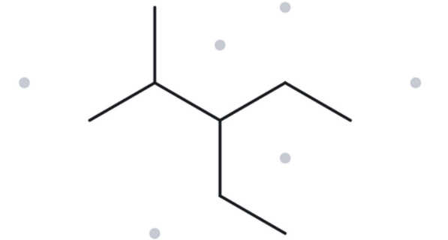
CARD B04— NAME→STRUCTURE
Level: Developing | Given Name: 3-ethyl-2-methylpentane
  Name Decoded
  Bond-Line Structure
Parent: pentane → 5-carbon chain.
Substituents: ethyl on C3, methyl on C2.
Expected formula: 5 + 2 + 1 = 8 C; open chain → C8H18 .
  Formula Check
  Back-Check
Counted from drawing: C8H18
Open chain rule: CnH2n+2 = C8H18 (Matches)
✓ Match
The Alkane returned: 3-ethyl-2-methylpentane.
Verification Strip
☑ parent length ☑ substituent positions ☑ formula agrees ☑ back-check recorded

Slide 16
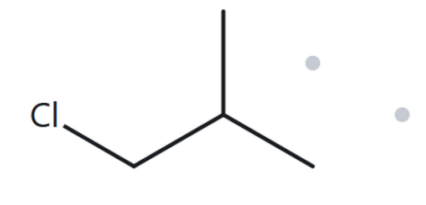
CARD B05— NAME→STRUCTURE
Level: Developing | Given Name: 1-chloro-2-methylpropane
  Name Decoded
  Bond-Line Structure
Parent: propane → 3-carbon chain.
Substituents: chloro on C1, methyl on C2.
Expected formula: 3 + 1 = 4 C. Open chain, minus 1 H for Cl → C4H9Cl.
  Formula Check
  Back-Check
Counted from drawing: C4H9Cl
Open chain rule: CnH2n+2 = C4H10 , swap 1 H for Cl = C4H9Cl (Matches)
✓ Match
The Alkane returned: 1-chloro-2-methylpropane.
Verification Strip
☑ parent length ☑ substituent positions ☑ formula agrees ☑ back-check recorded

Slide 17
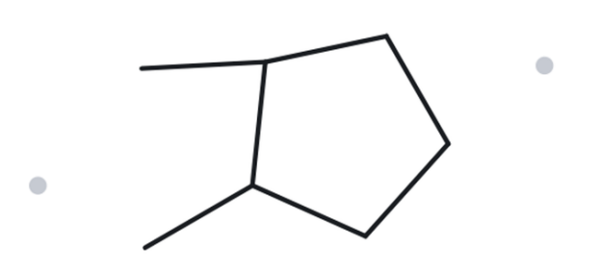
CARD B06— NAME→STRUCTURE
Level: Developing | Given Name: 1,2-dimethylcyclopentane
  Name Decoded
  Bond-Line Structure
Parent: cyclopentane → 5-carbon ring.
Substituents: methyl on C1, methyl on C2.
Expected formula: 5 + 2 = 7 C; one ring → C7H14 .
  Formula Check
  Back-Check
Counted from drawing: C7H14
One ring rule: CnH2n = C7H14 (Matches)
✓ Match
The Alkane returned: 1,2-dimethylcyclopentane.
Verification Strip
☑ parent length ☑ substituent positions ☑ formula agrees ☑ back-check recorded

Slide 18
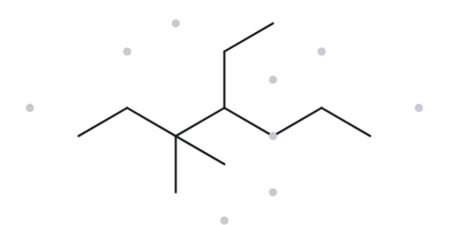
CARD B07— NAME→STRUCTURE
Level: Developing | Given Name: 4-ethyl-3,3-dimethylheptane
  Name Decoded
  Bond-Line Structure
Parent: heptane → 7-carbon chain.
Substituents: ethyl on C4, two methyls on C3.
Expected formula: 7 + 2 + 2 = 11 C; open chain → C11H24 .
  Formula Check
  Back-Check
Counted from drawing: C11H24
Open chain rule: CnH2n+2 = C11H24 (Matches)
✓ Match
The Alkane returned: 4-ethyl-3,3-dimethylheptane.
Verification Strip
☑ parent length ☑ substituent positions ☑ formula agrees ☑ back-check recorded

Slide 19
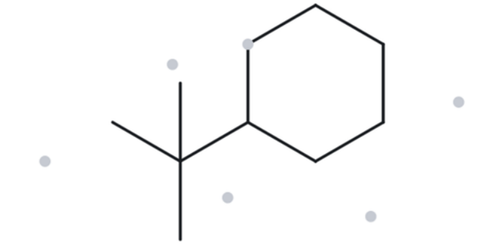
CARD B08— NAME→STRUCTURE
Level: Challenge | Given Name: tert-butylcyclohexane
  Name Decoded
  Bond-Line Structure
Parent: cyclohexane → 6-carbon ring.
Substituents: tert-butyl (4-carbon branched group) on C1.
Expected formula: 6 + 4 = 10 C; one ring → C10H20 .
  Formula Check
  Back-Check
Counted from drawing: C10H20
One ring rule: CnH2n = C10H20 (Matches)
⚠ Systematic Equivalent
The Alkane returned: (1,1-dimethylethyl)cyclohexane.
Both are completely correct; the tool returns the strict systematic name for the tert-butyl group.
Verification Strip
☑ parent length ☑ substituent positions ☑ formula agrees ☑ back-check recorded

Slide 20
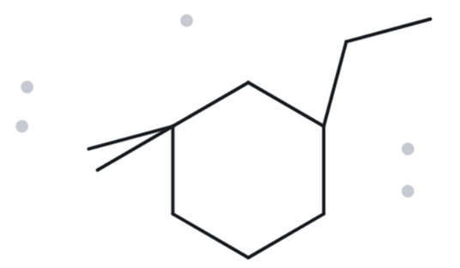
CARD B09— NAME→STRUCTURE
Level: Challenge | Given Name: 3-ethyl-1,1-dimethylcyclohexane
  Name Decoded
  Bond-Line Structure
Parent: cyclohexane → 6-carbon ring.
Substituents: two methyls on C1, ethyl on C3.
Expected formula: 6 + 2 + 2 = 10 C; one ring → C10H20 .
  Formula Check
  Back-Check
Counted from drawing: C10H20
One ring rule: CnH2n = C10H20 (Matches)
✓ Match
The Alkane returned: 3-ethyl-1,1-dimethylcyclohexane.
Priority and numbering correctly align.
Verification Strip
☑ parent length ☑ substituent positions ☑ formula agrees ☑ back-check recorded

Slide 21
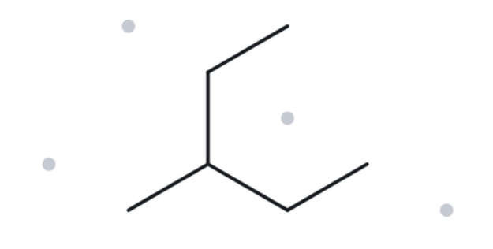
CARD B10— NAME→STRUCTURE
Level: Challenge | Given Name: 2-ethylbutane
  Name Decoded
  Bond-Line Structure
Parent: butane → 4-carbon chain.
Substituents: ethyl on C2.
Expected formula: 4 + 2 = 6 C; open chain → C6H14 .
  Formula Check
  Back-Check
Counted from drawing: C6H14
Open chain rule: CnH2n+2 = C6H14 (Matches)
⚠ Deliberate Mismatch (Error Found)
The Alkane returned: 3-methylpentane. The given name violates the longest-chain rule. Appending an ethyl group to C2 of a 4-carbon chain creates a continuous 5-carbon chain (pentane), leaving a methyl group on C3.
Verification Strip
☑ parent length ☑ substituent positions ☑ formula agrees ☑ back-check recorded

