Slide 1
ETHAN SETH S. GRATUITO
CHEM 13 - ORGANIC CHEMISTRY
BS Chemical Engineering 2A
one molecule,
four representations

Slide 2

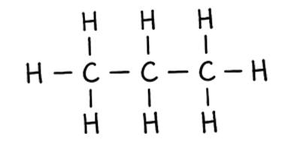
Card 1 - Propane (C₃H₈)
  Molecular Formula
  Lewis Structure
C₃H₈
  Condensed Structural Formula
  Bond-Line Formula (Ketcher)
CH₃CH₂CH₃
Verification Strip
☑ atom count verified ☑ valence checked
☑ bond order checked ☑ same connectivity confirmed

Slide 3
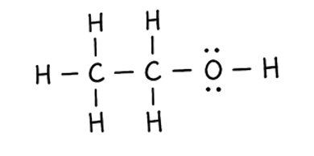

Card 2 - Ethanol (C₂H₆O)
  Molecular Formula
  Lewis Structure
C₂H₆O
  Condensed Structural Formula
  Bond-Line Formula (Ketcher)
CH₃CH₂OH
Verification Strip
☑ atom count verified ☑ valence checked
☑ bond order checked ☑ same connectivity confirmed

Slide 4
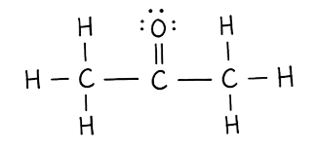

Card 3 - Acetone (C₃H₆O)
  Molecular Formula
  Lewis Structure
C₃H₆O
  Condensed Structural Formula
  Bond-Line Formula (Ketcher)
CH₃COCH₃
Verification Strip
☑ atom count verified ☑ valence checked
☑ bond order checked ☑ same connectivity confirmed

Slide 5
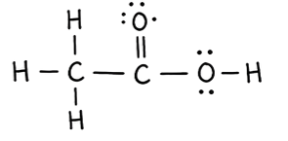

Card 4 - Acetic Acid (C₂H₄O₂ )
  Molecular Formula
  Lewis Structure
C₂H₄O₂
  Condensed Structural Formula
  Bond-Line Formula (Ketcher)
CH₃COOH
Verification Strip
☑ atom count verified ☑ valence checked
☑ bond order checked ☑ same connectivity confirmed

Slide 6
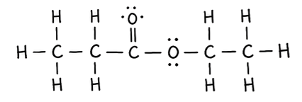

Card 5 - Ethyl Acetate (C₄H₈O₂ )
  Molecular Formula
  Lewis Structure
C₄H₈O₂
  Condensed Structural Formula
  Bond-Line Formula (Ketcher)
CH₃COOCH₂CH₃
Verification Strip
☑ atom count verified ☑ valence checked
☑ bond order checked ☑ same connectivity confirmed

Slide 7
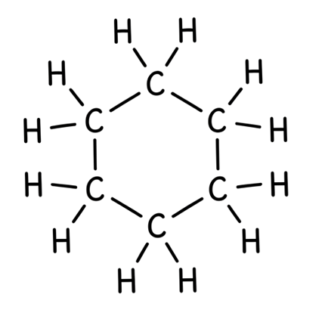

Card 6 - Cyclohexane (C₆H₁₂)
  Molecular Formula
  Lewis Structure
C₆H₁₂
  Condensed Structural Formula
  Bond-Line Formula (Ketcher)
(CH₂)₆
Verification Strip
☑ atom count verified ☑ valence checked
☑ bond order checked ☑ same connectivity confirmed

Slide 8
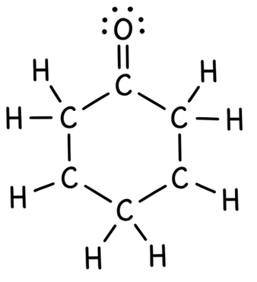

Card 7 - Cyclohexanone (C₆H₁₀O)
  Molecular Formula
  Lewis Structure
C₆H₁₀O
  Condensed Structural Formula
  Bond-Line Formula (Ketcher)
(CH₂)₅CO
Verification Strip
☑ atom count verified ☑ valence checked
☑ bond order checked ☑ same connectivity confirmed

Slide 9
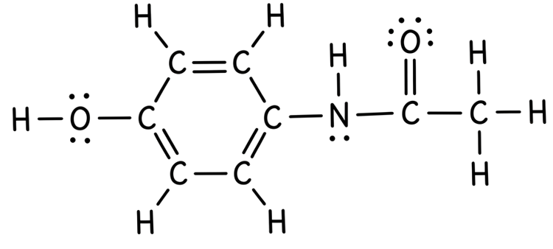
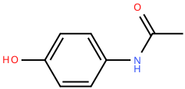
Card 8 - Acetaminophen (C₈H₉NO₂)
  Molecular Formula
  Lewis Structure
C₈H₉NO₂
  Condensed Structural Formula
  Bond-Line Formula (Ketcher)
HO-C₆H₄-NHCOCH₃
Verification Strip
☑ atom count verified ☑ valence checked
☑ bond order checked ☑ same connectivity confirmed

Slide 10
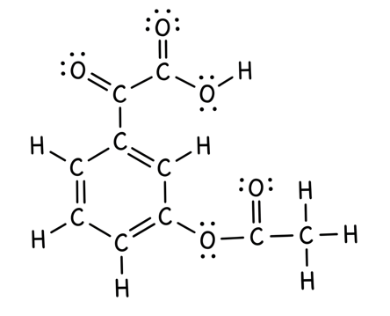
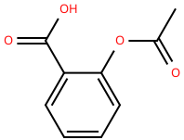
Card 9 - Aspirin (C₉H₈O₄ )
  Molecular Formula
  Lewis Structure
C₉H₈O₄
  Condensed Structural Formula
  Bond-Line Formula (Ketcher)
CH₃CO₂-C₆H₄-COOH
Verification Strip
☑ atom count verified ☑ valence checked
☑ bond order checked ☑ same connectivity confirmed

Slide 11
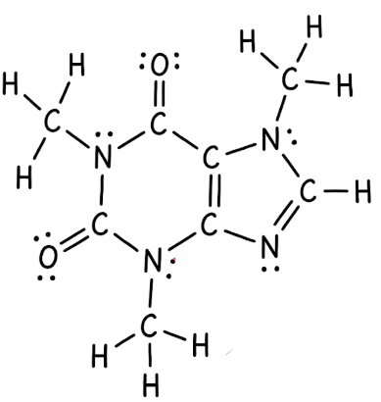
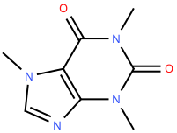
Card 10 - Caffeine (C₈H₁₀N₄O₂)
  Molecular Formula
  Lewis Structure
C₈H₁₀N₄O₂
  Condensed Structural Formula
  Bond-Line Formula (Ketcher)
C₈H₁₀N₄O₂
Verification Strip
☑ atom count verified ☑ valence checked
☑ bond order checked ☑ same connectivity confirmed

