Slide 1
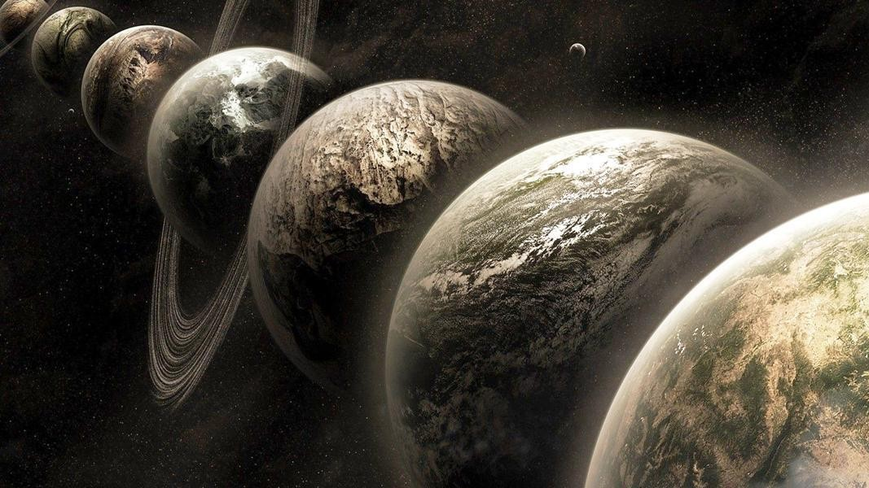
Multiverse Analysis: Being transparent about subjective decisions in data analysis Ethan Young

Slide 2

Garden of Forking Paths

Slide 3

Garden of Forking Paths Datasets
Results
Log
Exclude
…
Transform?
…
None
Raw Data
…
Multiverse
All possible versions of dataset
Outliers?
…
Log
…
Transform?
Include
…
None
…

Slide 4


Cherry Picking
Pigeonholes
⚠️

Slide 5



Cherry Picking
Selectively reporting the analysis that shows your preferred result
Pigeonholes
Becoming constrained by overly rigid analysis criteria
😬
😎
😬
😎
🤔
😬

Slide 6

Multiverse Analysis
Transparently and systematically analyze the whole multiverse
Transparency reduces cherry-picking
Systematically handling decisions reduces pigeonholing
Orben & Przybylski, 2019a, 2019b
Steegen et al., 2015
Simonsohn et al., 2020

Slide 7



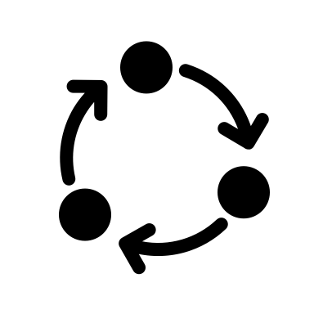



Multiverse Analysis
Non-Arbitrary
Some alternatives better than others
Arbitrary
Equally defensible alternatives
👎
👍
1. Identify arbitrary decisions
Arbitrary!
Non-Arbitrary
2. Build multiverse datasets
3. Analyze multiverse with the same model
Non-Arbitrary
Non-Arbitrary
4. Compile and display results
…

Slide 8
Example: Hidden Talents Study
Research question:
Can ecologically relevant stimuli improve task performance for people living in adversity?
Analysis:
Performance = adversity × stimulus type (abstract or real-world)
Sample:
681 adolescents from after schools clubs and middle schools in US

Slide 9
Hidden Talents Multiverse
Non-Arbitrary
Decisions
Arbitrary
Decisions
Equally Defensible
alternatives
Create Multiverse from all possible combinations
618
adolescents
Include after school clubs?
Minor distractions?
Attention check?
General special education?
Attention-Shifting accuracy?
Socially desirable responses?
64
datasets
x2 alternatives each
Notes:
Incomplete task data
Cognitive impairments
Attention checks (> 1)
Extreme distractions
> 60 minutes of special education services

Slide 10
Unpredictability
Violence
Poverty

Slide 13
Promise & Pitfalls
⚠️
Only use with arbitrary data processing decisions
Ask yourself:
Does my analysis always test the same question?
Promise
Powerful exploratory tool
Can be used with any statistical procedure (for programmers: it’s just a loop!)
Provides new guidelines for data decisions
Come with some pretty cool plots 🤓
Pitfalls:
What’s arbitrary?
How should draw inferences from a multiverse analysis?

Slide 14
Questions?

Slide 15
Resources
Conceptual Papers:
Steegen, S., Tuerlinckx, F., Gelman, A., & Vanpaemel, W. (2016). Increasing Transparency Through a Multiverse Analysis. Perspectives on Psychological Science, 11(5), 702–712. https://doi.org/10.1177/1745691616658637
Del Giudice, M., & Gangestad, S. W. (2021). A Traveler’s Guide to the Multiverse: Promises, Pitfalls, and a Framework for the Evaluation of Analytic Decisions. Advances in Methods and Practices in Psychological Science. https://doi.org/10.1177/2515245920954925
Simonsohn, U., Simmons, J. P., & Nelson, L. D. (2020). Specification curve analysis. Nature Human Behaviour, 4(11), 1208–1214. https://doi.org/10.1038/s41562-020-0912-z
Patel, C. J., Burford, B., & Ioannidis, J. P. A. (2015). Assessment of vibration of effects due to model specification can demonstrate the instability of observational associations. Journal of Clinical Epidemiology, 68(9), 1046–1058. https://doi.org/10.1016/j.jclinepi.2015.05.029
Muñoz, J., & Young, C. (2018). We Ran 9 Billion Regressions: Eliminating False Positives through Computational Model Robustness. Sociological Methodology, 48(1), 1–33. https://doi.org/10.1177/0081175018777988
Lundberg, I., Johnson, R., & Stewart, B. (2020, January 7). What is Your Estimand? Defining the Target Quantity Connects Statistical Evidence to Theory. https://doi.org/10.31235/osf.io/ba67n
Empirical examples
Orben, A., Dienlin, T., & Przybylski, A. K. (2019). Social media’s enduring effect on adolescent life satisfaction. Proceedings of the National Academy of Sciences of the United States of America, 116(21), 10226–10228. https://doi.org/10.1073/pnas.1902058116
Orben, A., & Przybylski, A. K. (2019a). The association between adolescent well-being and digital technology use. Nature Human Behaviour, 3(2), 173–182. https://doi.org/10.1038/s41562-018-0506-1
Orben, A., & Przybylski, A. K. (2019b). Screens, Teens, and Psychological Well-Being: Evidence From Three Time-Use-Diary Studies. Psychological Science, 30(5), 682–696. https://doi.org/10.1177/0956797619830329
Heyman, T., & vanpaemel, w. (2020, July 14). Multiverse analyses in the classroom. https://doi.org/10.31234/osf.io/4eh6b
Blog Posts
100% CI: http://www.the100.ci/2021/03/07/mulltiverse-analysis/
My website: https://www.ethan-young.com/code/multiverse/
R packages:
specr https://philippmasur.de/2020/01/02/how-to-do-specification-curve-analyses-in-r-introducing-specr/

