Slide 1

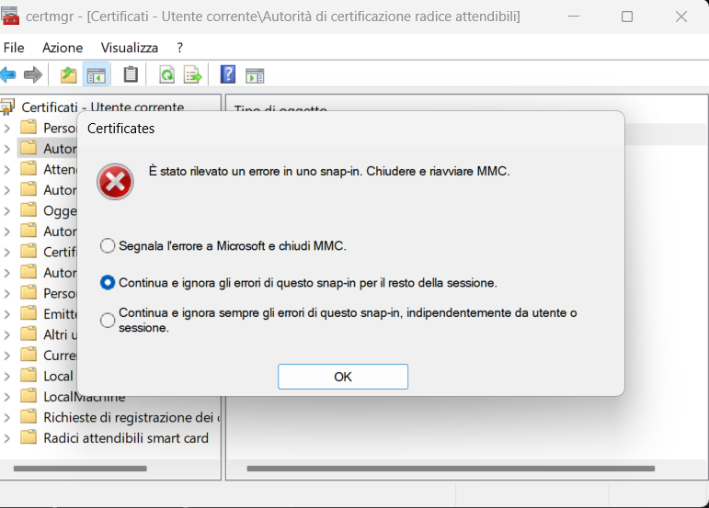
sassa
sassasa

