Slide 1
CG Project: my parthenon
Yaolung su
04/25/2018

Slide 2
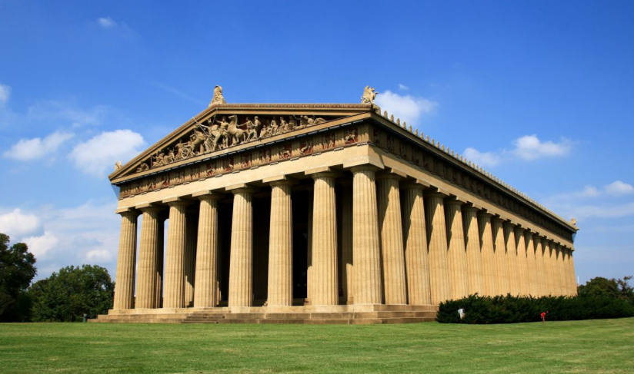
outline
1. What I did in this project?
II. What did I learn?
III. Demo

Slide 3
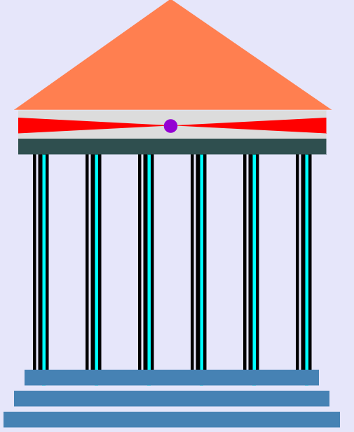
Project features
Draw three 2D "elevations" (front, top, side)

Slide 4
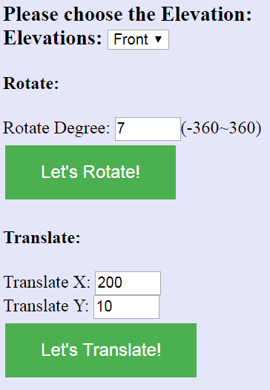
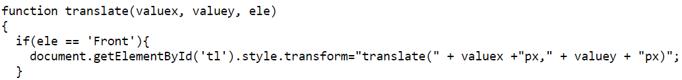
Project features
Transform object: apply 3D (Translate/Rotate/Scale/SHear)

Slide 5
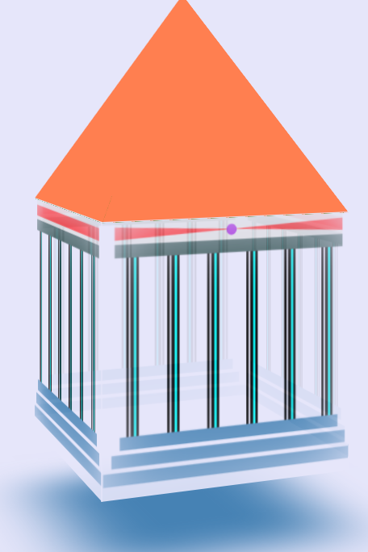

Project features
Viewing: view your created object from multiple views.

Slide 6
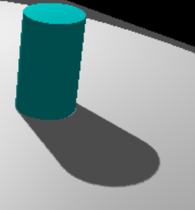
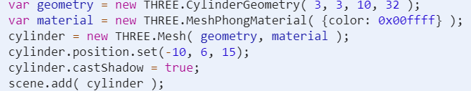
Project features
Transform camera/viewer/light sources(s).

Slide 7
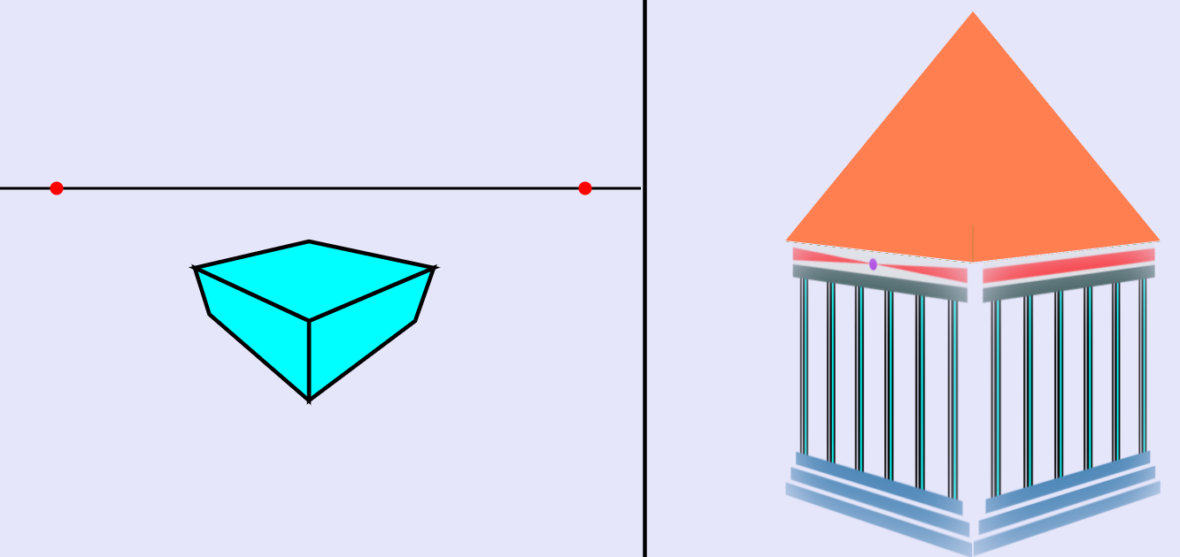
Project features
Generate different projections of the objects: Isometic
Edit/Change perspective projection vanishing points (1, 2, 3)

Slide 8
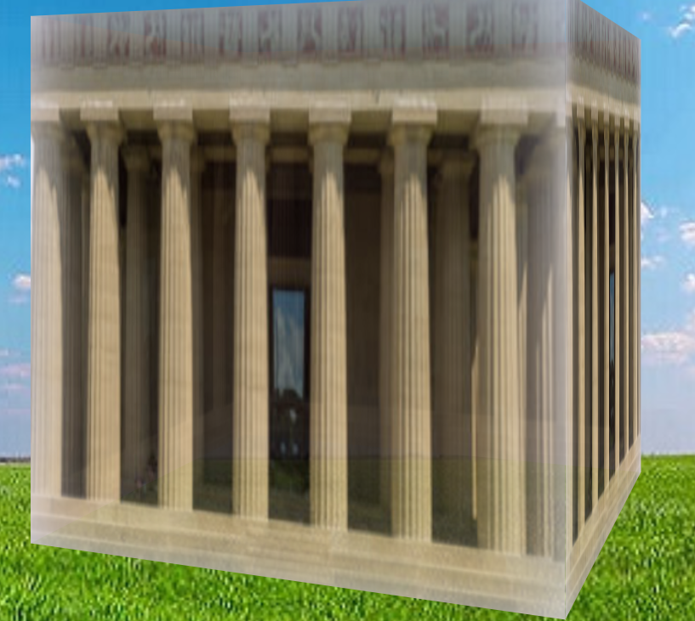
Project features
Create texture/bump/environmental mappings for the object.

Slide 9
I learned…
HTML
CSS
JavaScript
Graphic Applications

Slide 10
Demo
My Parthenon

Slide 11


