Slide 1
EECS427 Final Demo
Group 3
Yu-Sheng Ting, Cheng-Lin Lee, Xinxin Wang, I-Kang Wu, Yufan Gao, Ganrun Xu

Slide 2
Outline
I. Full Processor Layout with our Custom Block II. Baseline Processor III. Instruction for the Custom Block

Slide 3
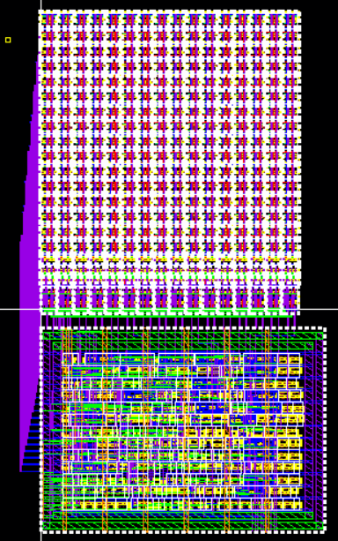
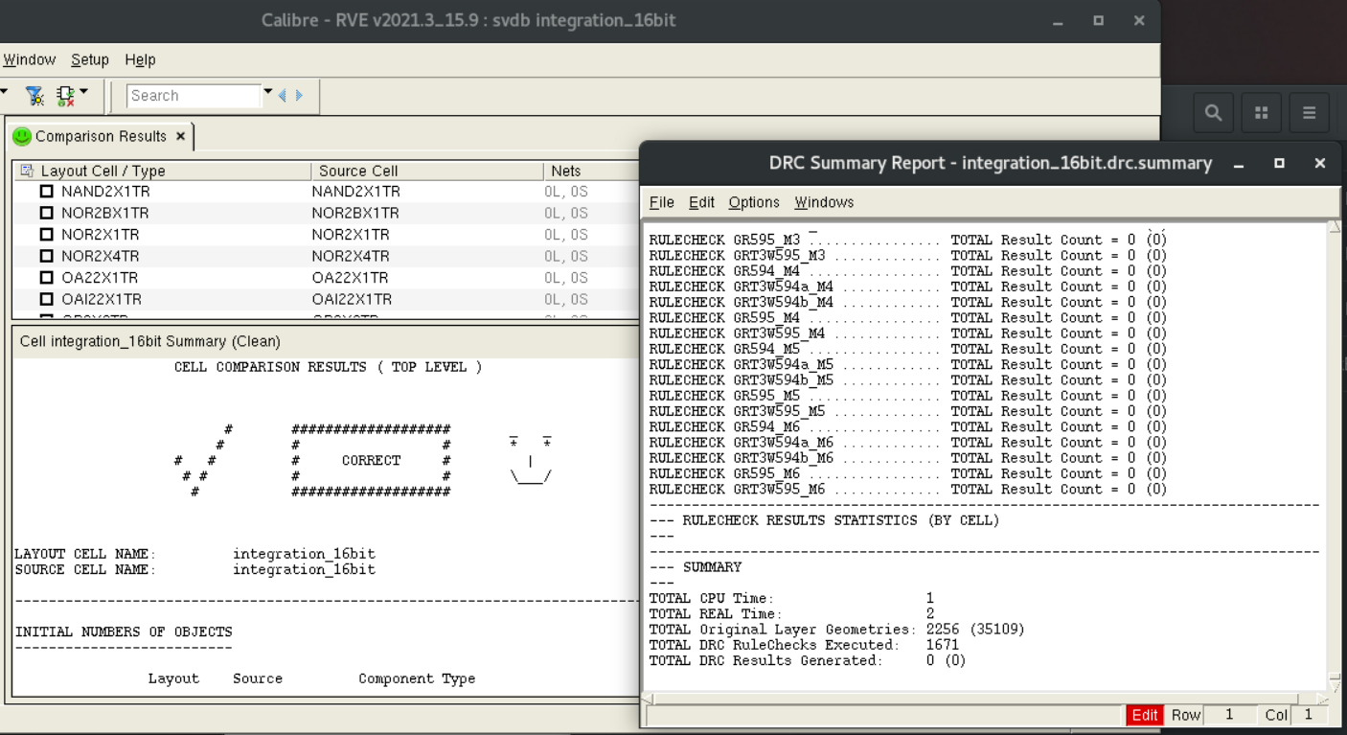
I-a. Custom Block- DRC & LVS
I-b. Custom Block- Layout
Pass in DRC & LVS
Demo: Layout, DRC & LVS
Notes:
Our custom block is the SRAM module. It combines with 16 bit SRAM cell and SRAM controller. The DRC's result shows zero unresolved item and LVS's result shows zero warning and error with a happy face. We can see the 6T SRAM cell , sense amplifier and SRAM controller layout after zoom in.

Slide 4
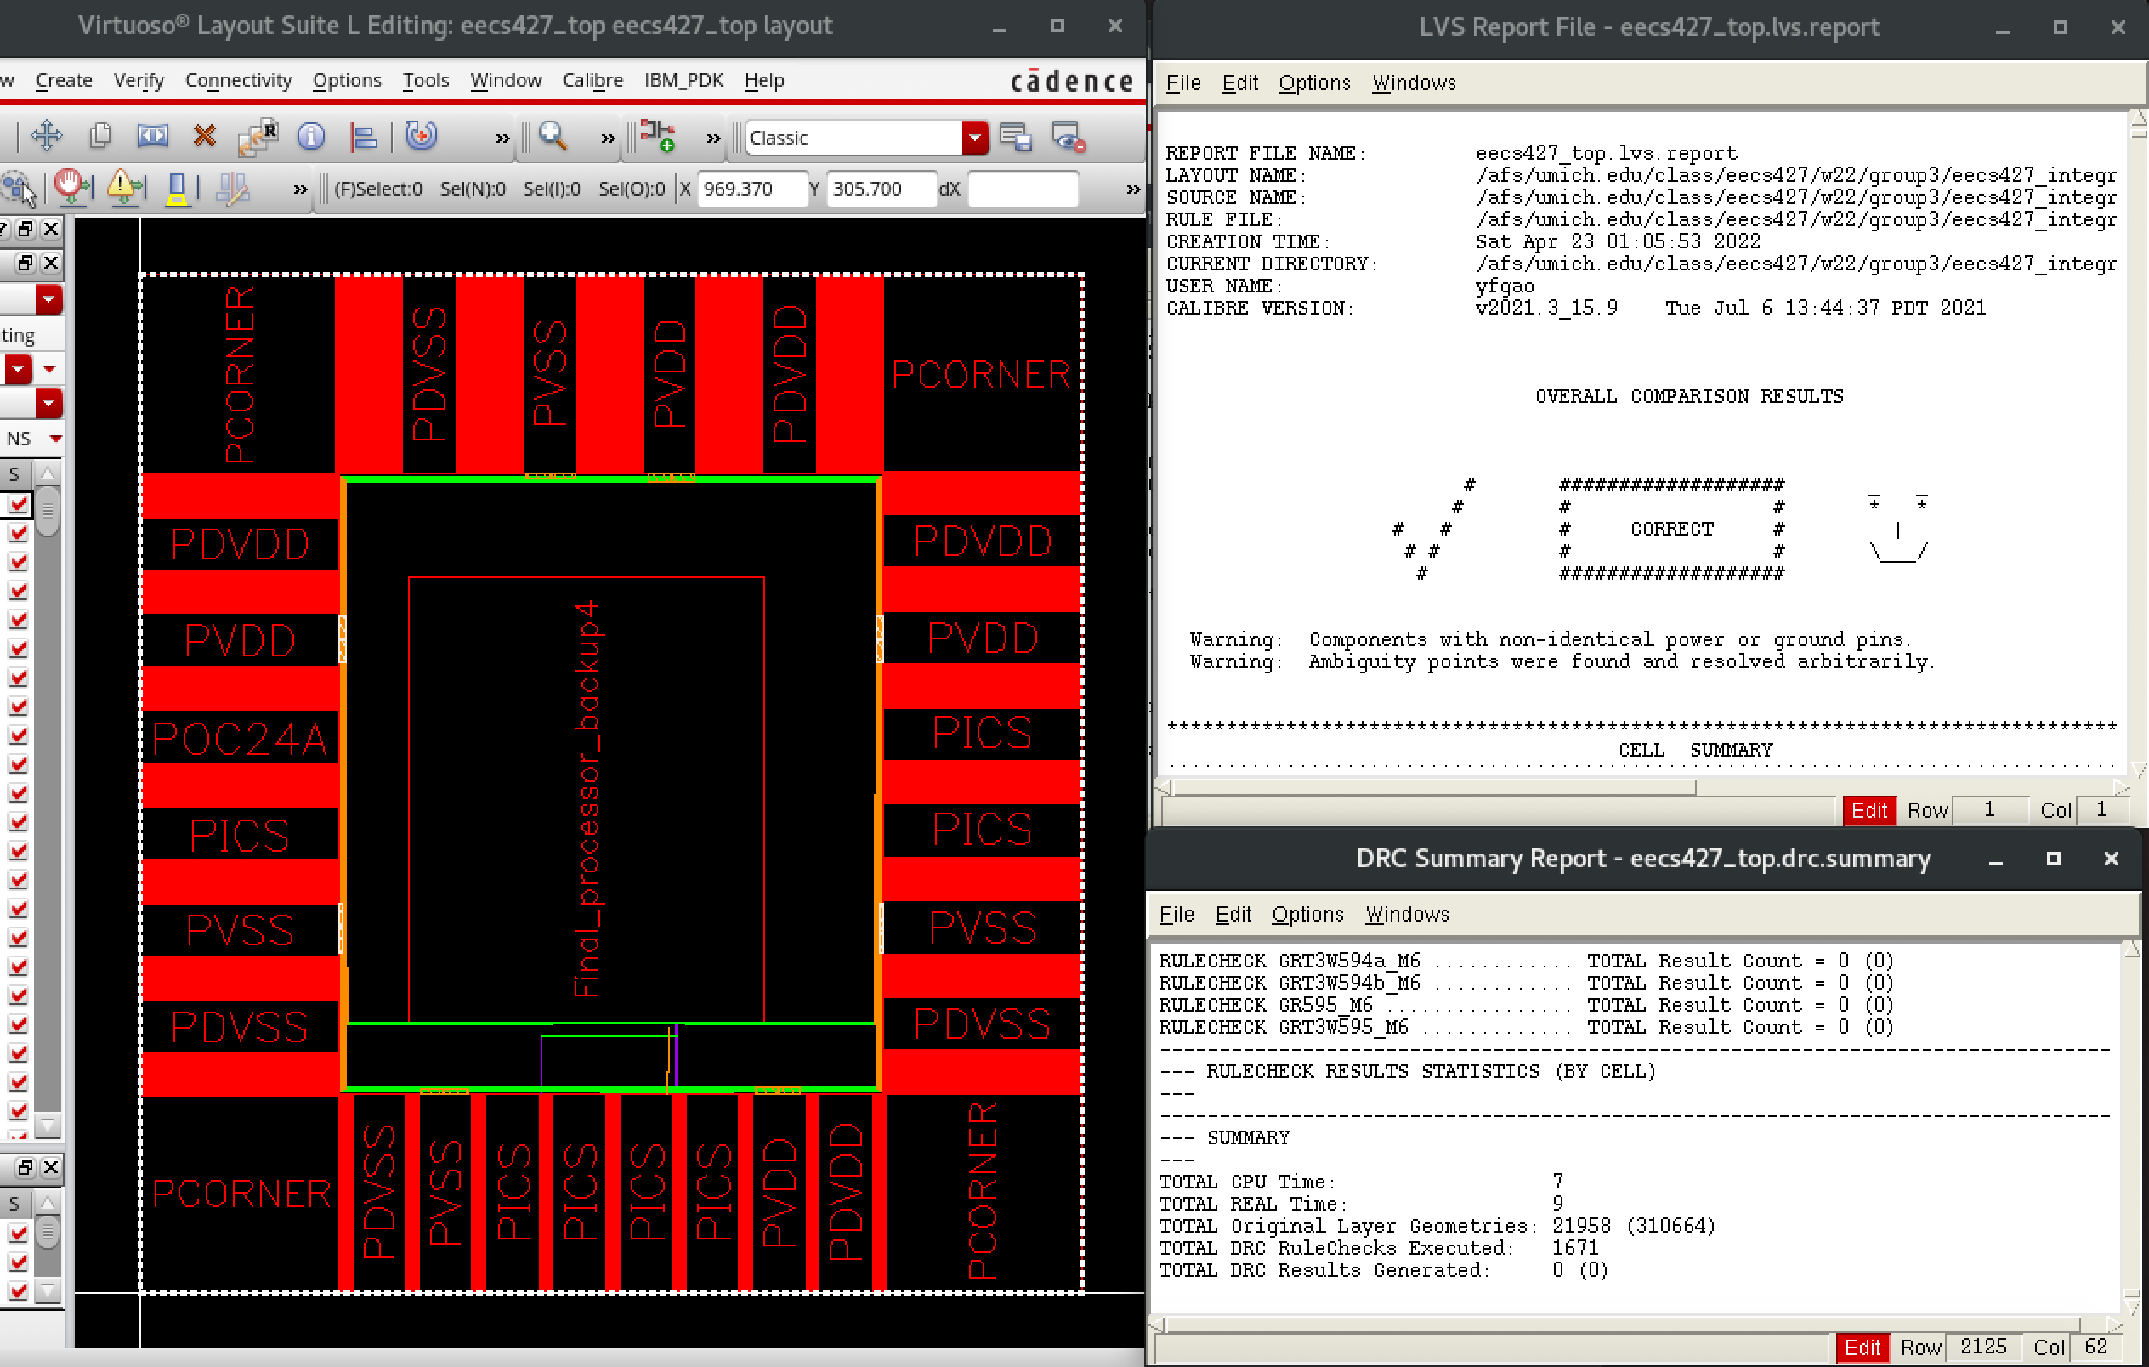
I-c. Processor with Pads - DRC & LVS
processor with pads
Notes:
The DRC's result shows zero unresolved item and LVS's result shows zero warning and error with a happy face.

Slide 5
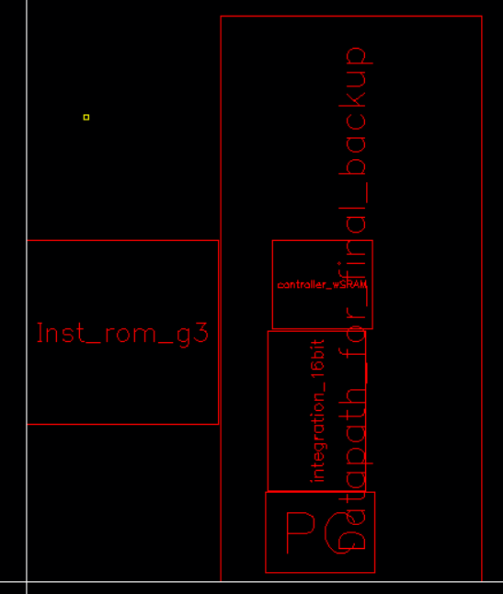

I-d. Processor with Pads– Layout & Core Density
Total area=242901.64${μm}^{2}$
Core density=0.643154
Yellow outline show the total area of the cells
Demo: Layout, DRC & LVS
Notes:
The yellow outline enclose the total area shown in the picture. Core density is 0.64 and can be calculated by estimated empty space.
The Core layout consists of the Datapth from previous CAD assignment, CPU controller, SRAM module and IMEM.
Total area:242901.64
Empty space= 217.62*188.6+50.2*332+153.6*188.6=86678.49
Core density=1-(86678.49/242901.64)=0.643154

Slide 6
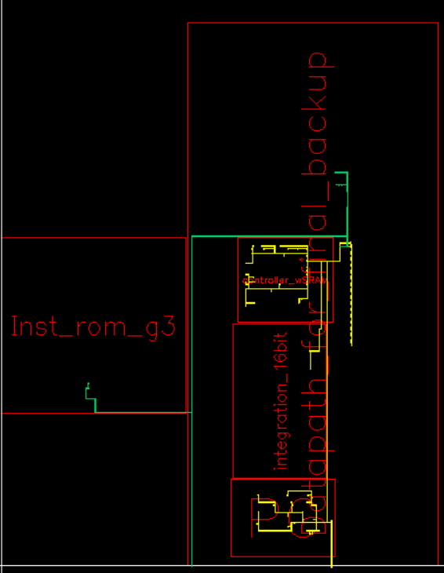
I-e. Clock distribution
Discuss your clock tree distribution considerations
Yellow route: clk
Green route: clk_b
Distribution considerations: Improve performance
Positive skew
clk routes through PC then through controller
clk_b routes through IMEM then through DMEM
Notes:
The clock and clock_b are illustrated in yellow and green route in the picture. We want to route the clock in a way able to improve the performance of the design. So we choose the positive clock skew. Clk would route through PC, then route through the controller. Similarly, clk_b would route through IMEM first, and then route through the DMEM.

Slide 7
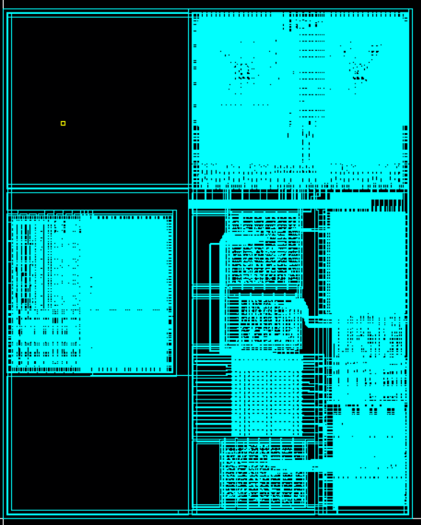
I-f. Power routing/rings/stripes
Red: Power ring
Orange: block ring of IMEM and DMEM(parts of block ring overlap the power ring)
Violet: Power stripe
Cyan: local power routing
Notes:
In the figure, the red line is the power ring. Orange color is the block ring of IMEM and DMEM. Some block rings overlap with the power rings. The violet is the power stripe. Power routing is shown in cyan color.

Slide 8
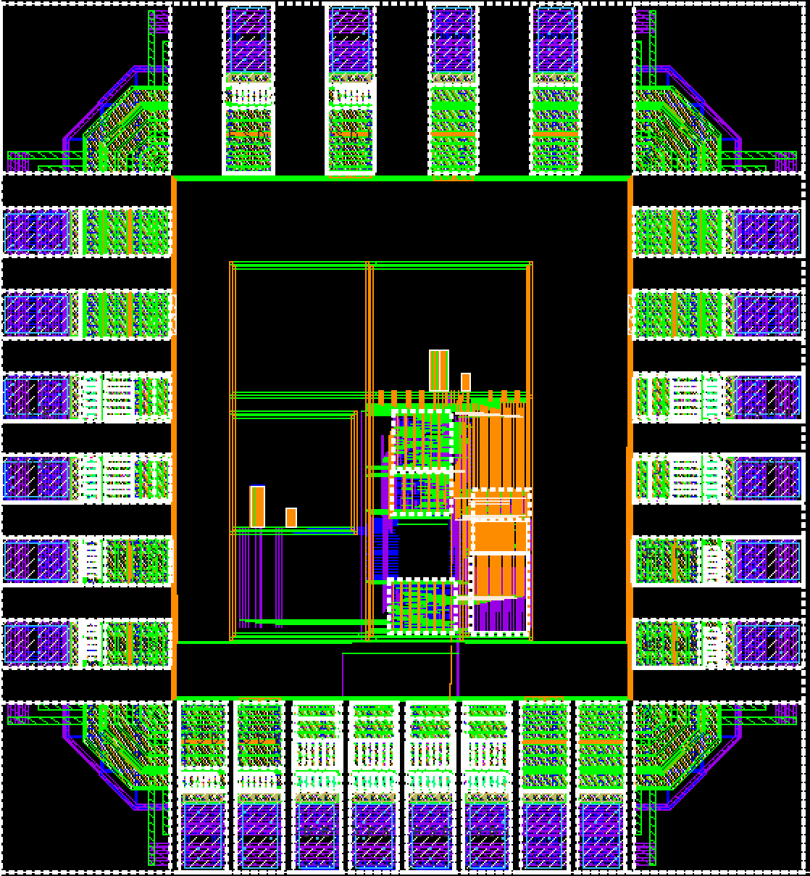
I-g. Total area I-h. Show the number of off-chip inputs and the pads for the processor
Total area
1264*1170um²
Total 7 Inputs
clk, clk_b, rst_n
scan_in, scan_en
Vref_IN
WL_duty
Total 1 Output
scan_out
Notes:
The total area is shown in the slide.
And we're about to Show the number of off-chip inputs and the pads for the processor
We have 7 inputs and 1 output
scan_in, scan_en, scan_out are signals for scan chain and Vref_IN and WL_duty are for sram

Slide 9
II-a. Show the assembly code program II-b. How we loop the calculation for Fibonacci Numbers and exit II-c. Explain one cycle of the calculation, including the load and store to RegFile
Step1 Clear register
Step3-1-1 Calculate Fibonacci
R0 + R1 -> R0
Step4-1 Calculate times 8
Load -> R4, Left shift 3 bits, Store
R3 ++
Step2 Initial register
0 -> R0, 1 -> R1
Step3-1-2 Exit Condition
R0 > 50
NO
Step4-2 Exit Condition
R3 > R2
NO
NO
Step3-2-1 Calculate Fibonacci
R0 + R1 -> R1
Yes
Step5 Clear Register
0 -> R_{n}
n= 0, 1, 4
Step3-1-2 Exit Condition
R1 > 50
Yes
Yes
Step3-3 DMEM max address -> R2
Notes:
Now we are going to introduce how our assembly code program for testing the Fibonacci number calculation works on baseline processor. We first initialized all the registers with 0. Then we store the first two Fibonacci numbers 0 and 1 to registers r0 and r1. Next, we use a loop to calculate the following Fibonacci series and store the results to DMEM until the result exceeds 50. After that, the stored results will be load back to registers, multiplied by 8, and then write back to DMEM. At last, registers containing Fibonacci numbers will be erased.
The loop for calculating Fibonacci is structured as follows: In the first stage, we use data in r0 as R_n-2, data in r1 as R_n-1, then sum up these two data and write the result back to r0. Then we store the result to DMEM and check if we can jump out of this loop by comparing the result with 50. In the second stage, data in r1 works as R_n-2, data in r0 works as R_n-1, then the addition of these two data will be write back to r1. Then we also store the result to DMEM and check the branch condition.
The basic steps in the second loop includes load back the Fibonacci number from DMEM to register r4, left shift the data by 3-bits, store the result back to DMEM, and increment the DMEM address by one. Once the DMEM address exceeds the max address value containing Fibonacci number, the program will exit this loop.
Here is the waveform. When the Fibonacci series reach 55, the code exits the first loop. When we get 8 times of 55, which is 440, the code exits the second loop.

Slide 10
II-d. Report the max operating frequency for your baseline processor
Critical path: Inst. Register -> Store data Register of RF
RF->ALU->MUX: 2.83ns
Inst. Register -> controller: 1.6ns
Max operating frequency: 1/(4.43ns) = 225.7 MHz
Notes:
To calculate our maximum operating frequency for our baseline processor, we need to identify the critical path in our design.
Under the calculation, this critical path is 4.43 ns. Namely, the maximum operating frequency is 225.7 MHz

Slide 11
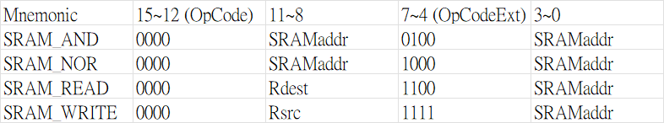
III-a. Function of our custom block
Support 4 additional instructions for SRAM
SRAM_AND or SRAM_NOR
Execute bitwise Boolean operations in 2 SRAM rows and store the result in one of them
SRAM_READ or SRAM_WRITE
Data transfer between register file and one of the SRAM address
Notes:
Our custom block, SRAM, support 4 additional functions. By using spare ISA encodes, we manage to use the same 16-bit ISA to complete our design.
Our SRAM_AND and SRAM_NOR…..
Our SRAM_READ and SRAM_WRITE….

Slide 12
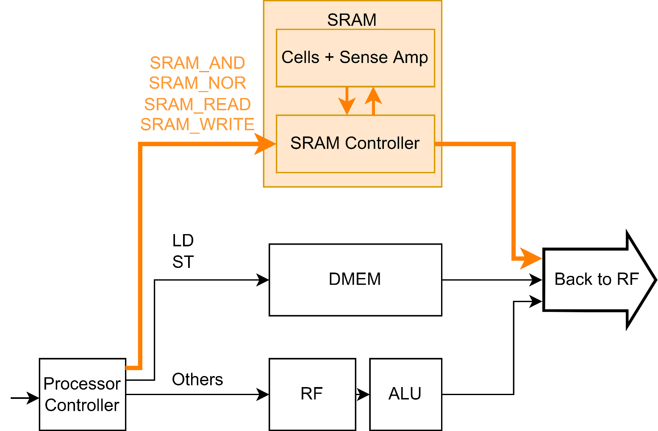
III-b. How we integrate the custom block into baseline (extra instructions)
Spare ISA encode
Instruction
Notes:
The following graph is the partial of our integrated design.
Since SRAM and DMEM are parallel in our memory hierarchy, SRAM and DMEM would also serve as a parallel structure in our design.
When executing the 4 SRAM related instructions, the processor controller would ensure sending the correct instruction and needed data to SRAM controller.
If the processor is executing SRAM_READ, it’ll use the datapath identical to DMEM and ALU to store the data to RF.

Slide 13
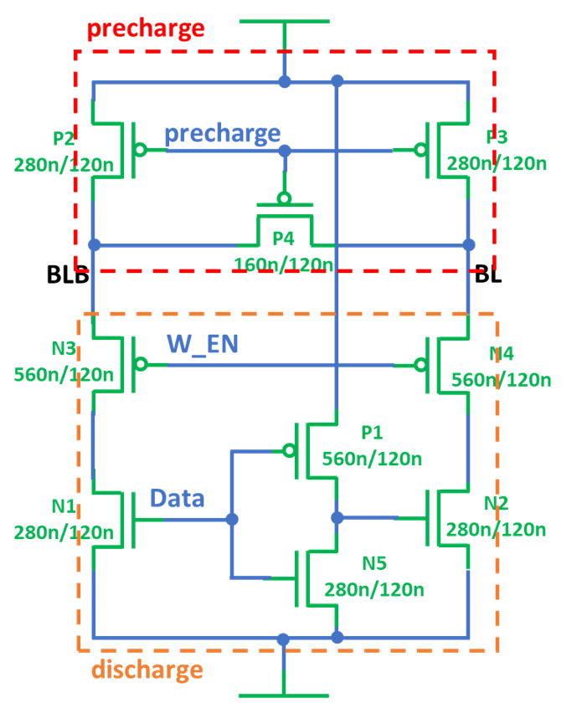
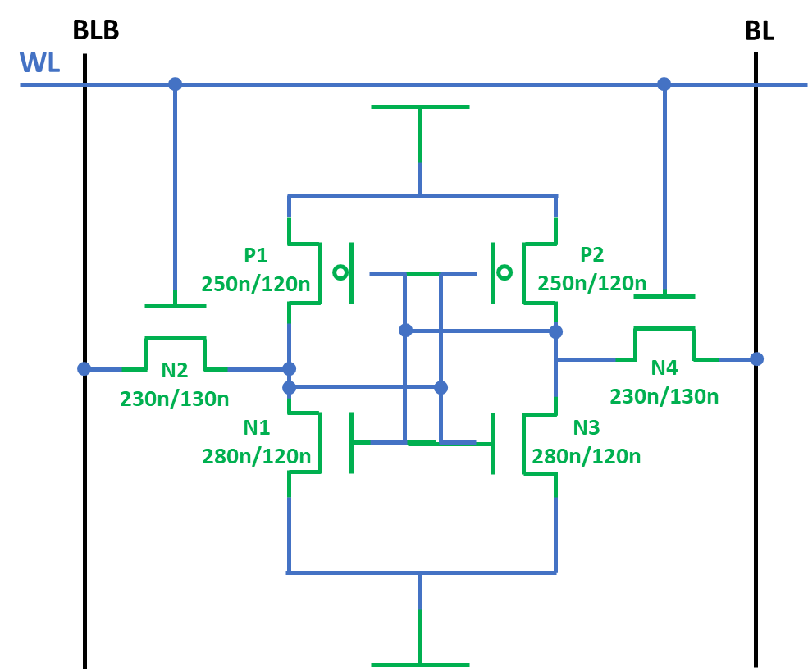
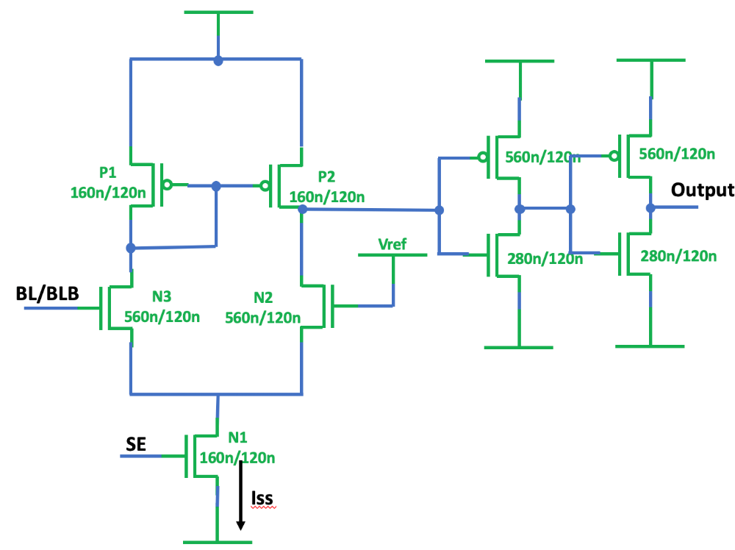
III-c. Design Considerations (Sizing)
Read stability: N1/N3>N2/N4
Leakage control: N2/N4 length↑
Write stability: N2/N4>P1/P2
Discharge stability: N>P, P2/P3>P4
Leakage control: N1/N2↓
Current mirror: P1=P2
Power control: N1 ↓
High to low: N2>P2
SRAM cell
Precharge & discharge
Sense amplifier
Notes:
To minimize the area of the design, we choose to implement 6T SRAM cell. ​
​
// We size the transistors in SRAM cell for the reasons introduced in the lecture.​
To maintain the read stability, the width of N1/N3 should be larger than N2/N4. To reduce the leakage current, the length of N2/N4 should be slightly larger than the other transistors. To maintain the write stability, the width of the two PMOS should be smaller than double of N2/N4.​
​
In the first half of each cycle, the precharge transistors should be turned on to precharge the BL to VDD. During write operaiton, the discharge path should turn on simultaneously with the precharge circuit. When both paths are conducting, the contention occurs. Thus, the discharge NMOS should be wider than the precharge PMOS. N1/N2 are smaller than N3/N4, because we want to reduce the leakage current. Although P4 is used to equalize BL and BLB voltage during precharge, BL and BLB shouldn’t be equalized when discharging, so P4 should be smaller then P2/P3 .​
​
In our design, we choose an analog based sense amplifier connected with a buffer. Size of P1 is equal to the size of P2, which makes P1 and P2 work as a current mirror. And size of N1 should be small since it functions as a current source, and smaller N1 means lower current and lower power consumption. After precharged, the output will stay at high or make a high to low transition. Therefore, N2 should be stronger than P2.

Slide 14
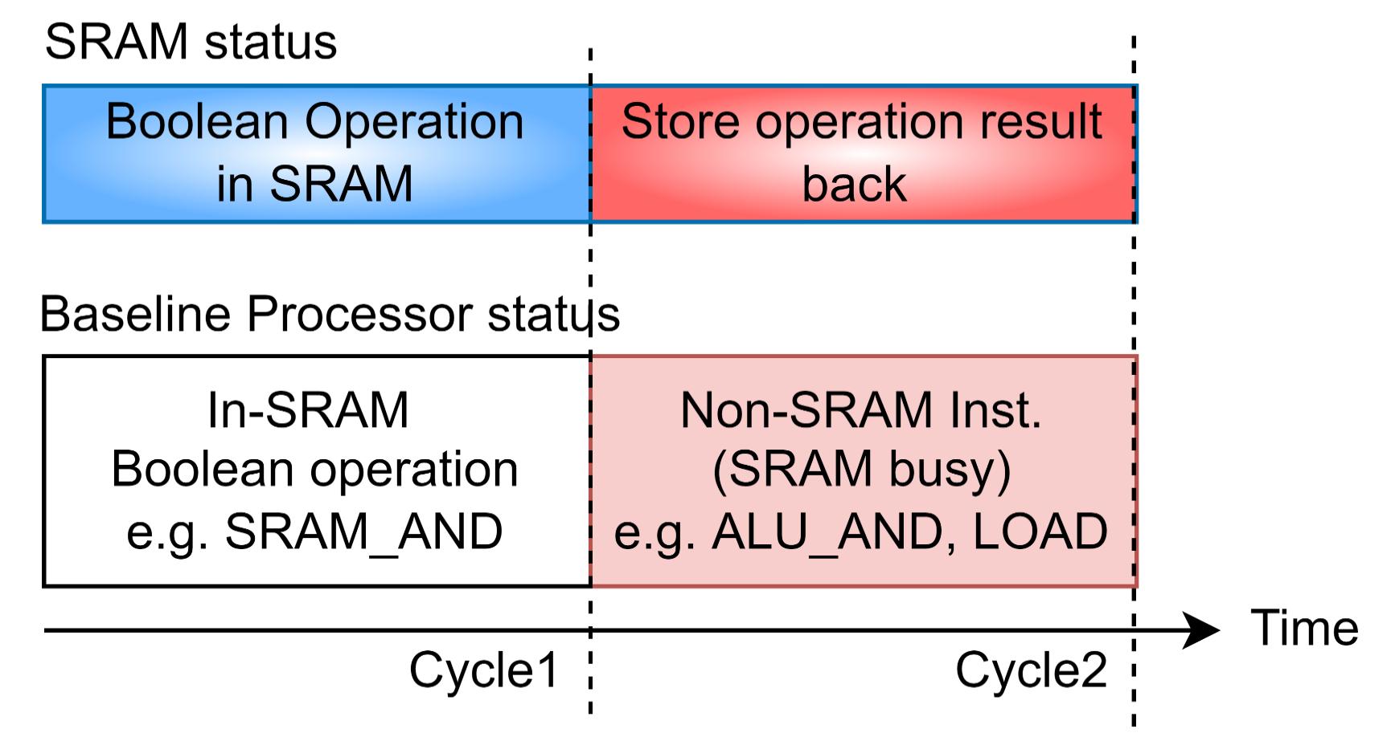
III-c. Design Considerations (Cycles)
Notes:
In our SRAM design, after executing the Boolean operation in SRAM, SRAM would enter the busy status in the next cycle because it’ll take another cycle to store the result back to SRAM.
Namely, SRAM wouldn’t execute the SRAM-related instruction right after the in-SRAM Boolean operation cycle.
Since the processor and SRAM operate in parallel, the processor can execute non-SRAM instruction during SRAM busy cycle.

Slide 15
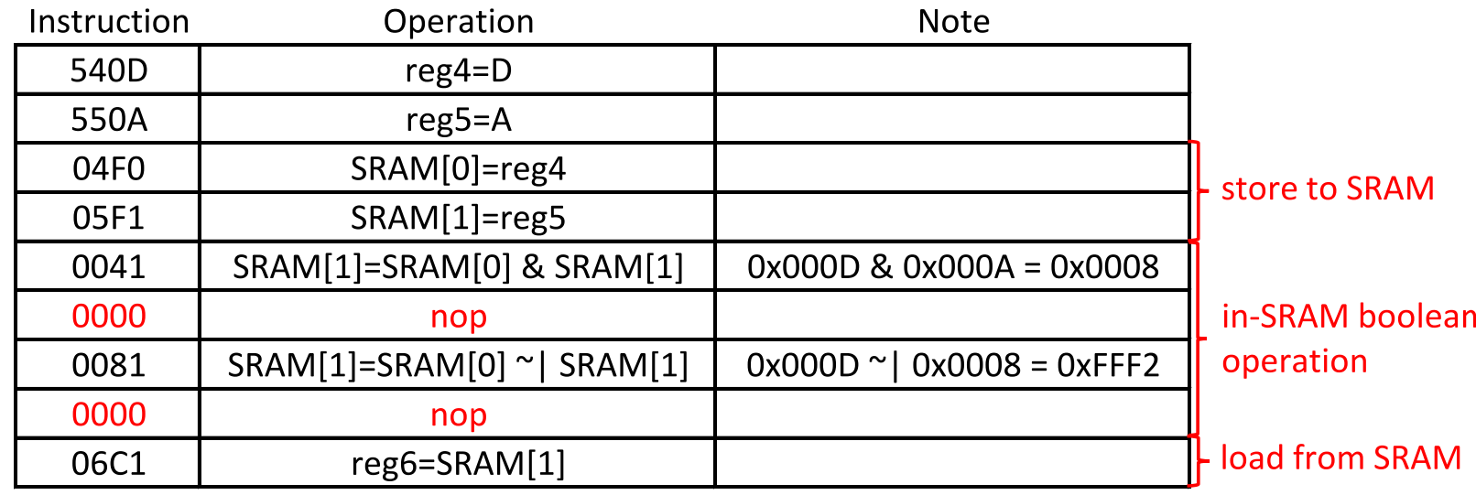
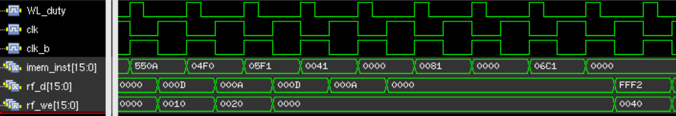
III-d. Show at least one operation for your custom block with baseline processor
store to SRAM
In-SRAM boolean operation
load from SRAM
Notes:
The table shows the testing assembly code, and it tests all four instructions in the testcase. The correctness of the SRAM functionality can be seen from the execution of 06C1 instruction, which grab the data in SRAM and store the value (shown as rf_d in the waveform) into RF. The expected result is same as the value on the waveform, which can conclude that our SRAM works well.

