Slide 1
SoundSense - Group 1
Sprint 3 — CNN Experiments & Wav2Vec2

Slide 2
CNN Model Architecture — MultiChannelCNN
From Feature Stack to Emotion
Key Choices
8-channel feature stack
mel · Δ · Δ² · rms · f0 · rolloff · bandwidth · contrast
Component
Choice
Input
8 of 11 channels · 128 × 110
Conv block 1 → 32 filters
3×3 conv · BatchNorm · ReLU · MaxPool · SpatialDropout 0.15
Dropped channels
chroma, pitch_conf, tempogram
Conv filters
32 → 64 → 128 (3×3)
Conv block 2 → 64 filters
same pattern — feature map halves again
Regularization
SpatialDropout 0.15 · Dropout 0.4
Conv block 3 → 128 filters
same pattern
Loss
CE + class weights + smoothing 0.1
Optimizer
Adam 3e-4 · cosine, 150 epochs
Adaptive avg pool 4×4
128 × 4 × 4 → 2,048 features
Trainable params
358 k (FC = 128)
FC head
Linear(2048 → 128) · ReLU · Dropout 0.4 · Linear(128 → 6)
Ensemble variant: FC = 128 and FC = 256 heads trained separately, softmax predictions averaged.

Slide 3
CNN Experiment Log
Run
Change
Result
1
Baseline — 7ch, ReduceLROnPlateau
0.634
start
2
SpecAugment (time + freq masking)
0.623
✗
3
+bandwidth, contrast (→ 8 channels)
0.639
✓
4
SpatialDropout2d + label smoothing
0.641
✓
5
CosineAnnealingLR · 150 epochs
0.647
✓
6
Focal loss γ=2
0.638
✗
7
Warm restart (LR kick after plateau)
0.649
✓
8
3-model ensemble (A+B+C)
0.654
★ best

Slide 4
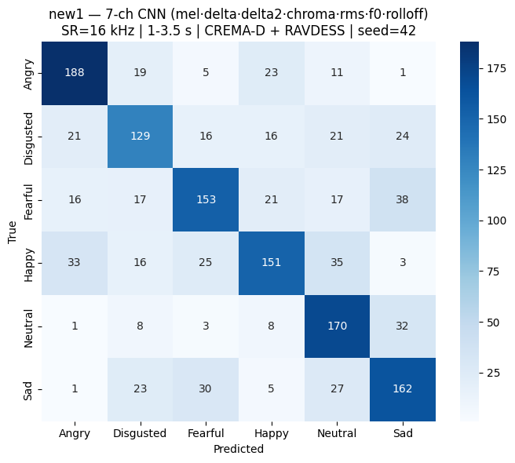
CNN Experiment

Slide 5
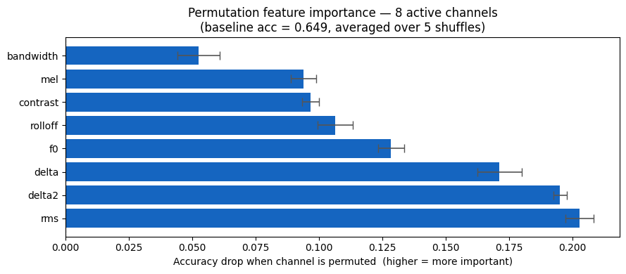
CNN Experiment

Slide 6
Best Results — 3-Model Ensemble (0.654)
Per-class F1
Structural Bottleneck
Class
Precision
Recall
F1
Disgusted F1 = 0.577 — never moved
Acoustically close to Angry
Both are high-arousal, negative-valence
RMS energy is our #1 feature — but
Angry + Disgusted share similar energy
No loss function or ensemble trick fixed it.
It's a data-level ceiling: not enough
actor diversity for Disgusted in
CREMA-D + RAVDESS.
Angry
0.739
0.769
0.754
Neutral
0.643
0.739
0.688
Sad
0.641
0.649
0.645
Happy
0.656
0.616
0.635
Fearful
0.631
0.599
0.614
Disgusted
0.600
0.555
0.577

Slide 7
Why Wav2Vec2— Moving Beyond Hand-Crafted Features
The Case for a Pretrained Encoder
CNN vs Wav2Vec
1. Feature ceiling at ~0.65
Hand-crafted mel + prosody is lossy —
we decide what to measure upfront.
2. Confusable classes need subtle cues
Fearful / Sad / Neutral separated by
breathiness, tension, speaking rate —
things mel spectrograms average out.
3. WavLM reads the raw waveform
24 transformer layers learn to capture
what we can't hand-engineer.
4. Weighted layer sum
Model picks which layers help most
for emotion (upper=semantics,
lower=phonetics/prosody).
CNN
WavLM
Input
8 hand-crafted ch
Raw 16 kHz waveform
Model
~200k params
300 M params
Optimizer
Adam / AdamW
LLRD (γ=0.95)
Loss
CE + class weights
Focal + class weights
Aug
None (hurt us)
Built-in SpecAugment
Split
Speaker-indep 80/20
Same — comparable
Dataset
CREMA-D + RAVDESS
Same

Slide 8
Wav2Vec2 Model Architecture — WavLM-large
From Raw Waveform to Emotion
Key Choices
Raw waveform
16 kHz mono · 1–5 s clips, capped at 5 s
Component
Choice
Backbone
WavLM-large · 300 M params
CNN feature encoder — FROZEN
pretrained conv front-end → 20 ms frames
Feature encoder
Frozen (CNN front-end)
Layer sum
Trainable weight per layer
24 transformer layers — fine-tuned
hidden = 1024 · learns prosody, tension, rate
Head
Linear(1024 → 6)
Class weights
Balanced — helps Disgusted
Weighted layer sum
trainable scalar per layer — model picks the mix
Trainable params
~311 M
Same dataset, speaker-independent split, and seed as the CNN runs — results are directly comparable.
Classification head
Linear(1024 → 6 emotions)

Slide 9
Wav2Vec2 Experiment - 0.732
Per-class F1
Class
Precision
Recall
F1
Angry
0.765
0.945
0.846
Neutral
0.711
0.928
0.805
Sad
0.556
0.679
0.611
Happy
0.911
0.649
0.758
Fearful
0.719
0.541
0.617
Disgusted
0.827
0.682
0.748

Slide 10
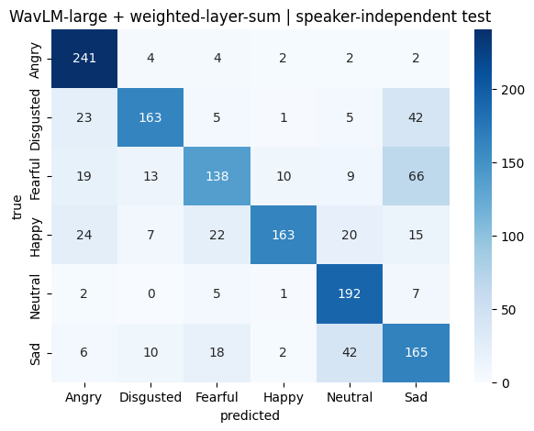
Wav2Vec2 Experiment

Slide 11
Thank You
Group 1 · SoundSense · Sprint 3

