Slide 1
2016 eQuotation SOP
30th June 2016

Slide 2
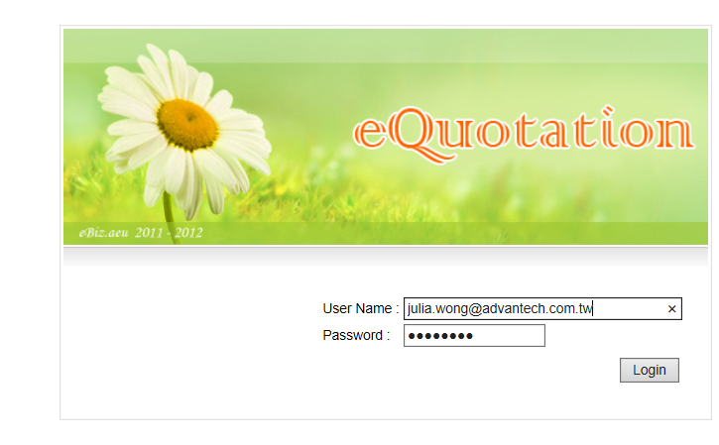
Step 1. Log in eQuotation
http://eq.advantech.com/login.aspx

Slide 3
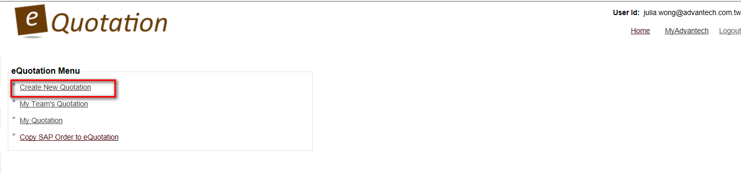
Step 2-1. Create New Quotation
http://eq.advantech.com/login.aspx
Create a new quotation.
View my quotation.
Create quotation from previous SAP/eStore order/quotation.

Slide 4
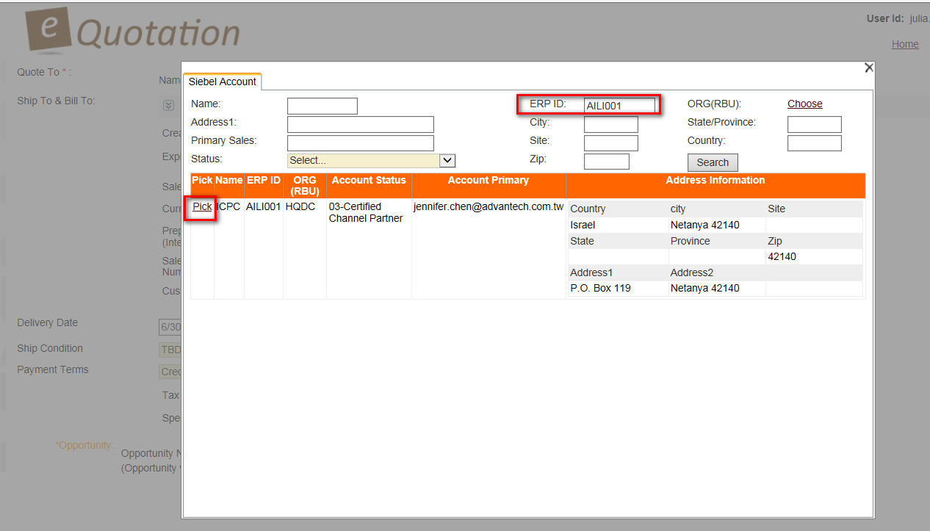
Step 2-2. Pick Quotation Account
http://eq.advantech.com/login.aspx
1. Fill in at least 1 Siebel account info to query.
2. Pick 1 Siebel account.

Slide 5
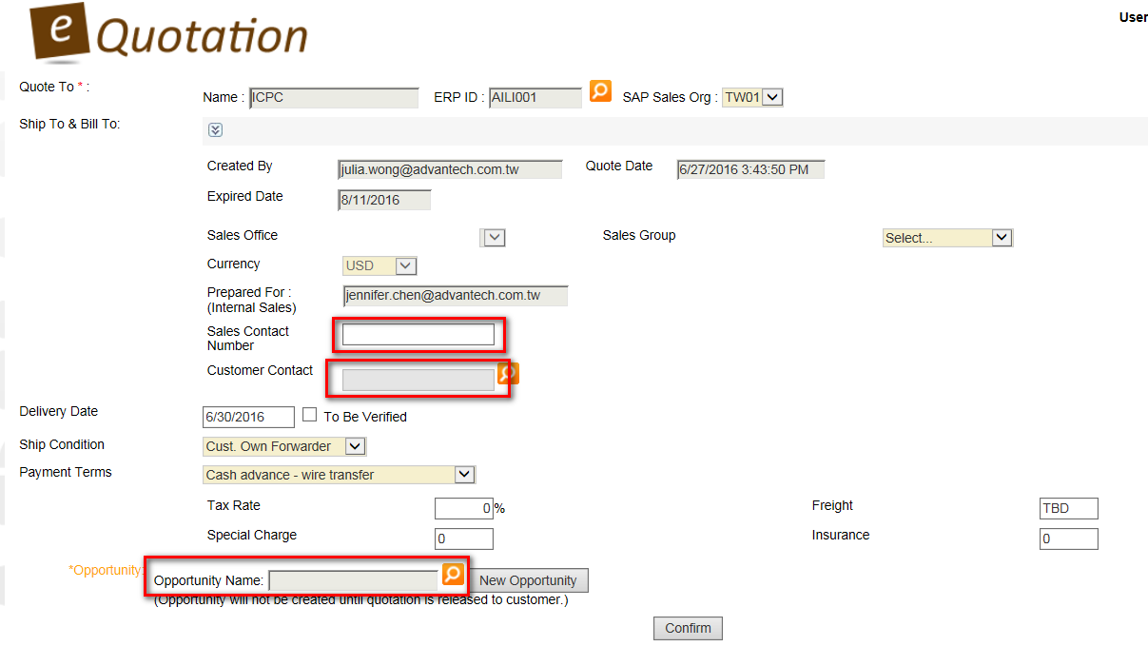
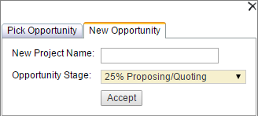
Step 2-3. Fill in Quotation Basic Info
http://eq.advantech.com/login.aspx
1. Fill in your contact number
2. Pick account Siebel contact
1. Fill in your contact number
2. Pick account Siebel contact
3. If order quota will be shared, select multiple sales.
4. Fill in quotation reference no..
5. Type or pick this quotation’s Siebel oppty by project
name or create an oppty directly via eQ.
(*Oppty stage can’t be 0% or 100%)
3. Type or pick this quotation’s Siebel oppty by project
name or create an oppty directly via eQ.
(*Oppty stage can’t be 0% or 100%)

Slide 6
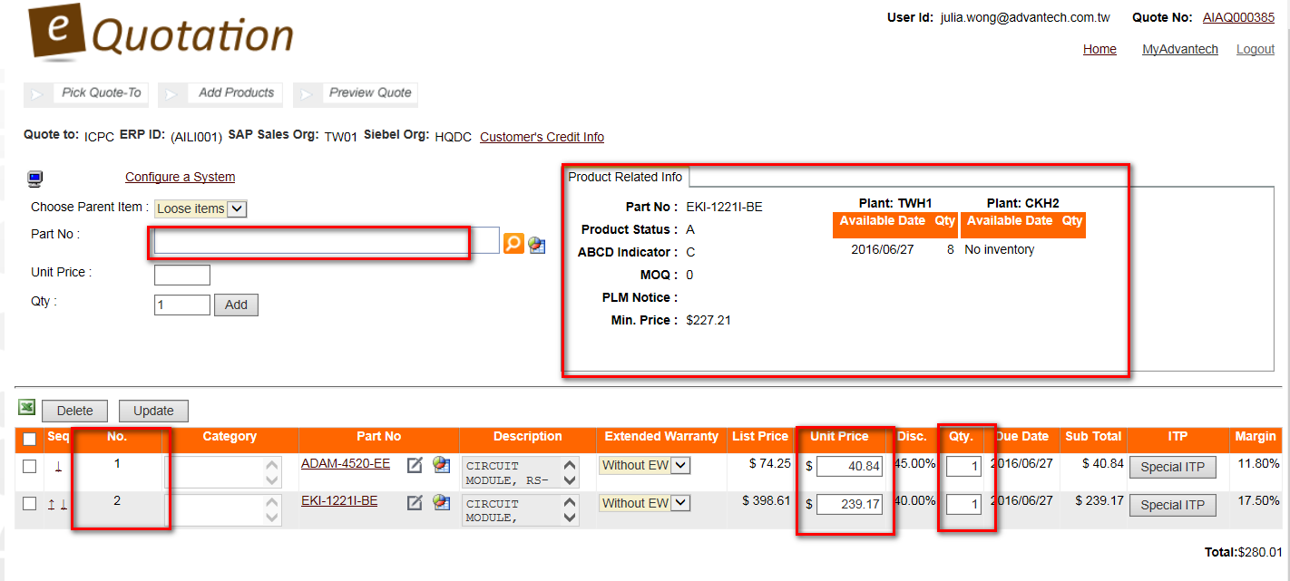
Step 3-1. Add Standard Product PN into Quotation
http://eq.advantech.com/login.aspx
2. Check PN Status/inventory here
1. Search standard product PN
3. Modify price & qty.
3. Modify Price & Q’ty
Draft Quotation is created once clicked confirm

Slide 7
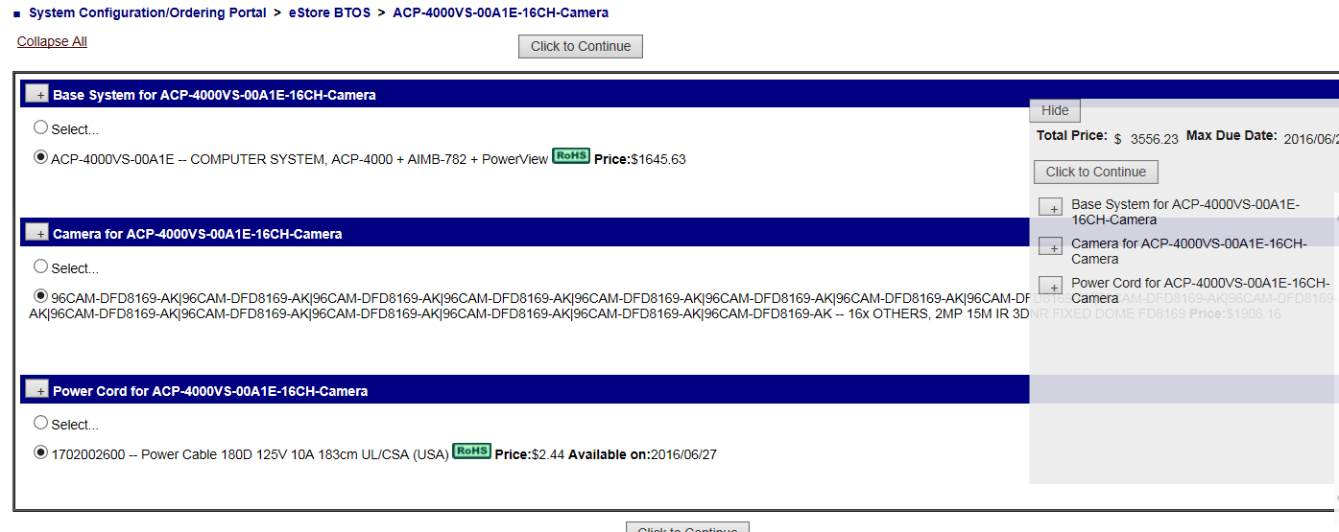
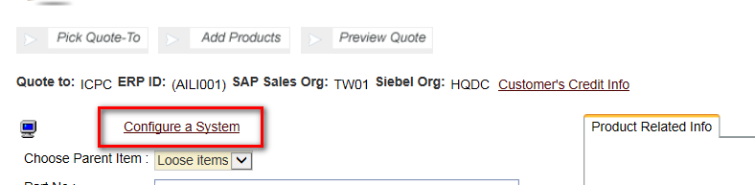
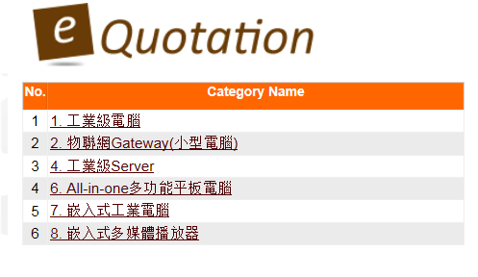
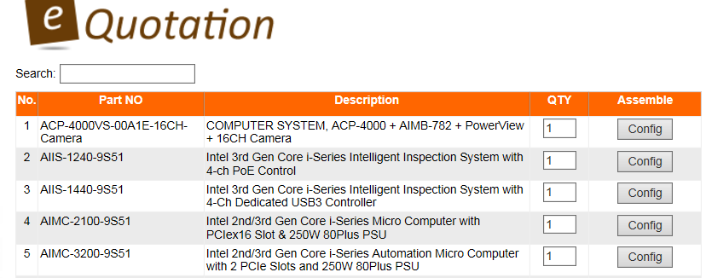
Step 3-2. Pick CTOS Items from eStore CBOM
http://eq.advantech.com/login.aspx
1. Select from eStore products.
4. Pick CTOS items to add to quotation.
2. Select eStore CTOS category.
3. Pick the CTOS PN.

Slide 8
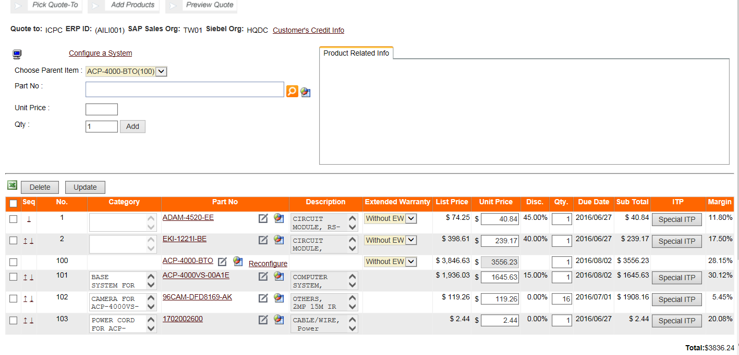
Step 3-2. Pick CTOS Items from eStore CBOM
http://eq.advantech.com/login.aspx

Slide 9
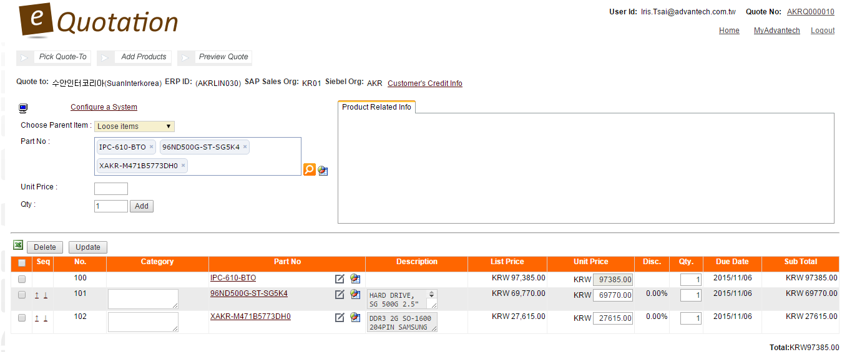
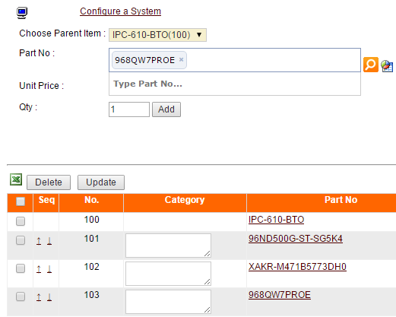
Step 3-3. Add CTOS Items Manually
http://eq.advantech.com/login.aspx
Put parent item first.
1. Add CTOS items
manually one by one.
2. To add another item into CTOS group, choose parent item first.
IMPORTANT:
To show only total price of CTOS, please group items no. together.
eg.
100,101,102,103 → CTOS1
200,201,202,203 → CTOS2
Notes:
Parent item example: IPC-610-BTO

Slide 10
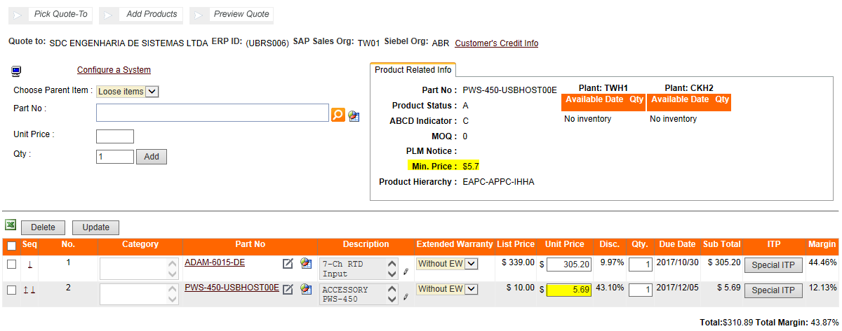
Step 3-4. GP approval
http://eq.advantech.com/login.aspx
Only when Unit Price is lower than minimum price + GP is lower than 15%, the GP approval process starts.
34050004
34050004

Slide 11
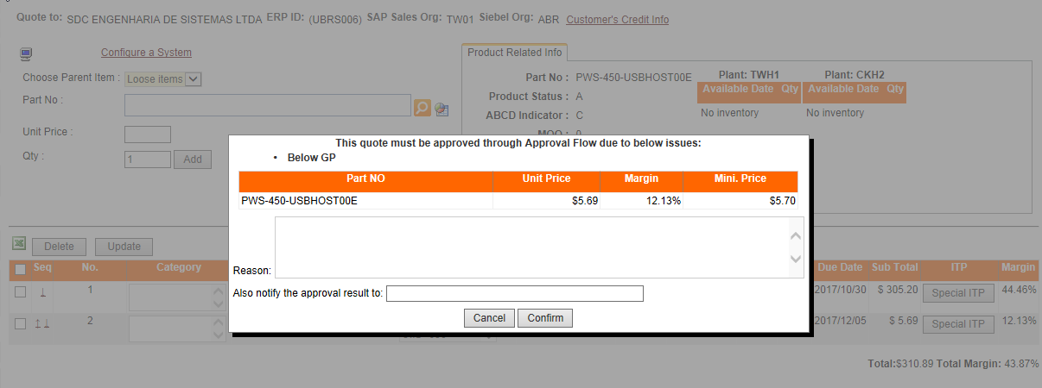
Step 3-4. GP approval
http://eq.advantech.com/login.aspx
Fill in low GP reason for reference.
34050004
34050004
34050004

Slide 12
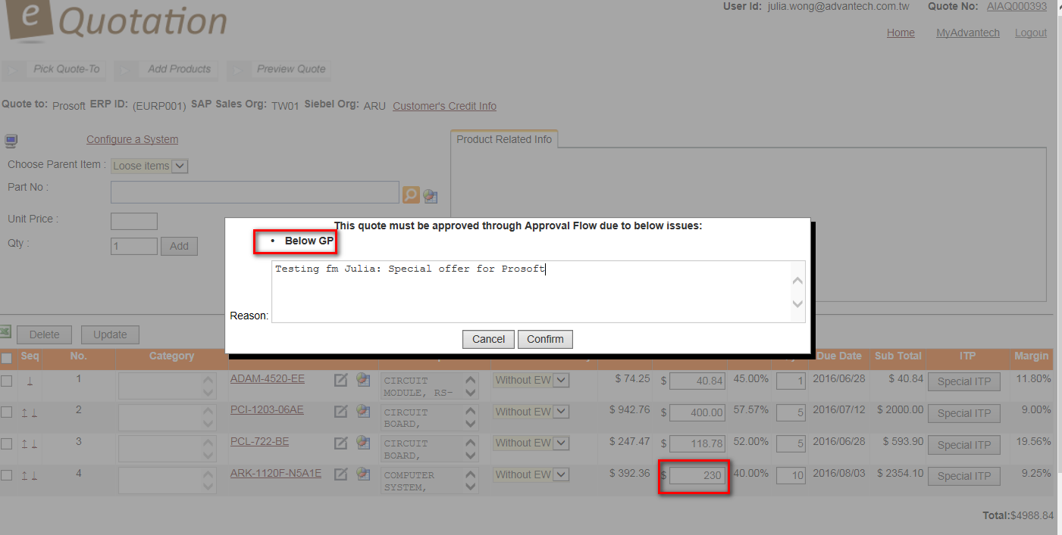
Step 3-4. Line item GP is lower than 15% (Prosoft)
http://eq.advantech.com/login.aspx
34050004
34050004
34050004

Slide 13
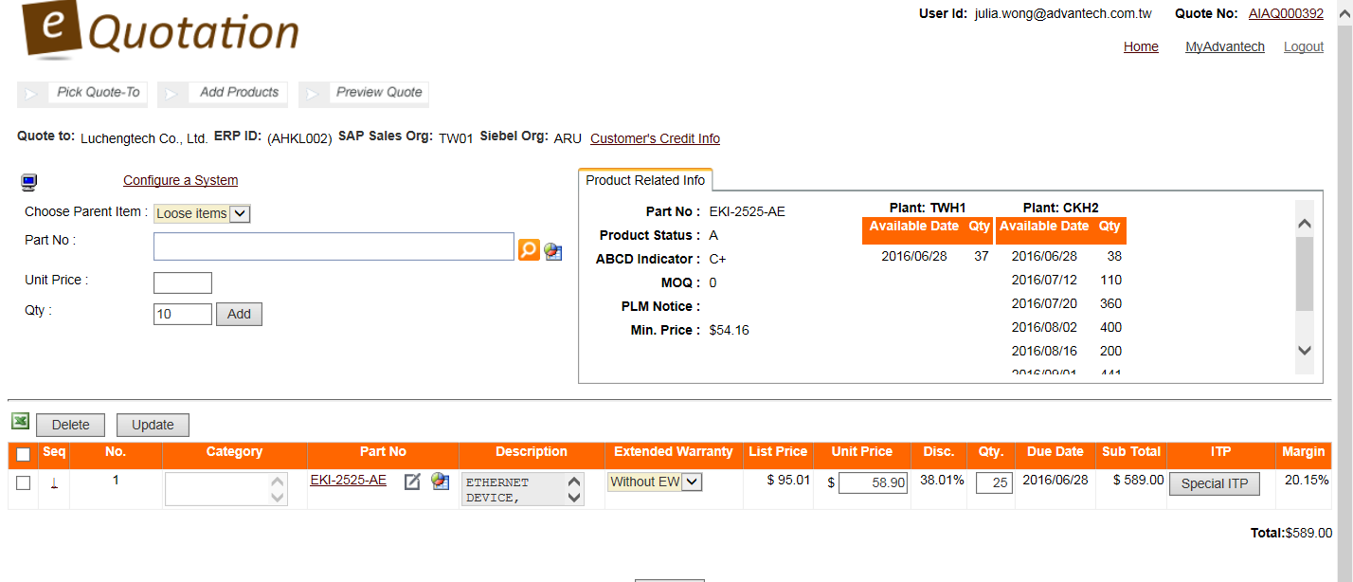
Step 3-5. Revise ITP after applying SPR
http://eq.advantech.com/login.aspx
GP is 20.15% before updating the Unit price & ITP

Slide 14
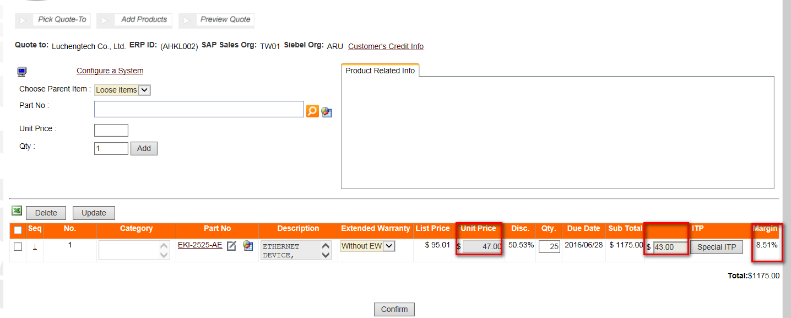
Step 3-5. Revise ITP after applying SPR
http://eq.advantech.com/login.aspx
1. Click Special ITP, 2. Key in SPR# to update the ITP
GP is updated to 8.51% after updating the line item unit price and special ITP
eQ will not start the GP Control Approval Flow if you have already applied SPR via EZ.

Slide 15
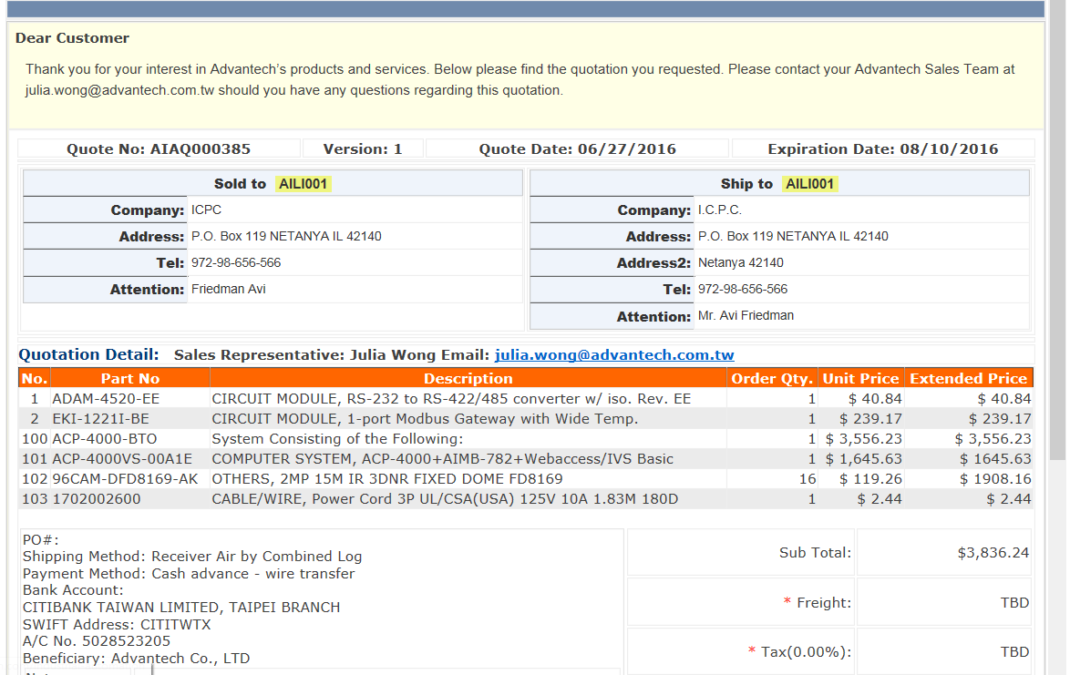
Step 4-1. Preview & Finish Quotation Creation
http://eq.advantech.com/login.aspx
If the line item profit is below 15%, eQ will start GP control approval flow. (appendix2)
34050004
34050004
34050004

Slide 16
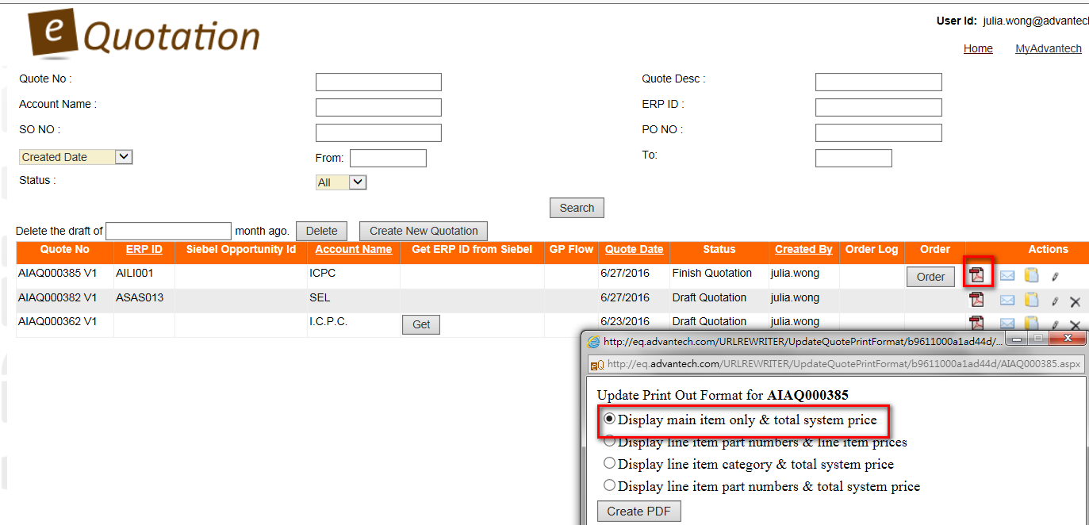
Step 4-2. Display Main item only & total system price
http://eq.advantech.com/login.aspx

Slide 17
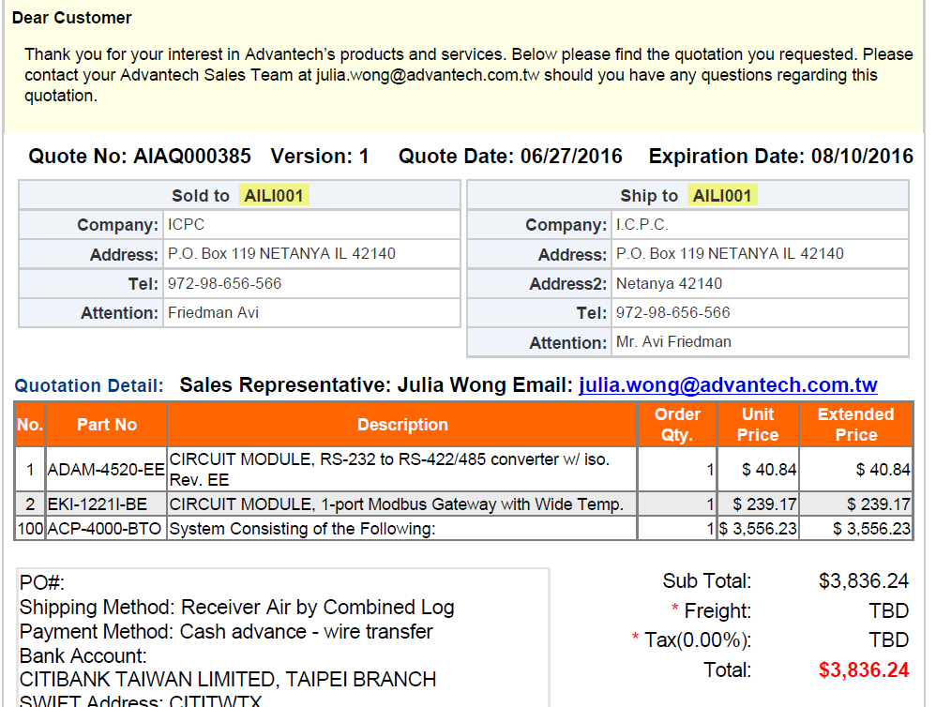
Step 4-3. Display Main item only & total system price
http://eq.advantech.com/login.aspx

Slide 18
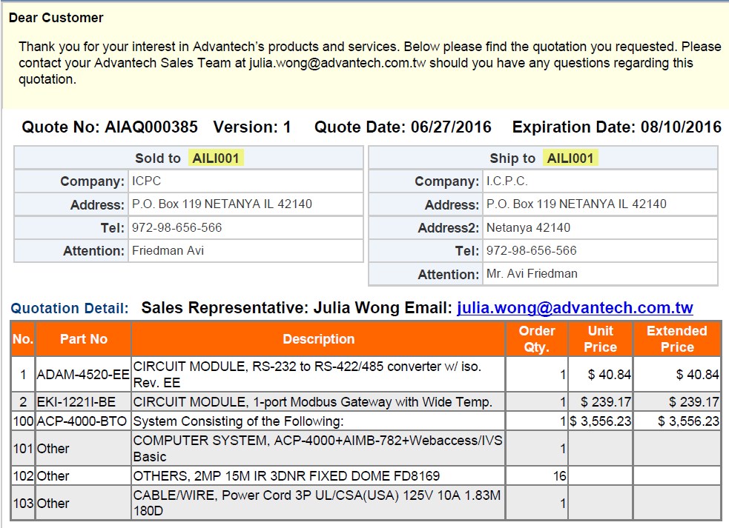
Step 4-4. Display line item category & total system price
http://eq.advantech.com/login.aspx

Slide 19
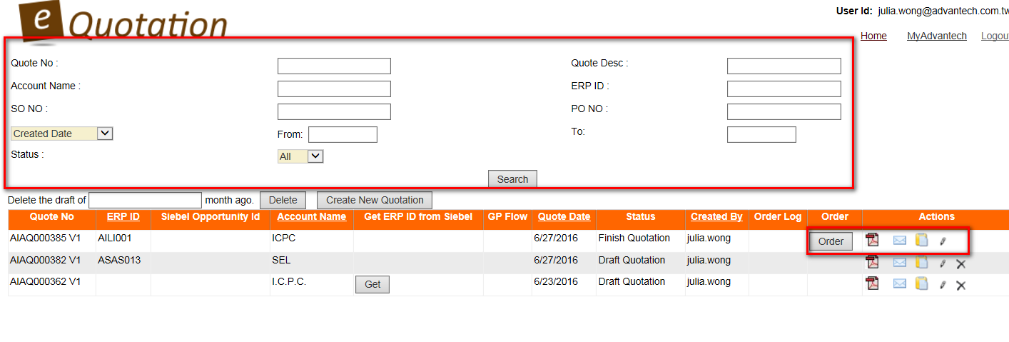
Step 5. Revise & Create New Version
http://eq.advantech.com/login.aspx
Search specific quotations by filling at least 1 field.
Attach product images here.
6..
1.
2.
3.
4/.
5..
1. Download quotation pdf
2. Send quotation w/ email greeting & product images. (appendix4)
3 Copy old quotation to create a new one.
4. Edit/create new version of quotation. (appendix3)
5. Delete Quotation
6. Convert quotation to SAP order directly

Slide 20
Appendix

Slide 21
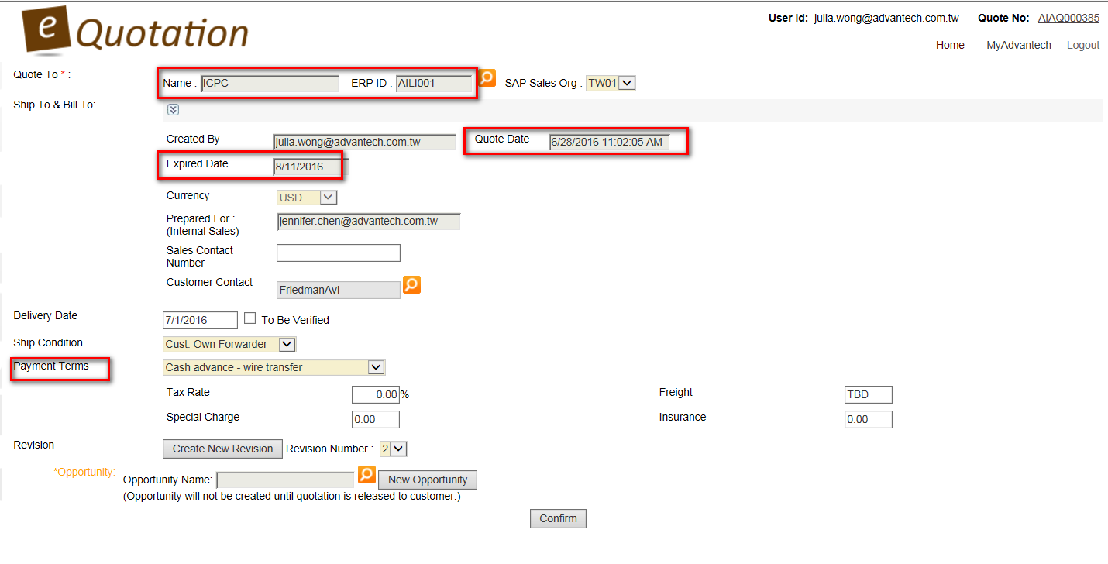
Appendix1. What Will Display on Final Quotation?
http://eq.advantech.com/login.aspx
Account Name (SAP)

Slide 22
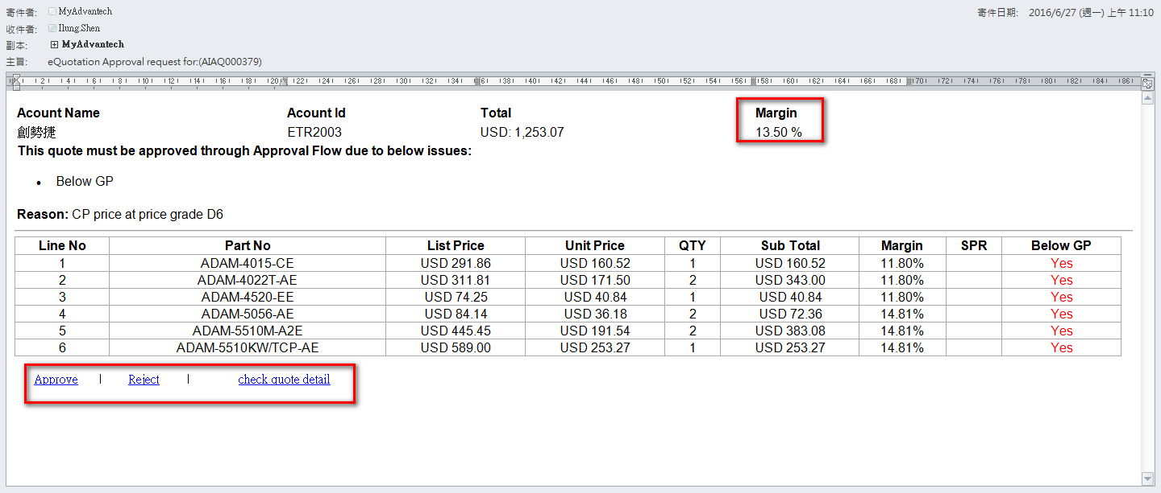
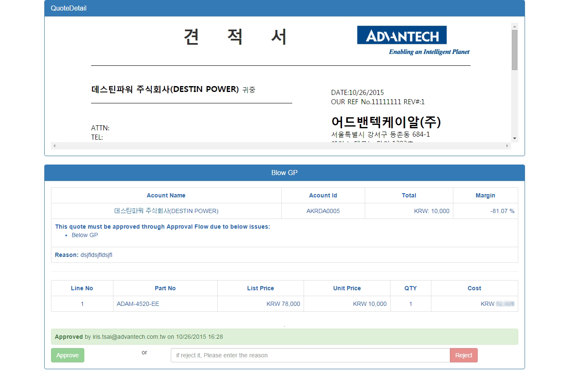
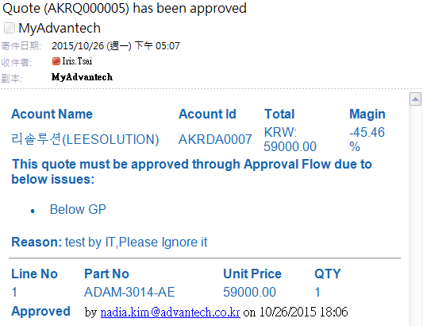
Appendix 2. Quotation GP Control Approval (MEA, AKR)
http://eq.advantech.com/login.aspx
1.
eQuotation will send approval notification to Ilung/ Mark for approval.
Approve or reject quotation
2.
Sales will receive notification once Manager approved/rejected.
Approve or reject quotation, and fill in reject reason.

Slide 23
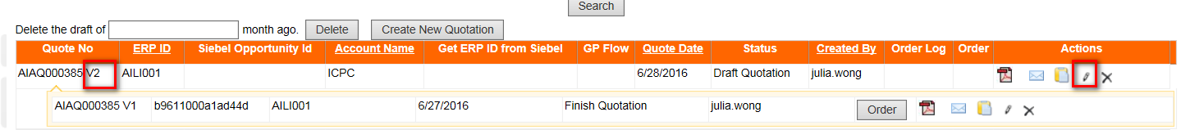
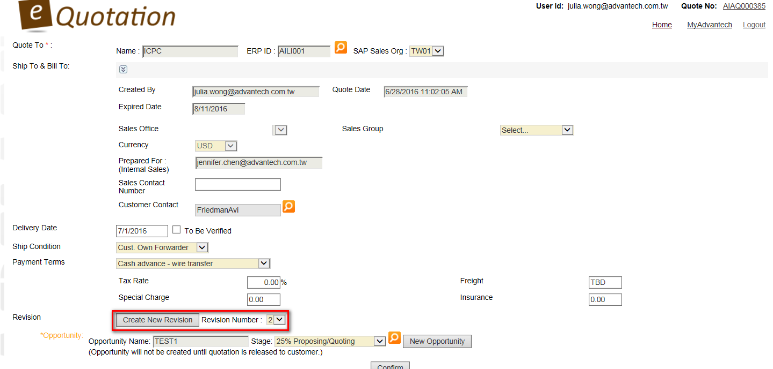
Appendix3. Revise Quotation & Create Multiple Versions
http://eq.advantech.com/login.aspx
1. Click Edit.
2. 2nd version will be created.
1. Click Create New Revision
1. Click Create New Revision.

Slide 24
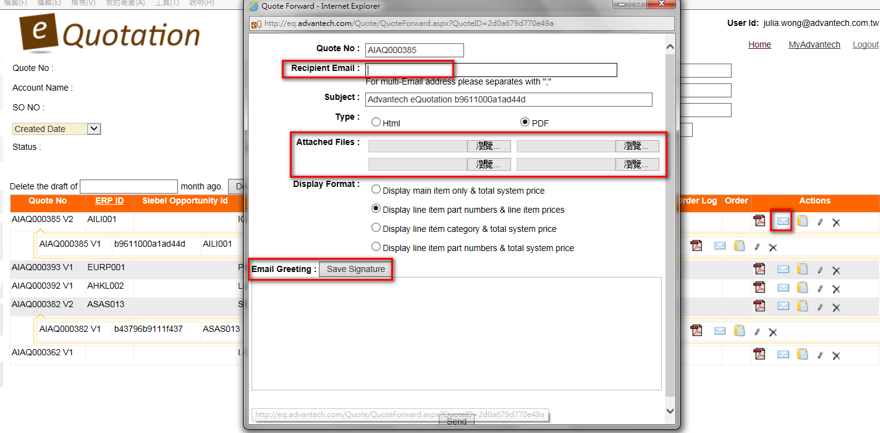
Appendix4. Attach Product Image ,Save Greeting Template
http://eq.advantech.com/login.aspx
Attach product images.
(* each image size max.1MB, file type: png, jpg, gif, bmp)
Save your greeting template

