Slide 1
ACN EIoT & AiSC eQuotation SOP
Iris.Tsai & Patty Chen
OMCC
2017/8

Slide 2



Benefits of launching eQuotation
Simplify the process of issuing and converting quotes
Forecast and manage business insights
Enhance info accuracy on quotations:
Linked with Siebel/SAP
Integrate CBOM from MyAdvantech for system configuration
Accelerate quotation issuing
Convert quotes to orders in one click
Eliminate manually key-in quotes
Check GP automatically
Monitor organizational profit
Predict sales revenue
Predict goods supply

Slide 3
eQuotation: quote/convert quotes process
Create a Siebel Account
Copy / recreate the quote
Apply for SPR (if needed)
Create an eQuotation quote
Check GP
Failed
Pass
Failed
Manager approval
Pass
(Send a quote)
(Send a quote)
No SAP Account
No Siebel ERPID
SAP Account
Siebel ERPID
No SAP Account
No Siebel ERPID
SAP Account
Siebel ERPID
Create SAP Account
Maintain Siebel ERPID
Create SAP Account
Maintain Siebel ERPID
Convert the eQuotation quote to an SAP order

Slide 4
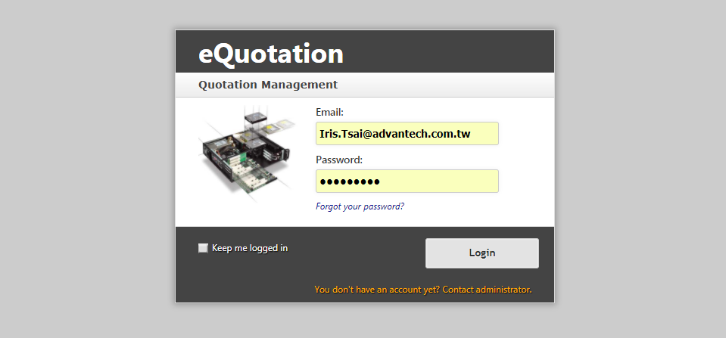
Step 1: Log in eQuotation with EZ account

Slide 5
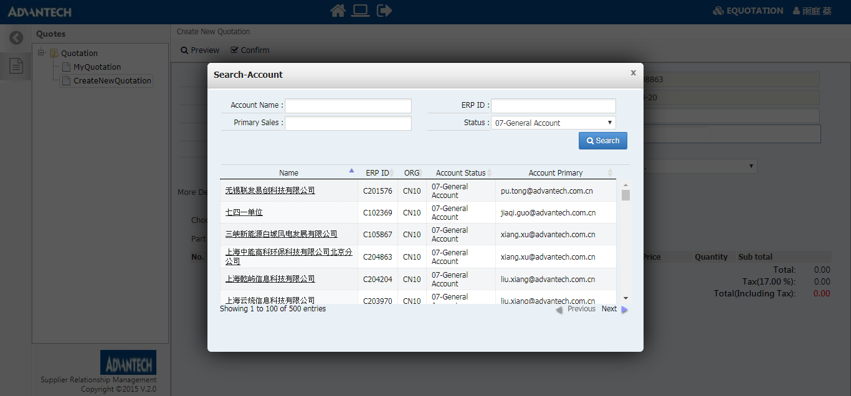
Step 2: Search Siebel account info and select a customer

Slide 6
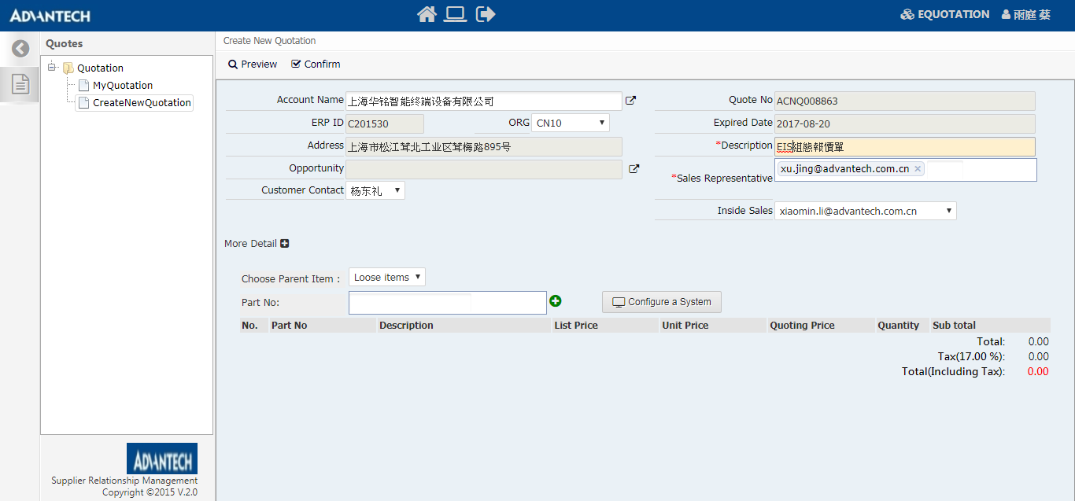
Step 3: Fill in quote information
SAP Account Org: company name on invoice, bank account, and payment terms
This info will only show in the system, not on the quotation itself.
Select customer contact (list from Siebel Account)
Assign an inside sales to convert the quote (SAP Sales List)
Select quote sales
(SAP Sales List)

Slide 7
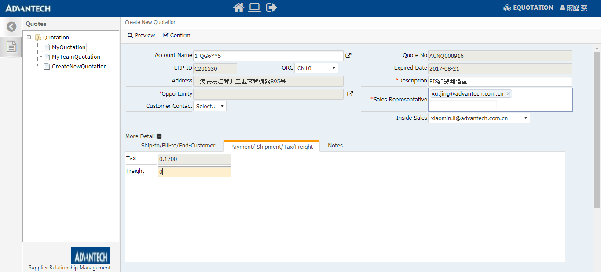
Step 3: Fill in shipping cost (optional)
Confirm Ship-to/Bill-to/End-Customer info

Slide 8
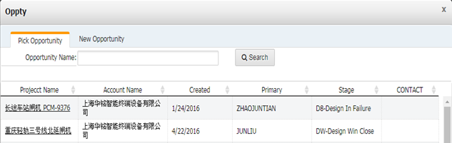
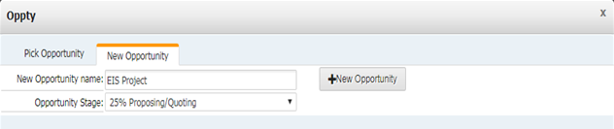
Step 4: Opportunity linked to Siebel
Link to an existing Opty
Or create a new Opty

Slide 9
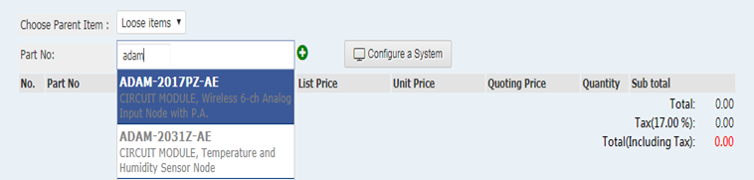
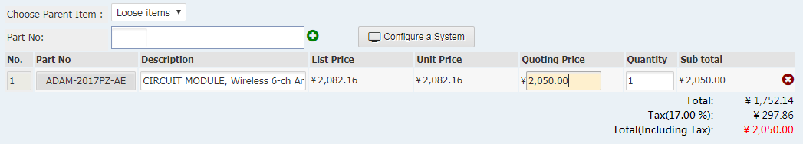
Step 5: Search / Quote Standard products
Search by P/N
Check stock status
Modify Desc. shown on quotes

Slide 10
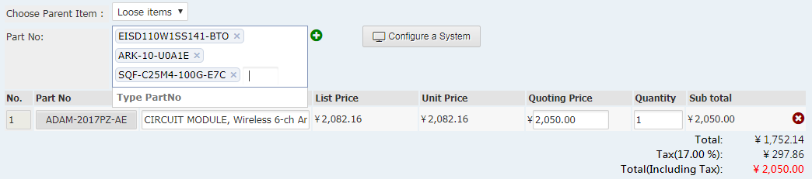
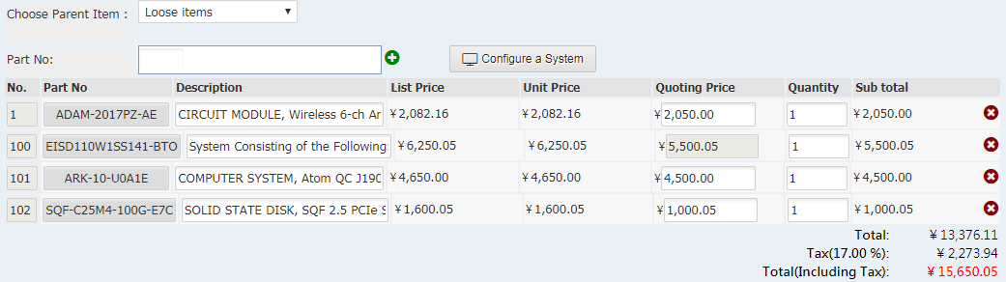
Step 5: Search / Quote Assembled products
Search by P/N
Check stock status
Modify Desc. shown on quotes
.
Fill in quote price

Slide 11
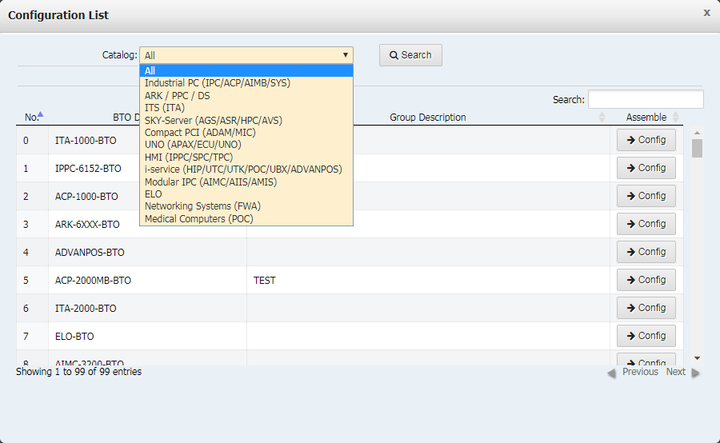
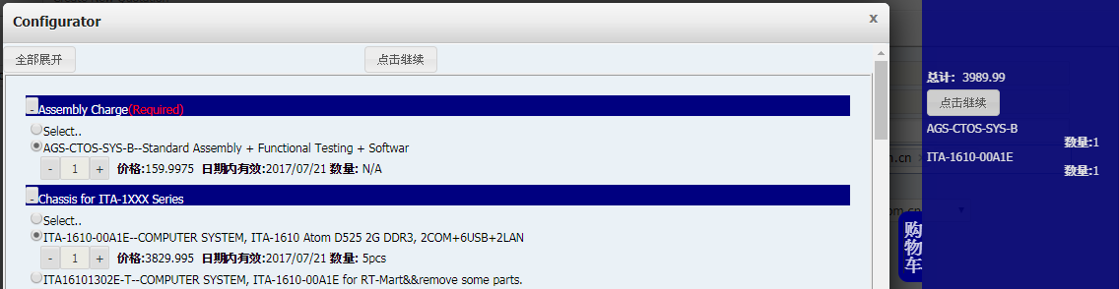
Step 5: Pick / Quote Assembled products
Select catalog and parent item or select parent item to configure.
Select sub-items under parent item by P/N
Linked to CBOM on ACN MyAdvantech, maintained by Bruce.Lee/Tianlan.ji

Slide 12
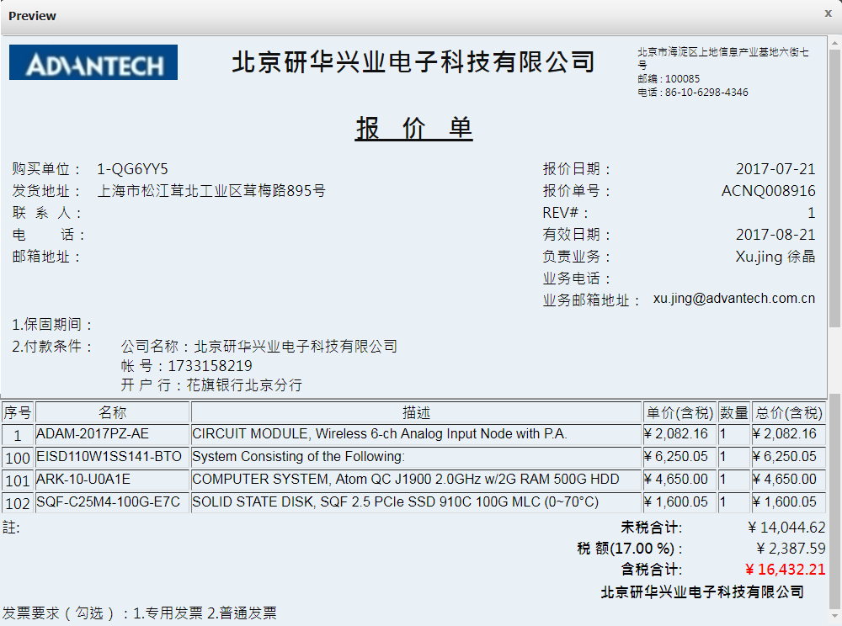
Step 6: Preview / finish a quotation

Slide 13
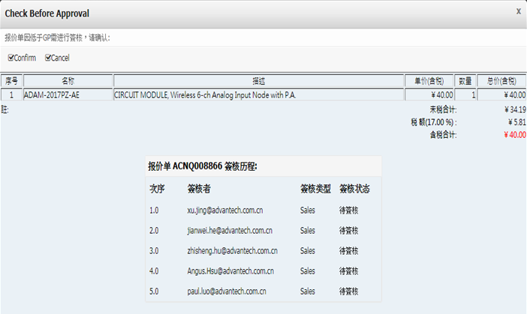
Step 7: Quotation approval process (below GP)
Confirm quote going for approval process
Check approval status

Slide 14
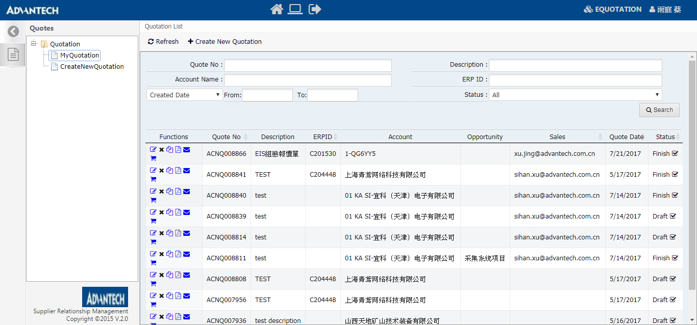
Step 8: Edit/Delete/Copy/Download PDF/Send quote
Search existing quotes

Slide 15
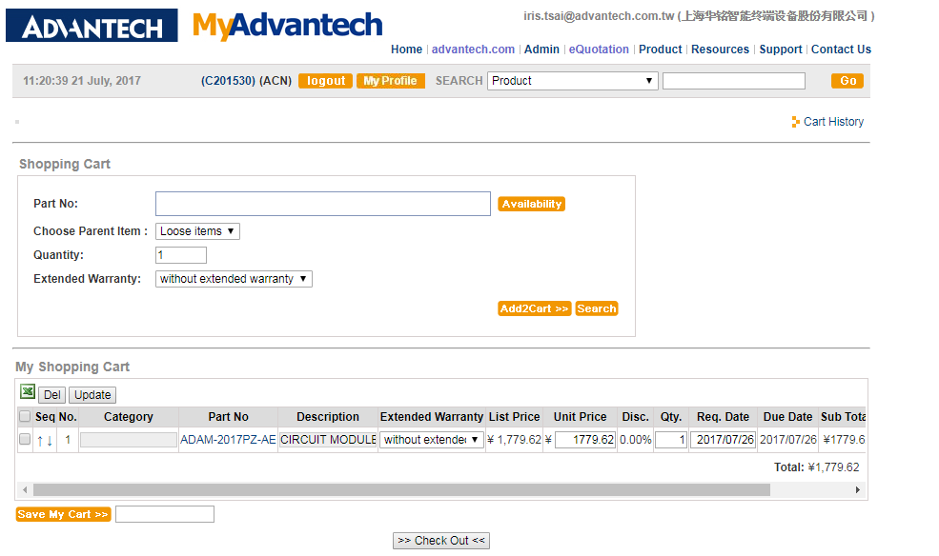
Step 9: Convert quotes to orders
报价单转订单
Can adjust qty and Req. Date

Slide 16
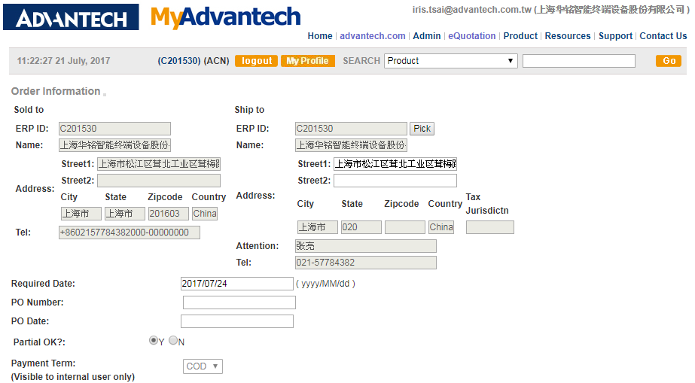
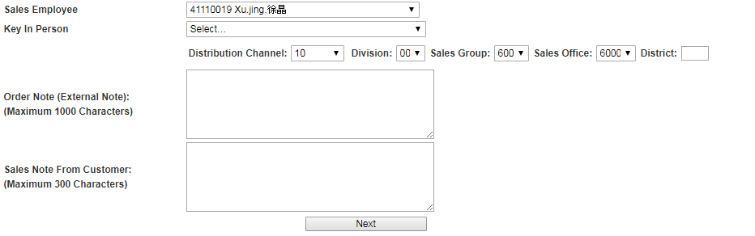
Step 9: Quote converted into order – Confirm order info
Requested delivery date
Partial shipment or not
Auto select the inside sales converting the quote to order

Slide 17
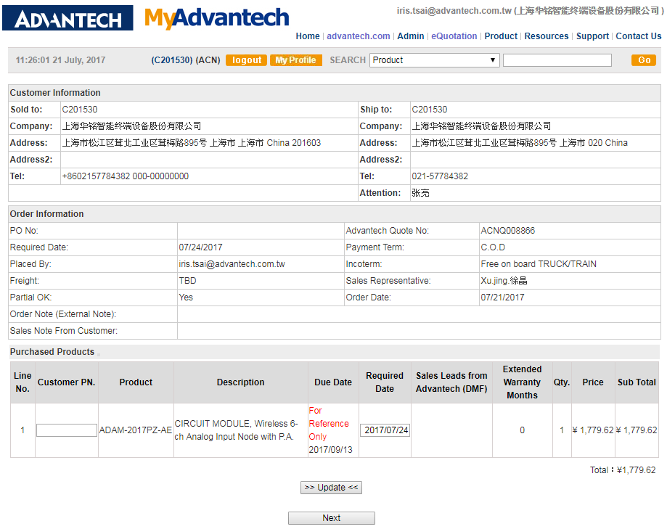
Step 9: Quote converted into order–Specify required date of each P/N

Slide 18
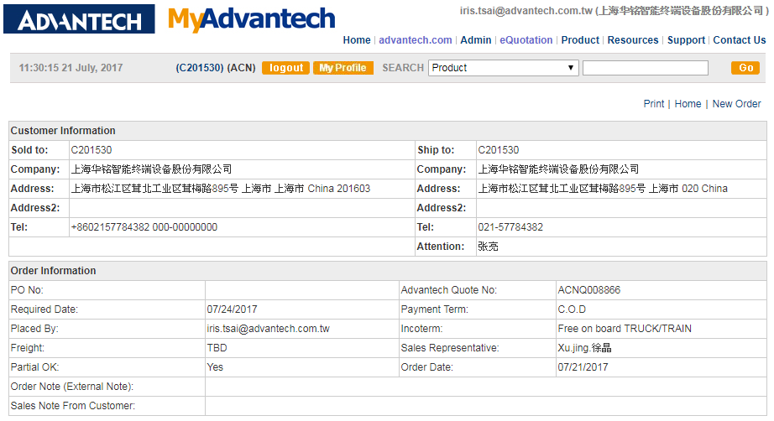
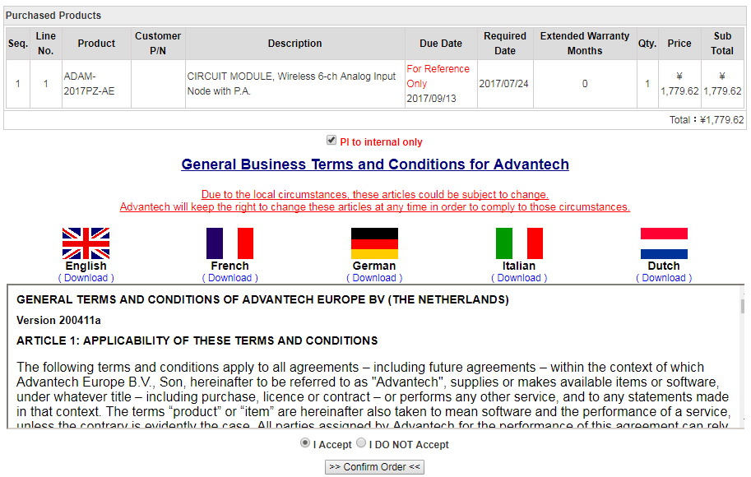
Step 9: Quote converted into order – final check & confirm order entry
Inform SAP Account responsible sales

Slide 19
Appendix: Fields on quotations
ORG
Account Name
Siebel Account Address
Customer Contact
ORG
Key in warranty period
Sales Representative
Quoting Price
Qty
Part No.
Description

Slide 20
Appendix: eQuotation sync with Opty/Quote/Product FCST
eQuotation sync with Siebel on Opty/Quote/Product FCST fields
Create a quote | Update quote timely | Convert quote into order
Project Name Opportunity Stage (5%) Total Revenue Product Forecast Primary Owner Create Date | Opportunity Stage Total Revenue Product Forecast Primary Owner | Opportunity Stage (100%) Total Revenue Product Forecast Primary Owner Close Date
Sales managers can review eQ Opty with Siebel reports
PSM can manage forecast product demand via Siebel PSM reports
(Quotes with Opty stage over 50% are included.)

Slide 21
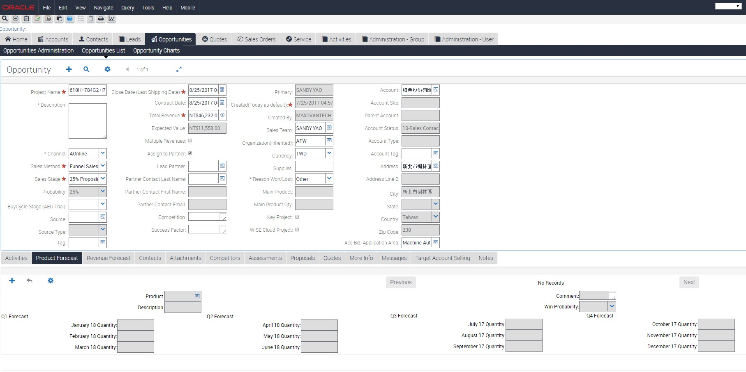
Appendix: eQuotation sync with Opty/Quote/Product FCST

Slide 22
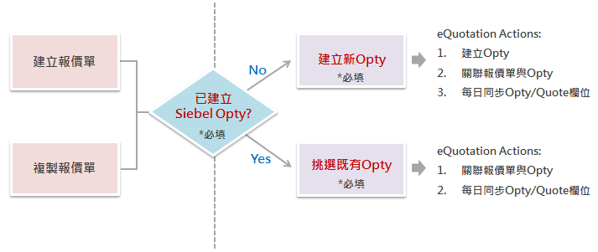
Appendix: eQuotation Opportunity rules
Create/copy a quote: select whether Opty has been created
NO → Create a new Opty on eQuotation to continue
YES → Select an existing Opty to continue

Slide 23
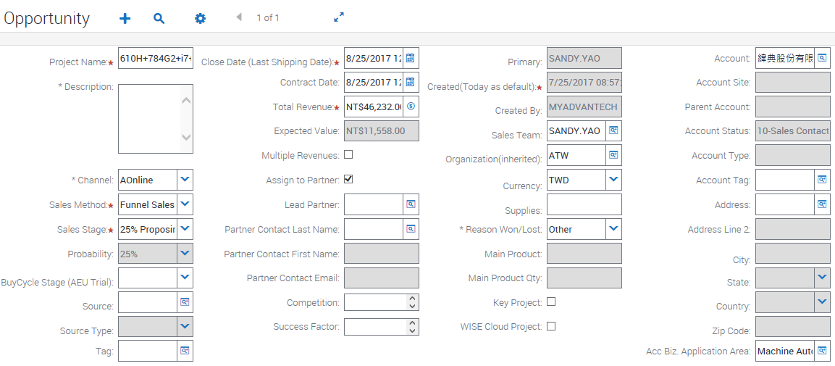
Appendix: eQuotation sync with Siebel Opportunity fields
eQuotation auto-creates/updates opportunities on Siebel with the yellow fields

Slide 24
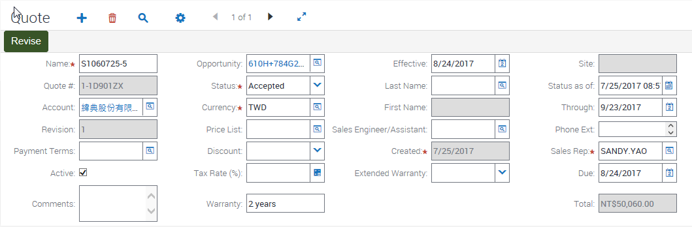
Appendix: eQuotation sync with Siebel Quote fields
eQuotation auto-creates/updates quotes on Siebel with the yellow fields

Slide 25
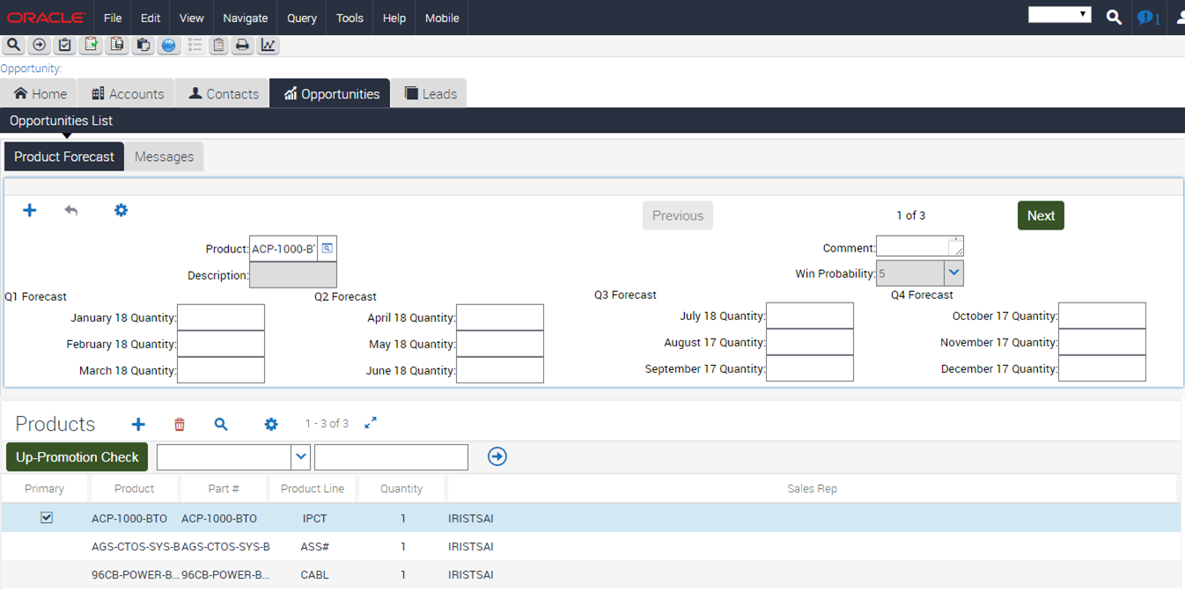
Appendix: eQuotation sync with Siebel Product FCST fields
eQuotation auto-updates forecast on Siebel with the yellow fields

