Slide 1
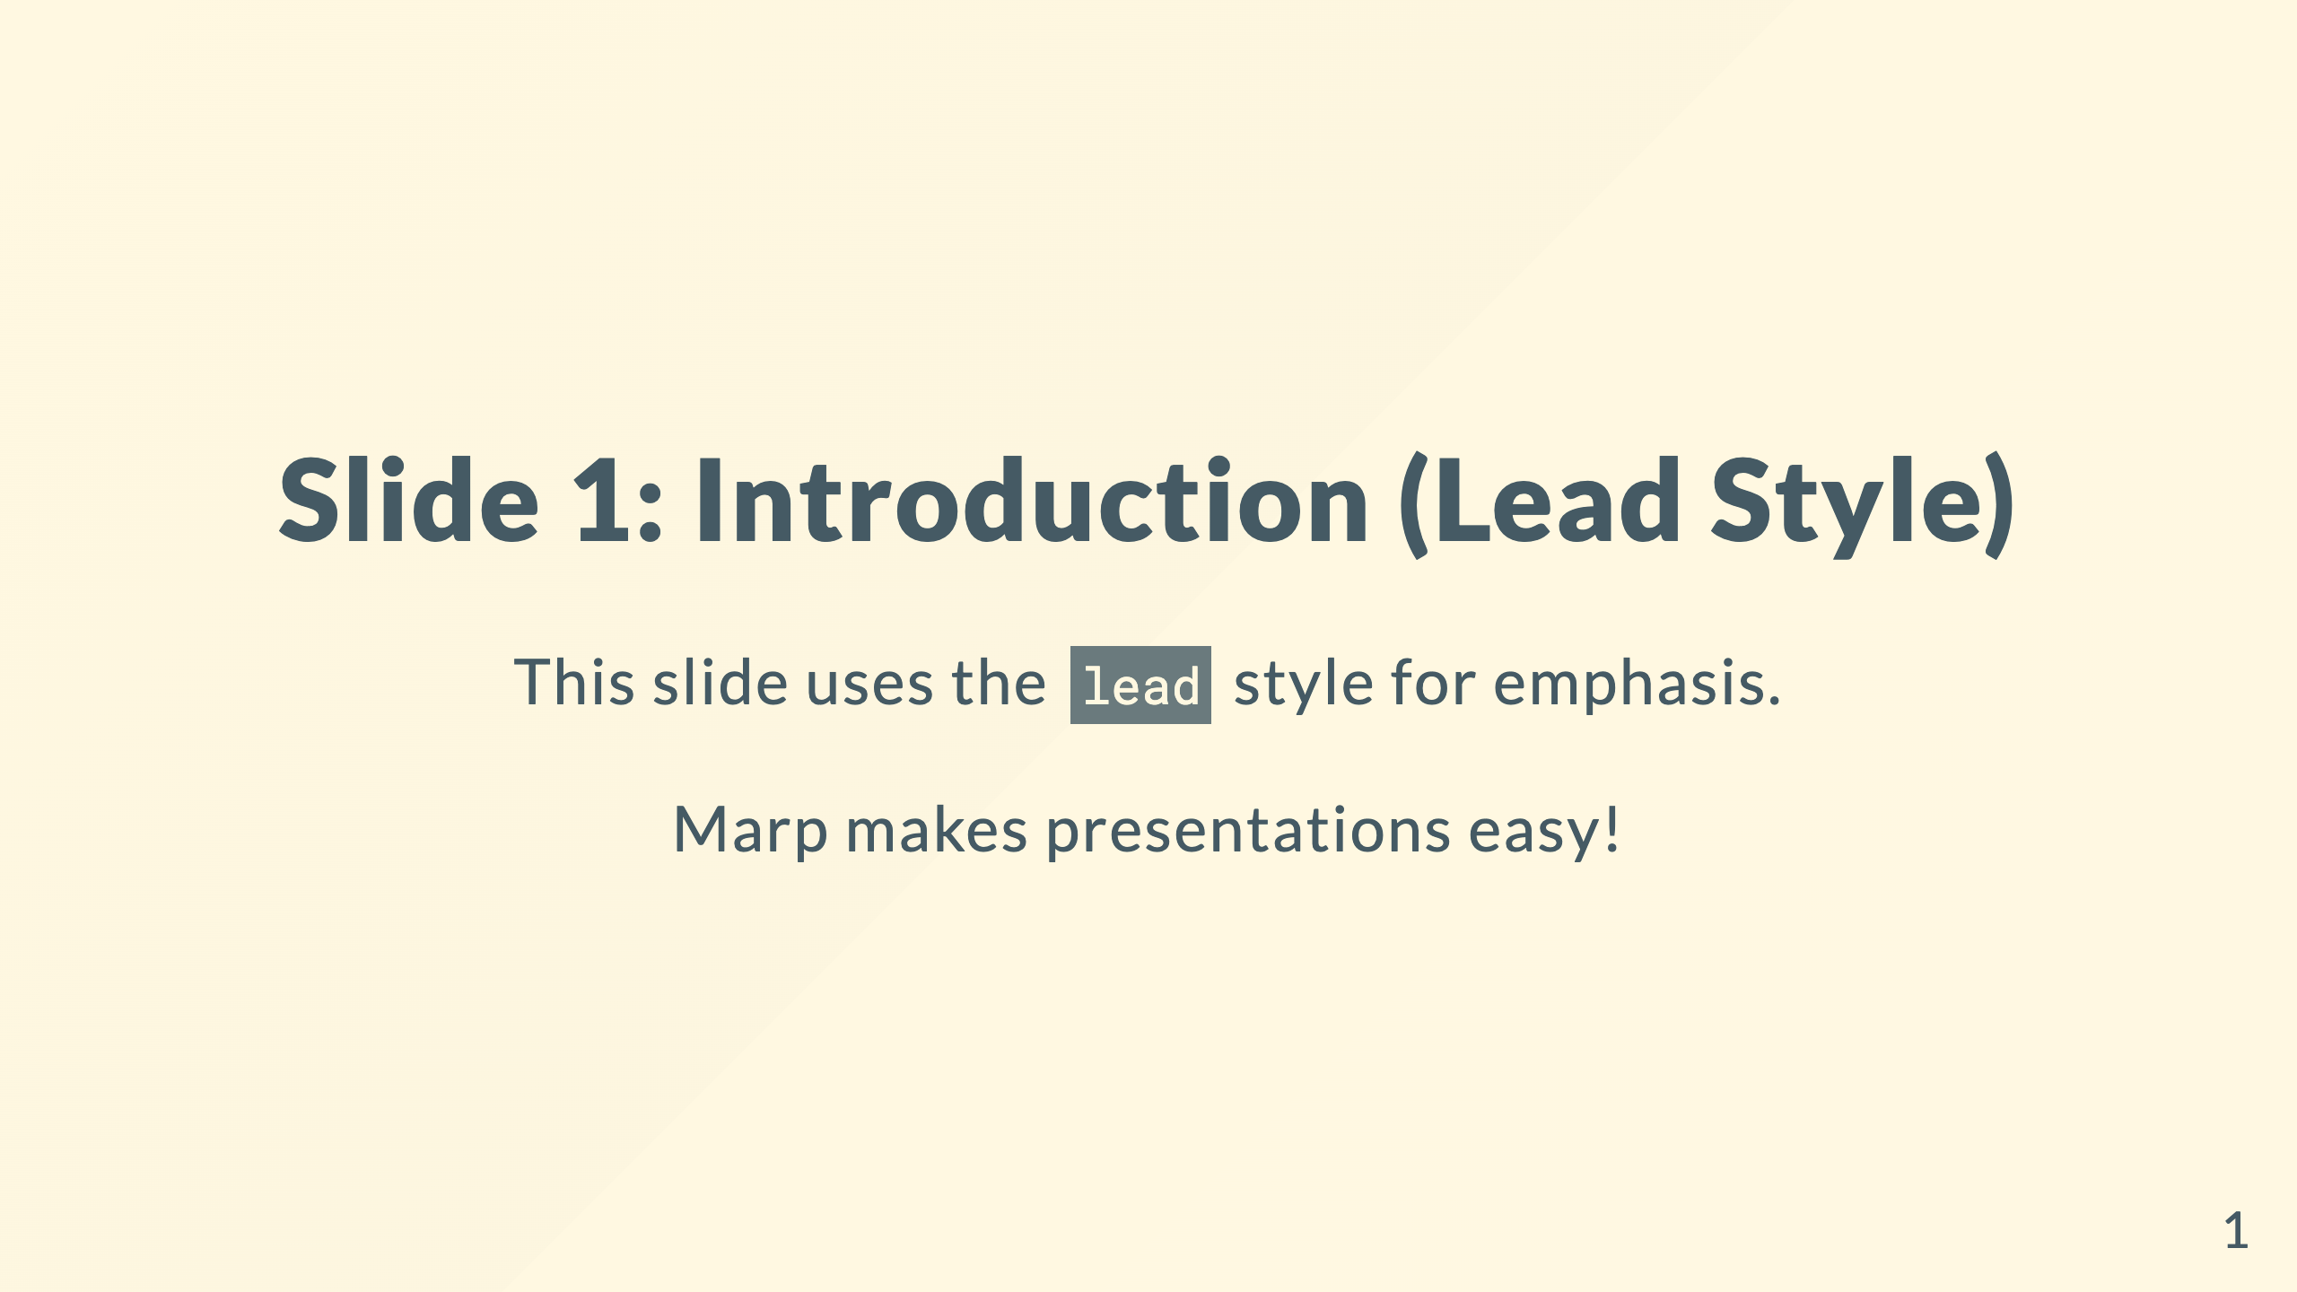

Slide 2
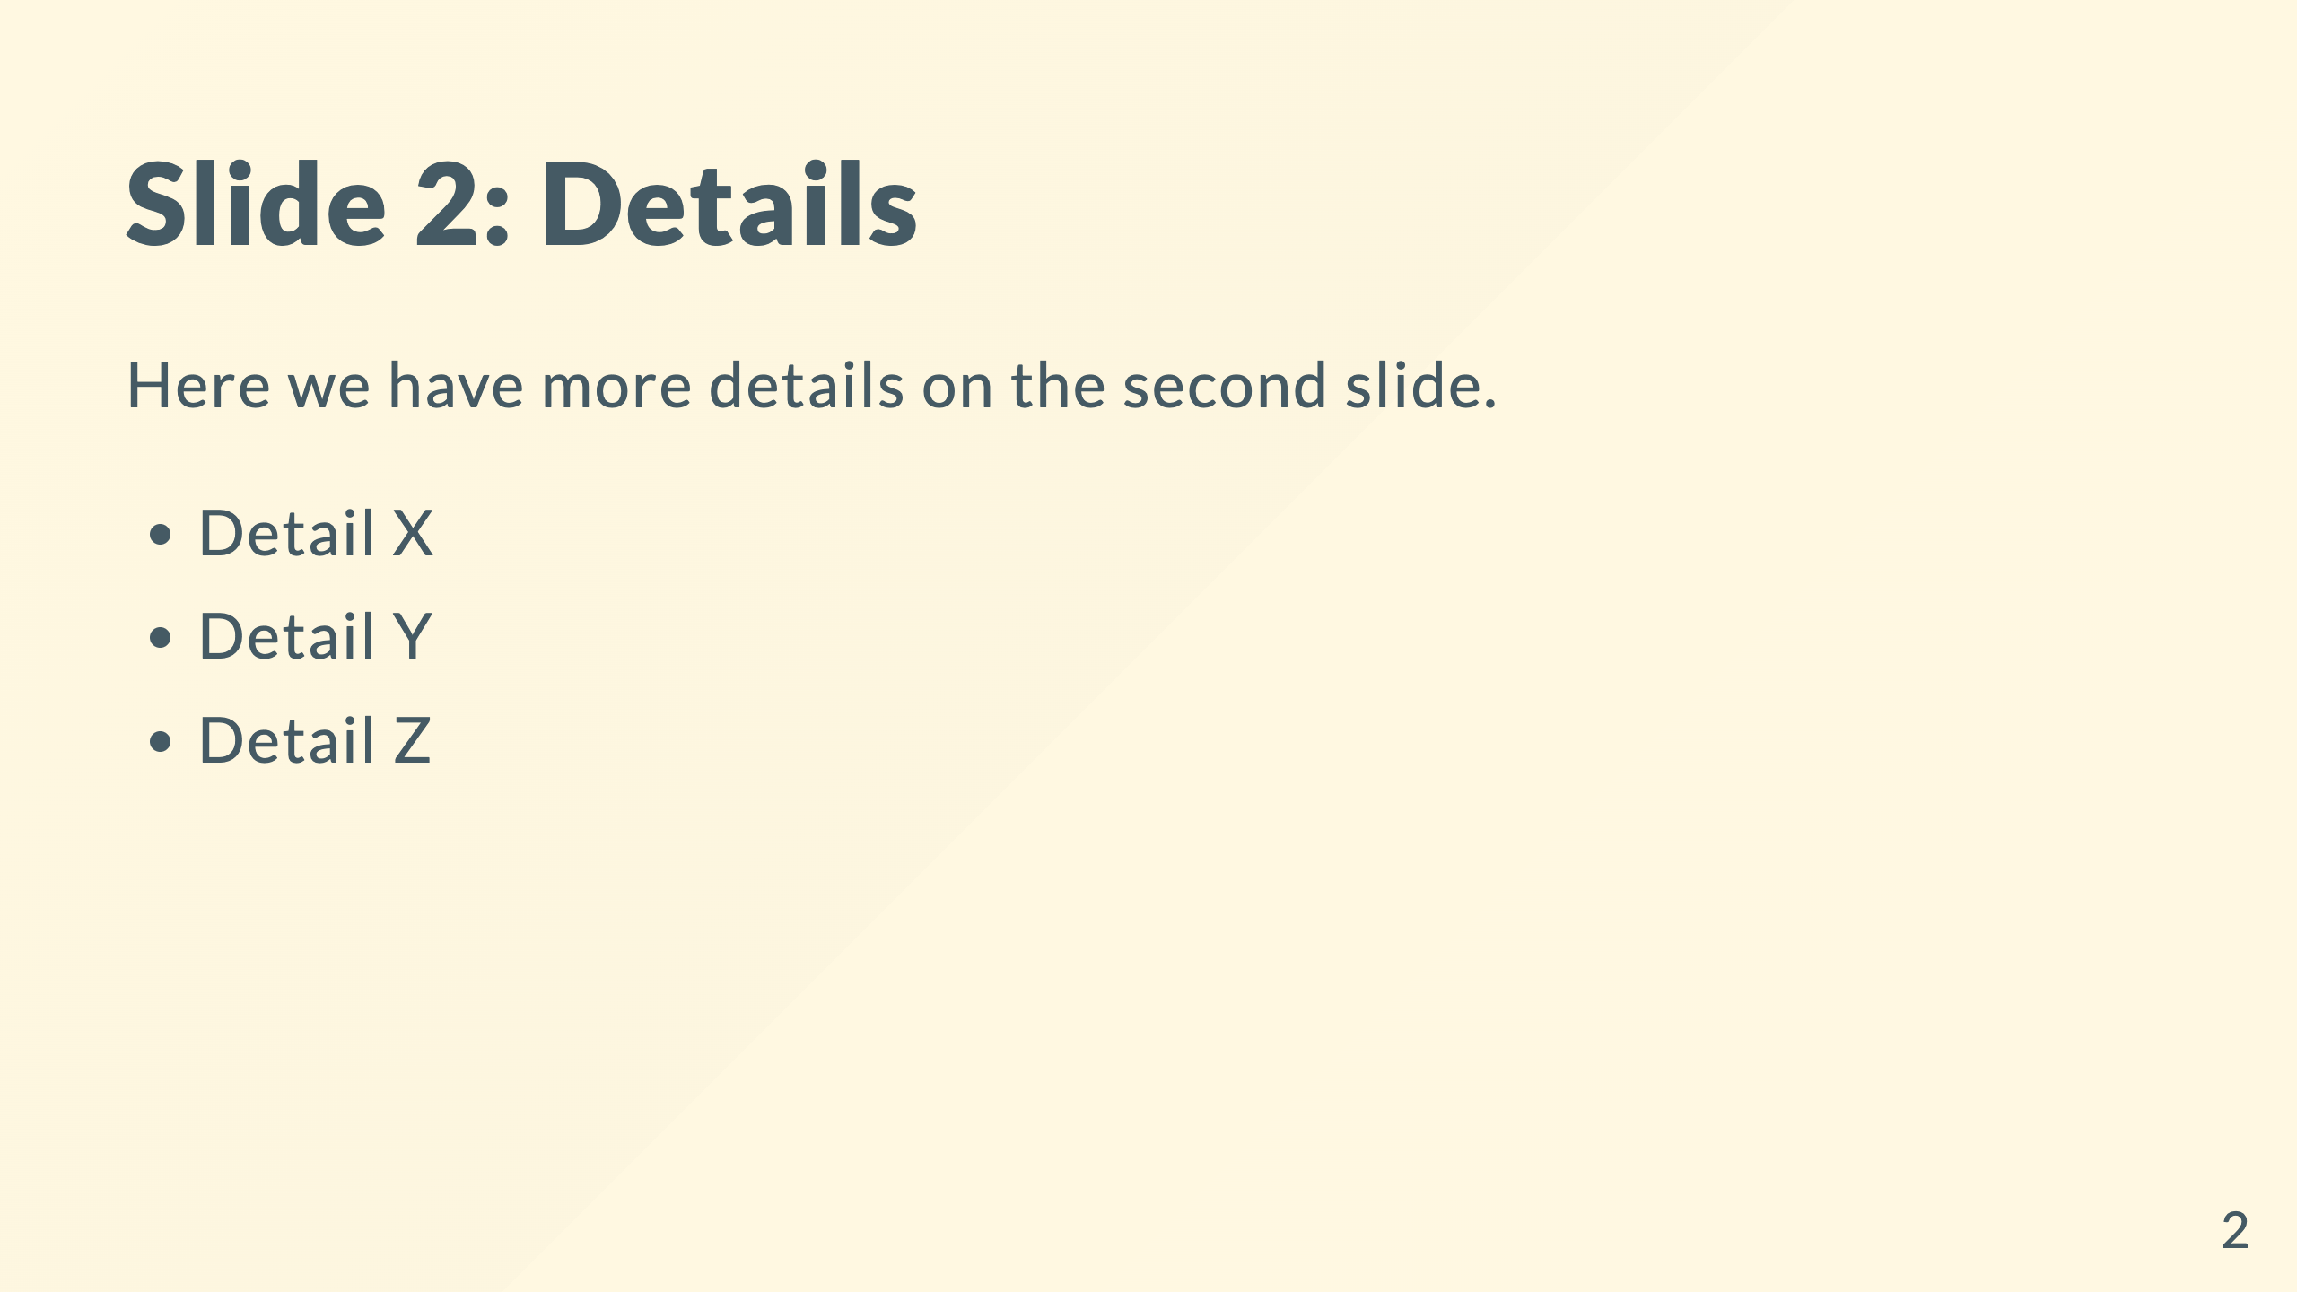
Notes:
Speaker notes: - Remember to mention the Q3 results here. - Highlight the synergy between X and Y.

Slide 3
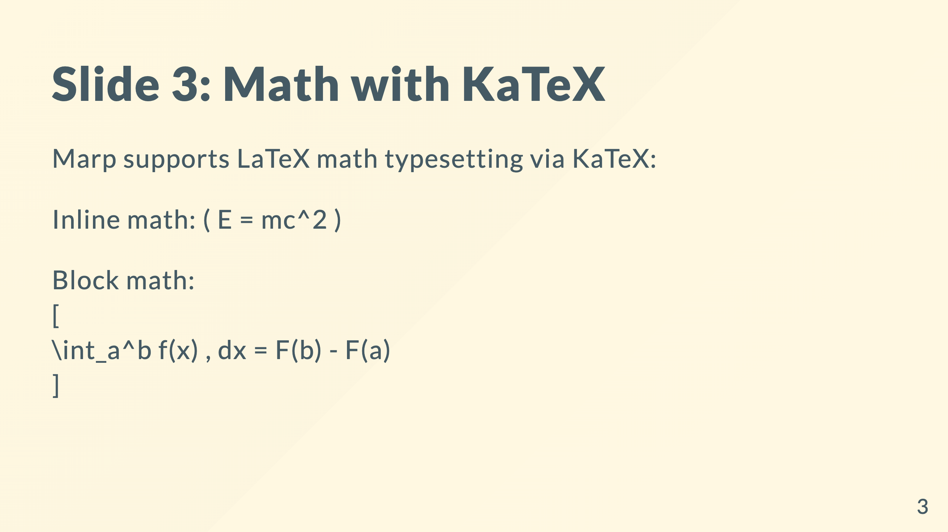

Slide 4
