Slide 1
Graphs
Ethan Rivers

Slide 2
Graphs
Used to represent connections within a data set.
Each data point is a “node.”
A connection between two nodes is an “edge.”
I will call a chain of edges a “path.”

Slide 3
Edges
An edge contains a cost that is a quantity required to traverse between the two linked nodes.
This could be the distance between two cities, or the cost of a plane ticket between airports (*cough*) for instance.

Slide 4
Directed
The edges of a directed graph have an associated orientation, and can only be traveled in one direction.
Formal definition:
A directed graph is an ordered pair G = (V, A) where
V is a set whose elements are called vertices, nodes, or points;
A is a set of ordered pairs of vertices, called arrows, directed edges (sometimes simply edges with the corresponding set named E instead of A), directed arcs, or directed lines.
(Thanks Wikipedia)

Slide 5
Implementation In C++
The nitty-gritty

Slide 6
Terminology
Some more terminology I’ll be using in the upcoming slides:
V – number of nodes/vertices
E – number of edges
Adjacency List – An implementation of a graph that stores edges in a linked list structure.

Slide 7
Adjacency List Structure
Graph
Node
Edge
Map
Edge List
Node Pointer
Cost
Data
Node Pointer
Edge (Node Pointer : Cost)
(Node*)
(Double)
{
}
A
B
C
0
2 : 5.0
{
}
1
0 : 3.0
2 : 2.0
{
}
2
0 : 1.5

Slide 8
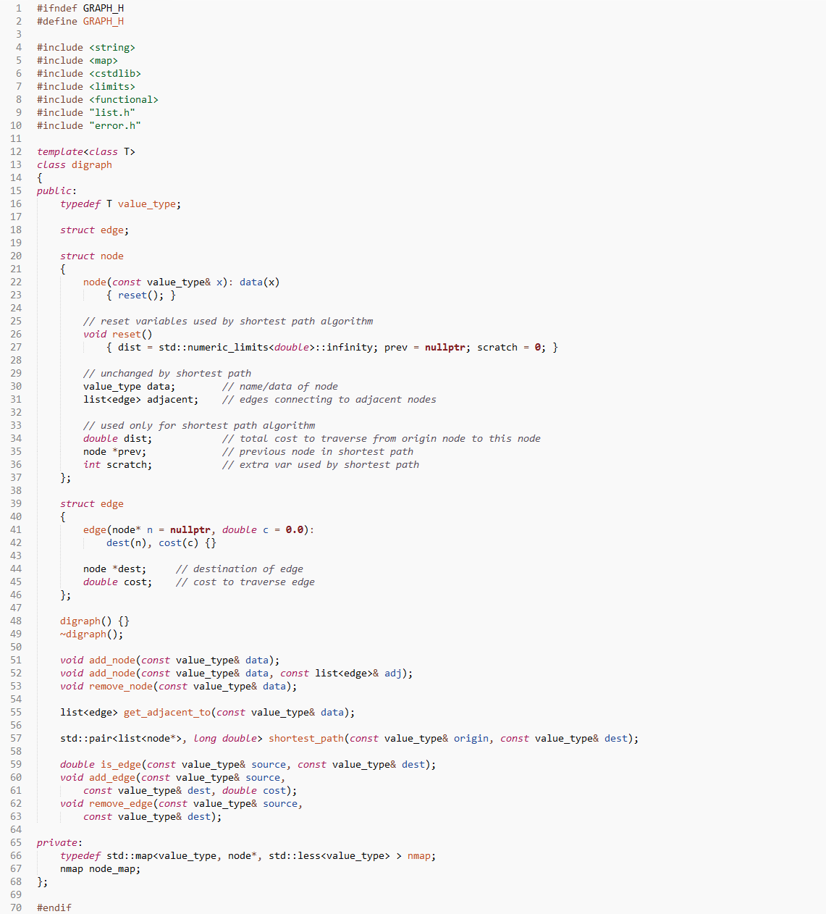
Adjacency List Code
Ideone Link
GitHub Link

