Slide 1
PyTorch Study Introduction
Presented By Jae Young Choi
July 19, 2019

Slide 2
Agenda
About Study
How to Study
What is PyTorch?
Ready to play
References

Slide 3
About Study
Study Overview
One of the studies hosted by AI Robotics KR group
FB Group- AI Robotics KR, Slack Channel – study_pytorch
When: Every Friday, PM 8 ~ 10, Total 13 Weeks, ~ Mid-October
Where: Seolleung Station, Gate 3, Sebang Building 7th Floor, - Supported By BI MATRIX

Slide 4
Say Hello to each other
jychoi.ethan@gmail.com
Deep Learning, Reinforcement Learning
Jae Young Choi
Notes:
<a href='http://www.freepik.com/free-photo/close-up-of-happy-executive_856028.htm'>Designed by Freepik</a>
<a href='http://www.freepik.com/free-photo/smiling-young-businessman_856555.htm'>Designed by Freepik</a>
<a href='http://www.freepik.com/free-photo/team-of-friendly-businesspeople_858813.htm'>Designed by Freepik</a>
<a href='http://www.freepik.com/free-photo/close-up-of-successful-entrepreneur_867979.htm'>Designed by Freepik</a>

Slide 5


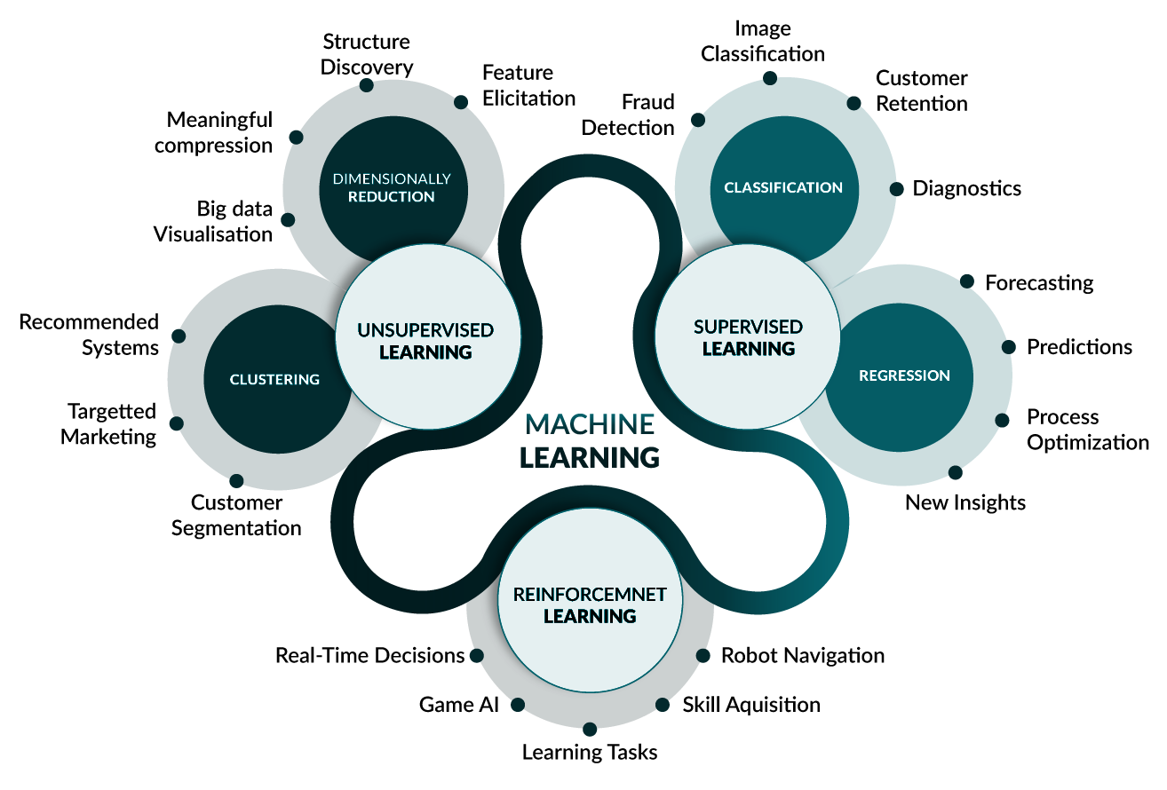
Study Objectives
Learn How to use PyTorch
Reinforce understanding for deep learning algorithms
Practice it with high-quality examples of deep learning

Slide 6
How to Study
Open discussion
Based on PyTorch Tutorials
Algorithms Introduction
Practice with Jupyter Notebook/Colab
Study materials will be shared in ai-robotics-kr/pytorch_study github
Exercise (optional) and share the results
?

Slide 7
Schedules - Summer
Week | Subject | Presenter
Week 1, 7/19 | Study Introduction, Setup Environments, Deep Learning with Pytorch: A 60 Minute Blitz-1 | 최재영
Week 2, 7/26 | Deep Learning with Pytorch: A 60 Minute Blitz-2 Data Loading and Processing Tutorial | 최재영/
Week 3, 8/2 | Learning Pytorch With Examples
Week 4, 8/9 | Transfer Learning Tutorial Saving and Loading Models
Week 5, 8/16 | Deploying A Seq2seq Model with The Hybrid Frontend
Week 6, 8/23 | What is torch.nn really ?

Slide 8
Schedules - Autumn
Week | Subject | Presenter
Week 7, 8/30 | Torchvision 0.3 Object Detection Finetuning Tutorial
Week 8, 9/6 | FineTunning Torchvision Model Spatial Transformer Networks Tutorial
Week 9, 9/20 | Neural Transfer Using Pytorch
Week 10, 9/27 | Deep Learning for NLP With PyTorch
Week 11, 10/4 | DCGAN Tutorial
Week 12, 10/11 | Reinforcement Learning (DQN) Tutorial
Week Final, 10/18 | Study Review, Future Plan, Party

Slide 9



Individually
Together

Slide 10
What is PyTorch ?
Why, When, Where to use?

Slide 11
What is PyTorch ?
PyTorch is a Torch based machine learning library for Python. It was developed by Facebook's AI Research Group in 2016.
PyTorch offers Dynamic Computational Graph such that you can modify the graph on the go with the help of autograd
It’s python-based scientific computing package targeted at two sets of audiences (pytorch.org)
A replacement for NumPy to use the power of GPUs
A deep learning research platform that provides maximum flexibility and speed
PyTorch is a Python machine learning package based on Torch, which is an open-source machine learning package based on the programming language Lua. PyTorch has two main features:
Tensor computation (like NumPy) with strong GPU acceleration
Automatic differentiation for building and training neural networks
https://www.kdnuggets.com/2018/11/introduction-pytorch-deep-learning.html
Quora - What is Pytorch
https://www.quora.com/What-is-Pytorch-1

Slide 12
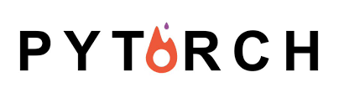

PyTorch vs Tensorflow
Pros:
Python-like coding
Dynamic graph
Easy & quick editing
Very good documentation available
Plenty of projects out there which use Pytorch
Cons:
Third party needed for visualisation
API knowledge needed in Python to move to production
Pros:
Simple built-in high level API
Tensorboard (easy to use visualisation tool)
Simple serving method on production
Very good documentation
Easy mobile support
Cons:
Static graph
Debugging method
Hard to make quick changes
https://ynd.co/blog/tensorflow-vs-pytorch/

Slide 13
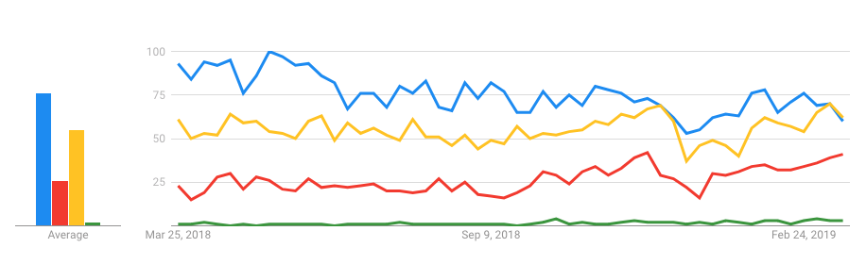
Which one are you going to use?
Source from:
Which Deep Learning Framework is Growing Fastest?
TensorFlow vs. PyTorch

Slide 14
Why Pytorch?
9 Reasons Why PyTorch Will Become Your Favourite Deep Learning Tool
PyTorch Is Based On Python
Dynamic Approach To Graph Computation
(Almost) Faster Deep Learning Training Than TensorFlow
Increased Developer Productivity
Easier To Learn And Simpler To Code
Small Community Of Focussed Developers
Simplicity and transparency
Easy To Debug
Data Parallelism
Source from:
https://www.analyticsindiamag.com/9-reasons-why-pytorch-will-become-your-favourite-deep-learning-tool/

Slide 15
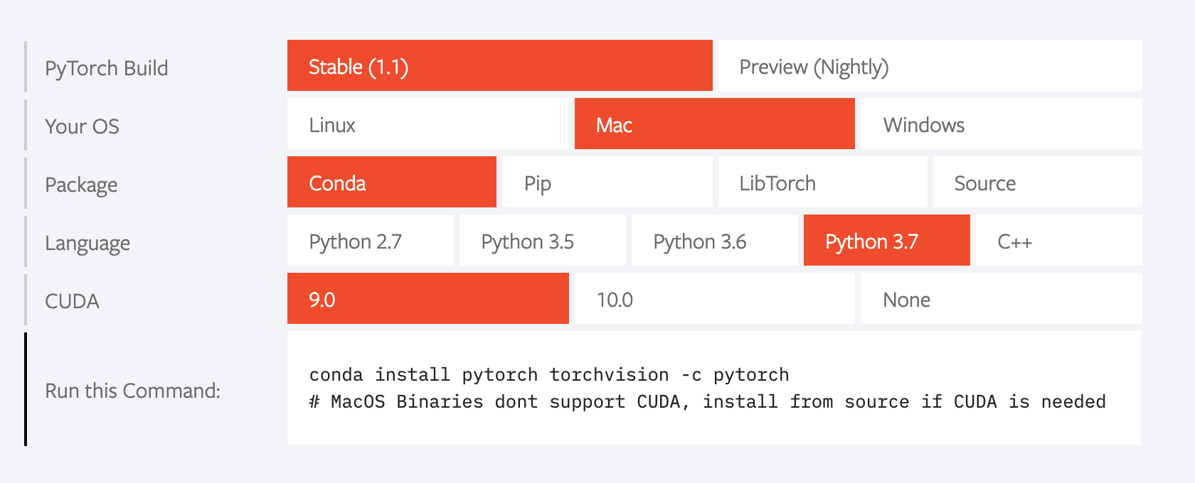
Installing on your local machine
https//pytorch.org/get-started/locally

Slide 16
How to install packages
Anaconda or pip
Install Python development environment on your system
Python 3
Package manager - pip, virtualenv, conda
Create a virtual environment
Using conda or virtualenv
https://www.tensorflow.org/install/pip - virtualenv
Conda
conda create -n 'pytorch_env' python=3.7
conda activate 'pytorch_env'
conda install pytorch torchvision -c pytorch ( pip install torch torchvision)
conda install scikit-learn matplotlib etc
Install jupyter notebook (https://jupyter.org/install)
conda install -c conda-forge jupyterlab
pip install jupyterlab
If you want, Build from source

Slide 17
Ready to Play ?
Verification
conda activate ‘your_env’
Jupyter notebook
In your notebook
from __future__ import print_function
import torch
x = torch.empty(5, 3)
print(x)
tensor([[0., 0., 0.],
[0., 0., 0.],
[0., 0., 0.],
[0., 0., 0.],
[0., 0., 0.]])

Slide 18
References
Please add any useful links for learning PyTorch
PyTorch Hub
PyTorchZeroToAll
The Incredible PyTorch
Udacity PyTorch Free Course
Deep Learning with Python and PyTorch

Slide 19
Thank you

