Slide 1
Computational Epidemiology Overview
Tina Johnson
Midwestern State University

Slide 2


Computational Epidemiology Because…
Emerging diseases are unpredictable
Impractical/unethical to run real experiments
Models
no risk
modifiable
simple to complex

Slide 3
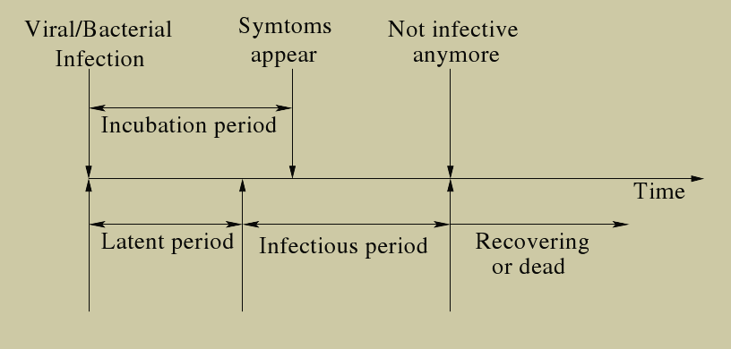
Disease Timeline
AR Mikler, A Bravo-Salgado and CD Corley, Global Stochastic Contact Modeling of Infectious Diseases

Slide 4
Disease Model - SIR
Susceptible Infectious Removed
transmission coefficient, β
removal rate, γ
Basic Assumptions:
Constant population size
Homogeneous mixing
No latent period
Once removed, always removed
Kermack and McKendrick, 1927, A Contribution to the Mathematical Theory of Epidemics

Slide 5
SIR Equations

Slide 6
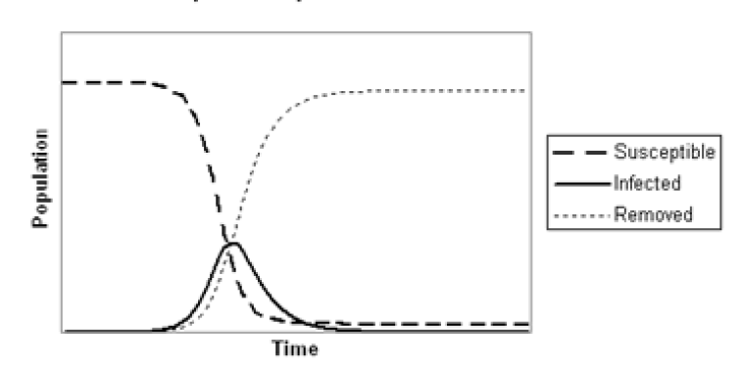
Disease Progression - SIR

Slide 7
Disease Modeling Methods
Mathematical
Agent-based
Cellular Automata
Graph-based

Slide 8
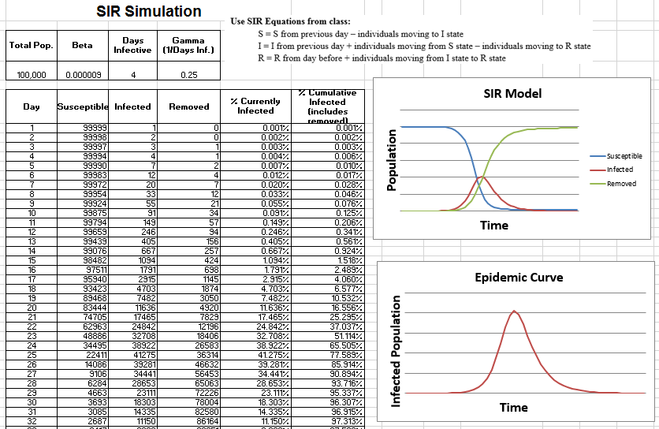
Mathematical SIR Modeling

Slide 9
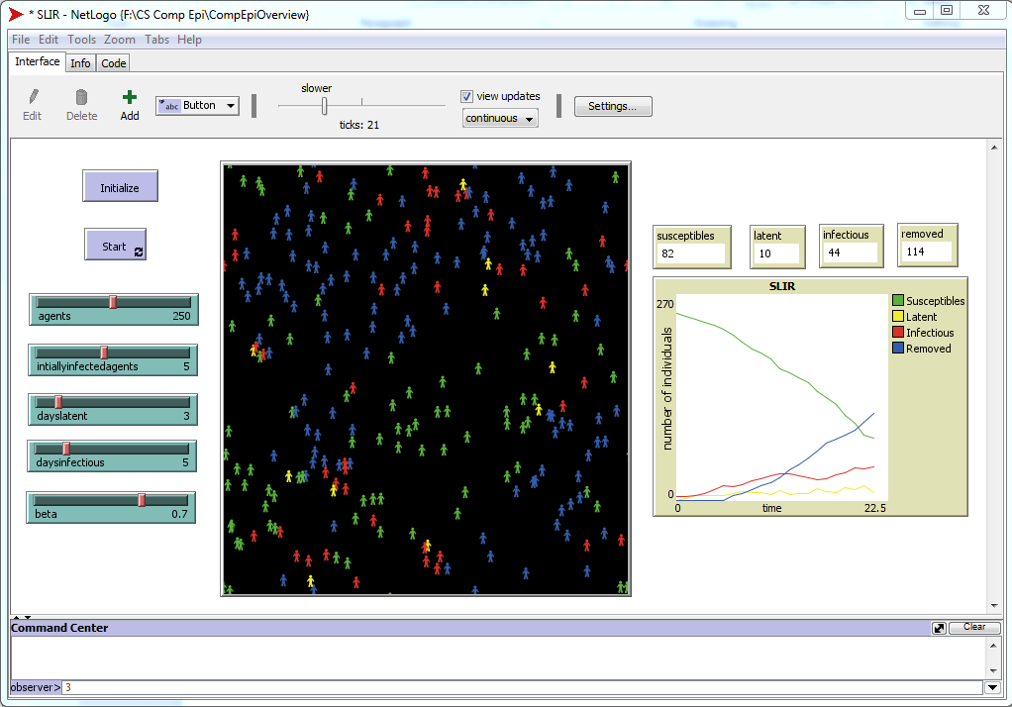
Agent-based SIR Modeling

Slide 10
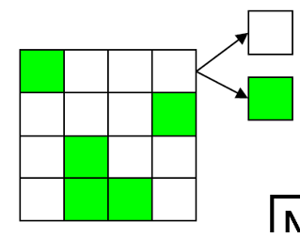
Cellular Automata SIR Modeling
A CA is an array of identically programmed automata, or cells, which interact with one another in a neighborhood and have a definite state.
Popularized by John Conway’s Game of Life in 1970. Each cell is either alive or dead.

Slide 11

Conway's Game of Life

Slide 12
Cellular Automata SIR Modeling
A CA is an array of identically programmed automata, or cells, which interact with one another in a neighborhood and have a definite state.
S | S | S | S | S
S | S | S | S | S
S | I | S | S | S
S | S | S | S | S
S | S | S | S | S
S | S | S | S | S
S | S | S | S | S
S | I | I | S | S
I | S | S | S | S
S | S | S | S | S
S | S | S | I | I
S | S | S | R | I
S | R | R | S | S
R | S | S | S | S
S | S | S | S | S
…

Slide 13
Graph-based SIR Modeling
Python with networkx library
Nodes represent individuals
Edges represent contacts between two individuals.
Visualization is difficult even with relatively small population size.

Slide 14
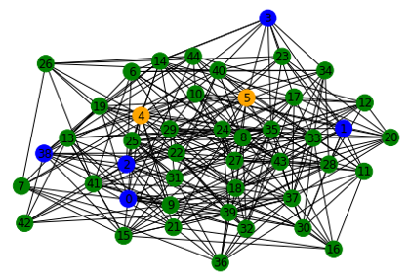
Graph-based SIR Modeling

Slide 15
Computational Epidemiology
Relevant
CMPS Elective
Introduction to variety of modeling paradigms
Fun!!!!! ☺

Slide 16

Questions

